Slide 1
FAA Military Training Routes in AIXM
Summary of Issues for AIXM 5.2 proposal
FAA AIXM CCB
Marina Chumakov Rozenblat (CNA)
Patrick Broom (AJM-336)
June 8, 2017

Slide 2
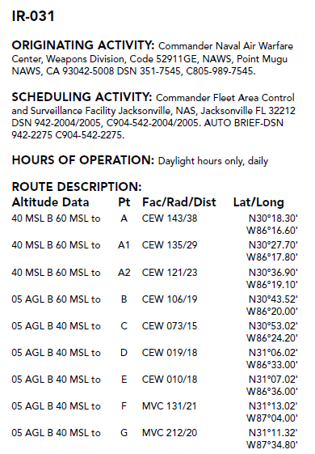
Background on MTRs
Military Training Route (MTR) static definitions published in AP1B publication, stored in NASR
Some MTR points represented as a Fix-Radial-Distance using Navaids like VORTAC, VOR/DME
  Others just as coordinates
  Spatially like surfaces in 2D (overlapping and intersections are permitted)
    Branching, looping complicates point sequences
  Multiple entry and exit points; same point more than once
  Widths of the route can vary within an MTR

Slide 3
AIXM Mapping Status
Held TIMs with SAA developers, analysts to identify gaps in AIXM 5.1 for capturing MTR data:
  Need a simplified representation of FRD, in the current structure the message is too long
  Expand corridor width description options:
    N/S/E/W instead of only widthLeft/widthRight
  No ability to add an operational schedule (RouteAvailability) to the RoutePortion
AIXM-181: Change AngleIndication and DistanceIndication from feature to object
Proposal attached on following slides
Proposal attached on following slides

Slide 4
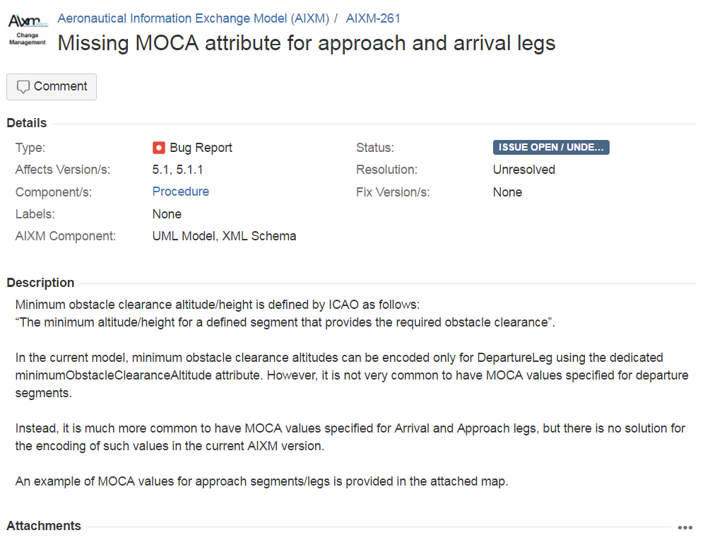

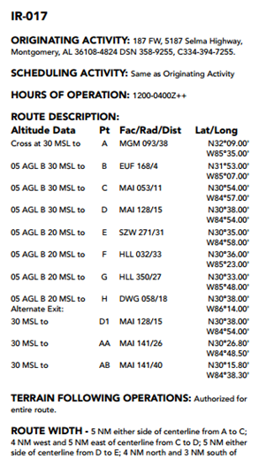
MTR Change Proposal (1/2)
XXX
RouteSegment widthLeft and widthRight attributes do not allow capturing the width in cardinal directions
Route
For certain type of routes, such as Military Training Routes (MTR), the route segment width is sometimes described in terms of cardinal directions, N/S/E/W, etc.. This occurs because these routes can loop upon themselves and can also be used in both directions. The widthLeft and widthRight options are not compatible with such data encoding.
It is suggested to add route width and width direction data elements. For width, the ValDistanceType should be sufficient. For width direction, the CodeCardinalDirectionType should allow for all cardinal direction combinations.

Slide 5
MTR Change Proposal (2/2)
XXX
There is no ability to add a RouteAvailability to an entire Route Portion
Route
While AIXM 5.1 allows adding a schedule (RouteAvailability) to each RouteSegment, the same cannot be done for an entire Route or RoutePortion. While the same information can be captured with each individual RouteSegment, this results in excessively long messages. The option to assign a schedule to an entire RoutePortion should be added to condense the same information to a single RouteAvailability object.
None.

Slide 6
Back-up Slides

Slide 7
UML Diagram of example AIXM 5.1 MTR Extension
Shown to Demonstrate the Gaps Described in the MTR Change Proposals
Adding RouteAvailability to the RoutePortion
To capture the route width in any cardinal direction, the model needs to capture width and direction. This can be done by:
Changing the options in RouteSegment feature (removing widthLeft, widthRight)
Adding width and direction attributes to RouteSegment
In this AIXM 5.1 extension example, the attributes are added as an object simply to represent the missing fields.

Slide 8
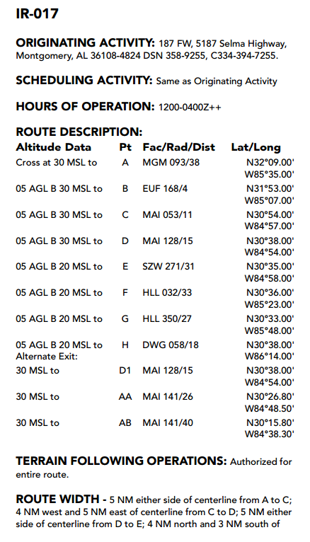
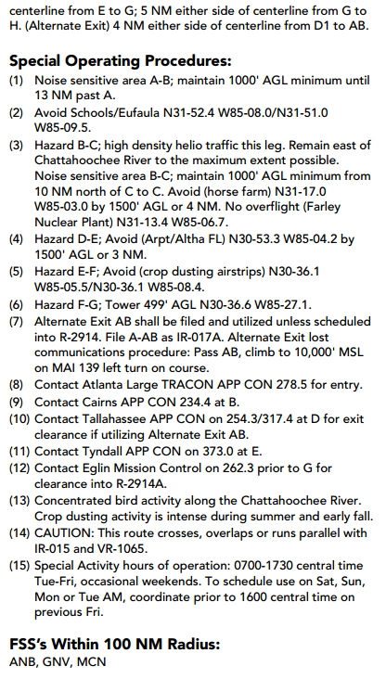
Full Description of IR-017

