Slide 1
FIXM Briefing
AIXM CCB meeting
EUROCONTROL HQ, Brussels
Hubert LEPORI
EUROCONTROL
01-Dec-2017

Slide 2
FIXM 4.1.0
15-Dec-2017
FIXM 4.1.0 RC_1 is publicly available!

Slide 3
FIXM 4.1.0
Optimization
&
Bug fixes
DG Rationalization
Latest
FF-ICE/1
knowledge
Base package improved
ICAO Semantics
Improved extension mechanism

Slide 4
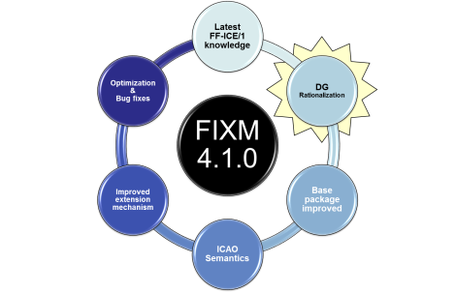
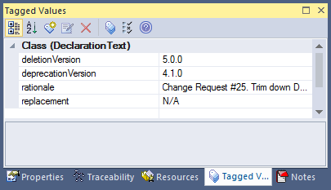
Example of deprecation in FIXM 4.1.0
4.1.0 implements the common policy for deprecation discussed in 2017

Slide 5
Example of deprecation in FIXM 4.1.0
<element name="declarationText" type="fx:DeclarationTextType" minOccurs="0" maxOccurs="1">
<annotation>
<documentation>
WARNING
This element is deprecated as of FIXM 4.1.0 per ATMRPP/2 and FIXM CCB decision. The
element will be removed starting FIXM 5.0.0.
<deprecated>
<deletionVersion>5.0.0</deletionVersion>
<deprecationVersion>4.1.0</deprecationVersion>
<rationale>Change Request #25. Outcomes of ATMRPP/2 shows DG data element other than NOTOC items are not required in FIXM Core.</rationale>
<replacement>N/A</replacement>
</deprecated>
</documentation>
</annotation>
</element>

Slide 6
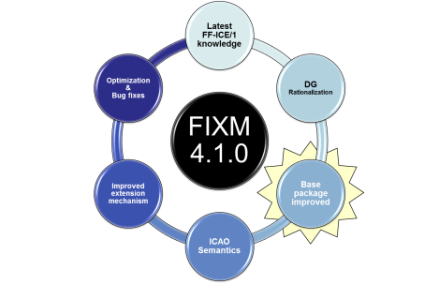
Encoding positions in FIXM 4.1.0
NO GML
Position (geographical). Set of coordinates (latitude and longitude) referenced to the mathematical reference ellipsoid which define the position of a point on the surface of the Earth. [ICAO Annex 15]
FIXM Logical Model | FIXM XML schemas
UML Class GeographicalPosition in package FIXM.Base.Airspace | <complexType name="GeographicalPositionType"> <complexContent> <extension base="fb:ExtensibleType"> <sequence> <element name="pos" minOccurs="0" maxOccurs="1"> <simpleType> <list itemType="xs:double"/> </simpleType> </element> </sequence> <attribute name="srsName" type="xs:string" use="required" fixed="urn:ogc:def:crs:EPSG::4326"> </attribute> </extension> </complexContent> </complexType> Complex type GeographicalPositionType in file Airspace.xsd

Slide 7
Encoding positions in FIXM 4.1.0
EXAMPLE 1
<fb:position srsName="urn:ogc:def:crs:EPSG::4326">
<fb:pos>59.0 -30.0</fb:pos>
</fb:position>
Even if FIXM is not based on GML, the guidance for position encoding from Chapter 7 of OGC document “Use of Geography Markup Language (GML) for Aviation Data” [ref OGC 12-028r1] is considered equally applicable to FIXM.
=> use of EPSG 4326
=> latitude first, then longitude
EXAMPLE 2
<fx:point4D srsName="urn:ogc:def:crs:EPSG::4326">
<fb:pos>50.03330555555556 8.570455555555556</fb:pos>
[...]

Slide 8

Encoding references to published aeronautical information in FIXM 4.1.0
NOR
NOR

Slide 9
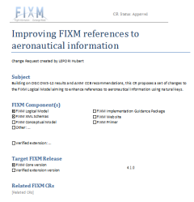
Encoding references to published aeronautical information in FIXM 4.1.0
Waypoint - the 5-letter coded designator is supposed to be unique world-wide (according to ICAO Annex 11), but in reality it is not. There are at least 5% duplicates/triplicates/even more […] The only combination that would make it unique is 5-letter designator and position.
Navaid – the en-route navaids (VOR, DME, NDB) designator is supposed to be unique (according to ICAO Annex 11) within 600 NM […] The only combination that would make it unique is type, designator and position.
FIXM
CR#7

Slide 10
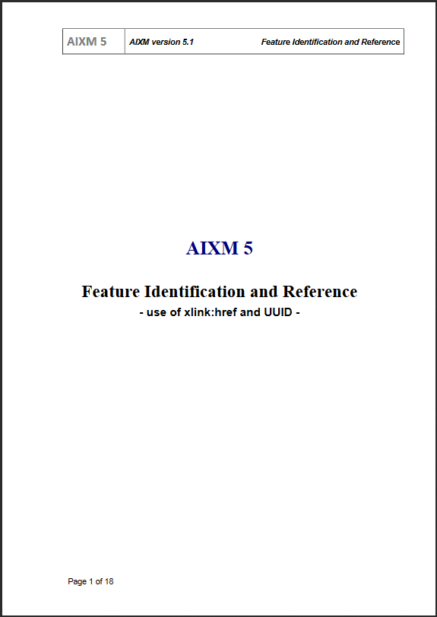
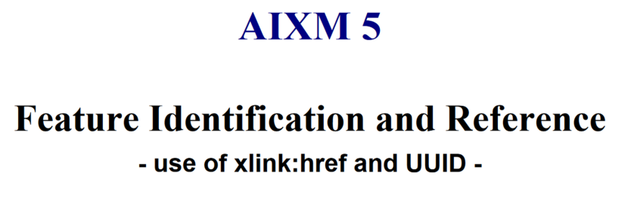
Encoding references to published aeronautical information in FIXM 4.1.0
Direct
reference
FIXM reference to
aeronautical information
AIXM feature
FIXM
CR#29
(Optionally)
Complementary xlink:href reference to a relevant AIXM feature instance
<aixm:[…] gml:id="uuid.a82b3fc9[…]">
<gml:identifier codeSpace="urn:uuid:">A82b3fc9[…]
</gml:identifier>
[…]
(As a minimum)
Designator identifying that piece of aeronautical information
(Optionally)
Additional properties for further plausibility checks
<aixm:designator>…</aixm:designator>
<aixm:navaidServiceType>…</…>
<aixm:position>…</…>
…
FIXM
CR#7
Different but mappable modelling.

Slide 11
Examples: references to Waypoints or Navaids in FIXM 4.1.0
FIXM Logical Model | FIXM XML schemas
UML Class DesignatedPointOrNavaid in package FIXM.Base.Airspace | <complexType name="DesignatedPointOrNavaidType"> <complexContent> <extension base="fb:SignificantPointType"> <sequence> <element name="position" type="fb:GeographicalPositionType" minOccurs="0" maxOccurs="1"> </element> </sequence> <attribute name="designator" type="fb:SignificantPointDesignatorType" use="optional"> </attribute> <attribute name="navaidServiceType" type="fb:NavaidServiceTypeType" use="optional"> </attribute> </extension> </complexContent> </complexType> Complex type DesignatedPointOrNavaidType in file Airspace.xsd

Slide 12
Examples: references to Waypoints or Navaids in FIXM 4.1.0
OPTION 1 designator | [Waypoint] <fx:routePoint xsi:type="fb:DesignatedPointOrNavaidType" designator="TEMPO"/> [Navaid] <fx:routePoint xsi:type="fb:DesignatedPointOrNavaidType" designator="BOR"/>
OPTION 2 designator +position +navaidServiceType | [Waypoint] <fx:routePoint xsi:type="fb:DesignatedPointOrNavaidType" designator="TEMPO"> <fb:position srsName="urn:ogc:def:crs:EPSG::4326"> <fb:pos>56.84 -29.860000000000003</fb:pos> </fb:position> </fx:routePoint> [Navaid] <fx:routePoint xsi:type="fb:DesignatedPointOrNavaidType" designator="BOR" navaidServiceType="VOR_DME"> <fb:position srsName="urn:ogc:def:crs:EPSG::4326"> <fb:pos>52.36833333333333 -32.375</fb:pos> </fb:position> </fx:routePoint>
Not for operational use
Based on fictitious DONLON dataset

Slide 13
Examples: references to Waypoints or Navaids in FIXM 4.1.0
OPTION 3 designator +xlink:href | [Waypoint] <fx:routePoint xsi:type="fb:DesignatedPointOrNavaidType" designator="TEMPO" xlink:href="http://my.fictitious.donlon.service/DonlonWaypointService#uuid.81e47548-9f00-4970-b641-8ff8f99098a5"> [Navaid] <fx:routePoint xsi:type="fb:DesignatedPointOrNavaidType" designator="BOR" xlink:href="#uuid.08a1bbd5-ea70-4fe3-836a-ea9686349495">
Any recommendations about the parts of the AIXM Feature Identification and Reference doc that should be considered by FIXM?
OPTION 4 designator +position +navaidServiceType +xlink:href | [Waypoint] <fx:routePoint xsi:type="fb:DesignatedPointOrNavaidType" designator="TEMPO" xlink:href="http://my.fictitious.donlon.service/DonlonWaypointService#uuid.81e47548-9f00-4970-b641-8ff8f99098a5"> <fb:position srsName="urn:ogc:def:crs:EPSG::4326"> <fb:pos>56.84 -29.860000000000003</fb:pos> </fb:position> </fx:routePoint> [Navaid] <fx:routePoint xsi:type="fb:DesignatedPointOrNavaidType" designator="BOR" navaidServiceType="VOR_DME" xlink:href="#uuid.08a1bbd5-ea70-4fe3-836a-ea9686349495"> <fb:position srsName="urn:ogc:def:crs:EPSG::4326"> <fb:pos>52.36833333333333 -32.375</fb:pos> </fb:position> </fx:routePoint>
Not for operational use
Based on fictitious DONLON dataset

Slide 14

FIXM Implementation guidance
Update & consolidation is underway
Release date:
30-March-2018

Slide 15
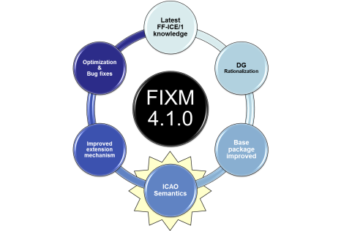
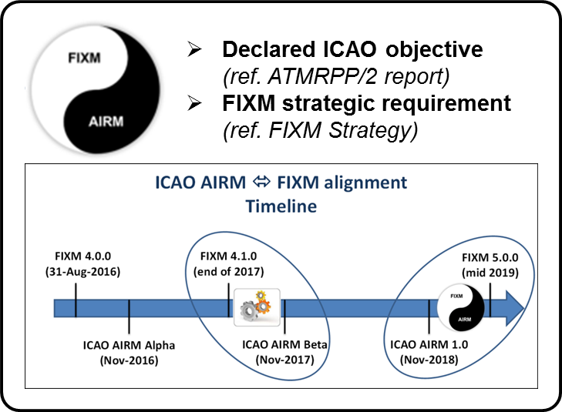
FIXM ⬄ ICAO AIRM coordination
ICAO AIRM BETA has leveraged FIXM materials for capturing the FF-ICE/1 semantics
FIXM 4.1.0 has leveraged the (draft) ICAO AIRM BETA for improving a few terms and definitions based on ICAO semantics (FIXM CR 36)

Slide 16
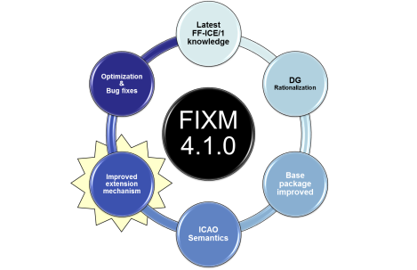
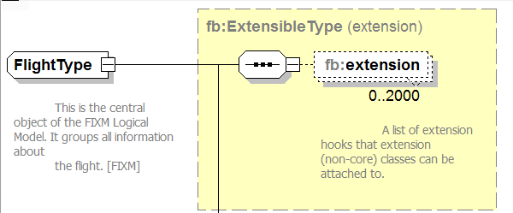

Extension mechanism in FIXM 4.1.0
Ability to allow Extension validation, multiple co-existing Extensions, and co-location of Extension data with the Core data it extends.
Guidance + examples will be provided on the use of XSLTs to remove unwanted Extension data.
…
Discussion topic for cross –XMs coordination?

Slide 17

Candidate topics for future cross-XM coordination
Cross -XMs
Common policies for Extensions
AIXM-FIXM
AIXM Flight restrictions as business rules for FIXM
…
AIXM-FIXM
Improve FIXM references to constraints at trajectory points, such as restricted/reserved airspace references (FF-ICE req).

Slide 18
Contact details
FIXM Community
FIXM Secretariat: fixm.secretariat@eurocontrol.int
FIXM CCB: FIXM.CCB@eurocontrol.int
FIXM Online Resources
www.FIXM.aero
FIXM Work Area (register here)
Cross-XM Coordination
Common -XM work area

Slide 19


