Slide 1

AIXM CCB
30 NOV – 01 DEC 2017, Eurocontrol, Brussels

Slide 2

Participants
Name, organisation
Any special interest with regard to AIXM evolution and the CCB in general?
Any particular expectations from this meeting?

Slide 3
AgENDA
See paper copy

Slide 4
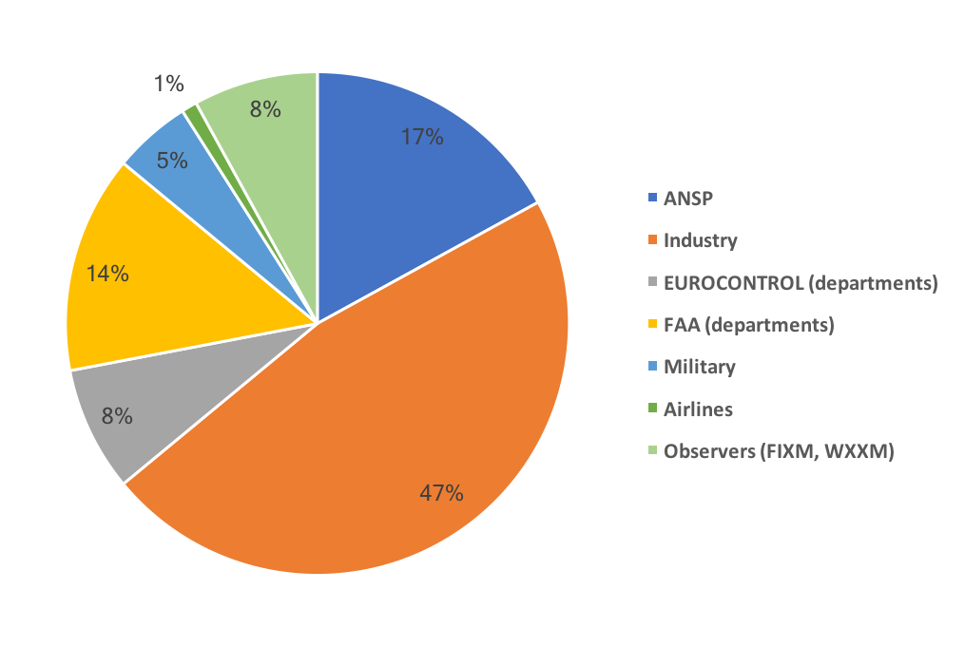
AIXM CCB
71 members
10 participants in the meeting
  therefore, not possible to take decisions
  work on issues and propose solutions in JIRA

