Slide 1
ICAO AIRM briefing
for the AIXM CCB
Scott WILSON
EUROCONTROL, ATM/STR/SWM
05-Dec-2016

Slide 2
Content
ICAO AIRM Purpose and Role
  IMP Job Card
  Relation with Information Exchange Models
  GANP
ICAO AIRM Alpha Release
  Sneak Peek
  Content
Towards the ICAO AIRM Beta

Slide 3

The ICAO ATM Information Reference Model
(ICAO AIRM)
a structured, traceable, unified, harmonised, common, digital representation based on standard modelling notation
UML class model comprised of ATM-specific terms, definitions, and essential associations, that serve as the common ICAO reference
Source:
IMPWG3WP16 Architecture ICAO AIRM Alpha v2.pdf

Slide 4
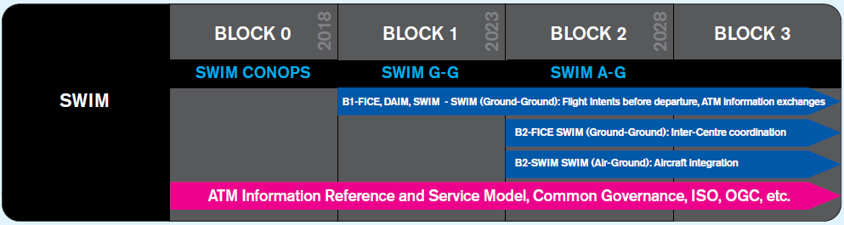
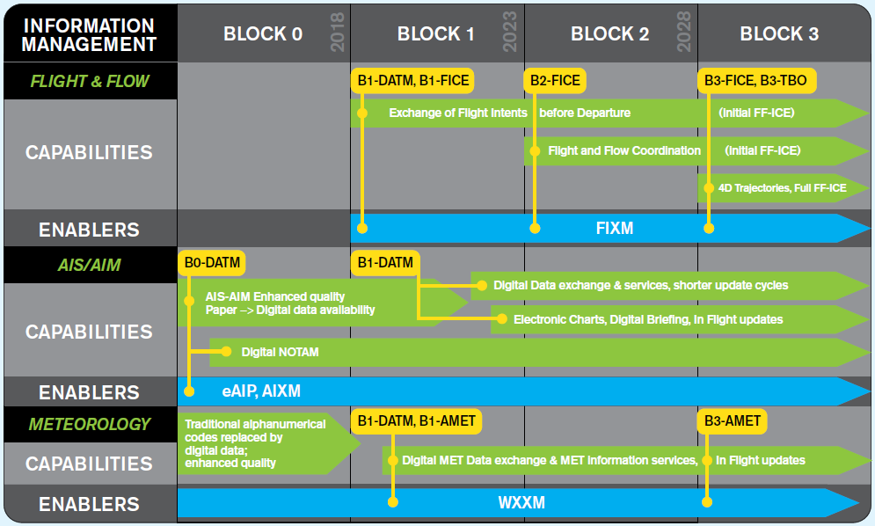
Source: ICAO Doc 9750 - GANP

Slide 5

Relation with Information Exchange Models
AIRM
  ensuring collaborative, semantic alignment
  reference for the XMs and information services
XM
  enable the management and distribution of information services data in digital format
  needed for implementation work
Source: IMP-WG-1 WP-04 AIRM.pdf

Slide 6
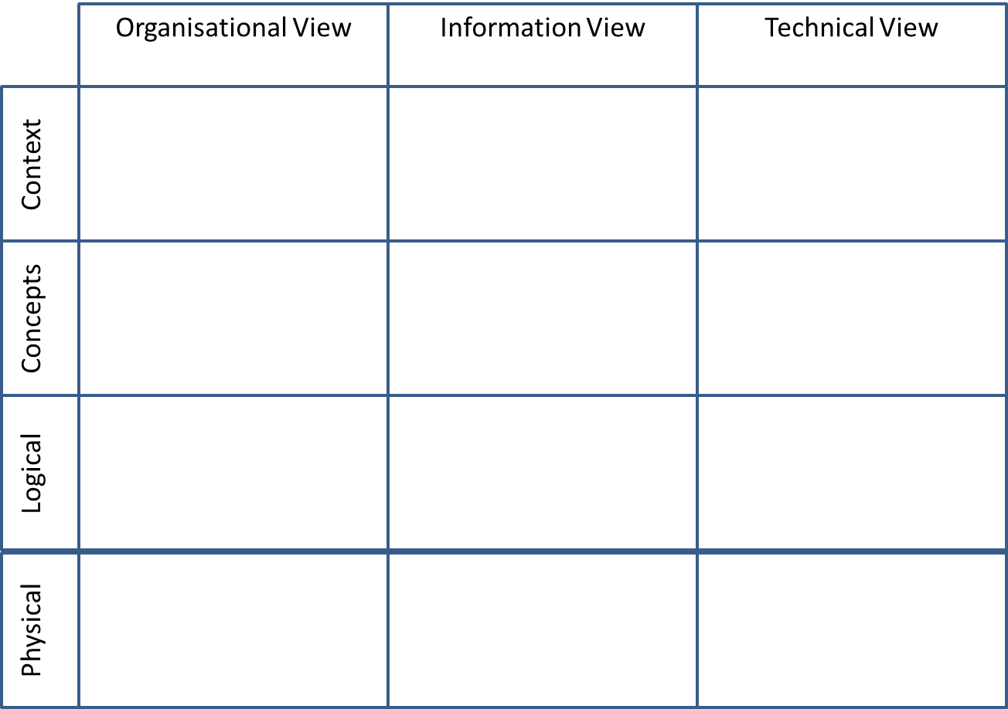
ICAO
AIRM Contextual Model
AIRM Conceptual Model
AIRM Logical Model
Aeronautical Information Community of Interest
AIXM Logical Model
AIXM Based Services
AIXM XSD
Source: Working material!

Slide 7
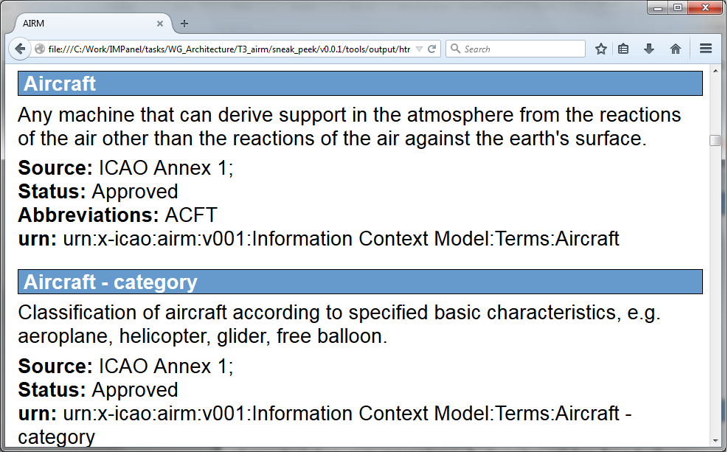
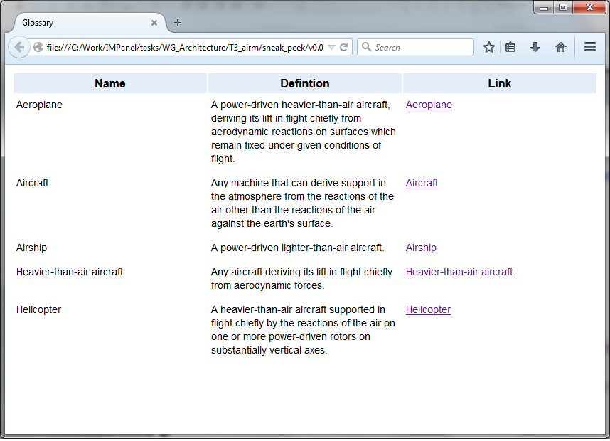
Source: ICAO AIRM Sneak Peek

Slide 8
Building the ICAO AIRM Alpha
Business Requirements
Terms
SARPS
PANS
Guidance
ICAO
AIRM
Publications,
Technical Artefacts
Data Dictionary
Information Exchange Models
Agree scope
Agree priorities
Agree working arrangements
Set-up modelling environment
Source: ICAO AIRM Sneak Peek

Slide 9
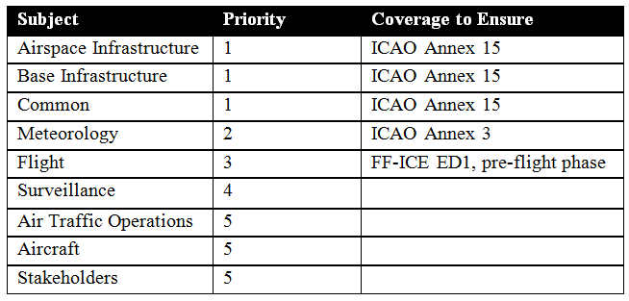
Priorities for ICAO AIRM Alpha
Source:
IMPWG3WP16 Architecture ICAO AIRM Alpha v2.pdf

Slide 10
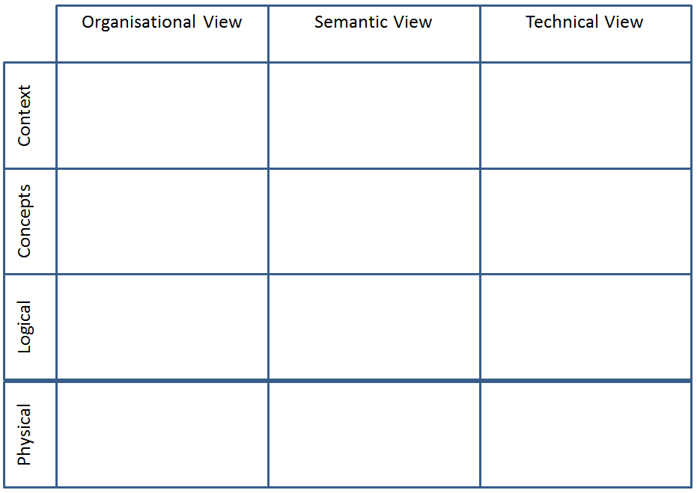

“Sneak Peek” Modelling Environment: ICAO
ICAO AIRM
ICAO ATM business terms
Added Relationships
Added Types
Source: ICAO AIRM Sneak Peek

Slide 11
Added ICAO ATM Business Terms
Source: ICAO AIRM Sneak Peek

Slide 12
Added Relationships
Source: ICAO AIRM Sneak Peek

Slide 13
Added Data Types
Source: ICAO AIRM Sneak Peek

Slide 14
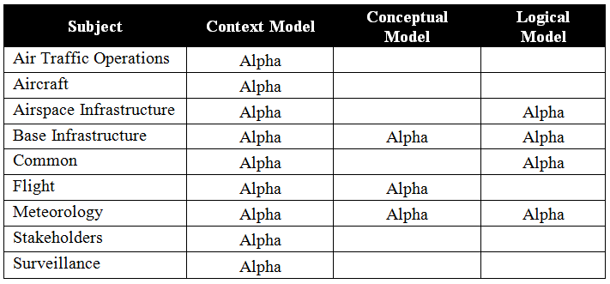
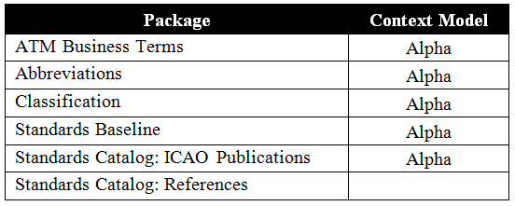
Mature for Review in ICAO AIRM Alpha
Source:
IMPWG3WP16 Architecture ICAO AIRM Alpha v2.pdf

Slide 15

Next Steps
2016
  Now - ICAO AIRM Alpha review
2017
  March – Start to work on ICAO AIRM Beta
  November - ICAO AIRM Beta
2018
  November - ICAO AIRM v1.0

Slide 16
Summary
Purpose and role of the ICAO AIRM agreed
ICAO AIRM Alpha delivered in November
Work towards Beta will start soon
Need to ensure the coordination with AIXM community

Slide 17


