Slide 1

AIXM 5.1 – Interoperability issues
AIXM CCB – Webex 12 December 2017

Slide 2
Agenda
Metadata requirements / solution for AIP Data Set
AIP Data Set open interoperability topics
Feature identification properties list

Slide 3
Metadata
Approach
  Short term
    Metadata specification for the new ICAO data sets, in particular AIP data set
      Based on the revised Annex 15 and new PANS-AIM provisions
      Using ISO 19115 (model) and ISO 19139 (XML schema)
    Related topic: Data Product Specification (ISO 19131) for the ICAO data sets
  Long term
    Metadata specification for data collection
    Keep using the ISO 19139 XML schema?
      extremely complex
      extremely verbose
      embedded in the GML schema

Slide 4
Metadata
Discussion about metadata in relation with Web services
  Some elements of metadata (such as validity of the data) is a query parameter (for example), therefore not really metadata
  Some metadata could sit in the services registry
  The IMP is currently working on a “services” specification, which includes discussion about metadata

Slide 5
Metadata
Working directory created in Google Drive
  https://drive.google.com/open?id=0BxlGN-YBj-q0cjZZUllWdzY3OXc
Conclusions from previous Webex
  Add list of mandatory ISO 19115 / ISO 19139 elements (such as Point of Contact for Metadata, topic category, language, etc.)
  find maybe a better solution for the “AIRAC” flag, which actually means that the current data set was issued under the AIRAC cycle rules
  See if possible to use more specific codes, such as “air transportation”. This might require changes in the ISO 19139 codeList

Slide 6
metadata
Discussion
  Applicability of the metadata proposal (currently labelled as “Metadata for AIP data set”)
    According to Annex 15 and PANS-AIM - minimal metadata to be provided for all ICAO data sets (AIP, obstacle, procedures, airports mapping, terrain)
    However, some dataset (such as airport mapping and obstacles) have additional metadata requirements
  Conclusion
    Scott will do a final edit of the document in Word, then it will be made available through the public web site
      https://ext.eurocontrol.int/aixm_confluence/display/ACGAIP/Metadata

Slide 7
Interoperability scenarios
Reason for scenarios
  Some interoperability issues (such as discordant UUID) are likely to have different solutions in different use cases
    If this is not really the case, the scenarios could be merged in the end…
Proposed scenarios (in the order of priorities)
    AIS publishing data under ICAO SARPS (including provision of data to DAT providers or to another ANSP)
    Hub scenario (EAD, other regional implementations)
      Including data coordination with other hubs
    Data originator(s) to/from ANSP (particular case – procedure designer, airport data originator)
Other possible scenarios (for later)
    Data merge between FIXM, AIXM and iWXXM data sets
    Large scale SWIM interoperability exercises using multiple non-coordinated data sets (such as in the SESAR or FAA demonstrations)
    Use of AIXM data for simulators?
    Digital NOTAM (world-wide)
    IMP “services”

Slide 8
AIP Data SET Use Case
Technical Interoperability rules
  Mature content - available for public comments on the new Confluence web site
    https://ext.eurocontrol.int/aixm_confluence/display/ACGAIP/Interoperability+rules
    One new comment concerning the use of OTHER…(3)
    Older comments – work in progress (1), (2)

Slide 9
AIP Data SET Use Case
Technical Interoperability rules
  Drafting area in Google Drive – for the participants in this working group
    https://drive.google.com/drive/folders/0BxlGN-YBj-q0bnZkSzFoaC1HbVE
    Propose to move to public web site
      Format and distribution – provision as files
      Use of nilReason
      Data Set – allowed features
      Additional XSD rule - NaN and INF not allowed
    Open issues
      See “suggested text in the document”…
        https://drive.google.com/open?id=1VSsMr3JVNFIrLowWxt8Ft6-M3n1xZL6lqED8f4m5Ppk

Slide 10
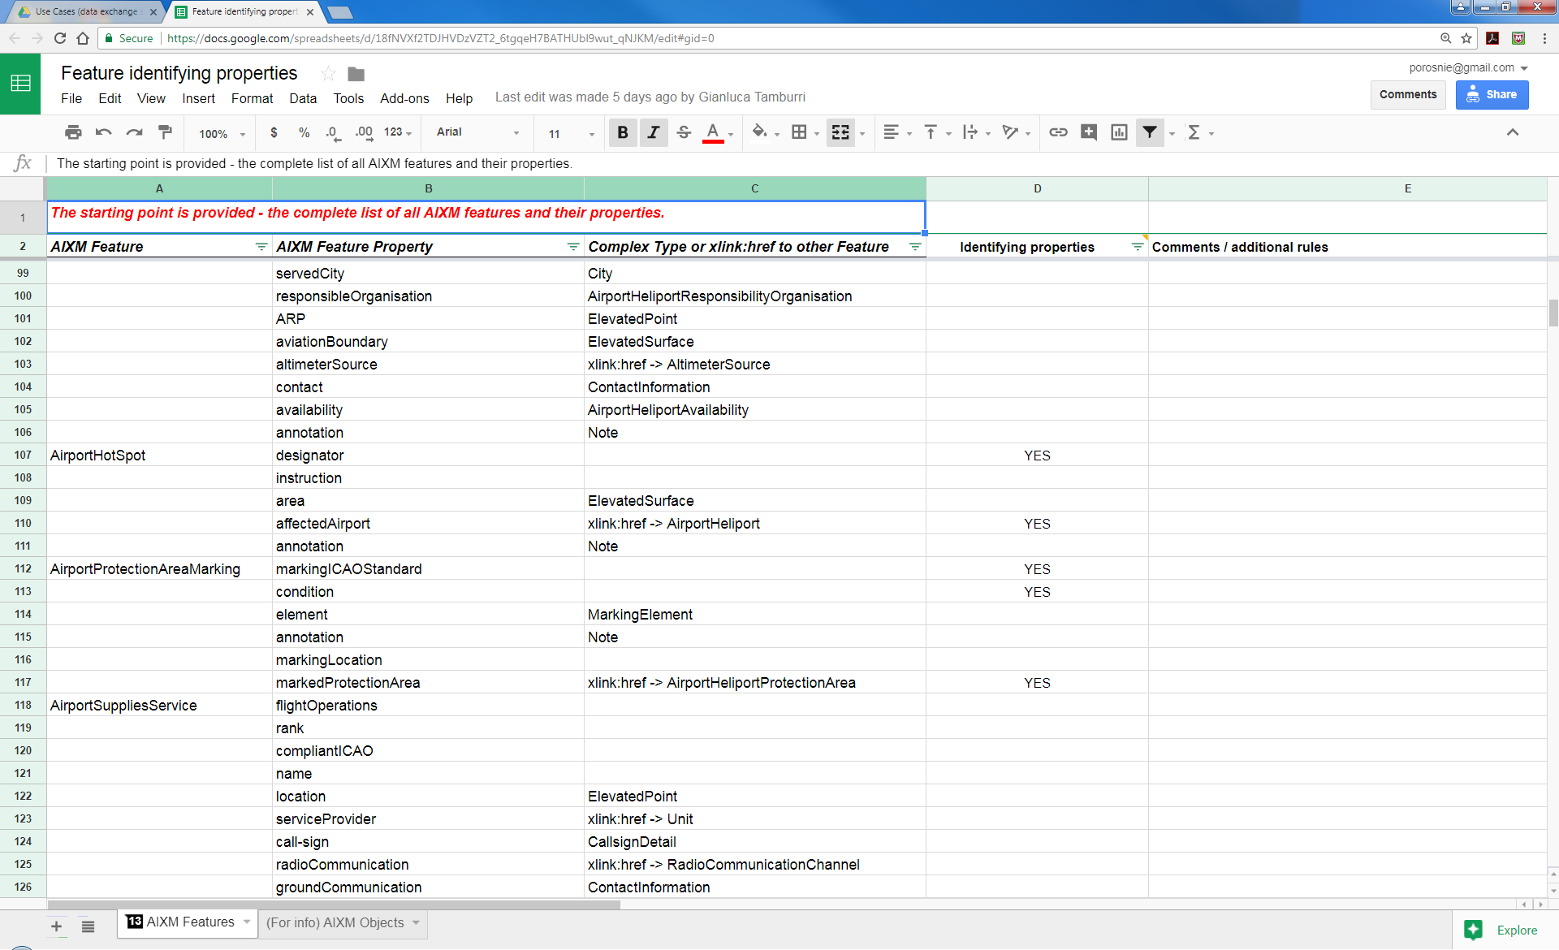
Feature identifying properties
Work in progress – looks almost finalised
  Thanks to Manfred Beckmann (Solitec) and Francois Germain (Thales) for drafting, Gianluca Tamburri (IDS) for review. Missed anyone else?
  https://drive.google.com/open?id=18fNVXf2TDJHVDzVZT2_6tgqeH7BATHUbl9wut_qNJKM

Slide 11
Feature identification properties
(Still) ToDo
  See what other XMs are using when they refer to aeronautical features, for example FIXM, iWXXM
    For example, FIXM is using also alternatives (such as ICAO or IATA or name for an aerodrome)
      See presentation of FIXM 4.1 from CCB meeting in Brussels: http://aixm.aero/sites/aixm.aero/files/imce/library/ccb_meetings/aixm_ccb_2017_11/fixm_briefing_to_the_aixm_ccb.pptx
  Cross-check the list with the proposed mandatory attributes for the AIP data set
  Focus on the features that are part of the AIP data set, publish a partial list that concerns only those features, in support of the AIP data set coding guidelines.
    Identify potential duplicates by “natural key” (data verification rules with ‘warning’ message
    Use in xlink:title

Slide 12
Global issues list
No new entries
  https://drive.google.com/open?id=1kLzaYXxtANNHQFpv1Y4HZM1g4S44IDnBSwgF188oS-g
  Needs a clean-up…

Slide 13
Next meeting
Next Webex
  WED 22 FEB
  14:30 – 16:30 Brussels time
  Work items topics expected to progress in the meantime
    Metadata requirements
    AIP Data Set open interoperability topics
    Feature identification properties list

