Slide 1
AIXM 5.2 – WIP
AIXM CCB – Webex 09 MaY 2017

Slide 2
Proposed Agenda
Atlassian JIRA – account changes
AIXM Confluence – new (replacing old wiki)
AIXM Interoperability scenarios – for info
IMP feedback
AIXM temporality concept
AIXM 5.2 – work in progress
AIXM CCB meeting - 12-14 June, Frankfurt, Germany

Slide 3
Atlassian changes
“We'd like to let you know that starting 24th April 2017, we're upgrading all users on aixmccb.atlassian.net to an Atlassian account. The next time they log in, they'll go through a simple email verification process that takes about 20 seconds.”
What this means for your users
users will need to use their email address to log in, instead of their username
users will need to complete a short email verification process when they next log in.

Slide 4
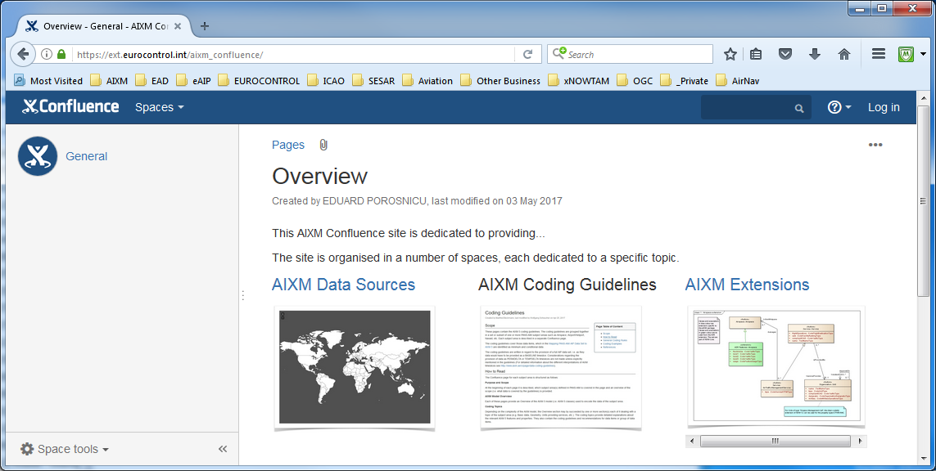
AIXM – Confluence (Wiki)
In development
www.aixm.aero/.... (will replace www.aixm.aero/wiki)

Slide 5
AIXM – Confluence (Wiki)
Proposal: three spaces
AIXM data sources
a map of the world, linking to individual pages where visitors should find detailed information about the AIXM data published by each State
AIXM coding guidelines
content is being developed for the AIP Data Set coding guidelines (see next slides)
AIXM extensions
dedicated to documenting extensions of the AIXM model

Slide 6
AIXM – coding Guidelines (WIP)
Focus Group established in Eurocontrol
Open to States/organisations from outside Europe, if interested
Not directly a CCB activity
Several CCB members are involved
Objective
Priority 1: coding guidelines for the new ICAO AIP Data Set
promote and standardise the use of AIXM 5
world-wide applicability (no regional specific rules)
Finalisation expected in July 2017
Priority 2: other ICAO data sets
Instrument flight procedures
Obstacles
Airport mapping data

Slide 7
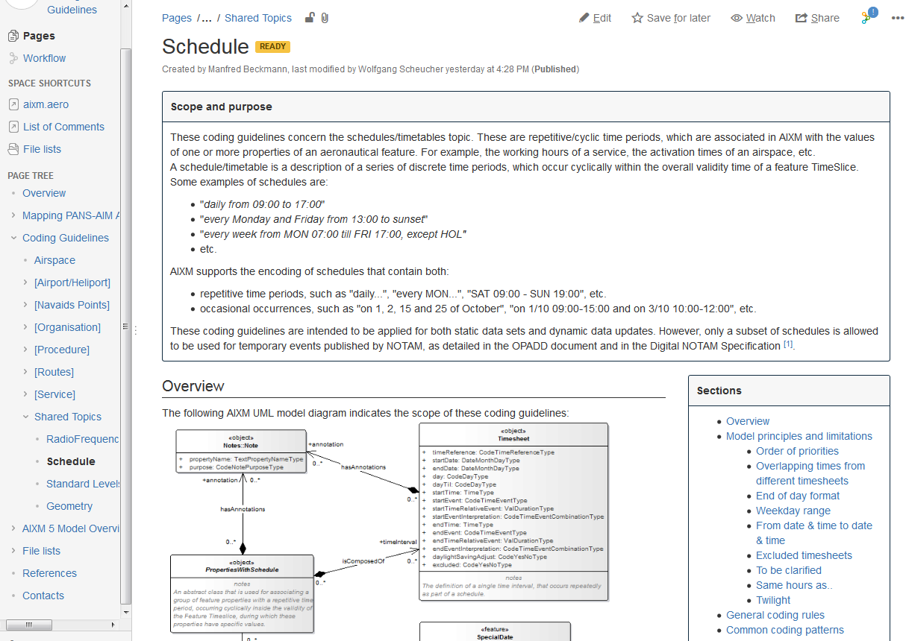
AIXM – coding Guidelines (WIP)

Slide 8
AIXM 5.1 interoperability
Dedicated AIXM CCB Webex
Next on 10th May, 14:30 Brussels time (CEST), 8:30am EDT
Invitation sent only to those who have indicated their strong interest and who have identified such issues, in particular developers
Work area established in GoogleDocs
https://drive.google.com/open?id=0BxlGN-YBj-q0eXpFZHBxVEl0cHc
Work in progress – define interoperability scenarios
See in particular the ICAO AIP Data Set scenario…

Slide 9
[AIXM-1xx] TeMPORALITY Concept
Temporality Concept clarifications (solve AIXM-153, AIXM-154)
No direct impact on the AIXM 5.1.1 UML or Schema
Just clarifications, no significant changes
Version 1.1 – working draft available in GoogleDocs (https://drive.google.com/open?id=1lBWtVYKFgphlj3lnHmB2itfZTLQDhhGPFNpRZKGq5so)
Remaining actions (for Eddy)
Add more non-nominal use cases in chapter 5 (such as postpone a future change, abandon a new feature creation, etc.)
Finalise validation rules - done
SBVR formulation will be included in the AIXM Business Rules, not in the document itself
Final editorial work - done
Open suggestions for adding/correcting text/graphics in various places
Review the language style (use ‘shall’/’should’/’may’ for the rules.

Slide 10
AIXM 5.2
See JIRA…
Several new issues
One draft change proposal – AIXM-245 (XML namespace policy)
Route/Point topics

Slide 11
Actions
All CCB Members
Please see the comments that ask for examples ( real world data, AIP extracts, charts, etc.)
Upload relevant examples in JIRA
Please raise as soon as possible other issues that have been identified in the past (for example, on the AIXM Forum) and that could be considered for AIXM 5.2.

Slide 12
Older actions (still open)
Issue that require external coordination
AIXM-130 (to address ICAO)
Action for Razvan Guleac (for one of the next IMP meetings)
Or maybe to see if there is another ICAO body (AIS secretariat) to be addressed
on hold for the moment
AIXM-175 (to coordinate XSD aspects with other XM CCB)
Action for Eddy Porosnicu (to clarify the request and evaluate the impact on AIXM;
Action for Razvan Guleac (to inform the IMP – architecture, but the problem needs to be described at a more conceptual level)

Slide 13
Next Webex/Meeting
WED 7 June – 14:00
Provisional Webex date, if needed before FRA meeting
AIXM CCB Meeting in Frankfurt, 12-14 June 2017
Please confirm participation as soon as possible by e-mail to eduard.porosnicu@eurocontrol.int
Agenda (will be prioritized based on the interests of the participants)
AIXM versioning policy
Routes/Points issues
Airspace issues
Procedures issues
Coding guidelines
Confluence
Keep in mind (not formal CCB meetings)
Webex on 10 May at 14:30 Brussels time – AIXM Interoperability
Webex on 18 May at 14:00 Brussels time - Procedures Coding

Slide 14
Future meetings/Webex
Next regular Webex – 1st week of July, to be decided in Frankfurt
Next meeting – possibility
In relation with the ATIEC 2017
this year in Brussels, 5-6 October (THU-FRI)
AIXM CCB could be on 3-4 October (TUE-WED)
In parallel with an ICAO interregional workshop on Digital AIM, which takes place on 2-4 October (MON-WED)

