Slide 1

AIXM 5.2 – WIP
AIXM CCB – Webex 29 March 2017

Slide 2
Proposed Agenda
Atlassian JIRA – account changes
AIXM Interoperability scenarios – for info
AIXM Coding guidelines – for info
AIXM temporality concept
AIXM 5.2 – work in progress
AOB

Slide 3
Atlassian changes
“We'd like to let you know that starting 24th April 2017, we're upgrading all users on aixmccb.atlassian.net to an Atlassian account. The next time they log in, they'll go through a simple email verification process that takes about 20 seconds.”
What this means for your users
  users will need to use their email address to log in, instead of their username
  users will need to complete a short email verification process when they next log in.

Slide 4
Atlassian changes
Impact on “read-only account”
  New Login / password
    please contact an AIXM CCB member in your organisation for details about the read-only account

Slide 5
AIXM 5.1 interoperability issues
Complaints about AIXM 5.1 “interoperability issues”
Dedicated AIXM CCB Webex
  Next on 10th May, 14:30 Brussels time (CEST), 8:30am EDT
  Invitation sent only to those who have indicated their strong interest and who have identified such issues, in particular developers
  Work area established in GoogleDocs
    https://drive.google.com/open?id=0BxlGN-YBj-q0eXpFZHBxVEl0cHc
    Work in progress – define interoperability scenarios
      See in particular the ICAO AIP Data Set scenario…

Slide 6
AIXM – coding Guidelines (WIP)
Focus Group established in Eurocontrol
  Open to States/organisations from outside Europe, if interested
  Not directly a CCB activity
    Several CCB members are involved
Objective
  Priority 1: coding guidelines for the new ICAO AIP Data Set
    promote and standardise the use of AIXM 5
    world-wide applicability (no regional specific rules)
    Finalisation expected in July 2017
  Priority 2: other ICAO data sets
    Instrument flight procedures
    Obstacles
    Airport mapping data

Slide 7
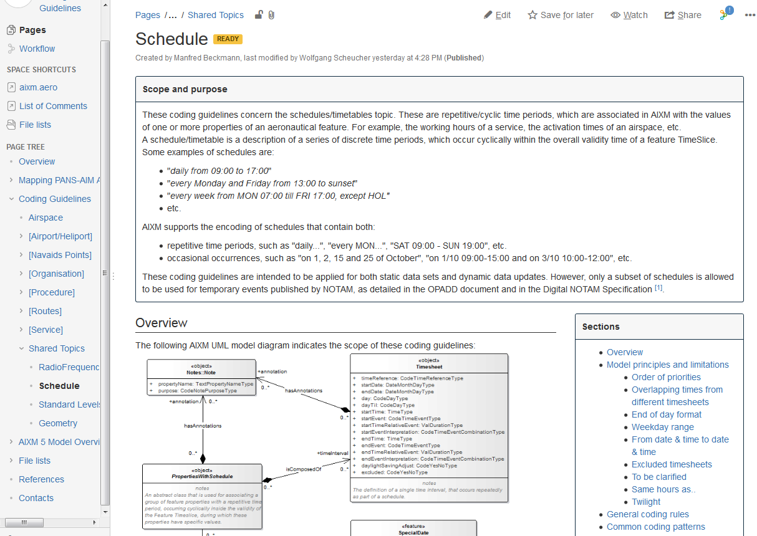
AIXM – coding Guidelines (WIP)
Note the use of Atlassian Confluence
(AIXM Wiki will also be moved to Confluence)

Slide 8
[AIXM-1xx] TeMPORALITY Concept
  Temporality Concept clarifications (solve AIXM-153, AIXM-154)
    No direct impact on the AIXM 5.1.1 UML or Schema
    Just clarifications, no significant changes
    Version 1.1 – working draft available in GoogleDocs (https://drive.google.com/open?id=1lBWtVYKFgphlj3lnHmB2itfZTLQDhhGPFNpRZKGq5so)
    Remaining actions (for Eddy)
      Add more non-nominal use cases in chapter 5 (such as postpone a future change, abandon a new feature creation, etc.)
      Finalise validation rules and formulate them in SBVR (Chapter 4)
      Final editorial work
        Open suggestions for adding/correcting text/graphics in various places
        Review the language style (use ‘shall’/’should’/’may’ for the rules.
    Should be done before next Webex…

Slide 9
AIXM 5.2
See JIRA…
  Not much activity from the previous Webex (28 Feb)

Slide 10
Actions
All CCB Members
  Please see the comments that ask for examples ( real world data, AIP extracts, charts, etc.)
    Upload relevant examples in JIRA
  Please raise as soon as possible other issues that have been identified in the past (for example, on the AIXM Forum) and that could be considered for AIXM 5.2.

Slide 11
Older actions (still open)
Issue that require external coordination
  AIXM-130 (to address ICAO)
    Action for Razvan Guleac (for one of the next IMP meetings)
    Or maybe to see if there is another ICAO body (AIS secretariat) to be addressed
      on hold for the moment
  AIXM-175 (to coordinate XSD aspects with other XM CCB)
    Action for Eddy Porosnicu (to clarify the request and evaluate the impact on AIXM;
    Action for Razvan Guleac (to inform the IMP – architecture, but the problem needs to be described at a more conceptual level)

Slide 12
Next Webex
Proposed date: 09 MAY 2017
  14:00-16:30 Brussels
  8am -10:30am Washington
Proposed agenda
  (postponed from today) AIXM Temporality Concept - finalisation
  AIXM 5.2 issues/change proposals
    (postponed from today) Route component related issues with priority
    https://aixmccb.atlassian.net/issues/?jql=project+%3D+AIXM+AND+issuetype+in+%28%22New+Feature%22%2C+Improvement%2C+%22Bug+Report%22%29+AND+%28fixVersion+%3D+earliestUnreleasedVersion%28%29+OR+fixVersion+is+EMPTY%29+AND+component+%3D+Routes
Keep in mind
  Webex on 06 April at 14:00 Brussels time for Procedures Coding Guidelines (not a CCB meeting)
  AIXM CCB Meeting in Frankfurt, Germany, 12-14 June 2017

