Slide 1
AIXM 5.1.1 – Work in Progress
AIXM CCB – Webex, 24 JAN 2014

Slide 2
Proposed Agenda
AIXM-JIRA issues proposed for AIXM 5.1.1
Start formal change proposals
Migration to Sparx EA
AIXM 5.1.1 “.eap” file
Scripts for core model
Scripts for extensions
Any other topic?

Slide 3
AIXm 5.1.1
Proposal – Secretariat (Eurocontrol and FAA) to start drafting formal change proposals by 20 January
Only for the issues identified at the ad-hoc CCB meeting as candidates for AIXM 5.1.1
A comment “candidate for 5.1.1 will be added today” to all these issues
Please review all existing issues and make eventual comments in JIRA

Slide 4
CCB-Jira issues
Issues proposed to be progressed with formal Change Proposals for AIXM 5.1.1 (also marked as such in JIRA, see comments)
https://aixmccb.atlassian.net/browse/AIXM-98 Description Updates
https://aixmccb.atlassian.net/browse/AIXM-99 XML schema - enumeration values that have typing errors
https://aixmccb.atlassian.net/browse/AIXM-100 Misspelled words and abbreviations
https://aixmccb.atlassian.net/browse/AIXM-101 Element name with space in the UML model
https://aixmccb.atlassian.net/browse/AIXM-103 UML - XSD discrepancies for association cardinalities
https://aixmccb.atlassian.net/browse/AIXM-106 Missing composition symbol in UML model for an association
https://aixmccb.atlassian.net/browse/AIXM-107 Missing nillable='true' attribute for one element in the XML Schema
https://aixmccb.atlassian.net/browse/AIXM-120 CodeProcedureFixRoleType missing value
https://aixmccb.atlassian.net/browse/AIXM-123 UML modeling of XML schema data types
https://aixmccb.atlassian.net/browse/AIXM-124 Missing nilReason in some AIXM properties
https://aixmccb.atlassian.net/browse/AIXM-127 Minor correction to descriptions of features/objects, and associated attributes to be included in AIXM 5.1.1. Types of changes include typographical, spelling out acronyms, gramatical, etc.
https://aixmccb.atlassian.net/browse/AIXM-131 ILS Operational Performance Categories IIIA, IIIB and IIIC
https://aixmccb.atlassian.net/browse/AIXM-132 Migration to Sparx EA
https://aixmccb.atlassian.net/browse/AIXM-134 Add missing aircraft engine type
https://aixmccb.atlassian.net/browse/AIXM-138 Note propertyName pattern

Slide 5
CCB-Jira issues
The following issues are proposed for a partial Change Proposal in AIXM 5.1.1, with a final solution in a later version
https://aixmccb.atlassian.net/browse/AIXM-102 UML - XSD discrepancies for element names that are result of an association
https://aixmccb.atlassian.net/browse/AIXM-110 HoldingPattern outboundCourseType correlated with the inboundCourse
https://aixmccb.atlassian.net/browse/AIXM-121 Add altitudeReference (CodeVerticalReferenceType) to DistanceIndication and AngleIndication

Slide 6
Change Proposals
Proposed – GoogleDocs Template
Let’s review / discuss it…
Looking for volunteers to start drafting the CPs
Once each CP ready
Secretariat will upload it in JIRA (as PDF!)
Follow-up in JIRA
If necessary, CP updated in GoogleDocs and re-upload in JIRA

Slide 7
Change Proposals
Timeline proposed
Review CP AIXM-139 by 6 FEB 2014
Improve the template, comment on eventual deficiencies of the proposal
All CP for 5.1.1 ready by end March 2014
Formal review until mid May 2014 (4-6 weeks)
AIXM 5.1.1 “beta” available mid June 2014
UML Model
Core XSD
Sample files
XSLT conversion scripts 5.1 – 5.1.1
Associated documentation

Slide 8
[AIXM-132] Migration to Sparx EA
Sparx EA Draft EAP model updated
https://extranet.eurocontrol.int/http://webprisme.cfmu.eurocontrol.int/aixmwiki_public/bin/download/Main/AIXM_5_1_UML_EA/AIXM5.1.1Draft0.4.eap
Correction to AircraftStands (with s)
New version of the EA Script
Fine-tuned by Pulsar Consulting
New: XSLT script that corrects the order of associations
Tested on core model, further testing necessary for extensions

Slide 9
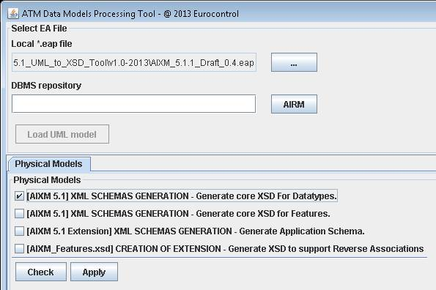
[AIXM-132] Migration to Sparx EA

Slide 10
[AIXM-132] Migration to Sparx EA
Next step – scripting support for extensions
EA script
Any voluntary to test the limits of existing scripts?
XSLT script
Any voluntary to test the limits of existing scripts?
Document migration process and the development of extensions directly in EA
Proposal – make your proposals using GoogleDocs
Anyone with the link can view/comment!
Interested to contribute/edit? -> please request access to the document directly in Google, using your Google ID

