Slide 1

AIXM 5.1.1 scripts and plannning
AIXM CCB – Webex, 19 Dec 2013

Slide 2
[AIXM-132] Migration to Sparx EA
Sparx EA Draft EAP model updated (thanks for Hubert Lepori)
  http://webprisme.cfmu.eurocontrol.int/aixmwiki/bin/download/Main/AIXM_5_1_UML_EA/AIXM5.1.1Draft0.3.eap
  issue with some stereotypes that prevented the export scripts from running properly
    The stereotypes <<DataType>> and <<CodeList>> are now used consistently (which is by the way compliant with the ISO19107 spelling)
New version of the EA Script (thanks for Hubert Lepori)
  Attached in JIRA to issue AIXM-132
  Script used in SESAR for AIXM and other XML schema generation, please ignore those functions, just use the AIXM one (see next slides)
New: XSLT script that corrects the order of associations
  See next slides
  First draft, further testing necessary

Slide 3
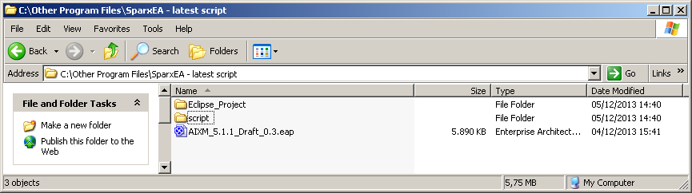
[AIXM-132] Migration to Sparx EA
This new version includes a number of property files that store textual key/value elements for different environment, including the AIXM environment. In particular, the file AIXMProperty (in package resources) contains for instance:
  aixm_51_stereotype_codelist = CodeList
  aixm_51_stereotype_datatype = DataType
  aixm_51_stereotype_xsd_facet = XSDfacet
  aixm_51_stereotype_feature = feature

Slide 4
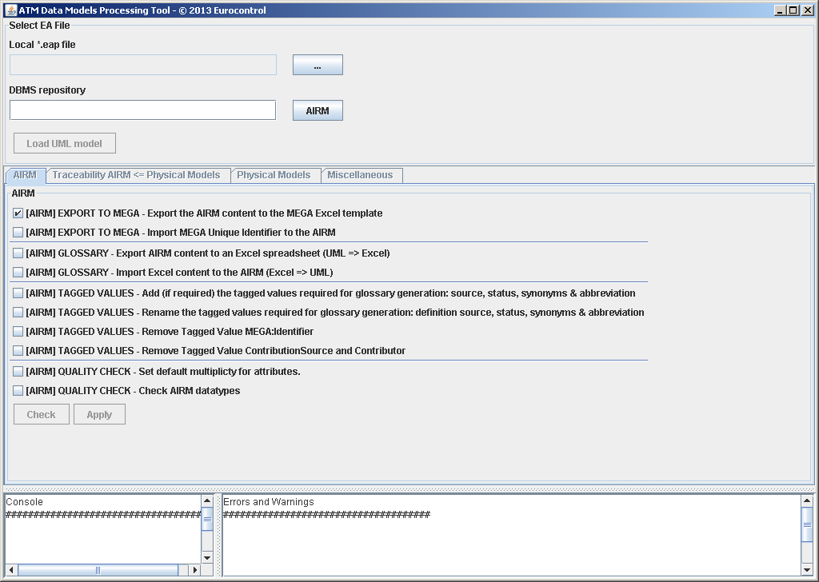
[AIXM-132] Migration to Sparx EA
Run the scripts
  Make sure that
    SSJavaCom.dll is in the Windows Path
    eaapi.jar is in the CLASSPATH
  Launch start.bat
    Should see this window ->
  Select AIXM eap file and
  Load UML Model
    See in Console
      “Loading complete…”
  See Physical Models tab

Slide 5
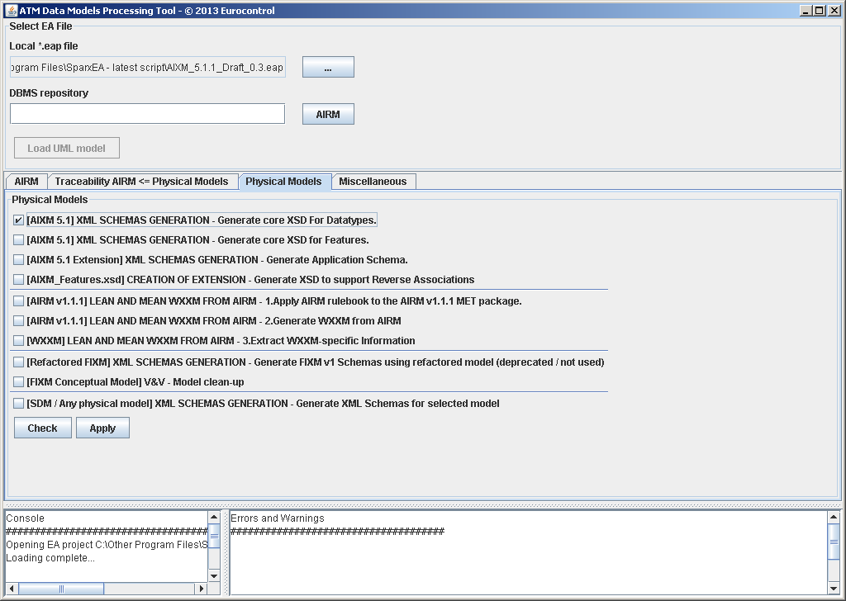
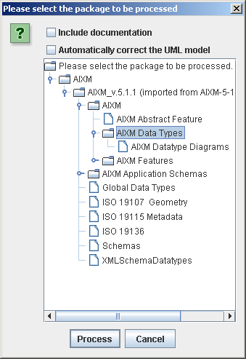
[AIXM-132] Migration to Sparx EA
Generate XSD for data types
When done:
Message “Done...” in Console
Resulting AIXM_DataTypes.xsd is in ‘output’ folder

Slide 6
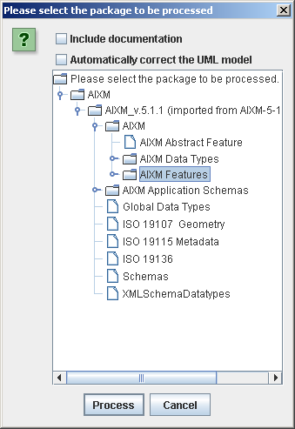
[AIXM-132] Migration to Sparx EA
Generate XSD for features
  Select “…Generate core XSD for Features”
  See the progress in Console
  When done:
    Message “Done...” in Console
    Resulting AIXM_Features.xsd in ‘output’ folder
Known issues
  “uom” mandatory instead of optional for some data types

Slide 7
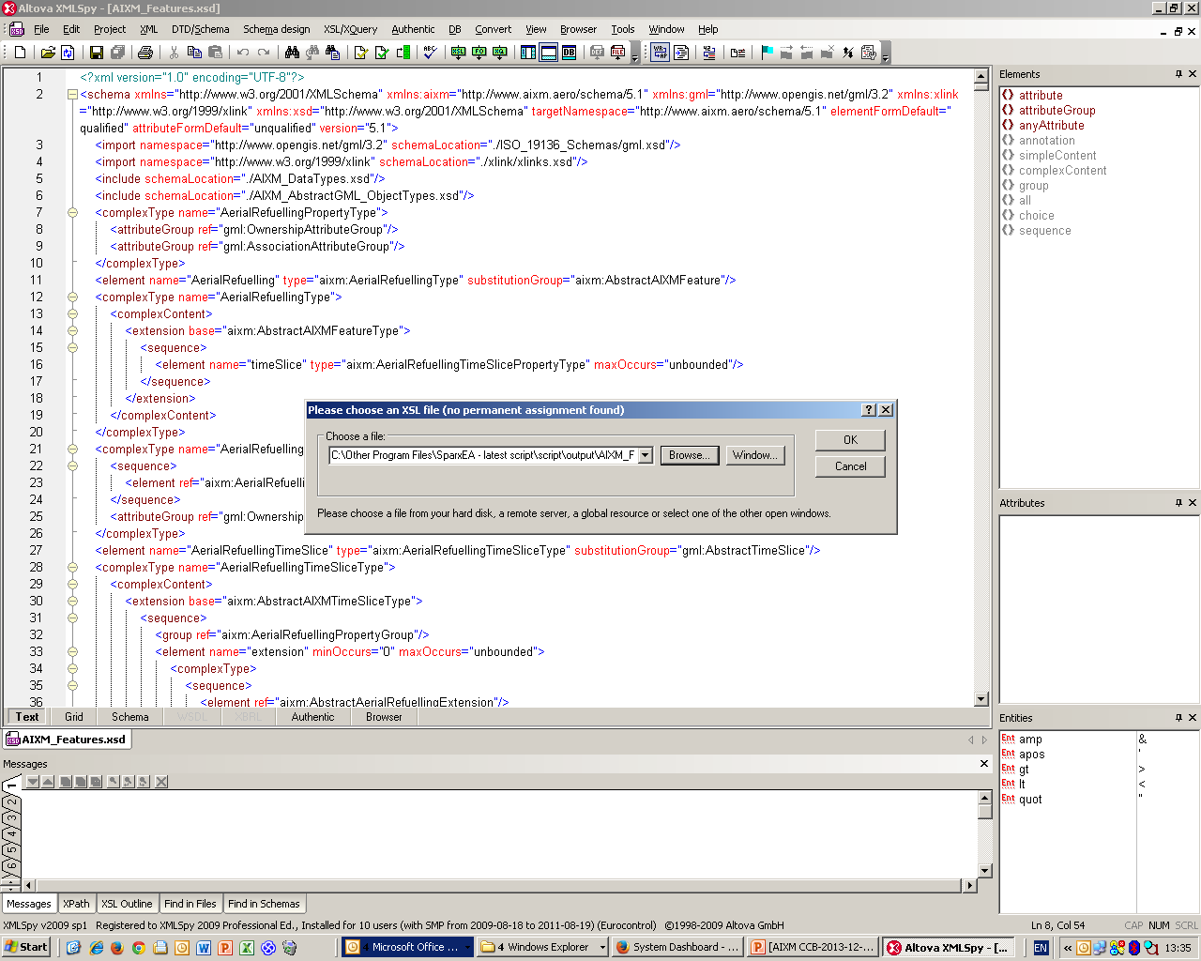
[AIXM-132] Migration to Sparx EA
Correct XSD for features – order of associations to be similar to previous version (where applicable)
  Use AIXM_Features_Script.xsl
    Here applied with XML Spy
    Attention! Needs AIXM_Features-5.1.xsd in the same folder (the previous version “reference” XSD schema!)

Slide 8
[AIXM-132] Migration to Sparx EA
Next step – scripting support for extensions
  EA script
    Any voluntary to test the limits of existing scripts?
  XSLT script
    Any voluntary to test the limits of existing scripts?
  Document migration process and the development of extensions directly in EA
    Proposal – make your proposals using GoogleDocs
      Anyone with the link can view/comment!
      Interested to contribute/edit? -> please request access to the document directly in Google, using your Google ID

Slide 9
AIXm 5.1.1
Proposal – Secretariat (Eurocontrol and FAA) to start drafting formal change proposals by 20 January
  Only for the issues identified at the ad-hoc CCB meeting as candidates for AIXM 5.1.1
    A comment “candidate for 5.1.1 will be added today” to all these issues
  Please review all existing issues and make eventual comments in JIRA

