Slide 1
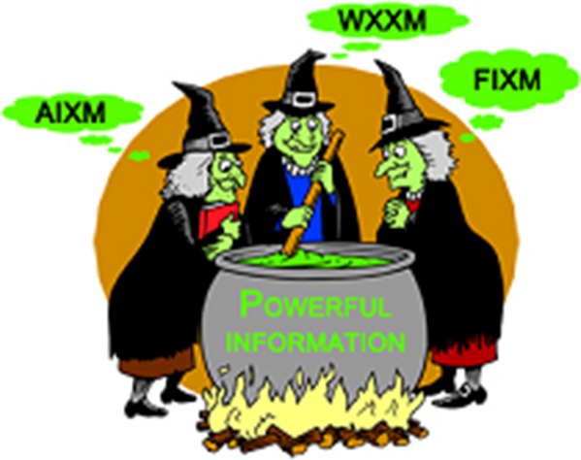
AIXM-FIXM-iWXXM coordination
26-July-2017
COMMON POLICIES

Slide 2
Agenda
Towards common policies for AIXM/FIXM/(I)WXXM?
  Versioning
  Namespace
  Deprecation
XSD Design rules for AIXM/FIXM/(I)WXXM
(optional) AIXM Routes model issues - seeking FIXM CCB opinion

Slide 3
VERSIONING
POLICY

Slide 4
Some industry best practices
Ref | Version policy | Link
GNU Coding standard: Releases | MAJOR.MINOR | https://www.gnu.org/prep/standards/html_node/Releases.html
Java™ Product Versioning | major.minor.micro | https://docs.oracle.com/javase/8/docs/technotes/guides/versioning/spec/versioning2.html
Semantic versioning 2.0.0 | MAJOR.MINOR.PATCH | http://semver.org/
Apache Portable Runtime Project | MAJOR.MINOR.PATCH | https://apr.apache.org/versioning.html
Shibboleth Java products and libraries | MAJOR.MINOR.PATCH | https://wiki.shibboleth.net/confluence/display/DEV/Java+Product+Version+Policy
Open MPI | Major.Minor.Release | https://www.open-mpi.org/software/ompi/versions/
.NET framework Assemble versioning | major.minor.build_number.revision | https://msdn.microsoft.com/en-us/library/51ket42z%28v=vs.110%29.aspx

Slide 5
Some industry best practices
Semantic versioning 2.0.0
MAJOR version when you make incompatible API changes,
MINOR version when you add functionality in a backwards-compatible manner, and
PATCH version when you make backwards-compatible bug fixes.
Java™ Product Versioning
Major version numbers identify significant functional changes,
minor version numbers identify smaller extensions to the functionality,
micro versions are even finer grained versions.
Apache Portable Runtime Project
MAJOR versions are incompatible, large-scale upgrades of the API.
MINOR versions retain source and binary compatibility with older minor versions, and
changes in the PATCH level are perfectly compatible, forwards and backwards.

Slide 6
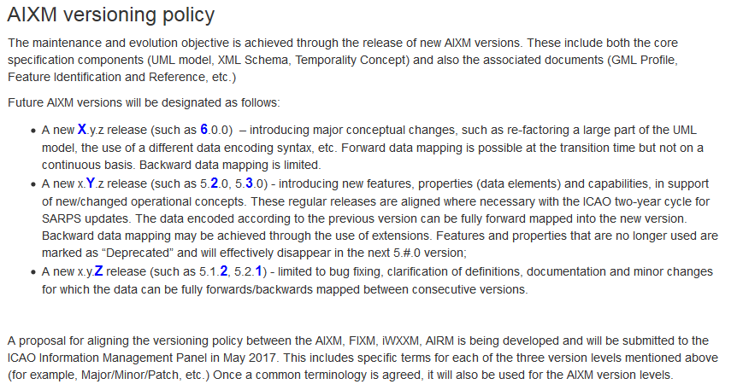
AIXM

Slide 7
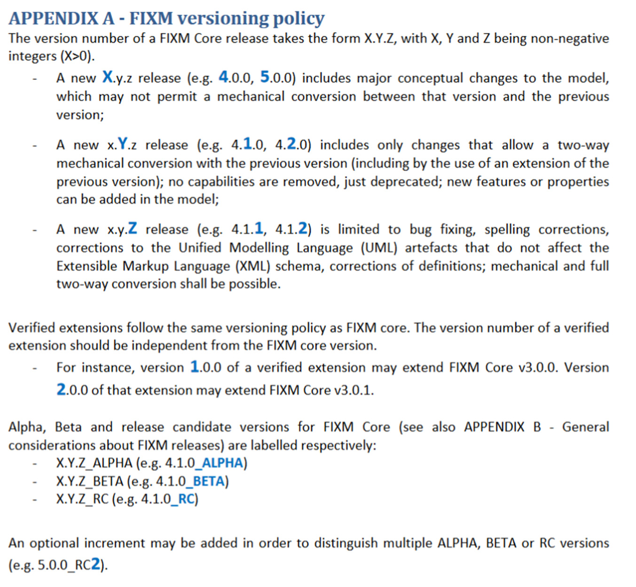
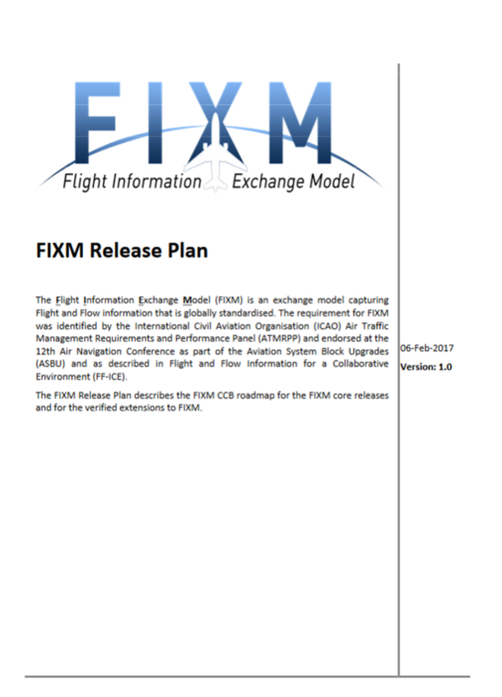
Mirrors AIXM
Version types are not named yet

Slide 8
(I)WXXM
  Any input?

Slide 9
PROPOSAL for the -XMs
MAJOR.MINOR.PATCH
=> Use ‘Semantic versioning 2.0.0’ as a common reference
Applied to the –XMs:
A MAJOR (X.y.z) version introduces major conceptual changes. Forward data mapping is not guaranteed.
The changes justifying a new MAJOR release include, but are not limited to:
  Re-factoring a large part of the model
  Scope reduction of the –XM / deletion of model elements without prior deprecation or replacement
  Use of a different data encoding syntax, or withdrawal of a given physical realization of the –XM Logical Model
A MINOR (x.Y.z) version introduces new model elements and capabilities guaranteeing forward data mapping for non-deprecated elements or deprecated elements with replacement. Loss of information may happen for elements being no longer required.
The changes allowed in a MINOR release include, but are not limited to:
  Inclusion of new model elements, in particular in support of evolving ICAO requirements (e.g. SARPS update)
  Deprecation of model elements, with or without replacement
  Deletion of model elements deprecated in a previous version
  Addition of a new physical realization of the –XM Logical Model
A PATCH (x.y.Z) version is limited to bug fixing. Forward and backward data mapping is guaranteed without loss of information. A PATCH version does not impose changes in a consuming system. PATCH may still require data conversion to be made ahead of the data entering in the consuming system (done by a mediator service)
The changes allowed in a PATCH release include, but are not limited to:
  Clarification of definitions, changes to the –XM documentation package and/or to the -XM Logical Model with no impact on the physical realization(s).
  Correcting spelling mistakes, incl. in physical realisations
  Updating external references
Example: FIXM 4.0.0 significantly revisits the modelling of trajectories and also removes capabilities previously supported by FIXM 3.0.0.
Example: AIXM 5.2.0 will enable, among others, the provision of ICAO data sets (except for terrain data) as specified in the new Annex 15 & PANS-AIM and the data provision for emerging concepts such as free routes, large-scale use of RPAS.
Example: AIXM 5.1.1 moves the maintenance of the AIXM UML model to a new modelling environment and corrects a few bugs.

Slide 10

PROPOSAL for the –XMs (cont)

Slide 11
Questions
Impact on namespace & deprecation policies
Version 1.0.0 of an –XM implements
  [MyFeature].ARP
The next version will implement instead
  [MyFeature].arp (lower case)
=> Would such a change be allowed in a PATCH version? Or should deprecation + replacement be considered in this case?
More generally, by backward / forward compatibility, do we only mean that backward / forward data mapping is enabled? Or should there be stricter requirements on XML validation?
  E.g. should an XML dataset encoded according to version x.y.z still validate against x.y.(z+1)?

Slide 12
NAMESPACE
POLICY

Slide 13
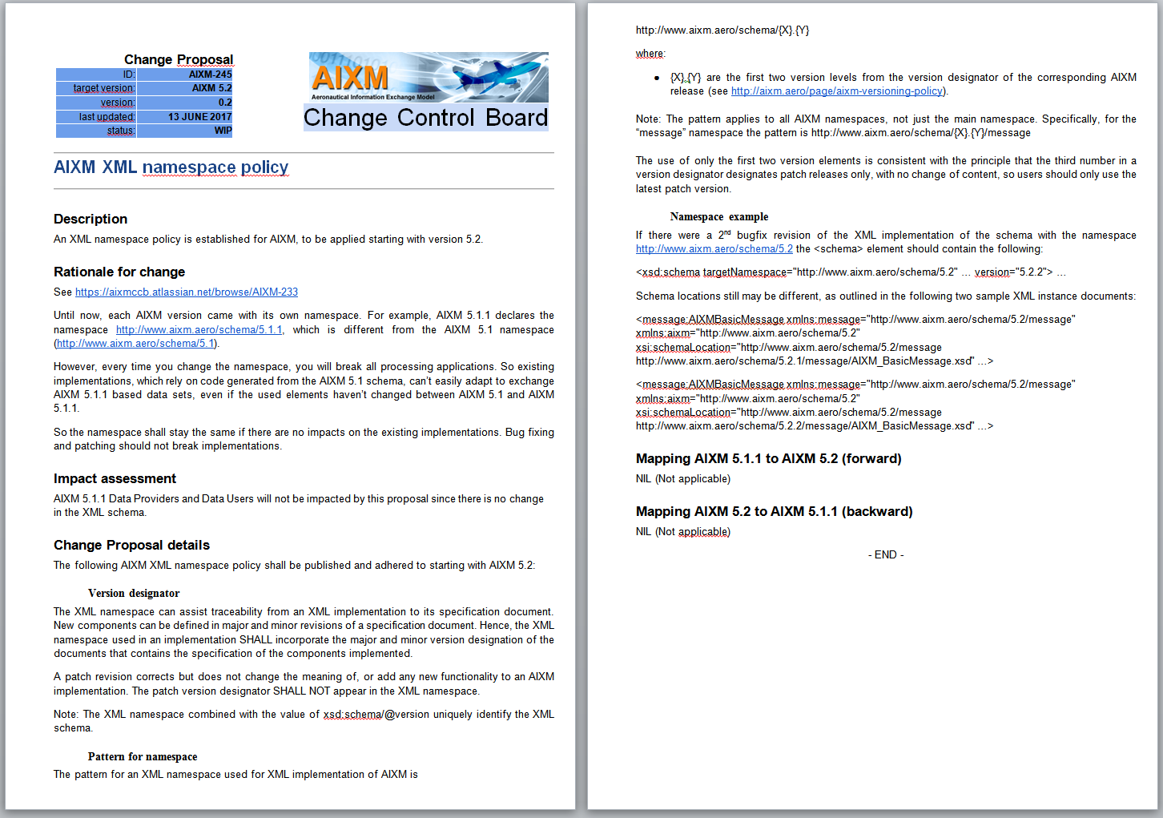

Slide 14

Extracts from FIXM workshop 2017 minutes
Namespace management
[…]
The meeting agrees in particular on the need to document the impact on schema users of a new release. Based on discussions, it is anticipated that only very minor changes would preserve the namespace (basically editorial changes to UML not affecting XML).
[…]
The FIXM Implementation package should further describe the FIXM changes that are considered compatible and those considered incompatible, as a complement to the versioning policy. The EUROCONTROL NM web services documentation provides examples of what compatible / incompatible changes for services are and may be used as an input.
The question of backward compatibility and how it is handled by FIXM is to be further documented (need perhaps to distinguish parsing from data validation).
[…]

Slide 15
(I)WXXM
  Any input?

Slide 16
PROPOSAL for the -XMs
Pattern for namespace
  The XM namespace pattern shall be http://www.??xm.aero/schema/{X}.{Y} where:
    {X}.{Y} are the first two version levels from the version designator of the corresponding XM release
  Version designator
    the namespace shall incorporate the major and minor version designation
    a patch version designator shall not appear in the XML namespace
    The use of only the first two version elements is consistent with the principle that the third number in a version designator designates patch releases only, with no change of content, so users should only use the latest patch version.

Slide 17
DEPRECATION
POLICY

Slide 18
DEPRECATION
=
DELETION
The deprecation of a model element indicates that the element is still supported but that its use is no longer recommended. A model element that is deprecated will be deleted in a subsequent release.

Slide 19
General requirements for deprecation information
Requirement | Description
Rationale | The reason for the deprecation, such as a replacement or a particular capability being no longer supported.
Replacement | A reference to other model element(s) that should be used instead, if applicable.
Deprecation version | The version in which the deprecation occurs.
Deletion version | The version in which the deletion is planned to occur.
Discussed and approved by the FIXM workshop 2017

Slide 20
Requirement | Applied to FIXM
Rationale | The rationale is expected to be formulated as follows: - As a minimum, the reference (number) of the approved FIXM CR having proposed the deprecation. Example: CR#21 - Ideally, relevant text from the FIXM CR, typically extracted from the “Motivation” section.
Replacement | The path to the corresponding FIXM model element replacing the deprecated element Example: Fixm.Flight.[…])
Deprecation version | Example: 4.1.0
Deletion version | The deletion version may not be known at the time of the release of the deprecation version. Therefore, the information will be either a FIXM version already identified in the FIXM Release Plan (e.g. 5.0.0) or the text “Not specified yet” if such a version is not yet identified in the FIXM Release Plan.
Discussed and approved by the FIXM workshop 2017

Slide 21
Capturing deprecation information (XML)
The FIXM workshop 2017 analyzed various implementation practices from other communities: ISO19136, AIXM 4.5, IATA, OpenTravel™ Alliance

Slide 22
Capturing deprecation information (XML)
Proposed solution for FIXM
- tag appinfo for marking the deprecation
- deprecation info appears as separate tags in the XML, not as plain text
<element name=“-XM_element" type="-XM_element_type">
<annotation>
<appinfo>deprecated</appinfo>
<documentation>
<deprecated>
<rationale>FIXM CR## - this element is deprecated because… </rationale>
<replacement>N/A</replacement>
<deprecationVersion>4.1.0</deprecationVersion>
<deletionVersion>5.0.0</deletionVersion>
</deprecated>
</documentation>
</annotation>
</element>
Discussed and approved by the FIXM workshop 2017

Slide 23
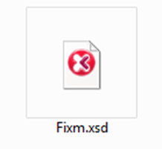
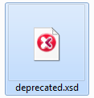
Capturing deprecation information (XML)
No need for deprecated XSD
Discussed and approved by the FIXM workshop 2017

Slide 24
Capturing deprecation information
In FIXM documents:
  The release notes
  (possibly) FIXM Primer
  ODD, online documentation...
In UML:
  FIXM community to investigate the use of stereotypes in Sparx EA

Slide 25

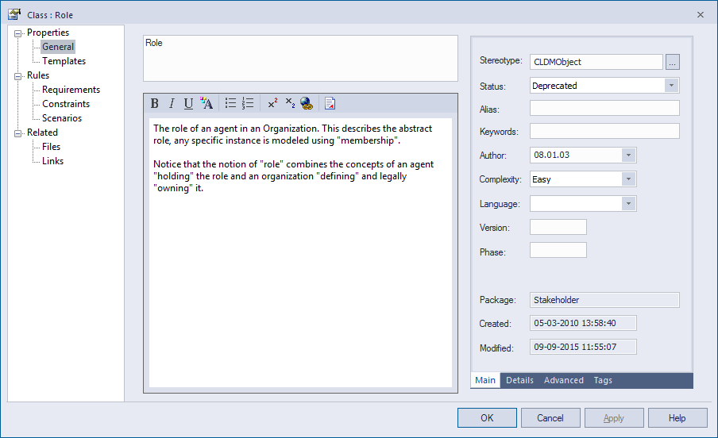
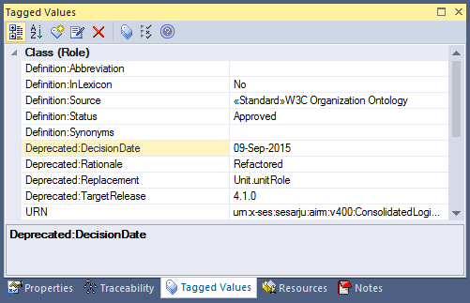
Capturing deprecation information
(UML)
SESAR AIRM

Slide 26
Capturing deprecation information
(UML)
EXAMPLE: Use of stereotypes in Sparx System EA
  FIXM community to investigate the use of stereotypes in Sparx EA

Slide 27
AIXM
Open AIXM CCB issue
  Apply deprecation starting with AIXM 5.2
    Deprecated items would effectively be removed in AIXM 5.3
  no details discussed yet
  deprecation needed for classes, attributes, associations, entries in a list of values
  the FIXM proposal seems to also satisfy the AIXM needs

Slide 28
(I)WXXM
    Any input?

Slide 29
PROPOSAL for the -XMs
Requirements for deprecation information in -XMs
Requirement | Description
Rationale | The reason for the deprecation, such as a replacement or a particular capability being no longer supported.
Replacement | A reference to other model element(s) that should be used instead, if applicable. Is an XPATH reference useful?
Deprecation version | The version in which the deprecation occurs.
Deletion version | The version in which the deletion is planned to occur. Need keyword designating next MINOR/MAJOR version if the version number is not know.
Capturing deprecation information in XSD
<annotation>
<appinfo>deprecated</appinfo>
<documentation>
<deprecated deprecationVersion=‘…’ deletionVersion = “” >
<rationale>[…]</rationale>
<replacement>[…]</replacement>
</deprecated>
</documentation>
</annotation>
How do we expect this information to be used by implementers? To be further explored

Slide 30
PROPOSAL for the -XMs
Capturing deprecation information in UML
Use Sparx EA Tagged value?
Deprecation::Rationale
Deprecation::Replacement
Deprecation::DeprecationVersion
Deprecation::DeletionVersion
Use stereotype <<deprecated>>?
Which impact on the XSD generation scripts?

Slide 31
Questions
In which type of –XM version can the deletion of deprecated elements be realised?
  Never delete deprecated elements in a PATCH version?
    OK for AIXM
  Wait at least for two consecutive MINOR versions before deleting?
    No. AIXM proposal is to use the next MINOR version for actually removing the deprecated items
  Only delete in MINOR versions the deprecated elements for which a replacement exists, and keep the others?
    No. in AIXM, a deprecation without replacement will occur only when that element is no longer used in the real world. Therefore, there is no reason to keep it.
  Deletion allowed only in MAJOR versions?
    Not OK for AIXM because it is unlikely to have a major version in the next 20 years ☺

Slide 32
XSD Design rules for AIXM/FIXM/(I)WXXM

Slide 33
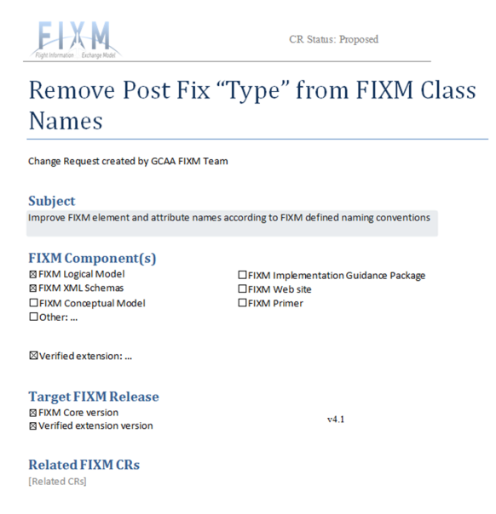
XSD Design rules for AIXM/FIXM/(I)WXXM
Appending "Type" to the end of complex type names is a wide-spread, well-known best practice when constructing schemas.
And effectively, AIXM 5.1.1, IWXXM 2.0 and FIXM 4.0.0 do apply this convention…
Proposal to remove "Type" from the end of each element name.
Is there any official documentation describing the design rules for the XML schemas of the –XMs?
FIXM does not have any
AIXM follows the GML standard (ISO 19139)
IWXXM?
But…

Slide 34
(optional) AIXM Routes model issues - seeking FIXM CCB opinion

Slide 35
Current AIXM 5.1(.1)
ALPHA
ECHOR
DELTA
M15
L32
BRAVO
CARLY
L32/M15
L32/M15
L32
M15
GOLFY
FOXTY
Two Route (M15 and L32)
Each RouteSegment belongs to exactly one Route
  L32, BRAVO-CARLY and M15, BRAVO-CARLY are two different RouteSegment
  Justifications
    inherited as such from earlier versions of AIXM
    not many duplicate segments left, except for North America
    protection surfaces might be different for the two segments (because the incoming turn)

Slide 36
AIXM change proposed in the CCB
ALPHA
ECHOR
DELTA
M15
L32
BRAVO
CARLY
L32/M15
L32/M15
L32
M15
GOLFY
FOXTY
Two Route (M15 and L32)
Each RouteSegment may belong to more than one Route
  BRAVO-CARLY exists just once, it is associated with both M15 and L32
Would this change facilitate or complicate the references from FIXM to AIXM?
(side note: In EUR, there exist route restrictions that depend on the route designator…)

