Slide 1

AIXM 5.1 – Interoperability issues
AIXM CCB – Webex 12 April 2018

Slide 2
Agenda
Summary of issues – current status
ICAO AIM interoperability project
AIP Data Set open interoperability topics
Feature identification properties list

Slide 3
Global issues list
No new entries
  https://drive.google.com/open?id=1kLzaYXxtANNHQFpv1Y4HZM1g4S44IDnBSwgF188oS-g
  Clean-up done
    Status of each issue evaluated in relation with
      1) ICAO data sets – see column D
      2) other use cases – see column E

Slide 4
ICAO AIM Projects
Project 10 – ‘Interoperability”
  Initial draft of a problem description sheet provided by ICAO (ANB PCI section)
  Sub-group of former AIS-AIMSG members involved in the review and further definition of the “job card”
    Still an informal group, ICAO working on the formalisation of the ‘AIM Projects’ approach
  Meeting in ICAO Montreal, 16-23 April
    Review all proposed AIM project descriptions, including
      …
      Project 7 – NOTAM
      …
      Project 9 – Data Sets
      Project 10 – Interoperability
      Project 11 – SWIM Service for data sets
      …

Slide 5
Interoperability scenarios
Reason for scenarios
  Some interoperability issues (such as discordant UUID) are likely to have different solutions in different use cases
    If this is not really the case, the scenarios could be merged in the end…
Proposed scenarios (in the order of priorities)
    AIS publishing data under ICAO SARPS (including provision of data to DAT providers or to another ANSP)
    Hub scenario (EAD, other regional implementations)
      Including data coordination with other hubs
    Data originator(s) to/from ANSP (particular case – procedure designer, airport data originator)
Other possible scenarios (for later)
    Data merge between FIXM, AIXM and iWXXM data sets
    Large scale SWIM interoperability exercises using multiple non-coordinated data sets (such as in the SESAR or FAA demonstrations)
    Use of AIXM data for simulators?
    Digital NOTAM (world-wide)
    IMP “services”

Slide 6
AIP Data SET Use Case
Technical Interoperability rules
  Mature content - available for public comments on the Confluence web site
    https://ext.eurocontrol.int/aixm_confluence/display/ACGAIP/Interoperability+rules
    Added recently:
      Metadata
      Format and distribution
      Use of nilReason
      Allowed feature types
    Open comments
      See Use of extensions

Slide 7
AIP Data SET Use Case
Technical Interoperability rules
  Drafting area in Google Drive – for the participants in this working group
    https://drive.google.com/drive/folders/0BxlGN-YBj-q0bnZkSzFoaC1HbVE
    Open issues
      See document…

Slide 8
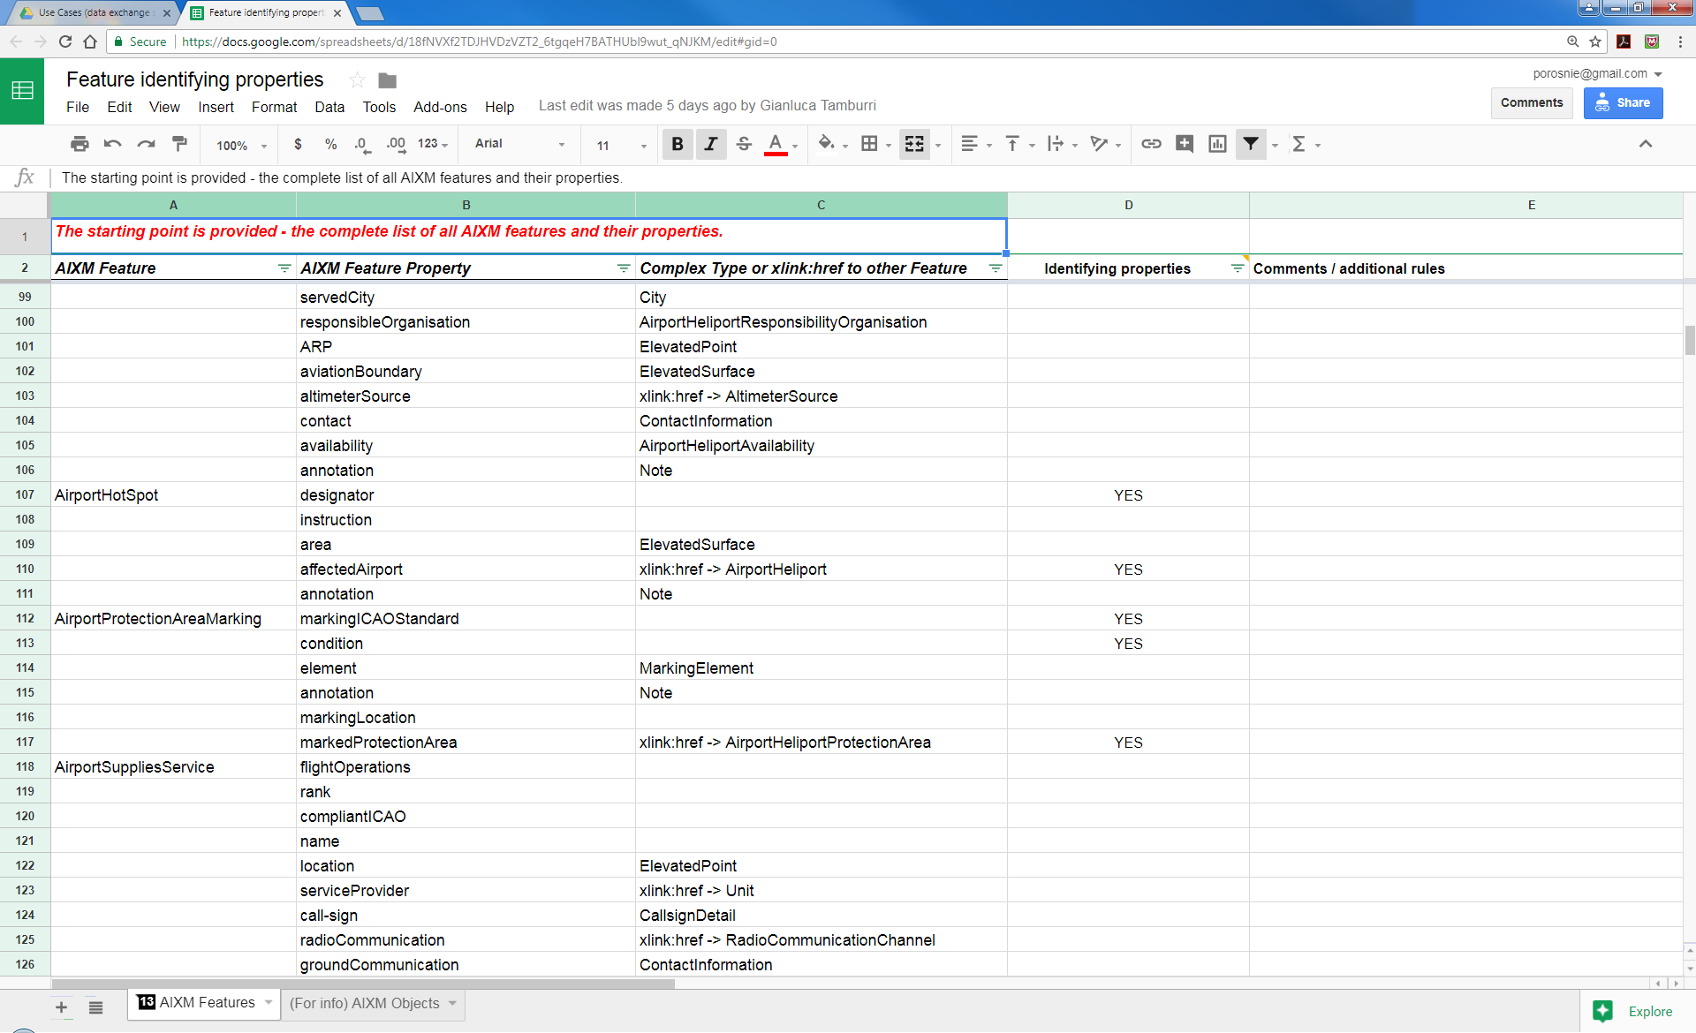
Feature identifying properties
Work in progress – looks almost finalised
  Thanks to Manfred Beckmann (Solitec) and Francois Germain (Thales) for drafting, Gianluca Tamburri (IDS) for review. Missed anyone else?
  https://drive.google.com/open?id=18fNVXf2TDJHVDzVZT2_6tgqeH7BATHUbl9wut_qNJKM

Slide 9
Feature identification properties
(Still) ToDo
  See what other XMs are using when they refer to aeronautical features, for example FIXM, iWXXM
    For example, FIXM is using also alternatives (such as ICAO or IATA or name for an aerodrome)
      See presentation of FIXM 4.1 from CCB meeting in Brussels: http://aixm.aero/sites/aixm.aero/files/imce/library/ccb_meetings/aixm_ccb_2017_11/fixm_briefing_to_the_aixm_ccb.pptx
  Cross-check the list with the proposed mandatory attributes for the AIP data set
  Focus on the features that are part of the AIP data set, publish a partial list that concerns only those features, in support of the AIP data set coding guidelines.
    Identify potential duplicates by “natural key” (data verification rules with ‘warning’ message
    Use in xlink:title

Slide 10
Next meeting
Next Webex
  Mon 07 May
  14:30 – 16:30 Brussels time
  Work items topics expected to progress in the meantime
    Summary of issues – current status
    ICAO AIM interoperability project
    AIP Data Set open interoperability topics
    Feature identification properties list

