Slide 1

AIXM 5.1 – Interoperability issues
AIXM CCB – Webex 14 NOVEMBER 2017

Slide 2
Agenda
Metadata requirements
  in relation with the AIP Data Set
Feature identification properties list
Interoperability rules for ICAO data sets
  Open points

Slide 3
Metadata
Approach
  Short term
    Metadata specification for the new ICAO data sets, in particular AIP data set
      Based on the revised Annex 15 and new PANS-AIM provisions
      Using ISO 19115 (model) and ISO 19139 (XML schema)
    Related topic: Data Product Specification (ISO 19131) for the ICAO data sets
  Long term
    Metadata specification for data collection
    Keep using the ISO 19139 XML schema?
      extremely complex
      extremely verbose
      embedded in the GML schema

Slide 4
ICAO Metadata Analysis

Slide 5
Metadata
Working directory created in Google Drive
  https://drive.google.com/open?id=0BxlGN-YBj-q0cjZZUllWdzY3OXc
What is new
  Consolidated document “[proposal] Metadata Requirements for Data Sets”
    Replaces the two separate requirements/analysis documents
    Changes based on comments / suggestions made by the group
    Presented by the author (Scott Wilson, EUROCONTROL)…

Slide 6
metadata
What is still to be done
  Add list of mandatory ISO 19115 / ISO 19139 elements (such as Point of Contact for Metadata, topic category, language, etc.)
  find maybe a better solution for the “AIRAC” flag, which actually means that the current data set was issued under the AIRAC cycle rules
  See if possible to use more specific codes, such as “air transportation”. This might require changes in the ISO 19139 codeList
Additional info from the ICAO AIS-AIM brainstorming session (Nov 2017)
  Confirmed that the end users are happy with the limited data sets metadata, not the full traceability information (such as who is the originator for which data item)

Slide 7
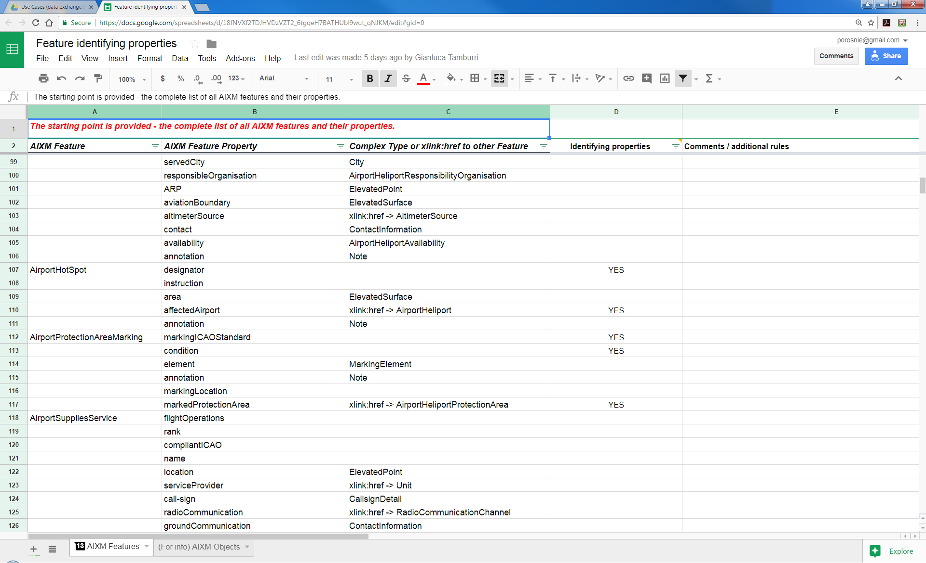
Feature identifying properties
Work in progress – looks almost finalised
  Thanks to Manfred Beckmann (Solitec) and Francois Germain (Thales) for drafting, Gianluca Tamburri (IDS) for review. Missed anyone else?
  https://drive.google.com/open?id=18fNVXf2TDJHVDzVZT2_6tgqeH7BATHUbl9wut_qNJKM

Slide 8
Feature identification properties
Proposed usage – to be discussed
  ICAO Data Sets
    Identify potential duplicates by “natural key” (data verification rules with ‘warning’ message
    Use in xlink:title?
    Use for creating a human-readable summary of data set?
      Possible to implement as a service (with XSLT scripts)
  Other use cases?
    Support applications that work with natural keys? how exactly?

Slide 9
Feature identification properties
ToDo
  Focus on the features that are part of the AIP data set, publish a partial list that concerns only those features, in support of the AIP data set coding guidelines.
  See what other XMs are using when they refer to aeronautical features, for example FIXM, iWXXM
    For example, FIXM is using also alternatives (such as ICAO or IATA or name for an aerodrome)
  Cross-check the list with the proposed mandatory attributes for the AIP data set

Slide 10
Interoperability scenarios
Reason for scenarios
  Some interoperability issues (such as discordant UUID) are likely to have different solutions in different use cases
    If this is not really the case, the scenarios could be merged in the end…
Proposed scenarios (in the order of priorities)
    AIS publishing data under ICAO SARPS (including provision of data to DAT providers or to another ANSP)
    Hub scenario (EAD, other regional implementations)
      Including data coordination with other hubs
    Data originator(s) to/from ANSP (particular case – procedure designer, airport data originator)
Other possible scenarios (for later)
    Data merge between FIXM, AIXM and iWXXM data sets
    Large scale SWIM interoperability exercises using multiple non-coordinated data sets (such as in the SESAR or FAA demonstrations)
    Use of AIXM data for simulators?
    Digital NOTAM (world-wide)
    IMP “services”

Slide 11
AIP Data SET Use Case
Technical Interoperability rules
  Mature content - available for public comments on the new Confluence web site
    https://ext.eurocontrol.int/aixm_confluence/display/ACGAIP/Interoperability+rules
    No new comments since last time, see previous discussions
      (1), (2)
  Drafting area in Google Drive – for the participants in this working group
    https://drive.google.com/drive/folders/0BxlGN-YBj-q0bnZkSzFoaC1HbVE
    Open issues
      See “suggested text in the document”…
        https://drive.google.com/open?id=1VSsMr3JVNFIrLowWxt8Ft6-M3n1xZL6lqED8f4m5Ppk

Slide 12
Global issues list
No new enties
  https://drive.google.com/open?id=1kLzaYXxtANNHQFpv1Y4HZM1g4S44IDnBSwgF188oS-g
  Needs a clean-up…

Slide 13
Next meeting
Next Webex
  TUE 12 December
  14:30 – 16:30 Brussels time
  Work items topics expected to progress in the meantime
    Finalise Metadata requirements / solution for AIP Data Set
    AIP Data Set open interoperability topics
      See issues proposed for review
    Feature identification properties list
      See ToDo list

