Slide 1
Delivering Digital
NOTAMs
United States
NOTAM Office
NOTAM Policy Update and System Modernization
By: Ernie Bilotto
Manager, US NOTAMs

Slide 2
Annual Increase in NOTAM Volume

Slide 3
History
Due to the increase of NOTAM issuance, the first steps towards modernization were taken with the introduction of keywords.
The purpose of keywords were twofold.
To provide a means for users to easily sort NOTAMs
To separate NOTAMs into broad categories that could eventually translate into ICAO “series”.
Keywords alone will not get us to where we want to go.
It does not accommodate filtering of extraneous data that pilots, depending on their type of flight do not need to see.
******** Runway NOTAMs ********
!FDK 05/015 FDK RWY 5 PAPI OUT OF SERVICE 1405271809-1405302200EST
!FDK 05/017 FDK RWY 23 PAPI OUT OF SERVICE 1405271809-1405302200EST
******** Obstruction NOTAMs ********
!FDK 05/018 FDK OBST TOWER LGT (ASR 1043510) 393436.40N0772917.00W (10.9NM NNW FDK) 2230FT (390FT AGL) OUT OF SERVICE 1405272031-1406112031
******** Airspace NOTAMs ********
!FDK 12/023 FDK AIRSPACE SEE FDC 1/1155 ZDC 99.7 TFR 1312211721-1412312359EST
******** Taxiway NOTAMs ********
!FDK 04/004 FDK TWY ALL TWY SIGNS UPDATED FOLLOW NEW SIGNAGE 1404091142-PERM
******** Service NOTAMs ********
!FDK 06/001 FDK SVC ATIS OUT OF SERVICE 1406031215-1406062300

Slide 4
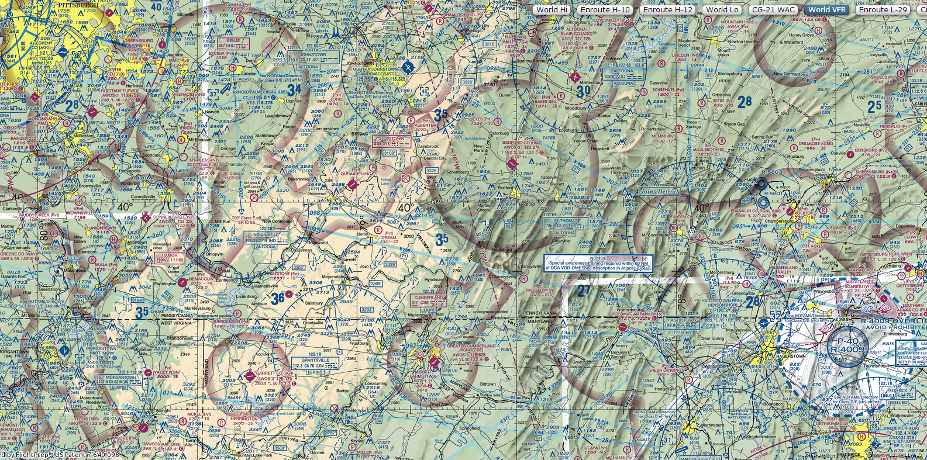
History
To illustrate this, we planned a low altitude IFR flight from FDK to AGC, using a direct route of flight.

Slide 5
History
******** Runway NOTAMs ********
!DCA 02/445 W50 RWY 26 THR DISPLACED 160FT NOT STD MARKINGS
1402241350-1406301600EST
!DCA 02/444 W50 RWY 8 THR DISPLACED 220FT NOT STD MARKINGS
1402241349-1406301600EST
!JYO 04/008 JYO RWY 17/35 WORK IN PROGRESS MOWING ADJ
1404161744-1404192000EST
!DMW 12/011 DMW RWY 16 PAPI UNUSABLE BEYOND 5 DEG RIGHT OF COURSE
1312261417-1412311417EST
!DMW 05/002 DMW RWY 16 RWY END IDENTIFIER LGT OUT OF SERVICE
1405211741-1411302359EST
!FDK 05/015 FDK RWY 5 PAPI OUT OF SERVICE 1405271809-1405302200EST
!FDK 05/017 FDK RWY 23 PAPI OUT OF SERVICE 1405271809-1405302200EST
!IPT 04/290 W05 RWY 6 CLSD SS-SR 1404301743-1406302359EST
!EKN 12/100 CBE RWY 5/23 UNGROOVED 1312111327-1412012359EST
!EKN 04/238 1W3 RWY 16/34 THR LGT OUT OF SERVICE
1404301658-1405312359EST
!EKN 04/240 1W3 RWY 9/27 THR LGT OUT OF SERVICE
1404301659-1405312359EST
!EKN 04/239 1W3 RWY 16/34 EDGE LGT OUT OF SERVICE
1404301658-1405312359EST
!EKN 04/241 1W3 RWY 9/27 EDGE LGT OUT OF SERVICE
1404301702-1405312359EST
!AOO 12/250 VVS RWY 14/32 THR LGT OUT OF SERVICE
1312212247-1408312359EST
!AOO 12/251 VVS RWY 14/32 EDGE LGT OUT OF SERVICE
1312212248-1408312359EST
!AOO 02/128 VVS RWY 14 PAPI OUT OF SERVICE 1402112202-1405112202EST
!AOO 05/174 P45 RWY 6/24 WORK IN PROGRESS MOWING
1405191900-1410312359
!AOO 05/175 P45 RWY 14/32 WORK IN PROGRESS MOWING
1405191900-1410312359
!LBE 12/007 LBE RWY 3/21 CLSD 1312191400-1406161400EST
!AOO 02/185 PJC RWY 17 CLSD TO LDG ACFT DAILY SS-SR
1402151816-1404152359EST
!AGC 04/021 AGC RWY 13/31 CLSD 1404281101-1409302200
!PIT 06/012 PIT RWY 10R/28L CLSD 1406031156-1406032359EST
!PIT 05/023 PIT RWY 14/32 CLSD 1405051257-1411032359
!PIT 05/157 PIT RWY 10R PAPI OUT OF SERVICE 1405291931-1406302359EST
******** Aerodrome NOTAMs ********
!IPT 06/011 W05 AD LGT ALL OF OUT SERVICE 1406021719-1406041718EST
!EKN 04/227 W35 AD BIRD ACTIVITY NEAR MOVEMENT AREAS 1404291451-PERM
!AOO 03/023 P45 AD WILDLIFE NEAR MOVEMENT AREAS
1403051414-1412312359EST
!AOO 04/121 5G8 AD ABN OUT OF SERVICE 1404170132-1405010130EST
!AOO 06/007 22D AD AIRPORT CLSD TO TRANSIENT ACFT
1406031600-1406032200
******** Obstruction NOTAMs ********
!DCA 06/013 ZDC OBST WIND TURBINE FARM WITHIN AREA DEFINED AS 5NM
RADIUS OF 380549N0803047W (10.13 S 3I4) 4074FT (386FT AGL) NOT LGTD
1406012231-1406162230EST
!DCA 05/014 ZDC OBST WIND TURBINE FARM WITHIN AREA DEFINED AS 7NM
RADIUS OF 391319N0793004W (23.4 SE CKB) 3900FT (250FT AGL) NOT LGTD
1405011530-1405151525EST
!CLE 06/027 ZOB OBST WIND TURBINE FARM WITHIN AREA DEFINED AS 2NM
RADIUS OF 421040N0773017W (14NM SE HTF) 2745FT (431FT AGL) NOT LGTD
1406030001-1412010001
!CLE 04/531 ZOB OBST TURBINE FARM WITHIN AREA DEFINED AS 1NM RADIUS
OF 395451N792339W (15NM E VVS) 2880FT (215 AGL) NOT LGTD
1404301922-1406301922EST
!CLE 04/532 ZOB OBST WIND TURBINE FARM WITHIN AREA DEFINED AS 1NM
RADIUS OF 395848N790045W (4.35NM S 2G9) 2640FT (215FT AGL) NOT LGTD
1404301927-1407311930EST
!CLE 04/534 ZOB OBST WIND TURBINE FARM WITHIN AREA DEFINED AS 1NM
RADIUS OF 395115N790411W (14.1 S 2G9) 2400FT (205FT AGL) NOT LGTD
1404301930-1407311930EST
!CLE 06/048 ZOB OBST WIND TURBINE FARM WITHIN AREA DEFINED AS 4.56NM
RADIUS OF 434639N0831803W 1031FT (631FT AGL) NOT LGTD
1406031129-1406301130
!CLE 03/569 ZOB OBST WIND TURBINE FARM WITHIN AREA DEFINED AS 4NM
RADIUS OF 424440.17N0781429.04W (13.6NM N D23) 2179FT (389FT AGL) NOT
LGTD 1403311222-1404301221EST
!CLE 06/044 ZOB OBST WIND TURBINE FARM WITHIN AREA DEFINED AS 4.92NM
RADIUS OF 434251N0831826W (14.53NM W BAX) 1437FT (400FT AGL) NOT LGTD
1406030319-1406180317
!DCA 05/329 GAI OBST TOWER LGT (ASR UNKNOWN) 390236.90N0771139.00W
(8.74NM SSW GAI) 556FT (150FT AGL) OUT OF SERVICE
1405211249-1406051248
!DCA 05/412 GAI OBST TOWER LGT (ASR 1060542) 390918.50N0771512.90W
(4.1NM W GAI) 614FT (240FT AGL) OUT OF SERVICE 1405272238-1406110400
!DCA 05/459 GAI OBST TOWER LGT (ASR 1253587) 390730.70N0770105.50W
(7.3NM ESE GAI) 544FT (155FT AGL) OUT OF SERVICE
1405300118-1406140118
!DCA 05/442 2W2 OBST TOWER LGT (ASR 1035850) 392743.50N0765439.60W
(4.9NM E 2W2) 888FT (309FT AGL) OUT OF SERVICE 1405290033-1406130033
!DCA 05/462 2W2 OBST TOWER LGT (ASR 1037288) 393131.50N0770026.00W
(3.6NM NE 2W2) 1142FT (319FT AGL) OUT OF SERVICE
1405300254-1406140254
!FDK 05/018 FDK OBST TOWER LGT (ASR 1043510) 393436.40N0772917.00W
(10.9NM NNW FDK) 2230FT (390FT AGL) OUT OF SERVICE
1405272031-1406112031
!MRB 05/022 MRB OBST TOWER LGT (ASR 1033110) 392443.60N0775833.50W
(0.7NM NNE MRB) 698FT (169FT AGL) OUT OF SERVICE
1405252147-1406092147
!IPT 04/291 W05 OBST TREES 395028.70N0771628.70W (1267FT WSW APCH END
RWY 6) UNKNOWN (100FT AGL) 1404301744-1406302359EST
!IPT 05/274 N42 OBST TOWER LGT (ASR 1232022) 400451.00N0772659.00W
(1.5NM NNE N42) 977FT (187FT AGL) OUT OF SERVICE
1405290810-1406130810
!IPT 05/299 N68 OBST TOWER LGT (ASR 1024599) 400228.80N0780002.30W
(16.8NM WNW N68) 1512FT (420FT AGL) OUT OF SERVICE
1405311205-1406151205
!IPT 06/015 N68 OBST TOWER LGT (ASR 1266675) 395934.60N0773734.70W
(1.4NM NNE N68) 838FT (156FT AGL) OUT OF SERVICE
1406030439-1406180439
!IPT 06/014 N68 OBST TOWER LGT (ASR 1258000) 400139.20N0773825.60W
(3.3NM NE N68) 943FT (254FT AGL) OUT OF SERVICE 1406030426-1406180326
!IPT 05/241 N68 OBST TOWER LGT (ASR 1020237) 395501.20N0773523.40W
(4.1NM SE N68) 1091FT (284FT AGL) OUT OF SERVICE
1405272359-1406112359
!EKN 12/200 W35 OBST TOWER LGT 393700N0782100W (9.77NM WSW W35)
UNKNOWN (250FT AGL) OUT OF SERVICE 1312211836-1401211831EST
!EKN 05/277 W35 OBST TOWER LGT (ASR 1270948) 395602.20N0780100.60W
(16.2NM NNE W35) 1357FT (250FT AGL) OUT OF SERVICE
1405301106-1406141106
!EKN 05/271 W35 OBST TOWER LGT (ASR 1276078) 393731.20N0781307.40W
(4.8NM SSW W35) 1166FT (315FT AGL) OUT OF SERVICE
1405290937-1406130937
!AOO 05/287 HMZ OBST TOWER LGT (ASR 1224764) 395847.10N0783305.90W
(6.7NM SSW HMZ) 1673FT (237FT AGL) OUT OF SERVICE
1405280743-1406120743
!EKN 05/232 CBE OBST TOWER LGT (ASR UNKNOWN) 394632.99N0785338.29W
(13.2NM NNW CBE) 2798FT (263FT AGL) OUT OF SERVICE
1405270055-1406111050
!EKN 05/178 CBE OBST WIND FARM LGT (ASR UNKN) 394722.56N0790010.92W
(25NM SE CBE) 3061FT (2661FT AGL) OUT OF SERVICE
1405200617-1406040617
!AOO 05/250 PSB OBST TOWER LGT (ASR 1231910) 404638.00N0780344.20W
(6.6NM S PSB) 1852FT (250FT AGL) OUT OF SERVICE 1405261849-1406100400
!EKN 05/204 2G4 OBST TOWER LGT (ASR 1286857) 394520.00N0790855.10W
(13.7NM NE 2G4) 3003.0FT (258.9FT AGL) OUT OF SERVICE
1405222200-1406062200
!EKN 06/017 2G4 OBST TOWER LGT (ASR 1035688) 393204.30N0793313.10W
(10.4NM WSW 2G4) 3306FT (345FT AGL) OUT OF SERVICE
1406030919-1406180919
!AOO 05/266 2G9 OBST TOWER LGT (ASR 1286940) 395541.40N0790943.50W
(9.6NM SW 2G9) 2544.3FT (258.9FT AGL) OUT OF SERVICE
1405271921-1406111921
!AOO 05/284 2G9 OBST TOWER LGT (ASR 1026248) 394948.50N0790123.30W
(12.6NM S 2G9) 2547FT (245FT AGL) OUT OF SERVICE
1405280534-1406120534
!AOO 05/237 2G9 OBST TOWER LGT (ASR 1032552) 401051.30N0790745.40W
(10.0NM NNW 2G9) 3091FT (390FT AGL) OUT OF SERVICE
1405250024-1406090024
!AOO 06/017 2G9 OBST TOWER LGT (ASR 1287762) 400046.70N0785320.70W
(5.9NM ESE 2G9) 2642.7FT (258.9FT AGL) OUT OF SERVICE
1406030550-1406180550
!AOO 05/297 VVS OBST TOWER LGT (ASR 1027986) 394639.20N0794210.90W
(11.2NM S VVS) 2981FT (312FT AGL) OUT OF SERVICE
1405281520-1406121520
!AOO 06/011 VVS OBST TOWER LGT (ASR 1220565) 395544.00N0793846.10W
(1.9NM SSE VVS) 1603FT (155FT AGL) OUT OF SERVICE
1406021712-1406171612
!AOO 05/212 VVS OBST TOWER LGT (ASR 1283549) 400330.10N0794629.60W
(8.0NM NW VVS) 1483.6FT (198.8FT AGL) OUT OF SERVICE
1405230541-1406070541
!AOO 05/305 VVS OBST TOWER LGT (ASR 1030610) 400109.50N0794621.10W
(6.4NM NW VVS) 1717FT (373FT AGL) OUT OF SERVICE
1405290739-1406130400
!AOO 06/018 P45 OBST TOWER LGT (ASR 1026672) 400230.60N0791726.60W
(12.1NM ESE P45) 3195FT (270FT AGL) OUT OF SERVICE
1406030710-1406180400
!AOO 05/321 P99 OBST TOWER LGT (ASR 1026289) 400543.00N0794123.30W
(6.5NM W P99) 1933FT (362FT AGL) OUT OF SERVICE 1405301813-1406141813
!LBE 05/019 LBE OBST WIND TURBINE FARM WITHIN AREA DEFINED AS 1NM
RADIUS OF 395516N0792325W (24NM S LBE) 2691FT (400FT AGL) NOT LGTD
1405280433-1406120433
!LBE 05/017 LBE OBST TOWER LGT (ASR 1231671) 402054.30N0792822.30W
(5.3NM NW LBE) 1402FT (195FT AGL) OUT OF SERVICE
1405270503-1406110403
!EKN 06/011 EKN OBST TOWER LGT (ASR 1233130) 385524.40N0795144.20W
(2.1NM N EKN) 2115FT (205FT AGL) OUT OF SERVICE 1406021711-1406171711
!AOO 05/282 G05 OBST TOWER LGT (ASR 1040945) 401706.10N0800216.20W
(2.6NM NNW G05) 1613FT (308FT AGL) OUT OF SERVICE
1405280211-1406110400
!AOO 05/193 PJC OBST TOWER LGT (ASR 1032553) 405045.10N0801323.70W
(3.8NM NW PJC) 1555FT (366FT AGL) OUT OF SERVICE
1405211230-1406051230
!AGC 06/006 AGC OBST CRANE 402057N0795631W (.5NM S AGC)
UNKNOWN (180FT AGL) FLAGGED AND LGTD 1406031157-1406032300
!AGC 05/019 AGC OBST TOWER LGT (ASR 1027985) 402949.80N0800015.90W
(9.2NM NNW AGC) 1553FT (239FT AGL) OUT OF SERVICE
1405240903-1406080903
!AGC 05/020 AGC OBST TOWER LGT (ASR 1025971) 402938.00N0800108.00W
(9.3NM NNW AGC) 2048FT (684FT AGL) OUT OF SERVICE
1405241105-1406081105
!AGC 12/086 AGC OBST CRANE 402717N0795948W (6NM NNW AGC) 1497FT
(792FT AGL) FLAGGED AND LGTD 1312212046-1412312359EST
!AOO 05/324 9G1 OBST TOWER LGT (ASR 1028249) 403527.00N0793428.00W
(11.4NM E 9G1) 1448FT (228FT AGL) OUT OF SERVICE
1405310654-1406150654
!PIT 06/006 PIT OBST TOWER LGT (ASR 1274951) 403137.70N0800344.90W
(8.0NM ENE PIT) 1423FT (218FT AGL) OUT OF SERVICE
1406021550-1406171550
!PIT 05/156 PIT OBST CRANE 402627N0801803W (3.55NM SW APCH END RWY
10R)
1454FT (200FT AGL) FLAGGED AND LGTD 1405291930-1406302359EST
******** Navigation NOTAMs ********
!DCA 12/341 GAI NAV NDB OUT OF SERVICE 1312211601-PERM
!MRB 05/027 MRB NAV TACAN AZM OUT OF SERVICE 1405301714-1406122000EST
!MRB 05/026 MRB NAV TACAN OUT OF SERVICE 1405281756-1406252000EST
!AOO 04/257 PSB NAV VOR GROUND RECEIVER CHECKPOINT OTS
!EKN 04/050 GRV NAV DME UNUSBL 307-070 BYD 20 BLW 5000/071-306
BYD 20 BLW 6000/108-113 BYD 38/325-345 BYD 35
!EKN 05/078 GRV NAV DME TACTICAL AIR NAVIGATION WITH DME ONLY (DMER)
COMMISSIONED
!EKN 04/234 GRV NAV VOR OUT OF SERVICE 1405011400-1505011630
!AOO 11/075 IHD NAV VOR OTS
!LBE 04/003 LBE NAV BENJE BHU NDB OUT OF SERVICE 1404031437-PERM
!EKN 03/174 EKN NAV LOCALIZER TYPE DIRECTIONAL AID OUT OF SERVICE
1403262053-1407252000EST
!EKN 01/128 EKN NAV LOCALIZER TYPE DIRECTIONAL AID UNUSABLE
1401091649-1412312359EST
!AGC 04/008 AGC NAV ILS RWY 28 OM DCMSN WEF 1304111610
!PIT 04/063 PIT NAV ILS RWY 32 LOC/GP/DME OUT OF SERVICE
1404141145-1411282000
******** Communication NOTAMs ********
!DCA 07/220 ZDC COM RTR QXC COMISSIONING DELAYED 272.75 REMAIN IN
USE
!DCA 01/053 ZDC COM REMOTE TRANSMITTER/RECEIVER 269.375 VICE 317.70
WEF 1101060001
!CLE 12/462 ZOB COM WEST VIRGINIA CLARKSBURG APPROACH CONTROL
119.425 1000-1100 MON-FRI PLUS SEE AIRPORT FACILITY DIRECTORY
1312171406-PERM
!IPT 05/074 N68 COM COMMON TFC ADVISORY FREQ 122.8 CHANGED TO 122.9
1405071820-PERM
!AGC 05/021 AGC COM EN ROUTE FLIGHT ADVISORY SERVICE OUTLET 122.0 OUT
OF SERVICE 1405261220-1405301220EST
******** Airspace NOTAMs ********
!SUAE 06/150 ZDC AIRSPACE R6613A ACT SFC-15000FT
1406042200-1406050500
!SUAE 06/151 ZDC AIRSPACE R6611A ACT SFC-15000FT
1406042200-1406050500
!SUAE 06/147 ZDC AIRSPACE R6613A ACT SFC-FL400 1406042101-1406042200
!SUAE 06/148 ZDC AIRSPACE R6613A ACT SFC-15000FT
1406032200-1406040500
!SUAE 06/146 ZDC AIRSPACE R6613B ACT FL400-FL600
1406031200-1406032200
!SUAE 06/145 ZDC AIRSPACE R6613B ACT FL400-FL600
1406041200-1406042200
!SUAE 06/141 ZDC AIRSPACE R6611B ACT FL400-FL600
1406041200-1406042200
!SUAE 06/144 ZDC AIRSPACE R6611A ACT SFC-FL400 1406042101-1406042200
!SUAE 06/143 ZDC AIRSPACE R6611A ACT SFC-FL400 1406032101-1406032200
!SUAE 06/142 ZDC AIRSPACE R6611A ACT SFC-15000FT
1406032200-1406040500
!SUAE 06/140 ZDC AIRSPACE R6611B ACT FL400-FL600
1406031200-1406032200
!SUAE 06/139 ZDC AIRSPACE R6612 ACT SFC-7000FT 1406042101-1406050500
!SUAE 06/198 ZDC AIRSPACE R6611B ACT FL400-FL600
1406051200-1406052200
!SUAE 06/149 ZDC AIRSPACE R6613A ACT SFC-FL400 1406032101-1406032200
!SUAE 06/197 ZDC AIRSPACE R6613B ACT FL400-FL600
1406051200-1406052200
!DCA 03/249 ZDC AIRSPACE VFR HELICOPTER/UNMANNED ACFT 1000/BLW 5NMR
ORF087009 CTC RANGE OFFICER, 757-422-7010 EXT 232
!SUAE 06/038 ZDC AIRSPACE R6612 ACT SFC-7000FT 1406032101-1406040500
!SUAE 06/131 ZDC AIRSPACE R5303A ACT SFC-6999FT 1406032201-1406040400
!SUAE 06/132 ZDC AIRSPACE R5304A ACT SFC-6999FT 1406032201-1406040400
!SUAE 05/609 ZDC AIRSPACE R6602B ACT 4000FT-10999FT
1406010000-1407010400
!SUAE 05/606 ZDC AIRSPACE R6602C ACT 11000FT UP TO BUT NOT INCLUDING
FL180 1406010000-1407010400
!SUAE 05/607 ZDC AIRSPACE R6602A ACT SFC-3999FT 1406010000-1407010400
!DCA 01/141 ZDC AIRSPACE UNMANNED ACFT WITHIN AN AREA DEFINED AS
.75NM RADIUS OF ILM068025 1200/BLW 0.75 SFC-1200FT CONTACT CAMP
LEJUNE RANGE CONTROL DUTY OFFICER 119.5/233.8 AND 910-451-3064
EXTION 4449 CALL SIGN BLACKBURN 1401062037-1501062359EST
!DCA 06/010 ZDC AIRSPACE SEE LBT 06/001 PJE 1406041300-1406042000
!DCA 05/121 ZDC AIRSPACE HIGH ALT BALLOON BAL248012.3 SFC-6000
NORTHBOUND 1405090600-1405090900EST
!DCA 01/422 ZDC AIRSPACE UNMANNED ACFT WITHIN AN AREA DEFINED AS
362757N0761343W 362803N0761007W 362613N0761008W 362605N0761051W
362605N0761149W 362603N0761340W TO POINT OF ORIGIN SFC-500FT AGL
1401241200-1407020200EST
!SUAE 06/184 ZDC AIRSPACE AR207NE(NE) ACT FL260-FL280
1406031615-1406031745
!SUAE 06/186 ZDC AIRSPACE AR207SW(SW) ACT FL260-FL280
1406031615-1406031745
!SUAE 06/177 ZDC AIRSPACE AR202AN ACT FL250-FL280
1406031500-1406031615
!DCA 06/018 ZDC AIRSPACE SEE LBT 06/002 PJE 1406060200-1406060400
!DCA 05/034 ZDC AIRSPACE UNMANNED ACFT WITHIN AN AREA DEFINED AS 2NM
RADIUS OF ECG354012 (NC61) SFC-1500FT DAILY SR-SS
1405030200-1407020200
!DCA 05/472 ZDC AIRSPACE UNMANNED ACFT WITHIN AREA DEFINED AS 10NM
RADIUS OF NKT SFC-2700FT DAILY 1000-0500 1406011000-1407010500
!SUAE 06/030 ZNY AIRSPACE R5206 ACT SFC-5000FT 1406031230-1406031800
!SUAE 06/202 ZNY AIRSPACE R5206 ACT SFC-5000FT 1406051230-1406051800
!SUAE 06/089 ZNY AIRSPACE R5206 ACT SFC-5000FT 1406041230-1406041800
!SUAE 06/084 ZNY AIRSPACE R5001B ACT 4000FT-8000FT AGL
1406041200-1406050400
!SUAE 06/051 ZNY AIRSPACE R5802B ACT SFC-13000FT
1406040201-1406041159
!SUAE 06/024 ZNY AIRSPACE R5001B ACT 4000FT-8000FT AGL
1406031200-1406040400
!SUAE 06/162 ZNY AIRSPACE R5802B ACT SFC-13000FT
1406050201-1406051159
!SUAC 06/108 ZOB AIRSPACE R5502A ACT SFC-5000FT 1406042101-1406042200
!SUAC 06/032 ZOB AIRSPACE R5502A ACT SFC-5000FT 1406032101-1406032200
!CLE 04/113 ZOB AIRSPACE UNMANNED ACFT WITHIN AREA DEFINED AS .3 NM
RADIUS DJB125019 SFC-0400FT 1404071646-1409012200EST
!CLE 03/341 ZOB AIRSPACE UNMANNED ACFT WITHIN AN AREA DEFINED AS
ART194036 TO ART102081 TO ART060075 TO ART070090 TO ART050050 TO
ART123090 TO ART215040 TO ART229052 TO ART250037 TO ART270025 TO
ART102011 TO POINT OF ORIGIN FL180-FL300 1403171325-1409302330EST
!DCA 12/351 GAI AIRSPACE SEE FDC 1/1155 0/8326 ZDC 99.7 TFR
1312211647-1412312359EST
!DCA 12/353 W50 AIRSPACE SEE FDC 1/1155 ZDC 99.7 TFR
1312211650-1412312359EST
!JYO 12/008 JYO AIRSPACE SEE FDC 1/1155 0/8326 ZDC 99.7 TFR
1312211704-1412312359EST
!JYO 02/016 JYO AIRSPACE FEB 6TH CHARTING ERROR CLASS E SFC AREA DOES
NOT EXIST 1402272046-PERM
!DCA 12/356 2W2 AIRSPACE SEE FDC 1/1155 ZDC 99.7 TFR
1312211658-1412312359EST
!DMW 12/010 DMW AIRSPACE SEE FDC 1/1155 ZDC 99.7 TFR
1312211710-1412312359EST
!FDK 12/023 FDK AIRSPACE SEE FDC 1/1155 ZDC 99.7 TFR
1312211721-1412312359EST
!IPT 12/319 P98 AIRSPACE SEE FDC 1/1155 ZDC 99.7 TFR
1312211714-1412312359EST
!MRB 12/027 MRB AIRSPACE SEE FDC 1/1155 ZDC 99.7 TFR
1312211726-1412312359EST
!IPT 12/320 W73 AIRSPACE SEE FDC 1/1155 ZDC 99.7 TFR
1312211718-1412312359EST
!IPT 12/317 W05 AIRSPACE SEE FDC 1/1155 ZDC 99.7 TFR
1312211636-1412312359EST
!LBE 06/002 LBE AIRSPACE SEE FDC 4/1708 ZOB 91.145 AIRSHOW
1406051600-1406082100
!LBE 05/020 LBE AIRSPACE SEE FDC 4/1708 ZOB 91.145 AIRSHOW
1406051600-1406082100
!PIT 06/005 MMJ AIRSPACE UNMANNED ROCKET WITHIN AREA DEFINED AS 1NM
RADIUS OF MMJ180021 (22D) SFC-4000FT 1406031600-1406032200
******** Taxiway NOTAMs ********
!DCA 05/394 GAI TWY PARALLEL TWY ADJ RWY 14/32 BTN TWY B AND TWY C
CLSD 1405271405-1405272300EST
!FDK 04/004 FDK TWY ALL TWY SIGNS UPDATED FOLLOW NEW SIGNAGE
1404091142-PERM
!AOO 12/252 VVS TWY E EDGE LGT OUT OF SERVICE
1312212250-1408312359EST
!AOO 02/129 VVS TWY B CLSD TO ACFT WINGSPAN MORE THAN 40FT
1402112203-PERM
!LBE 02/007 LBE TWY H BTN TWY B AND APCH END RWY 3, TWY G, J CLSD
1402141211-1406161400EST
!AGC 04/022 AGC TWY B CLSD 1404281102-1409302200
!AGC 04/023 AGC TWY B1 CLSD 1404281104-1409302200
!AFJ 06/002 AFJ TWY B EAST OF TWY D CLSD 1406031049-1406101045
!PIT 05/031 PIT TWY E BTN TWY P AND TWY N CLSD 1405051305-1411032359
!PIT 05/028 PIT TWY R1 CLSD 1405051301-1411032359
!PIT 05/134 PIT TWY E BTN TWY N AND APCH END RWY 28C CLSD
1405231036-1411302300EST
!PIT 06/011 PIT TWY T BTN TWY V3 AND TWY E CLSD
1406031156-1406032359EST
!PIT 05/027 PIT TWY N2 BTN RWY 14/32 AND TWY N CLSD
1405051300-1411032359
!PIT 05/024 PIT TWY N BTN TWY N4 AND TWY N2 CLSD
1405051258-1411032359
!PIT 05/025 PIT TWY N4 CLSD 1405051259-1411032359
!PIT 05/026 PIT TWY N3 CLSD 1405051259-1411032359
!PIT 05/160 PIT TWY N EDGE MARKINGS BTN TWY N5 AND TWY N3 NOT STD
1405292133-1411032359
!PIT 05/029 PIT TWY R BTN TWY P AND RWY 14/32 CLSD
1405051303-1411032359
!PIT 05/030 PIT TWY Q BTN TWY P AND RWY 14/32 CLSD
1405051304-1411032359
!PIT 05/147 PIT TWY C BTN TWY T AND TWY B1 CLSD
1405272345-1407272300EST
!PIT 05/104 PIT TWY E CL LGT BTN TWY N AND APCH END RWY 28C OUT OF
SERVICE 1405160052-1411032359
!PIT 05/149 PIT TWY T BTN TWY B AND TWY E SURFACE MARKINGS NOT STD
1405281753-1406202359
******** Service NOTAMs ********
!FDK 06/001 FDK SVC ATIS OUT OF SERVICE 1406031215-1406062300
!PIT 06/007 PIT SVC MICROBURST/WINDSHEAR DETECTION SYSTEM NOT AVBL
1406031300-1406031800
******** Unverified Aeronautic Information NOTAMs ********
******** Other NOTAMs ********
******** NOTAMs without keywords ********
There were 389 NOTAMs

Slide 6
History
Upon closer evaluation of those 389 NOTAMs, and “32” pages to scroll through, we found that only 68 were applicable for our particular flight.

Slide 7
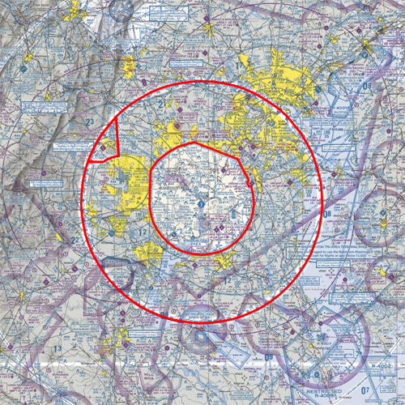
History
And roughly half of those 68 NOTAMs concerned the special airspace restrictions related to 9/11 that have been in place for over a decade in the DC area. Actually only 32 NOTAMs affect our route of flight. Thus a pilot or dispatcher would only have to look at 2 pages of NOTAMs.

Slide 8
Modernization
Question:
How will NOTAM System Modernization help reduce this information overload?
Answer:
Adopting ICAO NOTAM format and transitioning to digital NOTAMs.

Slide 9
Modernization
The conventional domestic NOTAM has very limited
potential for filtering through automation. It is basically
the same format that has been in use since NOTAMs were invented
The ICAO NOTAM, while at first glance even more
cryptic than the domestic, holds one distinct advantage.
!AGC 06/007 AGC NAV ILS RWY 28 LOC/GP OUT OF SERVICE 1406041200-1406041500
(A1334/14 NOTAMN
Q) KZOB/QICAS/I/NBO/A/000/999/4021N07955W005
A) KAGC B) 1406041200 C) 1406041500
E) ILS RWY 28 LOCALIZER/GP UNSERVICEABLE

Slide 10
Modernization
The “Q line” contains information not found in the domestic NOTAM.
!AGC 06/007 AGC NAV ILS RWY 28 LOC/GP OUT OF SERVICE 1406041200-1406041500
(A1334/14 NOTAMN
Q) KZOB/QICAS/I/NBO/A/000/999/4021N07955W005
A) KAGC B) 1406041200 C) 1406041500
E) ILS RWY 28 LOCALIZER/GP UNSERVICEABLE

Slide 11
Modernization
The “Q line” was designed for easy adaptation to
automated systems.
Q) KZOB/QICAS/I/NBO/A/000/999/4021N07955W005

Slide 12
Modernization
For example, the Q code, in this case QICAS tells the
automated system that the ILS is out of service. IC means “ILS Complete”, and AS means “unserviceable”
Q) KZOB/QICAS/I/NBO/A/000/999/4021N07955W005
2nd and 3rd letters = Identify the subject
4th and 5th letters = denote the status of the subject reported upon.

Slide 13
Modernization
The “I” means that this information is only useful for IFR flights. Therefore, automation can filter this NOTAM from VFR routes.
Q) KZOB/QICAS/I/NBO/A/000/999/4021N07955W005
I = IFR
V = VFR
K = NOTAM is a checklist

Slide 14
Modernization
The “NBO” further refines the target audience and in this case means that the NOTAM is for the immediate attention of aircraft operators, is to be included in weather briefings, and is for IFR flights.
Q) KZOB/QICAS/I/NBO/A/000/999/4021N07955W005
N – NOTAM selected for immediate attention
B - NOTAM selected for pre-flight info brief
O - NOTAM concerning flight operations
M - Miscellaneous NOTAM; not subject for a briefing, K - NOTAM is a checklist

Slide 15
Modernization
The “A” indicates that this NOTAM is for an aerodrome.
Other possible letters are “E” for enroute, “W” for nav warning.
Q) KZOB/QICAS/I/NBO/A/000/999/4021N07955W005
A – Aerodrome
E – Enroute
N – Nav warning
K - Checklist

Slide 16
Modernization
This is the vertical scope. In this case, from the surface (000) to unlimited (999).
Q) KZOB/QICAS/I/NBO/A/000/999/4021N07955W005

Slide 17
Modernization
And this is the location in lat long format…
Q) KZOB/QICAS/I/NBO/A/000/999/4021N07955W005

Slide 18
Modernization
And the lateral radius in nautical miles.
Q) KZOB/QICAS/I/NBO/A/000/999/4021N07955W005

Slide 19
Modernization
The sole purpose of this entire line is for automation. It is not meant to be read by humans. The plain language text and dates and times are in the other lines.
A1334/14 NOTAMN
Q) KZOB/QICAS/I/NBO/A/000/999/4021N07955W005
A) KAGC B) 1406041200 C) 1406041500
E) ILS RWY 28 LOCALIZER/GP UNSERVICEABLE
And by reading this line, an automated system can filter out many of the NOTAMs that are not relevant to your flight.

Slide 20
Digital NOTAM
ICAO format allows us to address much of our information overload issue. However, Digital NOTAMs have the capability to further reduce NOTAM clutter.

Slide 21
Digital NOTAM
A “Digital NOTAM” looks just like an old fashioned teletype era NOTAM, as shown in the example below…
!AGC 04/022 AGC TWY B CLSD 1404281102-1409302200
But, attached to this conventional NOTAM, invisible to
the pilot, there is more data that can be read by
automation.
And that data looks something like this…

Slide 22
Digital NOTAM
Currently the data is displayed conventionally as shown below…
!AGC 04/022 AGC TWY B CLSD 1404281102-1409302200
!AGC 04/023 AGC TWY B1 CLSD 1404281104-1409302200
!AGC 04/021 AGC RWY 13/31 CLSD 1404281101-1409302200
Or, digital information is plotted graphically such as this…

Slide 23
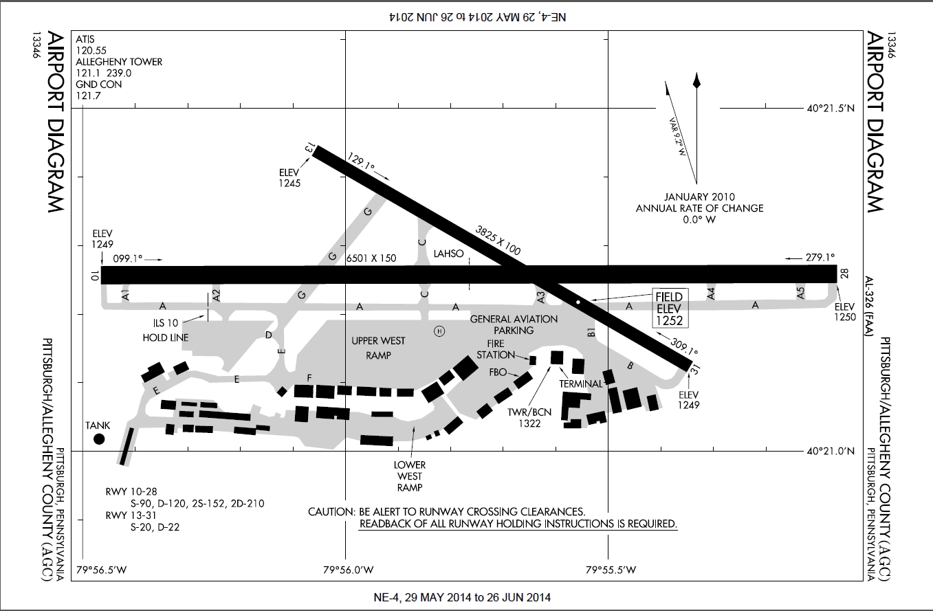
Digital NOTAM Implementation
Example of the NOTAMs on the previous page graphically depicted on an Electronic Chart Display (ECD).
X
X
X
X

Slide 24
Digital NOTAM Implementation
Instead of interpreting this FDC NOTAM while
flying the approach at our destination…
!FDC 4/9972 AGC IAP PITTSBURGH/ALLEGHENY COUNTY, PITTSBURGH, PA.
ILS OR LOC RWY 28, AMDT 29...
S-ILS 28: DA 1550/HAT 300 ALL CATS.
S-LOC 10C: MDA 1700/HAT 450 ALL CATS.
CIRCLING: CATS A/B/C MDA 1800/HAA 538.UNLESS OTHERWISE
AUTHORIZED BY AIR TRAFFIC CONTROL (ATC). 959 MSL TEMP CRANE
1.24 NM S OF AIRPORT. 1405301433-1412291433EST
Through the use of Digital NOTAM technology…

Slide 25
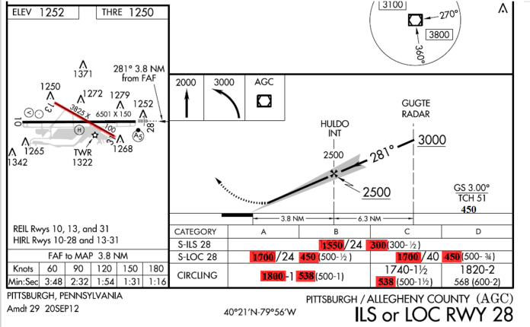
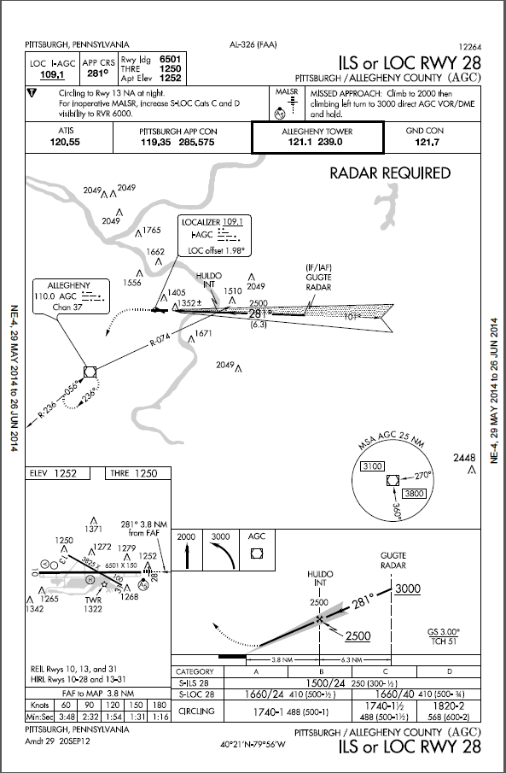
Digital NOTAM Implementation
The information displayed
on your digital device.

Slide 26
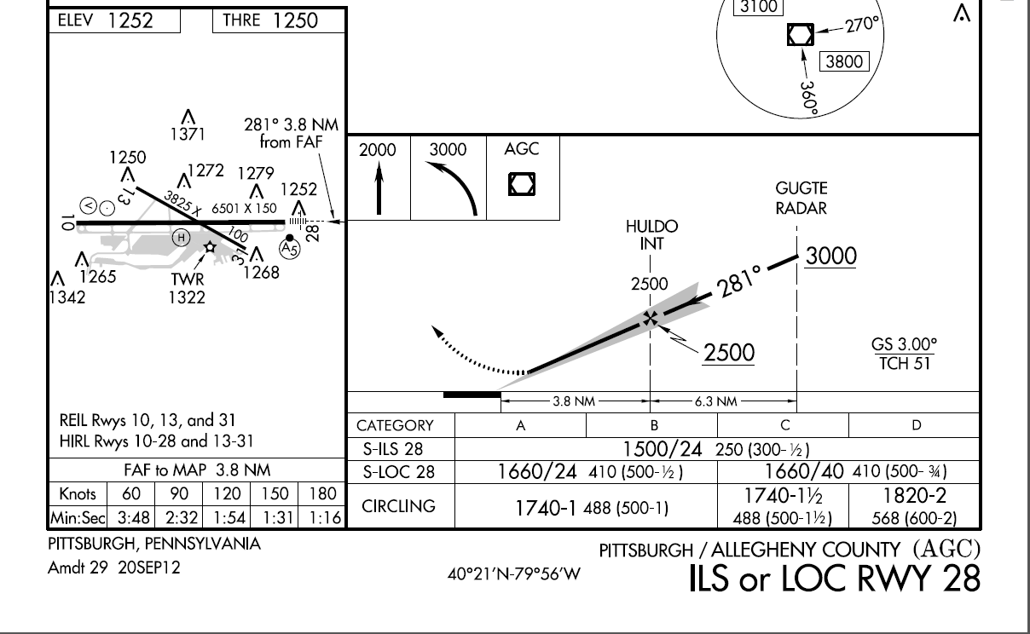
Digital NOTAM Implementation
450
1550
300
1700
450
1700
450
1800
538
538

Slide 27
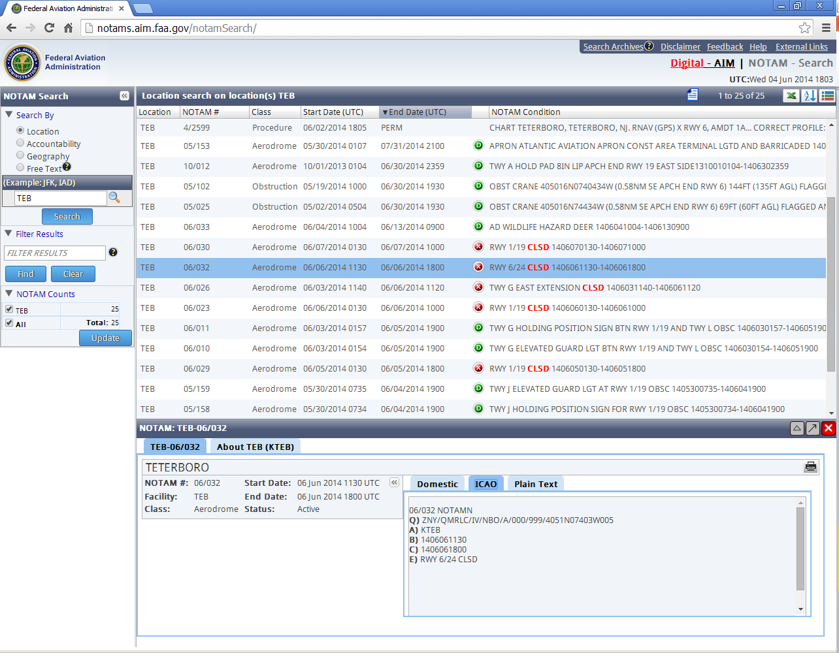
Digital NOTAM Implementation
Many NOTAMs issued today are already digitally encoded. In this screen shot of Teterboro NOTAMs, each of the NOTAMs with a green or red circle are digital.

Slide 28
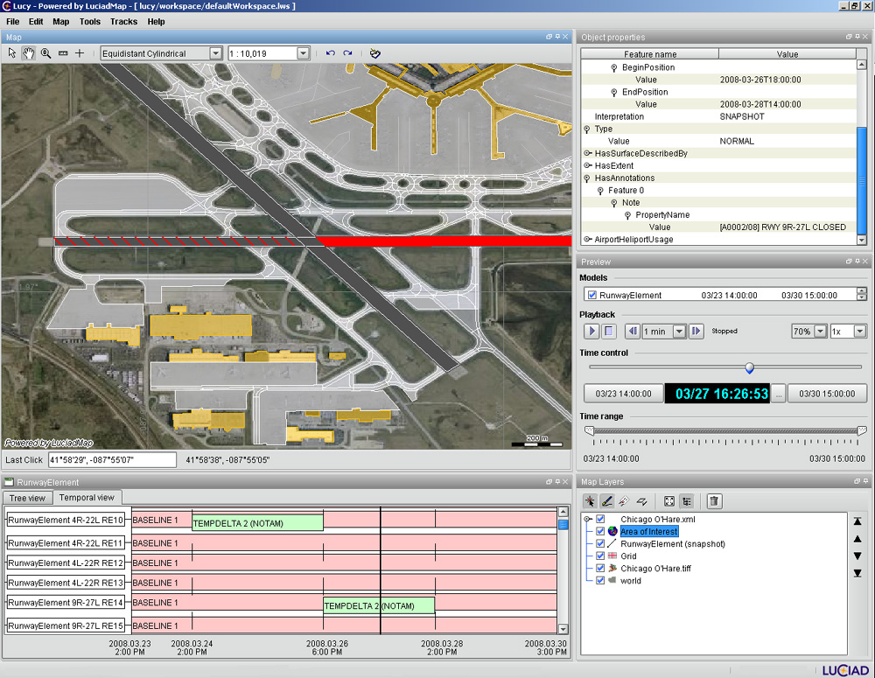
Digital NOTAM Implementation
Prototype digital depiction of a runway closure from Eurocontrol.

Slide 29
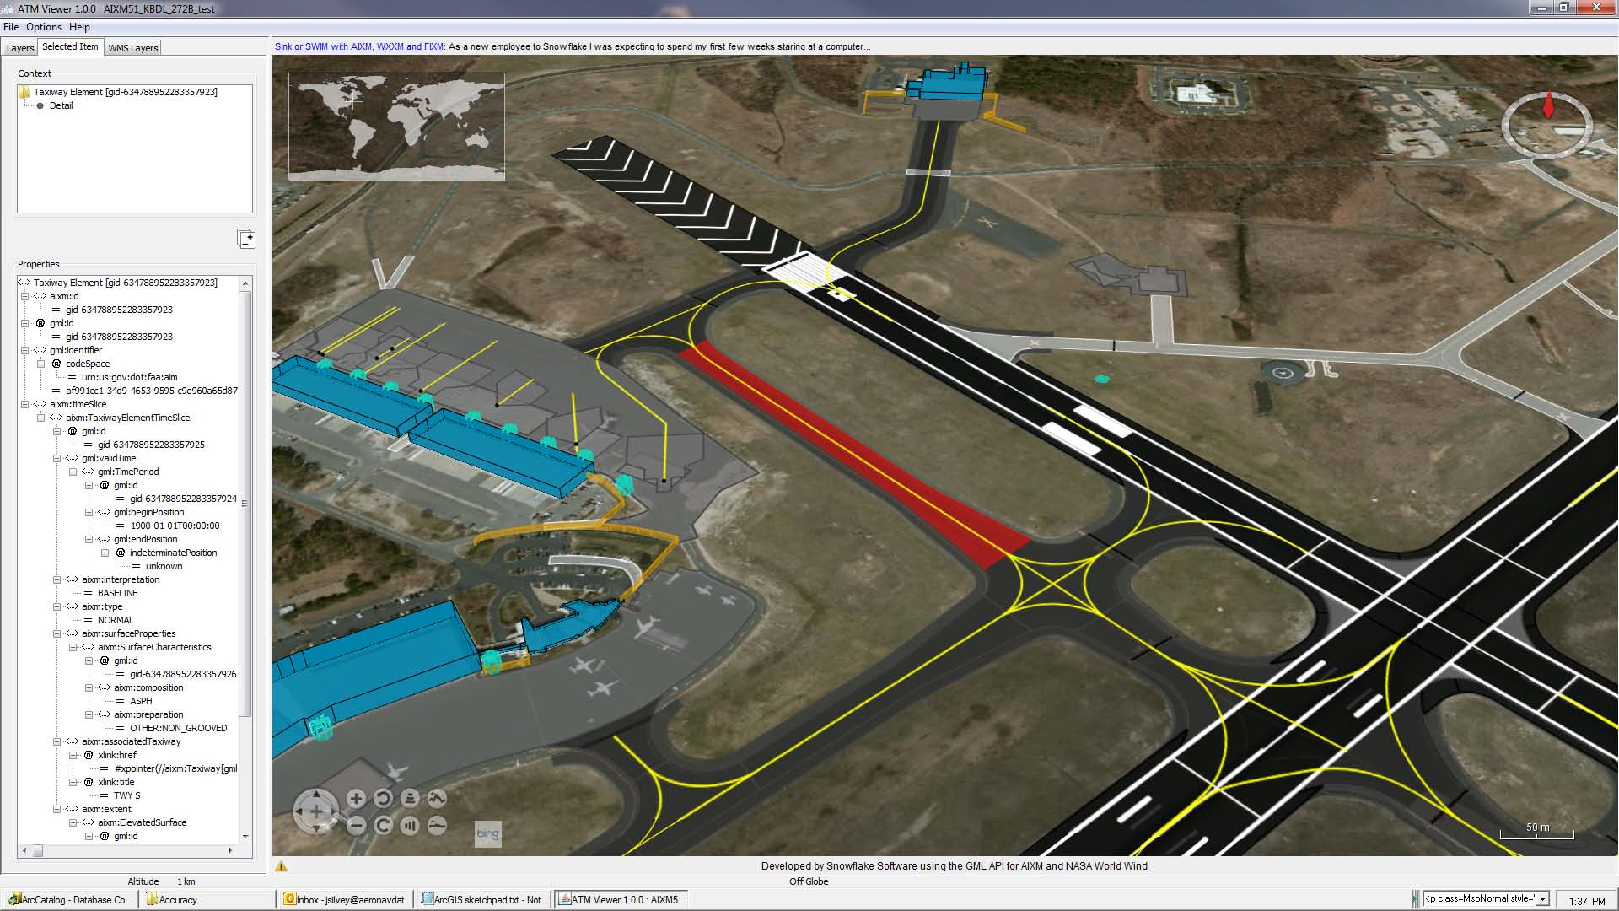
Digital NOTAM Implementation
Another example from Eurocontrol.

Slide 30
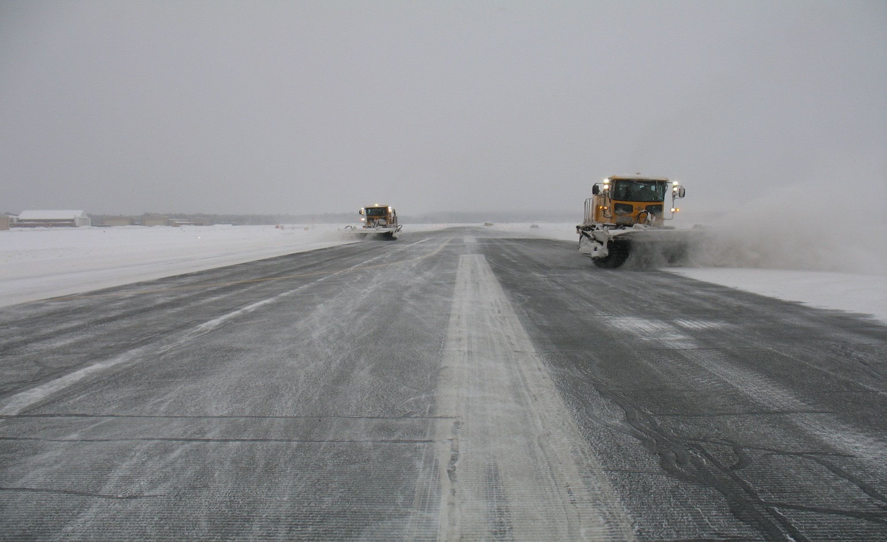
Digital NOTAM Implementation
Another beneficial element of the ICAO system is the SNOWTAM

Slide 31
Digital NOTAM Implementation
While usable in its native text format…
SWEN0393 ENGM 04200243
(SNOWTAM 0393 A) ENGM B) 04200243
C) 05 F) 48/7/47 G) 02/XX/03 H) 5/5/5/GRT
N) 47
R) 47
T) RWY SANDED)

Slide 32
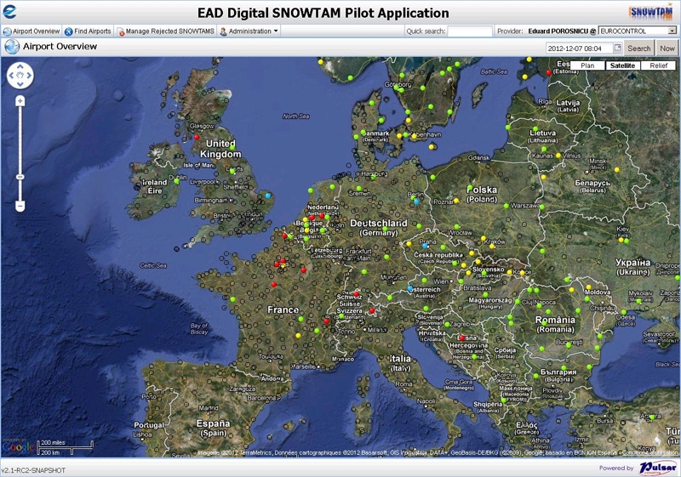
Digital NOTAM Implementation
When digital SNOWTAMs are graphically displayed, they are a much better tool.

Slide 33
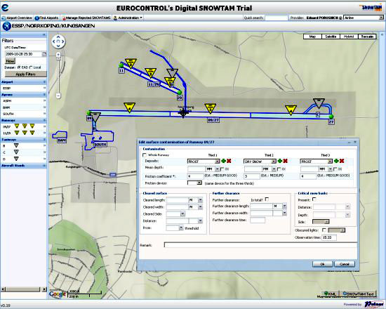
Digital NOTAM Implementation
Digital SNOWTAM,
airport view.

Slide 34
Progress
More than 300 US airports are currently providing digital data
Most FAA maintained communication and NAVAIDs are now digital
Goal - ICAO compliance by 2020

Slide 35
NOTAM Modernization
Questions?
Discussion?

Slide 36
Contact Information
Ernie Bilotto
Manager, US NOTAMs
Policy & Operations
E-mail: ernie.bilotto@faa.gov
DC Office:
USNOF Office:
iPhone:
202-267-3551
540-422-4760
202-604-9718

