Slide 1
Delivering Digital
NOTAMs
NOTAM Impact on Obstacle Clearance and Engine-Out Analysis
Presented By: Heinz Conrad

Slide 2
Background
Operators are legally required to determine a maximum takeoff weight for each takeoff.
By regulation they have to assume that an engine fails during takeoff run and that the subsequent flight path is flown with one engine out.
The SIDs as published by the authorities assume all engine performance and thus, might require climb gradients which can’t be matched in an engine out case without unduly weight restrictions.
Operators therefore develop engine out procedures, that might significantly deviate from the SIDs and, by avoiding limiting obstacles or terrain, are optimized for takeoff weight.

Slide 3
Background
Unclear NOTAM or airport information about obstacles have been identified as a source of unduly restriction in takeoff weight.
To address this issue, the IATA APTF (Airplane Performance Task Force) working group has drafted a paper in 2010:
“Educational Paper on Obstacle Clearance and Engine-Out Analysis – A summary for NOTAM releasing authorities”
This presentation shall serve as a short review of this paper.

Slide 4
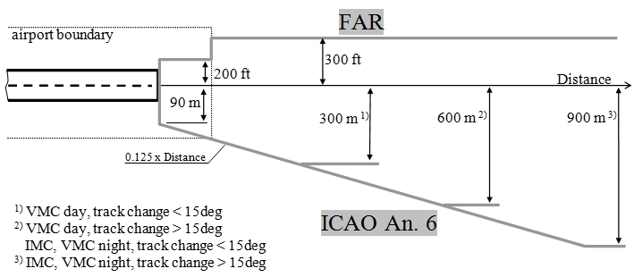
Takeoff Obstacle Clearance
Horizontal area around the intended flight path where obstacles have to be taken into account.
Vertical obstacle clearance

Slide 5
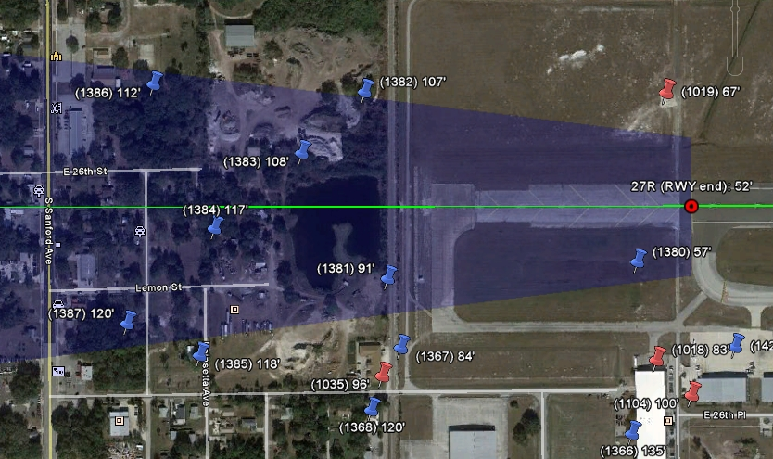
Obstacle Selection
ICAO Cone
intended Flightpath

Slide 6
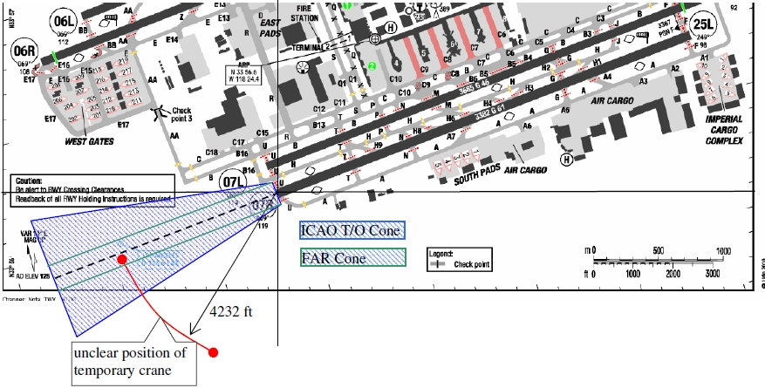
Example 1 - Obstacle Position
?
... TEMPORARY CRANE, 292 FT MSL, 4232 FEET SW OF RWY 07R ...
Difference in TO Weight:
MD80: 3380 kg/7450 Lbs
B767-300W: 12890 kg/28400 Lbs
B777-200ER: 18900 kg/41650 Lbs

Slide 7
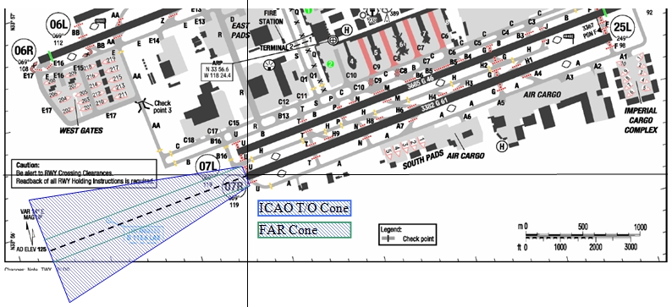
Example 1 – Obstacle Position
Better Alternatives:
Provide distance and heading from an unambiguous reference point (eg Airport Reference Point).
Provide (WGS 84) coordinates.

Slide 8
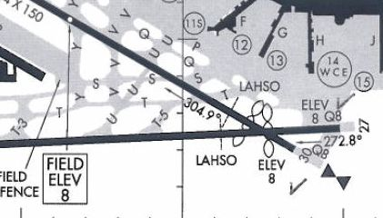
Example 2 - Obstacle Height
?
... WIP 300 FT FM DEP END RWY, EQPMT UP TO 30 FT AGL ...
We generally know about these elevations
Elevation?
Elevation?
We generally do not know about elevations beyond the runway end
Better Alternatives:
- Provide the obstacle elevation in reference to mean sea level (MSL).
- If you deem a height AGL information useful, also provide the ground elevation.

Slide 9
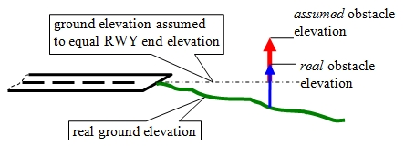
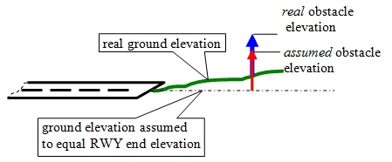
Example 2 - Obstacle Height
If we assumed the ground elevation to equal the RWY end elevation, then ...
... in this case our assumption would be conservative. (we would limit our takeoff weight)
... but in this case our assumption would be unsafe ! (the obstacle is higher than we think it is)

Slide 10
Example 3 - Clustered Obstacles
... MULTIPLE TREES 1500 FT to 2000 FT FM DEP END RWY, UP TO 60 FT MSL ...
In reality the situation might be like this.
However, with the given information, we have to assume the situation to be like this.

Slide 11
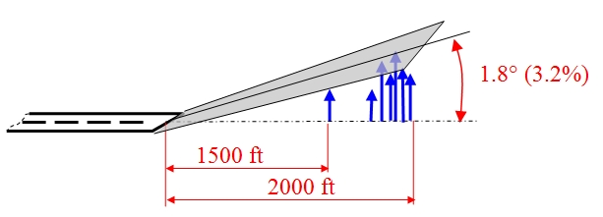
Example 3 - Clustered Obstacles
Better Alternatives:
If a large number of obstacles is located on a confined space (eg forests), it makes no sense to provide information on each individual obstacle.
A better way to provide obstacle information in this case is to define a sloped surface that is not protruded by any obstacle.
... MULTIPLE TREES 1500 FT to 2000 FT FM DEP END RWY, OBST NOT PRODRUDING SURFACE OF 1.8 DEG STARTING AT DEP END RWY ...

Slide 12
Contact Information
John Synnott, IATA synnottj@iata.org
Heinz Conrad, Lufthansa heinz.conrad@lhsystems.com
Walter Emmerling, Condor walter.emmerling@condor.com

Slide 13
Questions ?
Thank You !

