Slide 1

Delivering Digital
NOTAMs
Airline Operations Pilot Perspective
Presented By: GUY WOOLMAN
SOUTHWEST AIRLINES PILOTS’ ASSOCIATION

Slide 2
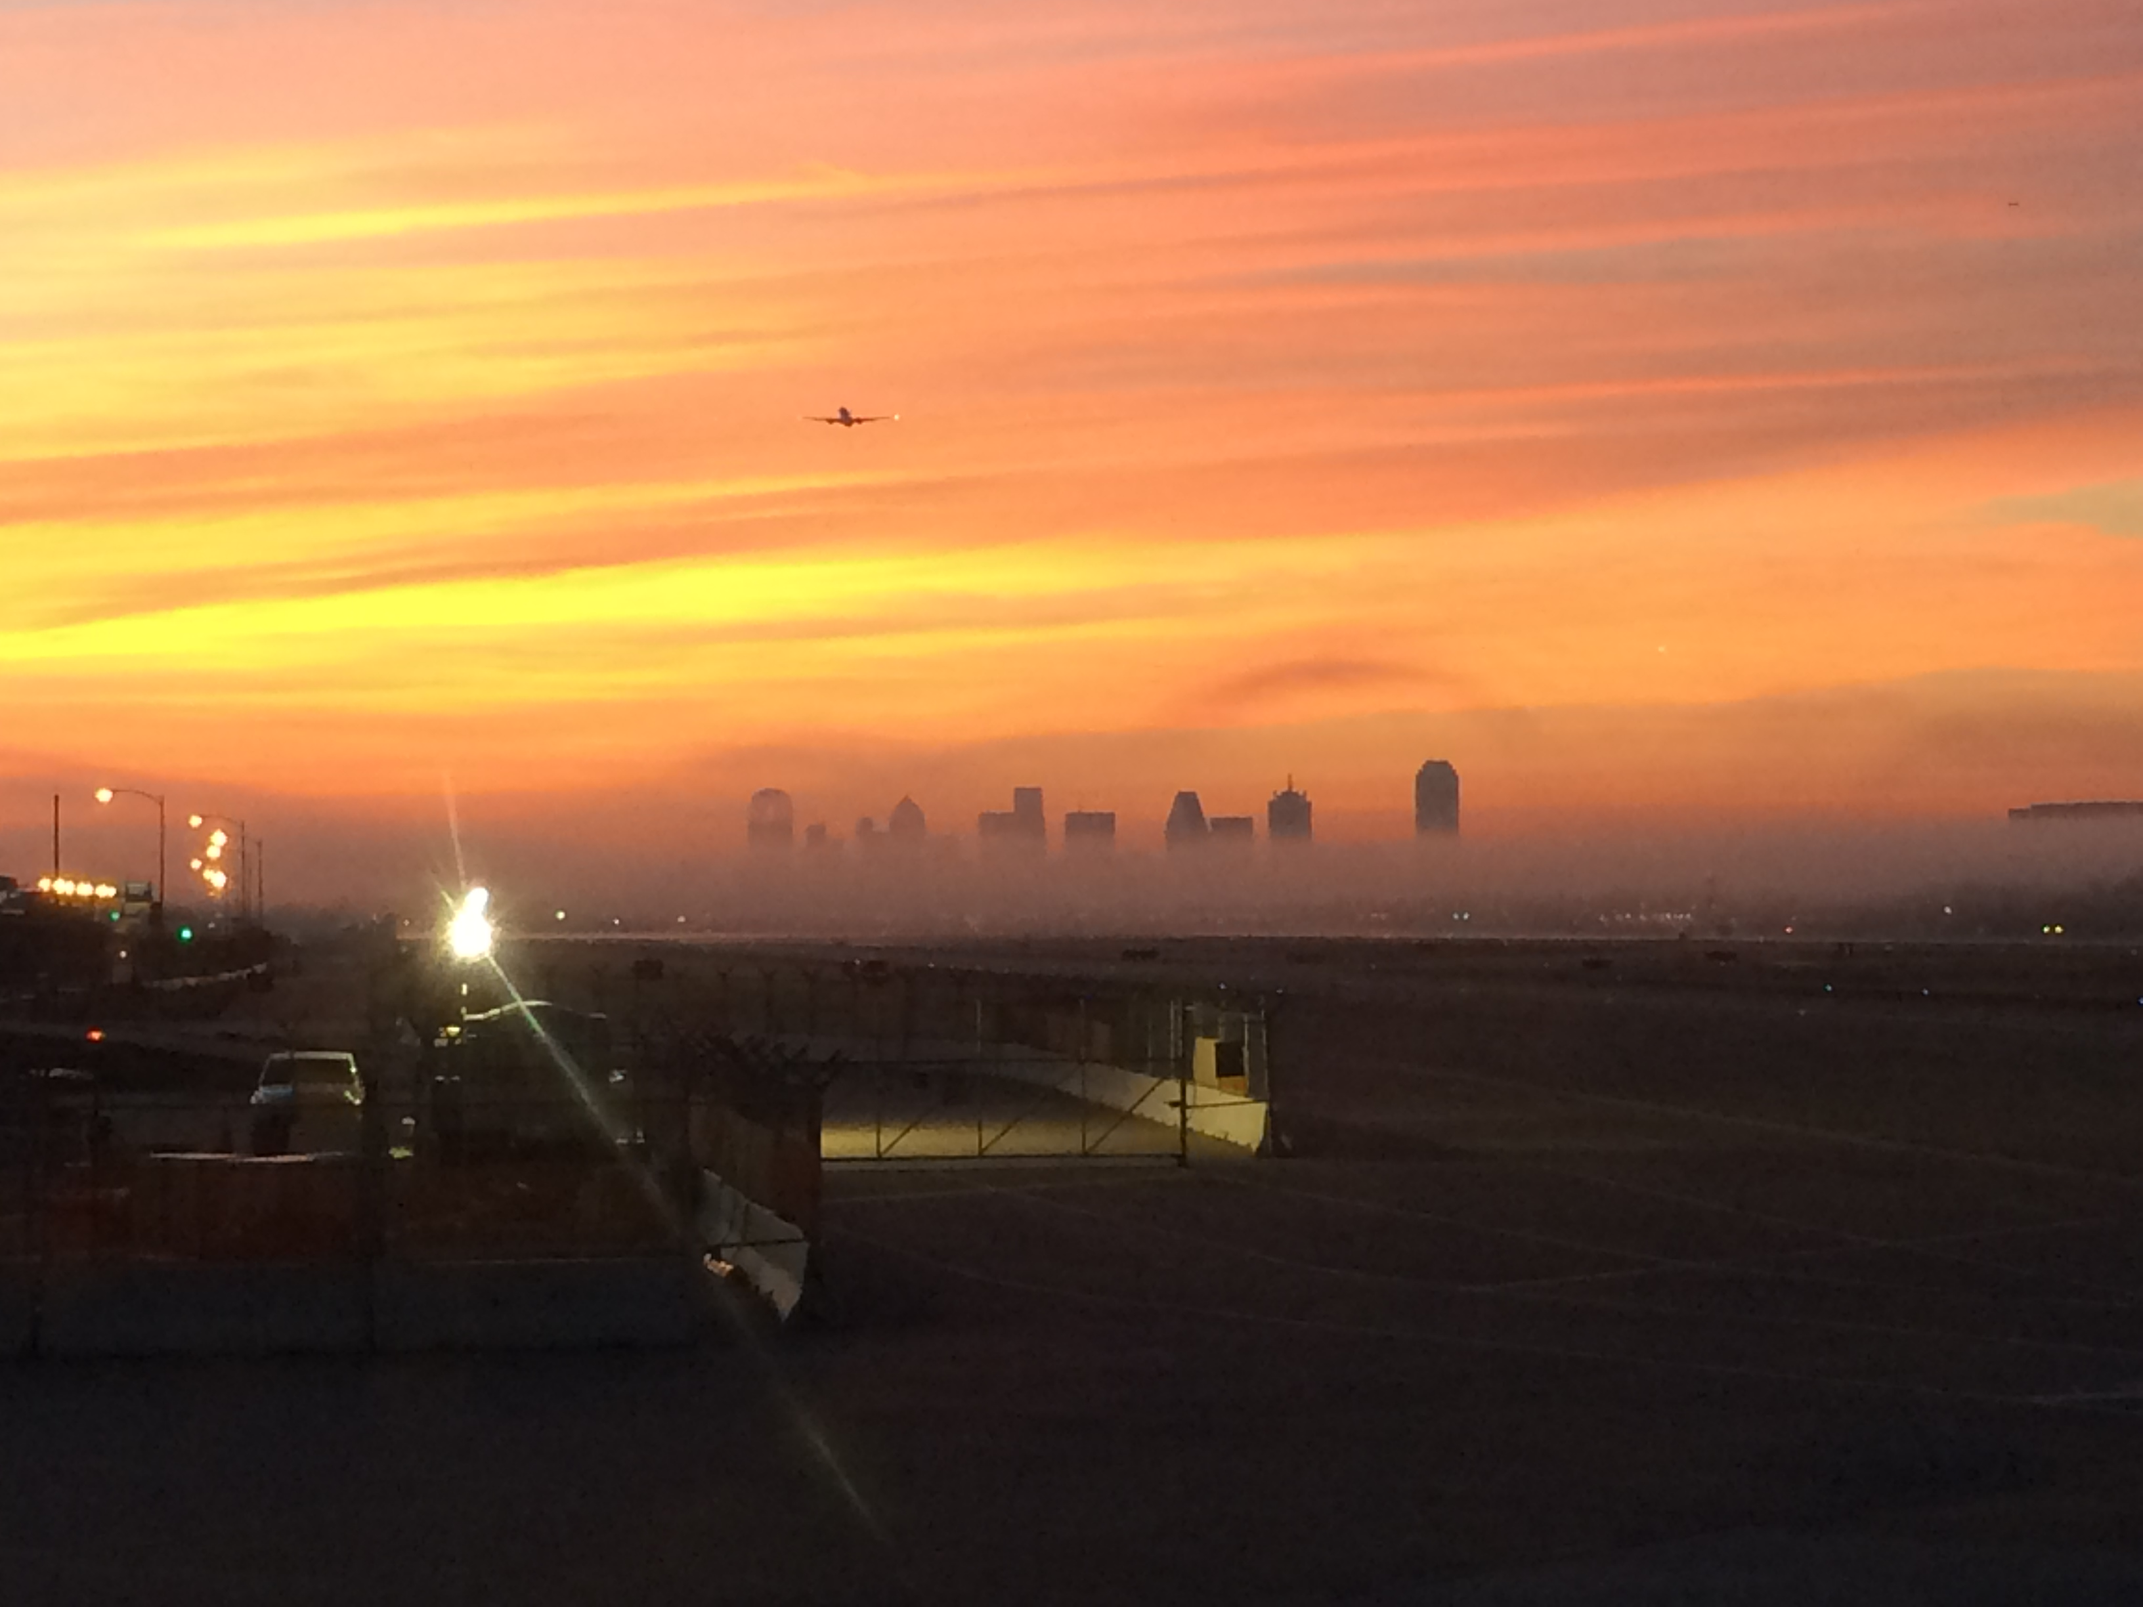
Southwest Scope of Operations
Fly from 3200-3500 flights a day
U.S, Caribbean and Mexico

Slide 3
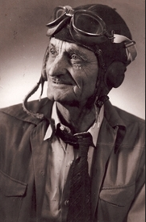
Progress
Pilots of yesteryear would need lots of training to fly today’s aircraft.
Would readily adapt to today’s Airman Information.

Slide 4
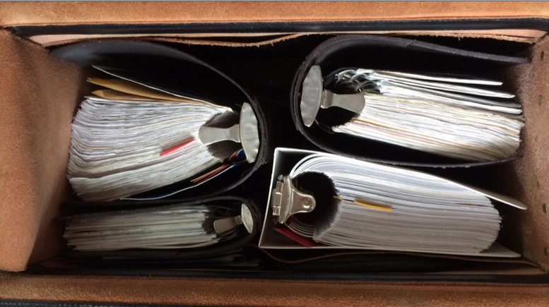
Photo of pre ‘11 pilot brain bag
From this personal bag

Slide 5
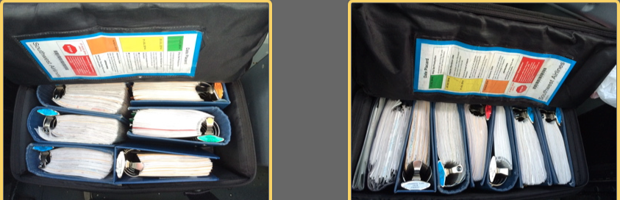
2011-Jun 2014
To this

Slide 6
Need for EFB
Added route complexity/airports
Real Estate limited on Flight Deck
Decrease aircraft weight/fuel burn
Reduce OJI
By product. Easier to use for pilots.

Slide 7
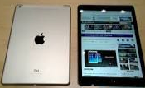
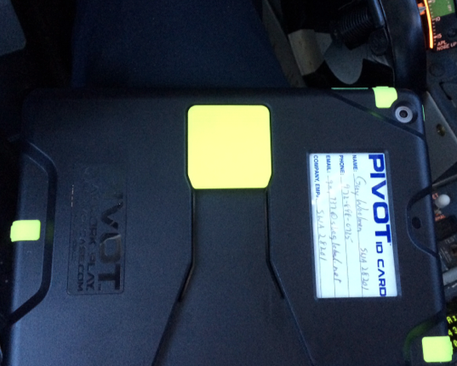

SWA EFB
Notes:
iPad Air, mounting system

Slide 8
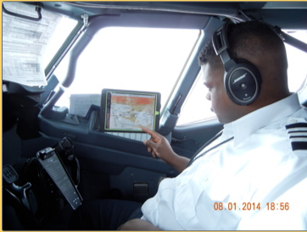
To This

Slide 9
EFB Demonstration
Washington Reagan to Austin, Texas
Notes:
Walk through DCA to AUS flight on Jepp
We are Own ship capable but prohibited to use.
Can’t use aircraft Wifi on flight deck.

Slide 10
Our NOTAM products
Paper weather/NOTAM package
ACARS
Still very much in the ‘70s

Slide 11
Pilot Mental Model
Does my information paint an accurate picture?
  Is it recallable at the right time
Hardware is available now
Some Apps are better than others
All are evolving
Notes:
Has to be timely and recallable.

Slide 12
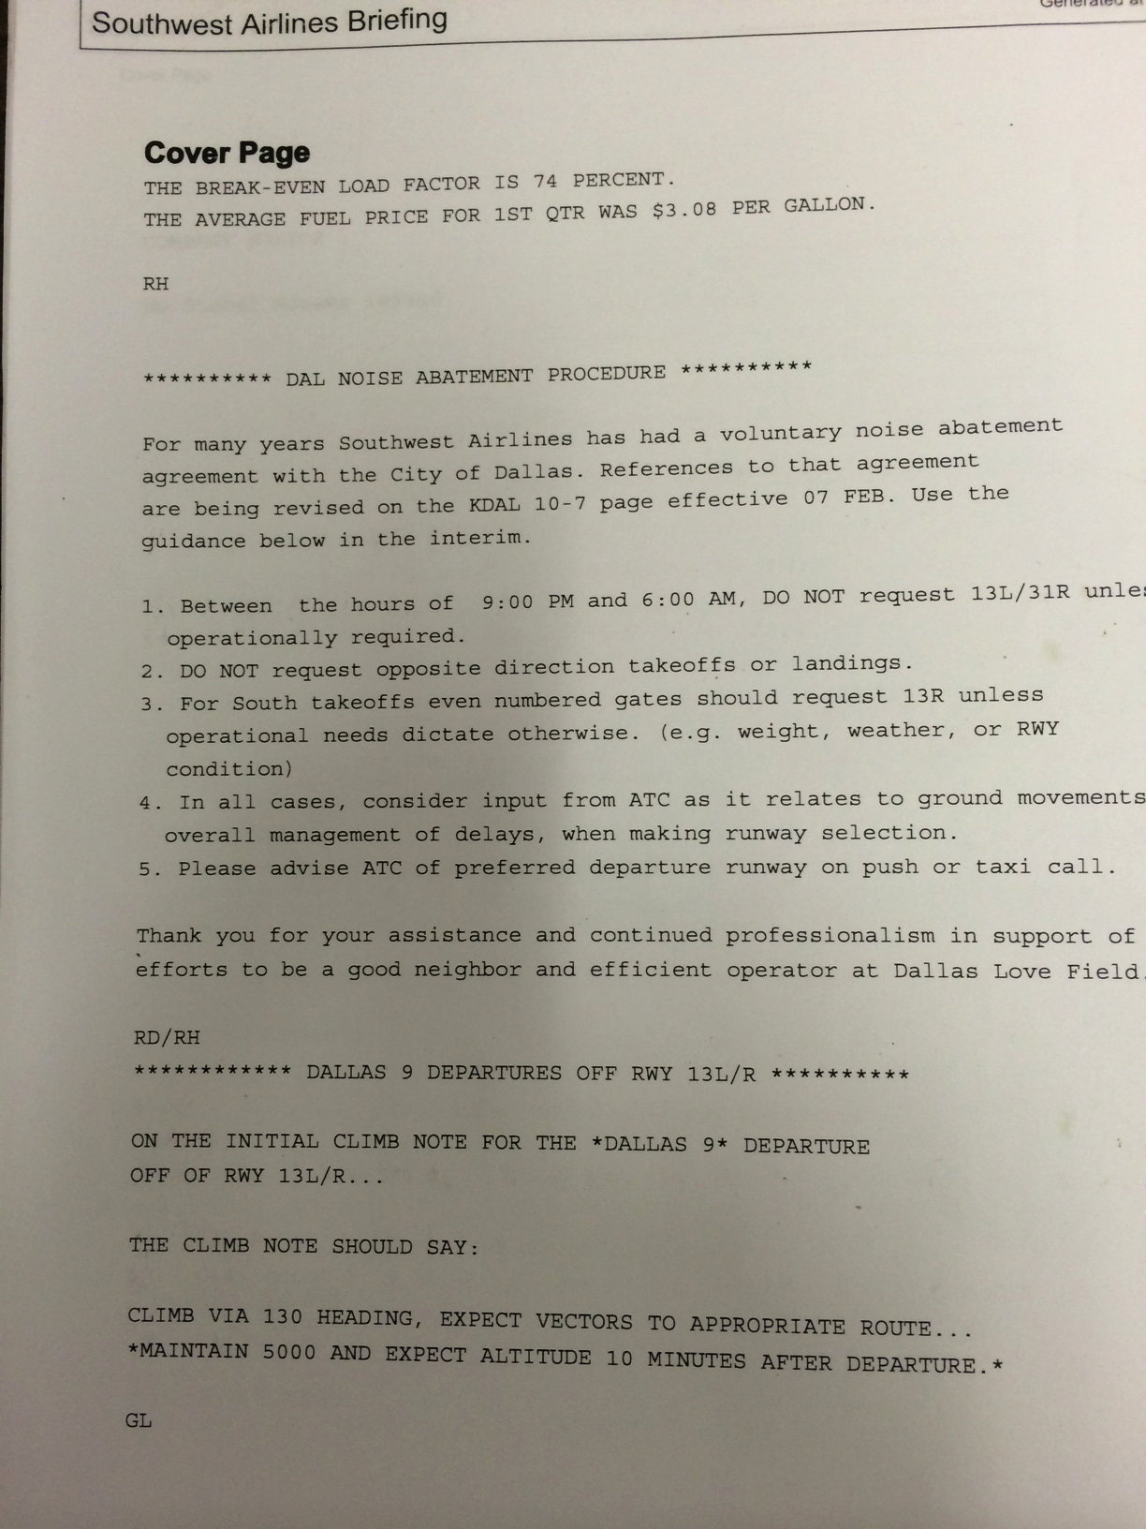
NOTAM examples
Helpful
  Southwest cover sheet
    Covers biggies we might overlook
Notes:
21 pages in package. 3 devoted to NOTAMS with two alternates.

Slide 13
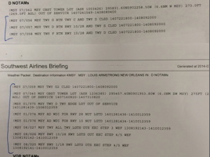
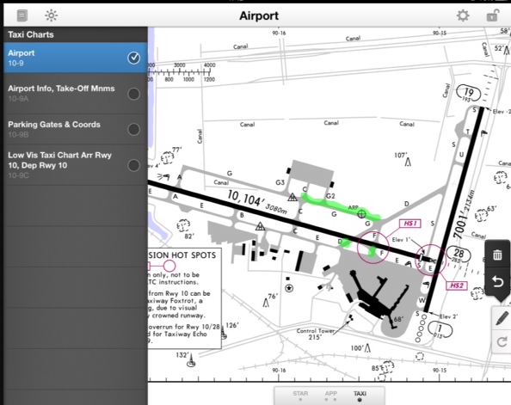
Cave man graphical
Notes:
Took 4 minutes to translate/28 NM. ATC traffic call and one freq change.

Slide 14
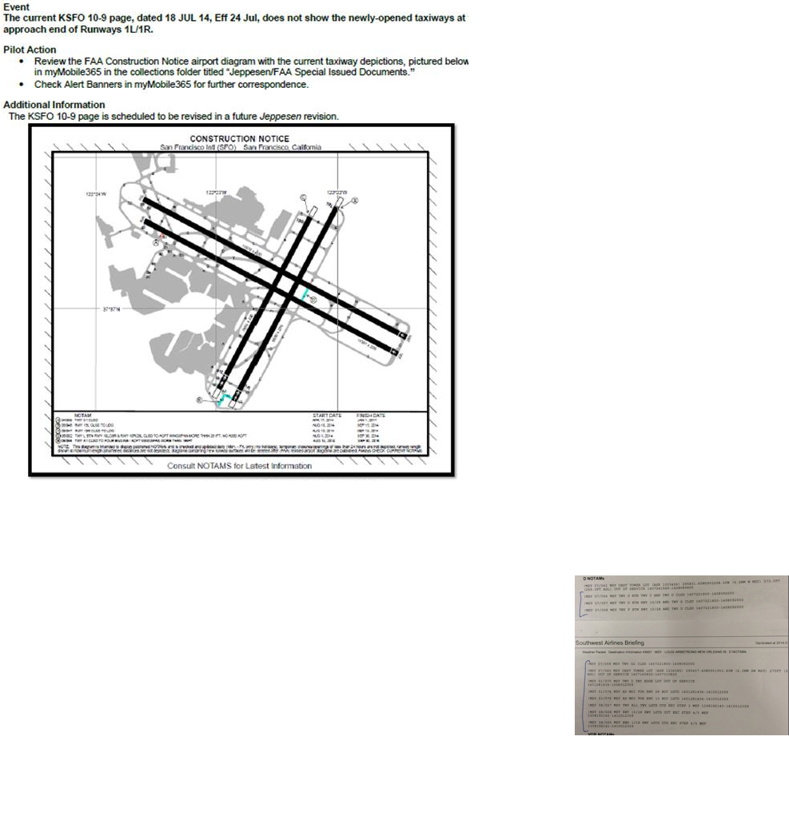
Workaround. We have to remember to remember!
Notes:
It would be nice to have this automatically update airport diagram page.

Slide 15
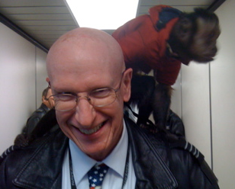
It’s time to get the monkey off our backs

Slide 16
What do we need?
Accuracy is crucial. Data in has to be good
Timely
Graphic display great aids mental model
  Deeper dive capable
Sort, filter, sift, graphical.
Meet the need from GA to Dispatchers, Pilots
  SWA pilots have 3-4 NOTAM pages/flight
  Dispatchers have 25-50 pages. Work multiple city pairs.
Tie in to new technology. Synthetic vision etc
Get users involved from the beginning.

Slide 17
THE CHALLENGE
Government, academia, industry. We need your help.
Will you accept the challenge?

Slide 18
Contact Information
Guy Woolman
Southwest Airlines Safety/Technical Pilot
gwoolman@swapa.org
Brookview Plaza
1450 Empire Central
Suite 737
Dallas, TX 75247
Cell: 972-898-0725

