Slide 1
Delivering Digital
NOTAMs
Airport
Operations
Presented By: Mark Sprague, C.M.

Slide 2
About DCA
Ronald Reagan Washington National Airport – DCA
Located in Arlington, VA
3 Miles from Washington DC
Situated on 860 acres (130 of those unusable)
Serving almost 20 million passengers annually
Slot Controlled Airport
About 900 flights a day
Runway 1/19 (North – South): Primary
Runway 15/33 (NW – SE): Secondary
Runway 4/22 (NE – SW): Closed for construction

Slide 3
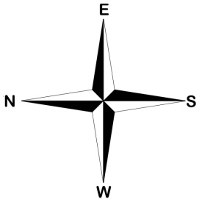
DCA Limitations
Land locked and efficient use of land in imperative.
Shorter Runway Lengths
Prohibited Airspace in DC
Need both Primary and Secondary Runways Operational for the capacity of traffic.
Scheduling of maintenance along with Construction during night time hours.

Slide 4
Airport Operations Responsibilities
Airport in compliance
Scheduling of maintenance
Controlling the airport during abnormal conditions.
Disseminate changed conditions using the Digital NOTAM System.
75 NOTAMs per month

Slide 5
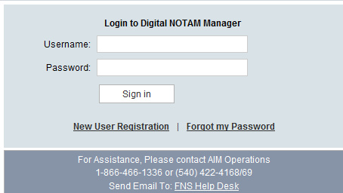
Benefits of the Digital NOTAMs
Training
Web Based
Time Interval
Record Keeping
Unlimited Access to Demo
Airport Personnel sending information.
Seconds !!!!!
Database

Slide 6
Utilization of the Digital NOTAMs
Runway, Taxiway, Apron Closures
Inclement Weather –
Winter Operations
Field Conditions
Paint Markings
Unlit, Replacing, or Damaged Signs
Obstructions
Construction

Slide 7
Explaining This ?

Slide 8
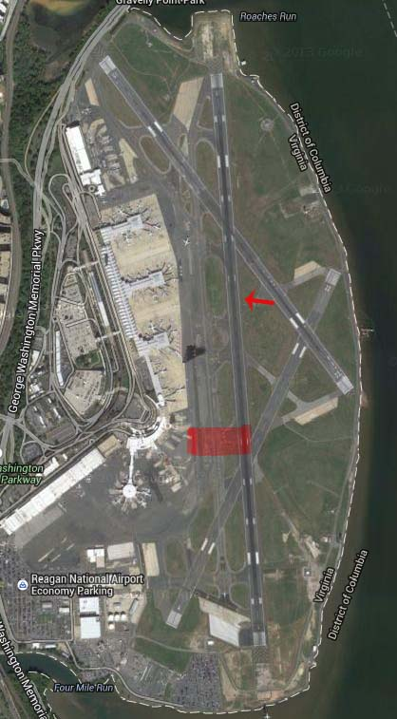
Practical Application
Primary Runway CLOSED
Secondary Runway OPEN
Gave ATCT Taxi Routes
NOTAMs Issued
Repair: 1 hr : 30 min

Slide 9
Conclusion
Operations: Knowing your airport
For The User: Painting a picture of the changed condition
Digital NOTAMs: Fast, accurate, and efficient
Effective: Proven by the practical example

Slide 10
Contact Information
Mark Sprague, C.M.
Airport Operations Duty Manager, NOTAM Administrator, 139 Coordinator
Ronald Reagan Washington National Airport
MA-110
1 Aviation Circle
Washington, DC 20001
Mark.Sprague@mwaa.com
703.417.8050

