Slide 1


Delivering Digital
NOTAMs
Delivering Digital NOTAMs over
FAA System Wide Information Management (SWIM)
Presented By: Jim Robb
Date: August 25th, 2014

Slide 2
Agenda
What is SWIM?
NAS Enterprise Messaging Service (NEMS) Infrastructure
Delivering Digital NOTAMs over SWIM
2

Slide 3
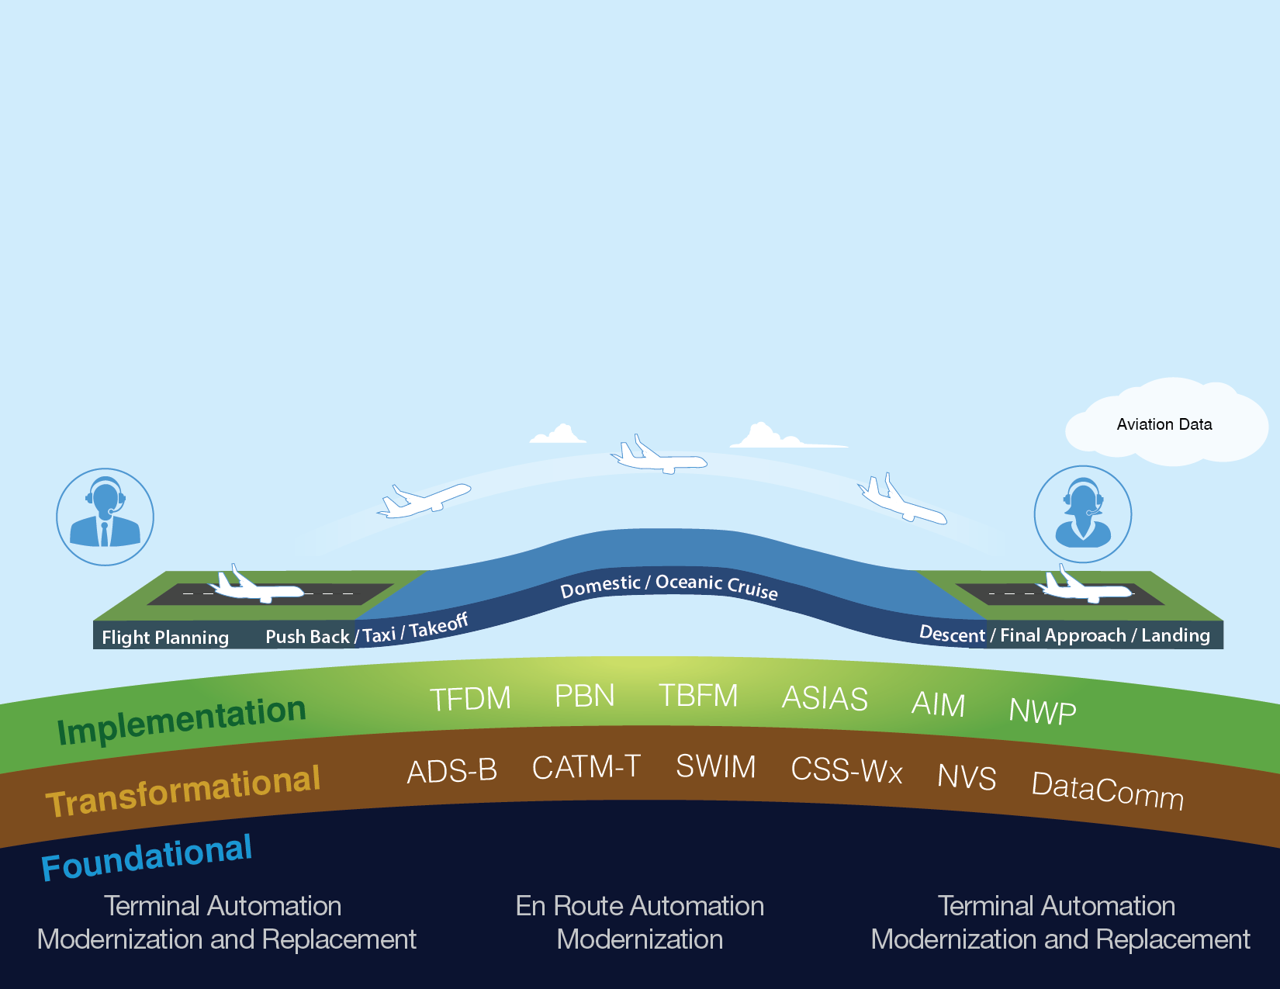
Delivering NextGen Improvements
Legacy System
NextGen
Radar
Inefficient Routes
Voice Communications
Disparate Information
Fragmented Weather Forecasting
Weather Restricted Visibility
Forensic Safety Systems
Nationwide Focus
Satellite
Performance Based Navigation (fuel savings)
Voice & Digital Communications
Automated Decision Support Tools
Integrated Weather Information
Improved Access in Low Visibility
Prognostic Safety Systems
Focus on Congested Metroplexes
3
Notes:
NextGen implementation is organized into foundational and transformational programs, and other activities that enable operational capabilities and improvements.
We will have much of our foundational infrastructure in place in the near future.
By 2015, the agency expects to have largely completed the infrastructure that will enable additional layers of operational improvements, with TAMR being completed at large TRACONs by May of 2016.
Think of this foundation as an iPad, on which NextGen “apps” can be loaded to provide benefit in the NAS.
The iPad, itself, is not NextGen, but the capabilities it enables are.
It is on this foundation that the FAA will continue to implement the transformational technologies that provide operational benefits to users throughout the NAS.
Performance Based Navigation (PBN) will improve operational efficiencies much like upgrades to the U.S. interstate system improved our highways. Because we have updated our automation systems, we can increase use of PBN to deliver benefits to users like savings in time, fuel, and reduced emissions.

Slide 4

4

Slide 5
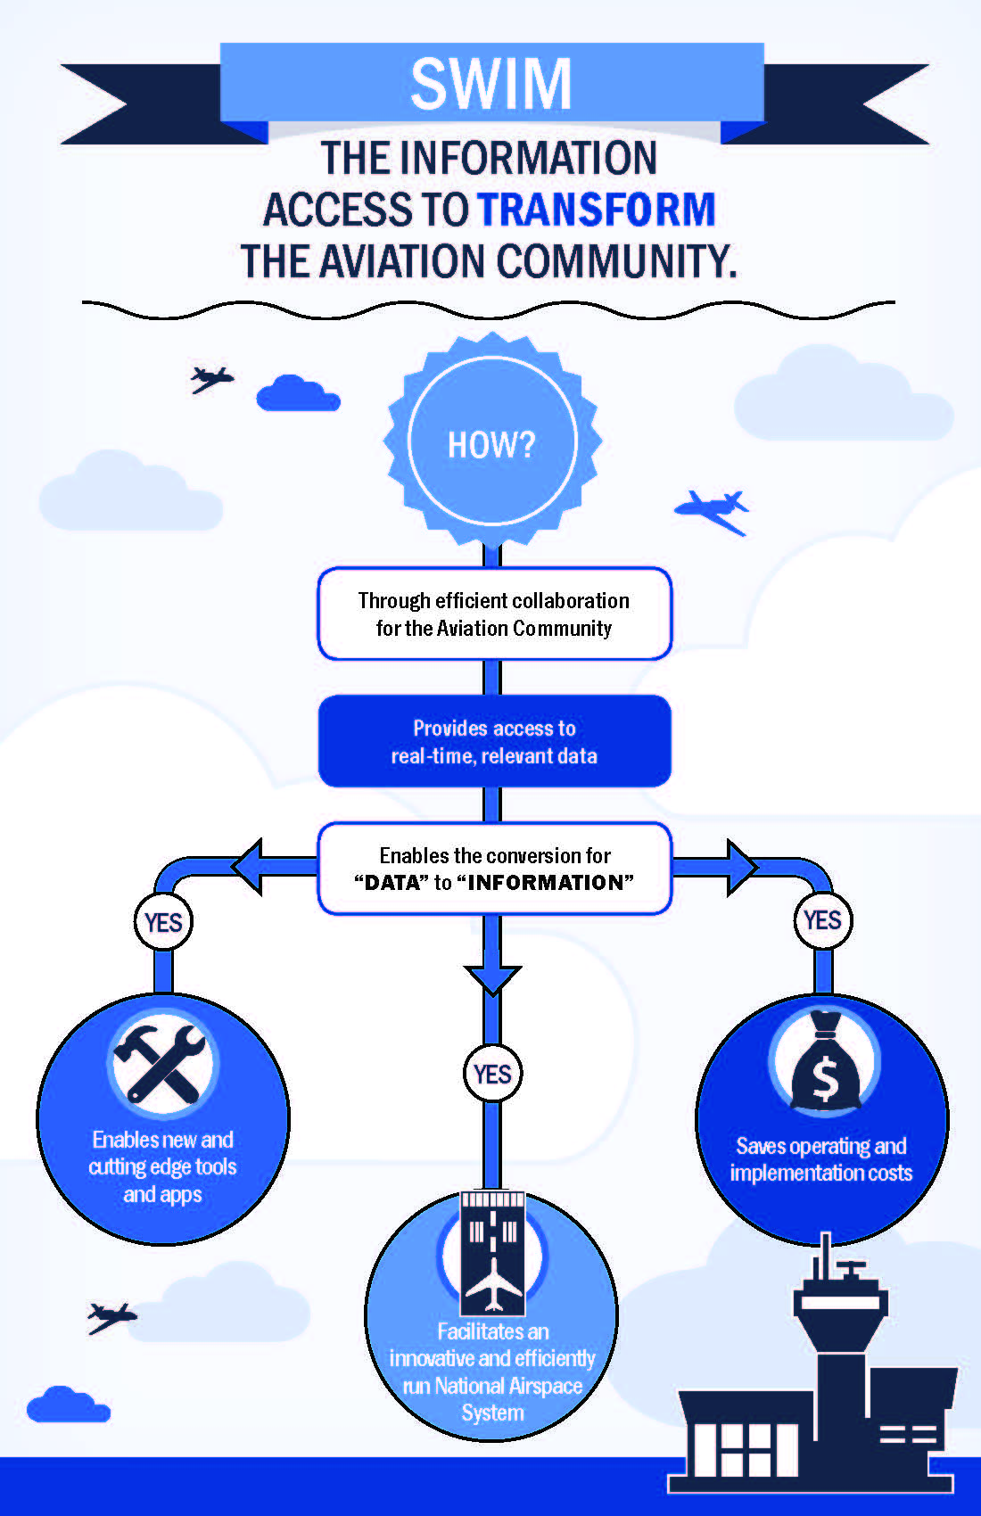
Replaces unique interfaces with modern standards-based data exchange
Provides SWIM users access to information without directly connecting to another system
Provides enterprise security for incoming and outgoing data
5

Slide 6
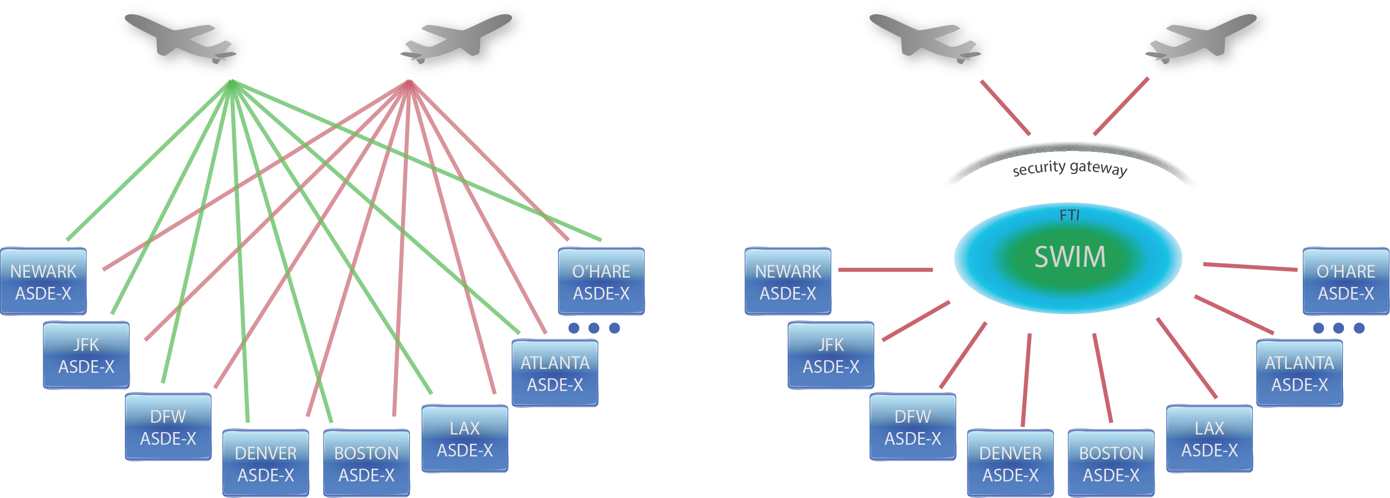
SWIM: Information Access to Transform the Aviation Community
Legacy operating environment:
Point-to-point connections
SWIM operating environment:
Data Exchange
(Published once, consumed by many)
6
Notes:
- SWIM is all about making important information easily accessible. The cost and time to develop SOA services has been reduced.

Slide 7
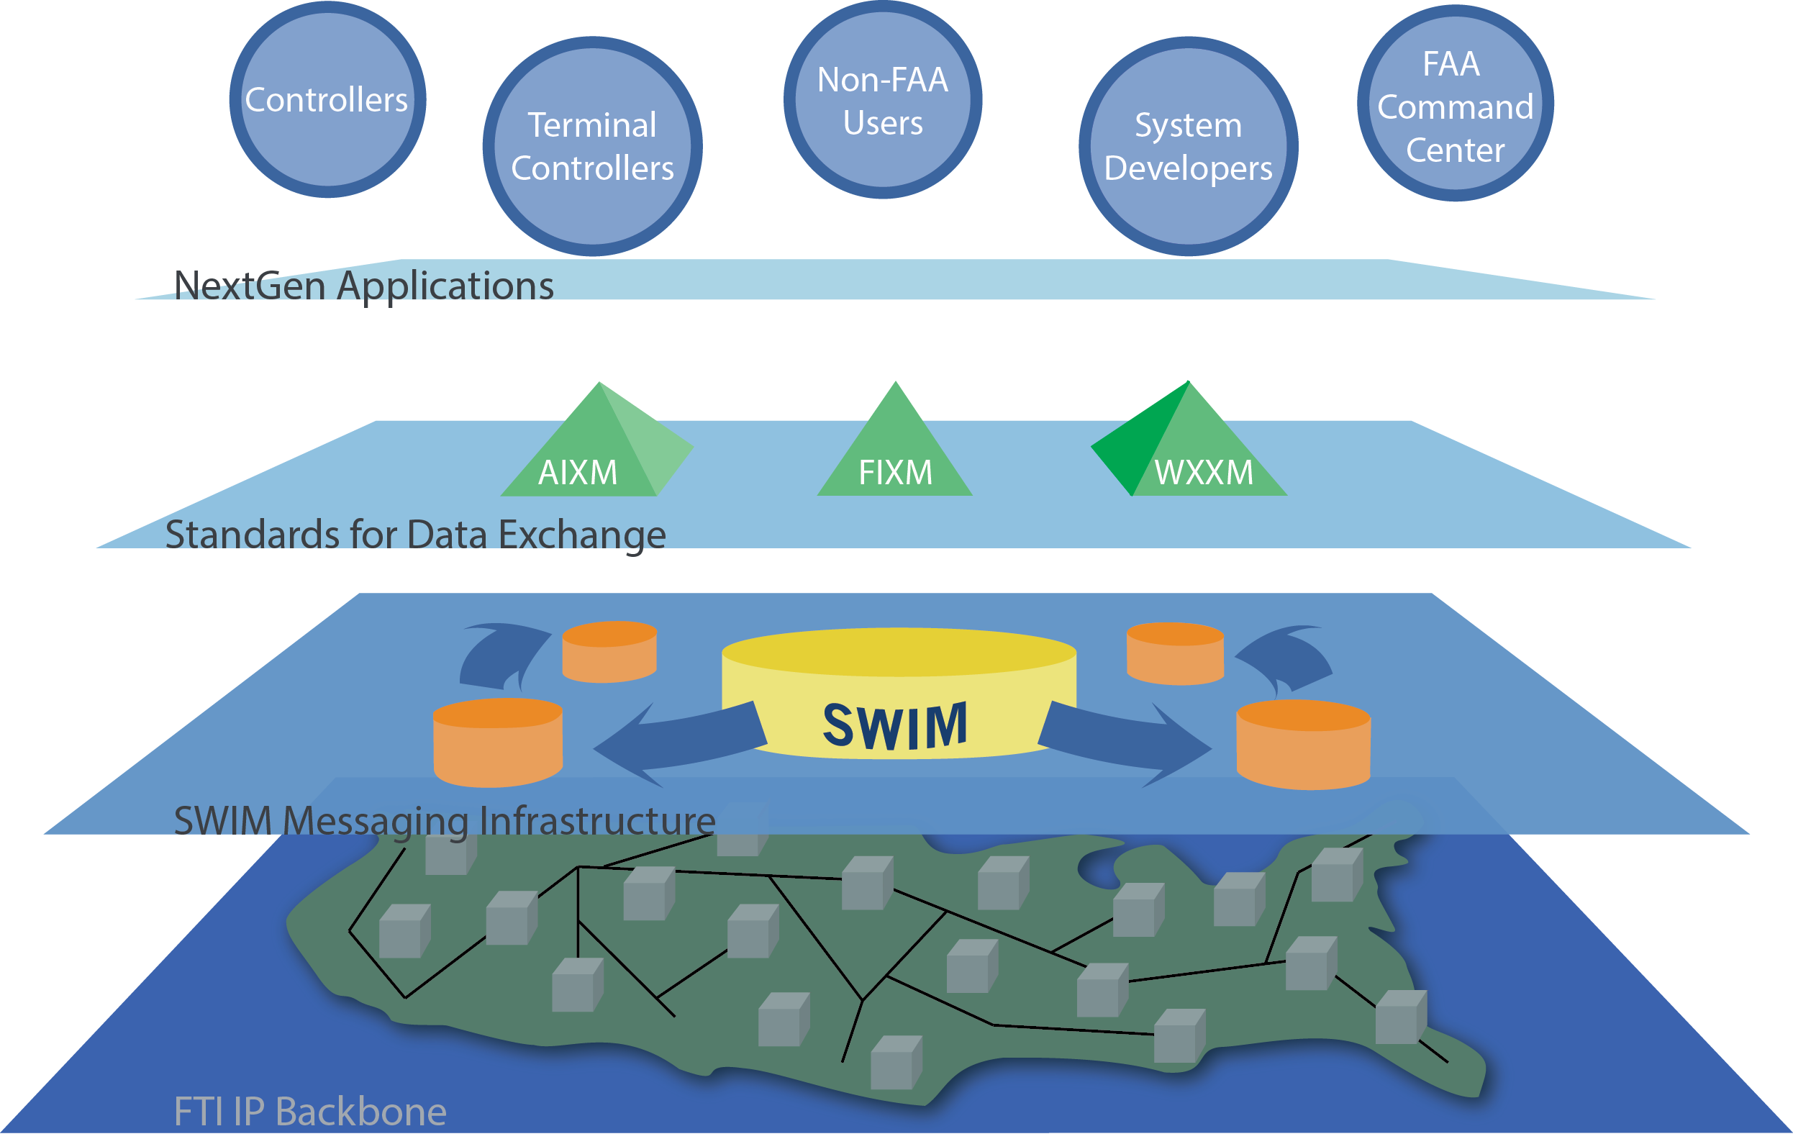
NextGen Information Sharing Architecture
Mission Services/
Application Layer:
FDPS, STDDS, ITWS, AIM, etc.
Common Support:
Data Standards &
Harmonization
Enterprise Messaging:
SWIM Core Services
Physical Network:
FTI Operational IP network provides secure transport
7
Notes:
Highlights:
To have a net-centric enterprise, a reliable, high-performance network is necessary
Having the all-digital, ubiquitous network for the FAA (FTI) creates ripe environment for realizing network centric milestones (inclusive of SWIM)

Slide 8
SWIM Infrastructure Deployment
NAS Enterprise Messaging Service (NEMS)
Existing NEMS Nodes
NEMS Gateway
R&D and FNTB Nodes
Planned NEMS Nodes 2015
Mission Support Nodes (Admin)
ARTCC Sites
FTI Operations Center
8

Slide 9
SWIM Data Exchange – Participating Programs
The following FAA systems publish products on the SWIM/NEMS
enterprise service bus today
SAA
Flow Publication Service
Aeronautical Situational
Display to Industry (ASDI)
STDDS
NDS
Sep’14
EWD
TFMS
SWIM Terminal Data
Distribution System
Special Activity Airspace
Nov’14
NOTAM Distribution
Service
WARP
Enhanced WINS
Dissemination
Traffic Flow Management System
TBFM
WMSCR
FDPS
Weather and Radar
Processor
ITWS
Time Based Flow
Management
Weather Message Switching
Center Replacement
Jun’15
Aug’14
Flight Data Publication
Service
SWIM
Integrated Terminal
Weather System
FTI
N E S G
- security gateway
CIWS
External Consumers
Corridor Integrated
Weather System
9

Slide 10
AIM FNS Available via SWIM
The Federal NOTAM System (FNS) is a component of the NAS, and a centerpiece of the FAA’s Aeronautical Information Management (AIM) Modernization plan.
FNS-NDS, NOTAM Distribution Service is a Web Service (WS) standards compliant system, intended for external query and use
FNS-NDS offers numerous benefits including:
  uses Open Geospatial Consortium (OGC) Web Feature Service (WFS) 2.0 with FES 2.0 as the framework for distributing NOTAMs.
  uses the Aeronautical Information Exchange Model (AIXM), as the message payload.
  Schema used is harmonized between both the FAA and EUROCONTROL
NOTAMs not originated through FNS are still included in FNS-NDS, but only contain limited data provided from the legacy system
10

Slide 11
AIM FNS Available via SWIM (cont.)
AIM Modernization “onramps” NDS to SWIM / NEMS using Web Service Proxies
Service will be available to internal (NAS) and external users
AIM Modernization Segment 2 will enhance the service by offering additional capabilities including query, error checking and subscription services based on WS-Notification.
11

Slide 12
Assumptions
FNS-NDS will be deployed in the Internal DMZ of the OEX NAS Enterprise Service gateway (NESG)
FNS-NDS will onramp a Web Service Producer onto the NEMS node located in the Internal DMZ of the OEX NESG
SWIM/NEMS will make the FNS-NDS Service available via Public DMZ.
12

Slide 13
Technologies
FNS-NDS will be deployed in the Internal DMZ of the OEX NAS Enterprise Service gateway (NESG)
FNS-NDS will onramp a Web Service Producer onto the NEMS node located in the Internal DMZ of the OEX NESG
NEMS will make the FNS-NDS Service available via Public DMZ
13

Slide 14
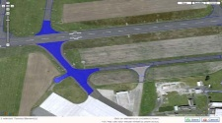

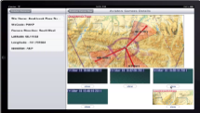


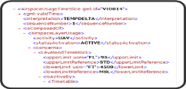
Federal NOTAM System – NOTAM Distribution Service Overview
Provides distribution of Notices to Airmen (NOTAMs)
Data feed that uses OGC WFS web-services
  Enables graphical NOTAM representation
Standards: Aeronautical Information Exchange Model (AIXM) 5.1 format
ALL or Some: Query and select types of data
External Market: Enables 3rd party app development
Standards: Include info needed for fusing data
Request/
Reply
FNS
NEMS
Pub/Sub
14

Slide 15

Questions
15

Slide 16
Contact Information
Jim Robb, SWIM Program Manager
email: jim.robb@faa.gov
  Andy Isaksen, Enterprise Engineering Lead
  email: andy.isaksen@faa.gov
16

