Slide 1

Delivering Digital
NOTAMs
NOTAM Search Enhancements
Overview & Implementation Plan
Presented By: Scott Jerdan, Manager
AIM Systems Group, FAA

Slide 2

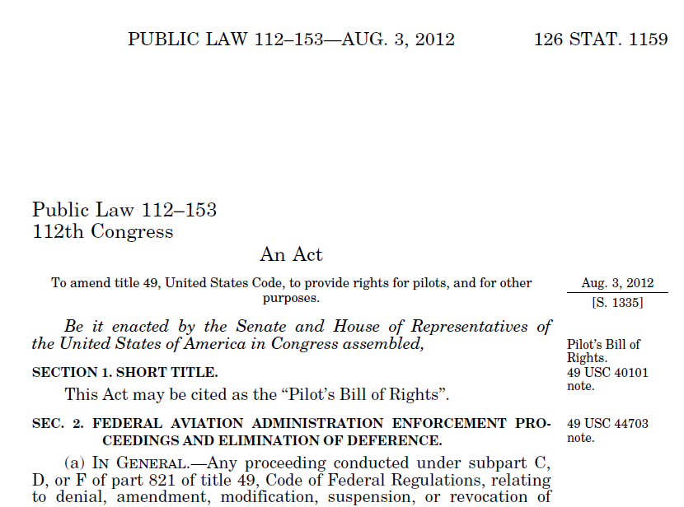

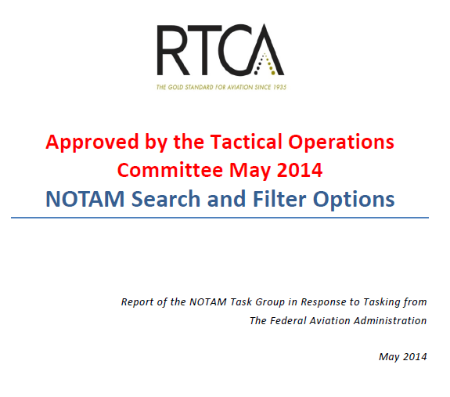
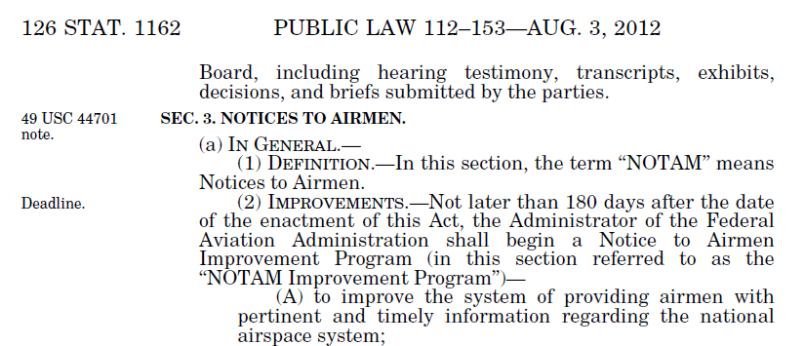
Background
Pilot’s Bill of Rights (PBoR):
Congressional mandate to improve the NOTAM System
RTCA NOTAM Task Group:
Guidance from aviation stakeholders
Notes:
Pilot’s Bill of Rights (PBoR)
Defined high-level guidance for providing NOTAM information to consumers
RTCA NOTAM Task Group
Expanded on the PBoR guidance to provide insight into what capabilities/functions were needed by NOTAM consumers
NOTAM Activity Prioritization Report
NOTAM Success Criteria and Metrics
NOTAM Search and Filter Options
AIM Review of PBoR and RTCA Guidance
Utilize a phased approach to release NOTAM Search enhancements
NOTAM Search
Current FNS-based public NOTAM query tool that will be updated/ redesigned to meet the PBoR and RTCA guidance

Slide 3
NOTAM Task Group Priorities
From “NOTAM Search and Filter Options: Report of the NOTAM Task Group in Response to Tasking from the Federal Aviation Administration”
Specific Search/Filter Recommendations:
Search by Flight Plan
Search by Effective Dates and Times
Filter by Keywords
Filter for Procedure Type
Filter by Runway Characteristics
Append Specific Airports
Additional Recommendations:
Search multiple keywords
Filters include/exclude the filter term
Create personalized accounts
Consolidate into one FAA NOTAM website
Notes:
Notes:
RTCA NOTAM Task Group provided 10 recommendations in the “NOTAM Search and Filter Options” report
6 recommendations were related to prioritizing specific search and filter options
Remaining 4 recommendations were more general NOTAM Search enhancements

Slide 4
NOTAM Search Enhancements
Phase 1
Route of Flight Query
Phase 2
User Profiles
Phase 3
User Profile Enhancements
Filter Enhancements
Phase 4
PilotWeb Functionality
New Filters
User Interface (UI) Update
Sunset PilotWeb

Slide 5
Phase 1 Enhancements
Phase 1
Phase 2
Phase 3
Phase 4
Route of Flight Query
New Filters
User Profiles
User Profile Enhancements
PilotWeb Functionality
UI Updates
Filter Enhancements
Sunset PilotWeb

Slide 6
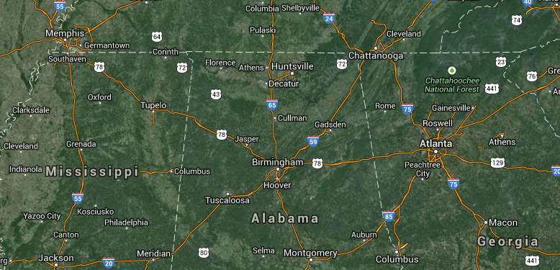
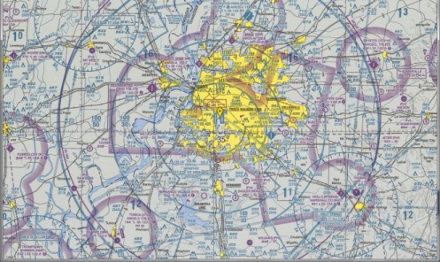
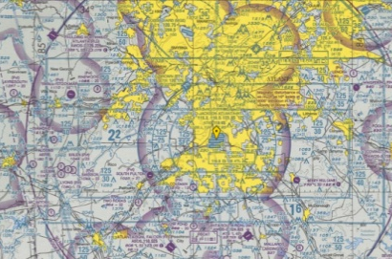
Route of Flight Query
Example Route: KMEM HLI V54 MSL V325 GAD DALAS KATL
KMEM
Flight path
Divert Airport
HLI
V54
MSL
V325
DALAS
GAD
KPDK
Buffer
KATL
NOTAM Search returns all NOTAMs within buffered flight path + diverts
Notes:
Notes:
Flight path covers all points on the route between user entered points (in the example on the slide, the flight path includes all points on route V54 between HLI and MSL, and all points on route V325 between MSL and GAD)
Each route entered in a flight path must be preceded and followed by a navaid, fix, or airport
User cannot enter two consecutive route identifiers

Slide 7



Route of Flight Query Options
User Entry
Enter flight path string
  2-20 designators
    Airport
    Navaid
    Named fix
    Route/airway
Enter divert airports
  0-5 designators
Enter buffer
  1-125 nautical miles from center line
Validation Rules
All designators validated against FAA data
Flight path limited to US and territories
Flight path determined by order of entry
First/last designators must be airports
Consecutive routes not supported
System Output
NOTAM results separated into groups for independent sorting & filtering
  Departure Airport
  Arrival Airport
  Divert Airport(s)
  En Route
Notes:
Notes:
System Output:
En Route group will be further separated into “En Route – Manually Entered” (capturing NOTAMs from points entered as part of the flight path by the user) and “En Route – Buffered” (capturing NOTAMs from points within the buffer of the flight path)

Slide 8
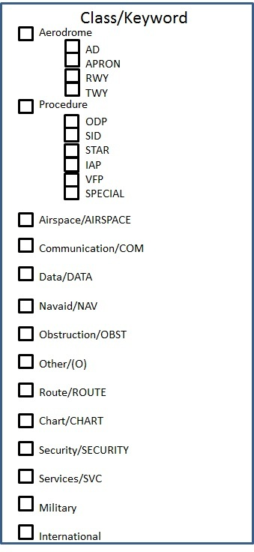

New Filters
Date/time range
View only NOTAMs that are effective during a specific time period (e.g., a planned flight)
Keywords/classes
ARTCC/FDC/regulatory notices
Remove/include these lengthy NOTAMs as necessary
Includes 20 standard NOTAM keywords
Filter related keywords or special groups by choosing a class
Notes:
Notes:
Classes can be groups of keywords (e.g., Aerodrome class contains AD, APRON, RWY, and TWY keywords) or special groups (e.g., Military)

Slide 9
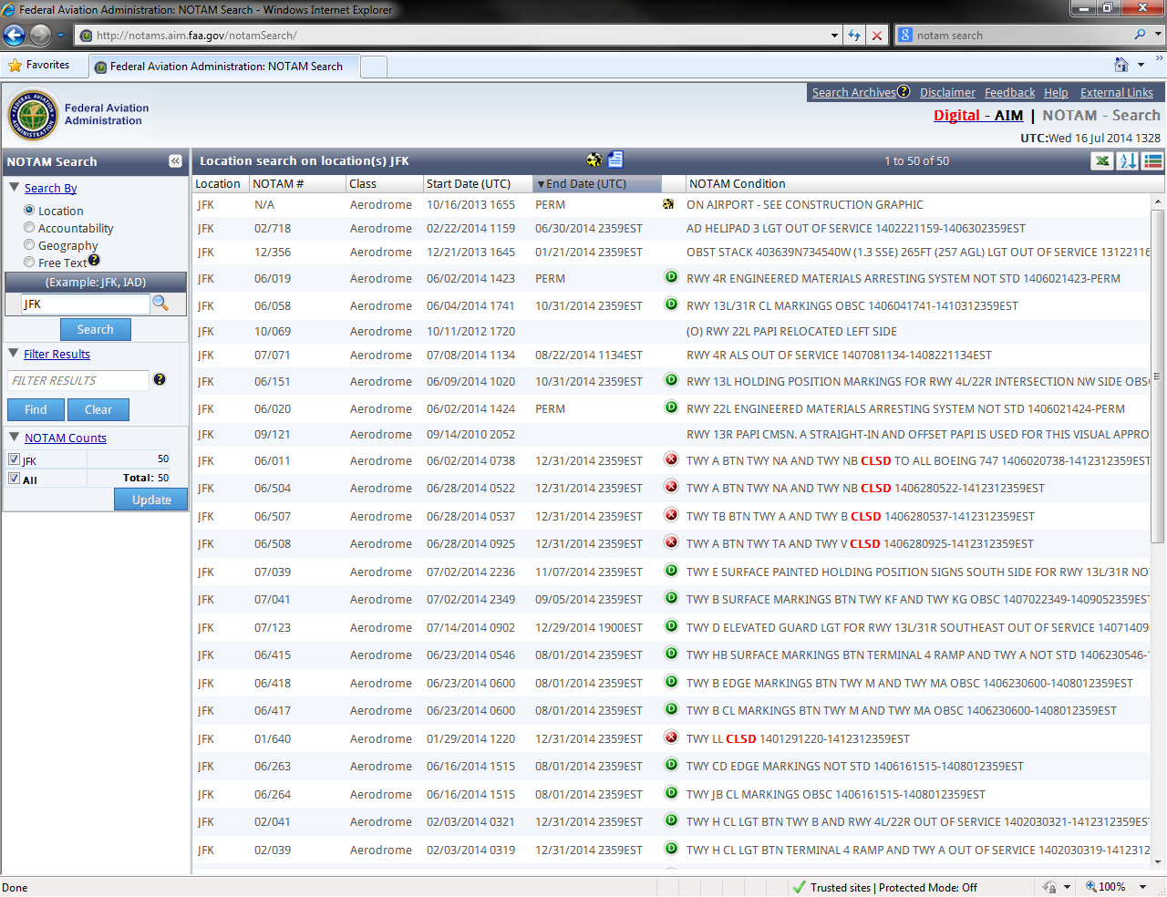
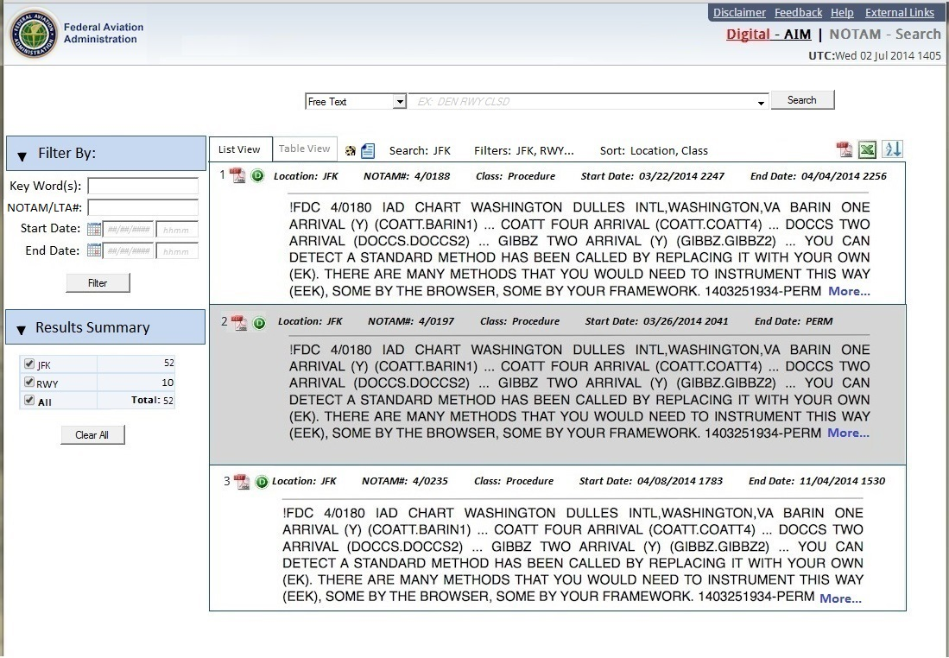

Updated User Interface
Google-style search
Modern web technology
Multiple layout options
Printer-friendly PDF export

Slide 10
Phase 2 Enhancements
Phase 1
Phase 2
Phase 3
Phase 4
Route of Flight Query
New Filters
User Profiles
User Profile Enhancements
PilotWeb Functionality
UI Updates
Filter Enhancements
Sunset PilotWeb

Slide 11


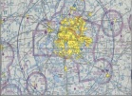


User Profiles
Create user login to save search preferences
Optional feature
Designed for avid users
Ability to save up to 10 pre-defined flight path queries
Additional features in Phase 3

Slide 12
Phase 3 Enhancements
Phase 1
Phase 2
Phase 3
Phase 4
Route of Flight Query
New Filters
User Profiles
User Profile Enhancements
PilotWeb Functionality
UI Updates
Filter Enhancements
Sunset PilotWeb

Slide 13

Profile & Filter Enhancements
User Profile Enhancements
Save/recall previous queries
Save filter settings
Save sorting settings
Filter Enhancements
Procedure type*
Length/width
Surface type
Weight limits*
Runway characteristics
Designate preferred airports
*Subject to data availability
Notes:
Notes:
“Procedure type” filter may be dependent on digital procedure NOTAMs from NMPC; otherwise would need to develop a parsing-based solution
Need further research to determine if NASR data can support “weight limits” filter

Slide 14
Phase 4 Enhancements
Phase 1
Phase 2
Phase 3
Phase 4
Route of Flight Query
New Filters
User Profiles
User Profile Enhancements
PilotWeb Functionality
UI Updates
Filter Enhancements
Sunset PilotWeb

Slide 15
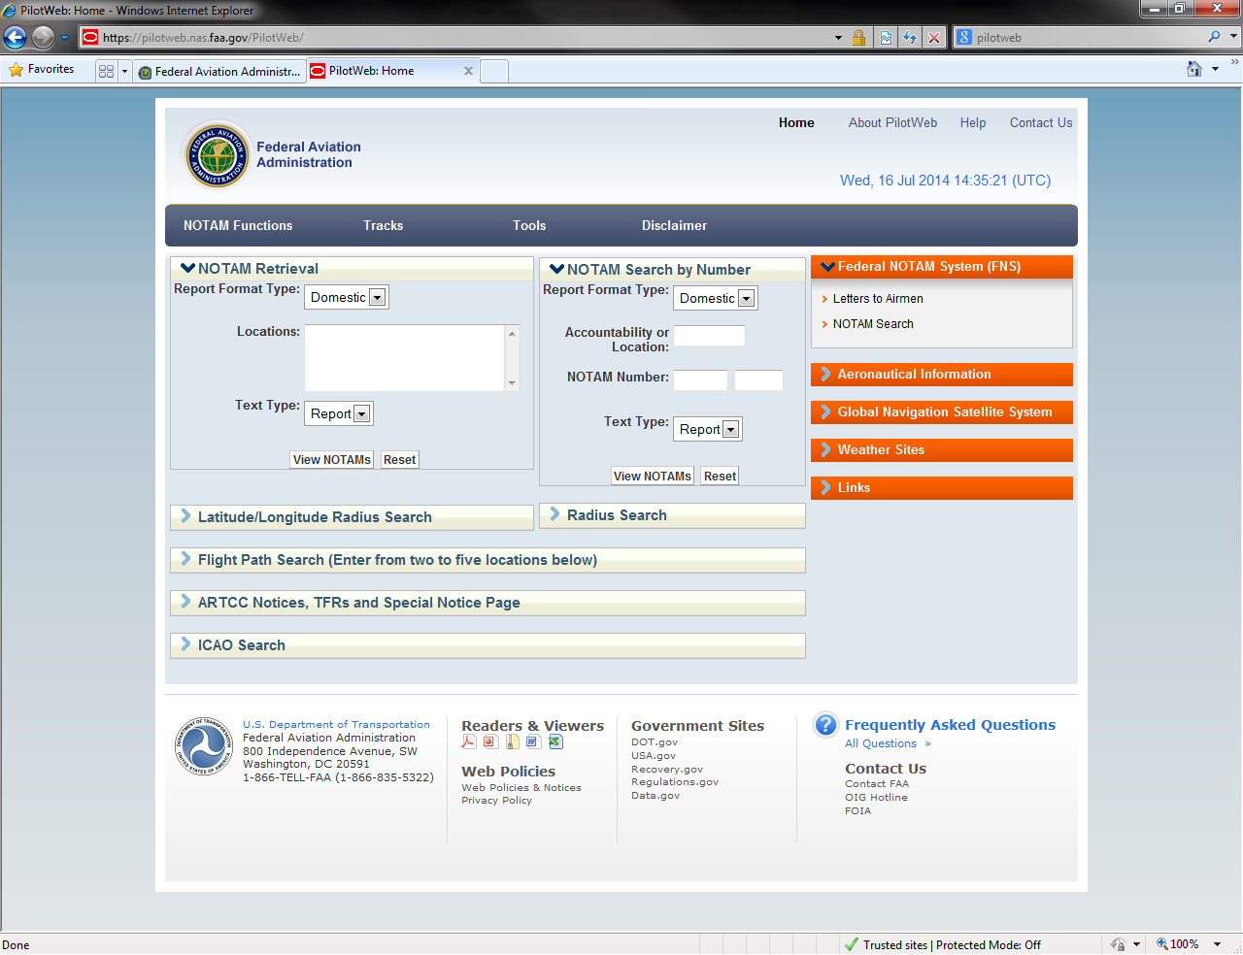

PilotWeb Functionality
Implement PilotWeb Functionality
Sunset PilotWeb
Integrate remaining PilotWeb features
Examples:
  - Pre-defined NOTAM queries
    TFRs
    CARF
    GPS
  - North Atlantic and Pacific Tracks
Notes:
Notes:
Phase 4 will focus on integrate all remaining features of PilotWeb (i.e., those not captured in previous phases) into NOTAM Search to allow the sunsetting of the PilotWeb website
Examples of this functionality includes pre-defined queries for specific NOTAM types such as TFRs, CARF, and GPS NOTAMs
This list is not exhaustive and will be generated throughout the first 3 phases and with input from Task Group

Slide 16
Enhancements Roadmap
 | FY14 Q4 |  |  | FY15 Q1 |  |  | FY15 Q2 |  |  | FY15 Q3 |  |  | FY15 Q4
 | JUL | AUG | SEP | OCT | NOV | DEC | JAN | FEB | MAR | APR | MAY | JUN | JUL | AUG | SEP
NOTAM Search
Phase 1 Release
Phase 2 Release
Phase 3 Release
Phase 4 Release
Phase 1:
Route of Flight Query
Phase 1 Brief to NOTAM TG
Phase 2:
User Profiles
Phase 2 Brief to NOTAM TG
Phase 3:
Enhanced Profiles & Filters
Phase 3 Brief to NOTAM TG
Phase 4:
Pilotweb Functionality
Phase 4 Brief to NOTAM TG
(Oct 2015)
Notes:
Notes:
RTCA NOTAM Task Group will be briefed a couple of weeks after each release
These briefings will be used to gain feedback and user satisfaction from different aviation stakeholder groups

Slide 17

Summary
NOTAM Task Group Recommendation | Phase 1 (Nov ‘14) | Phase 2 (Feb ‘15) | Phase 3 (Jun ‘15) | Phase 4 (Sep ‘15)
Search by Flight Plan Route String
Search by Effective Dates and Times
Filter by Keywords
Filter by Procedure Type
Filter by Runway Characteristics
Append Specific Alternate Airports
Search Multiple Keywords
Include/Exclude Filter Term
Create User Profiles
Consolidate Websites
Notes:
Notes:
All 10 recommendations from RTCA “NOTAM Search and Filter Options” report will be implemented via NOTAM Search Phased Approach

