Slide 1

Delivering Digital
NOTAMs
Progress of Digital NOTAM Development and Implementation
Presented By: Eduard Porosnicu (Eurocontrol)
Date: August 25th, 2014

Slide 2

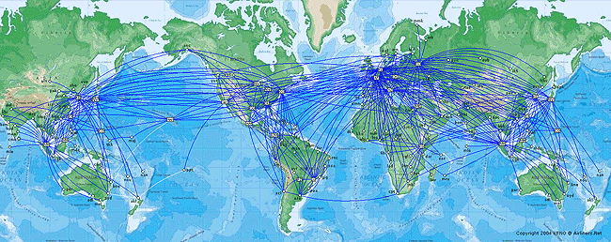
Notes:
This presentation will look at the Digital NOTAM developments from an international perspective, highlighting aspects such as specifications, trials and initial implementations, tools provided by industry, challenges to world-wide implementation.
Almost one million international NOTAM are issued every year by the 191 ICAO Member States. This is three times more than 15 years ago. Around 30 000 NOTAM are in force world-wide at every moment. It represents a huge amount of data, which has direct impact on the safety and efficiency of air navigation and of air traffic management operations. Only digital data processing will allow the ATM system to stay on top of this constantly growing set of dynamic information. Digital NOTAM promises include more intelligent data filtering and presentation for all phases of flight, graphics, automatic data validation, up-to-date data for automatic processes in ATC and on-board the aircraft.

Slide 3
Content
Digital NOTAM key principles
Benefits
Automatic data validation
Current situation in Europe
Challenges to implementation

Slide 4
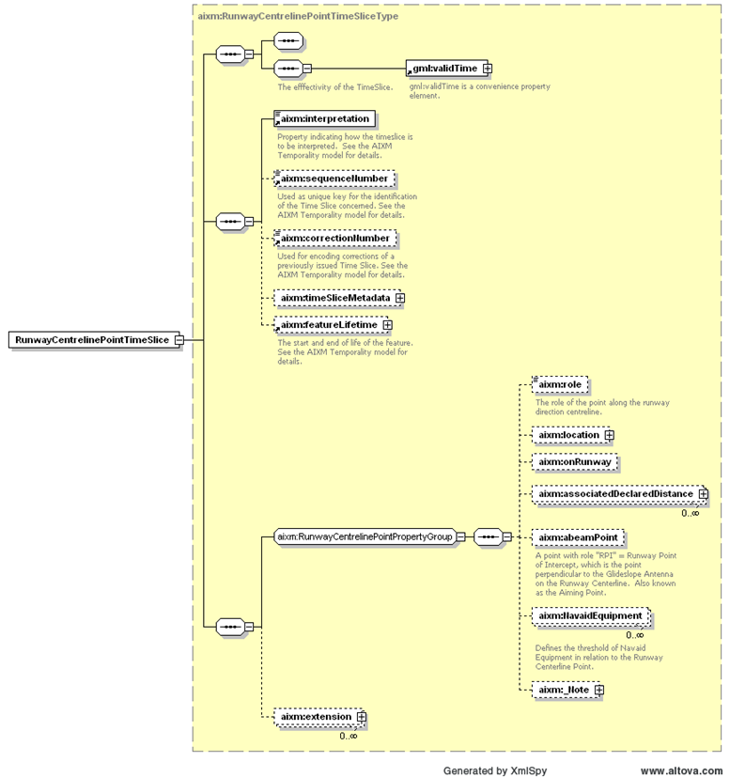
AIXM as data model
XSD
UML
Temporality Concept

Slide 5
XML/GML as data exchange format

Slide 6













Harmonized coding rules -
Digital NOTAM Event Specification
Example – Special Activity Area – activation
optional
optional
optional
optional
optional
optional
optional, multiple
End

Slide 7
AIXM Mapping
type
name
designator
schedule
activity type
note
activation status
upper limit
lower limit
FLOOR - CEILING

Slide 8
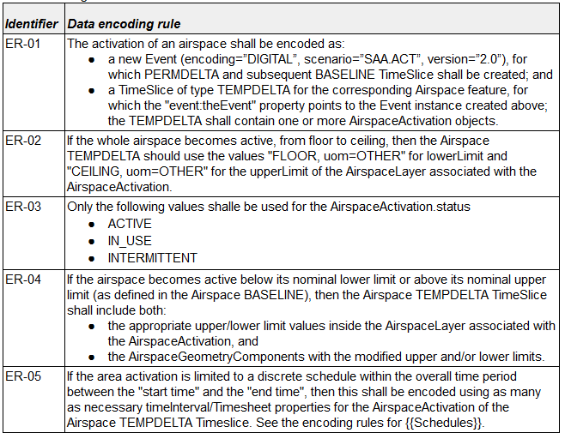
Rules – data encoding

Slide 9
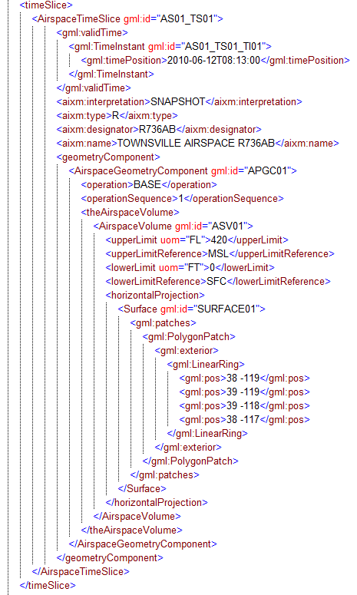
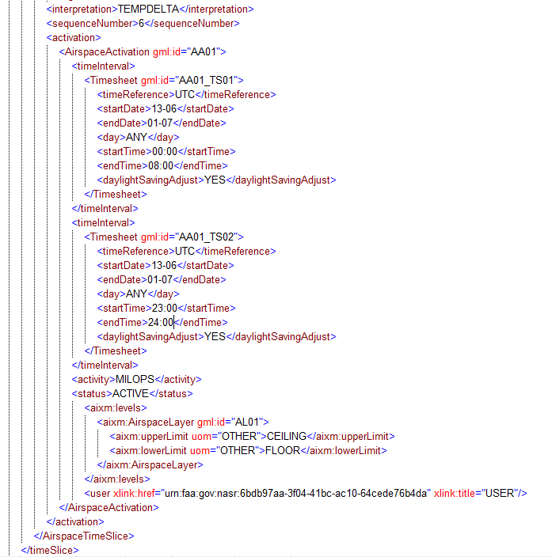
AIXM Message

Slide 10
Legacy NOTAM message
(automatic generation)
A0001/14 NOTAMN
Q)EADL/QRRCA/IV/BO/W/000/420/5221N00745W050
A)EADL
B)1406132300 C)1407010800
D)DAILY 0000-0800 2300-2359
E)RESTRICTED AREA R736AB TOWNSVILLE ACTIVE, MILITARY OPERATIONS.
F) SFC G) FL420
Notes:
Note that original NOTAM had QRTCA as Q code.

Slide 11
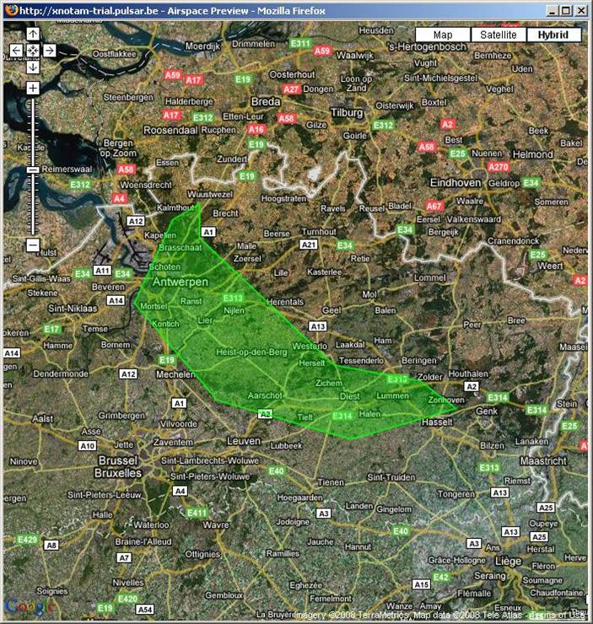
Benefits – data quality
Digital data:
clearer / more precise than free text
enables validation
  automatic by the system
  visually by the operator
Notes:
Digital data is much more clear/precise than free text:
Position of obstacles
Shape of restricted airspace
Schedules
Etc.
Digital data enables much more automatic validation checks:
For example, if THR is displaced, check if declared distances and OCA/OCH have been modified, etc.
Or, check the shape and location of a temporary restricted area
Check the shape and location of the airport surfaces that are work in progress or temporarily closed

Slide 12
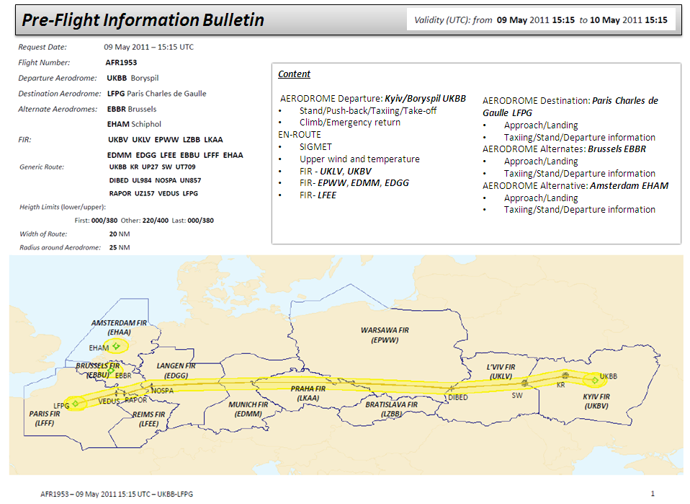
Enhanced Pre-flight
Information Bulletin
Phase of flight

Slide 13
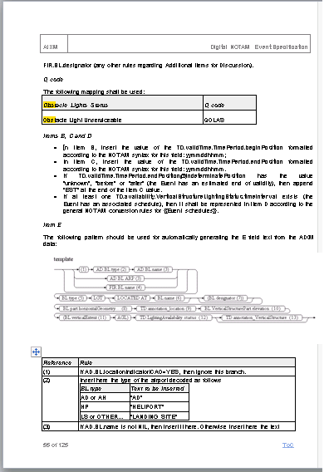
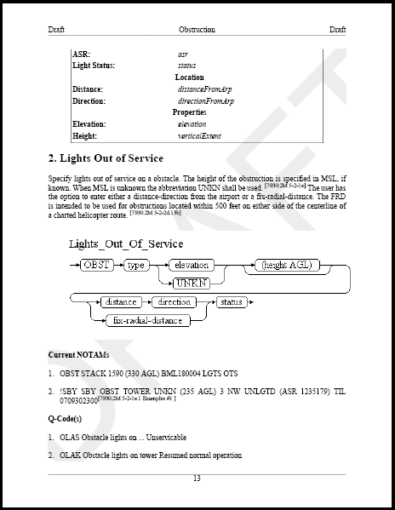
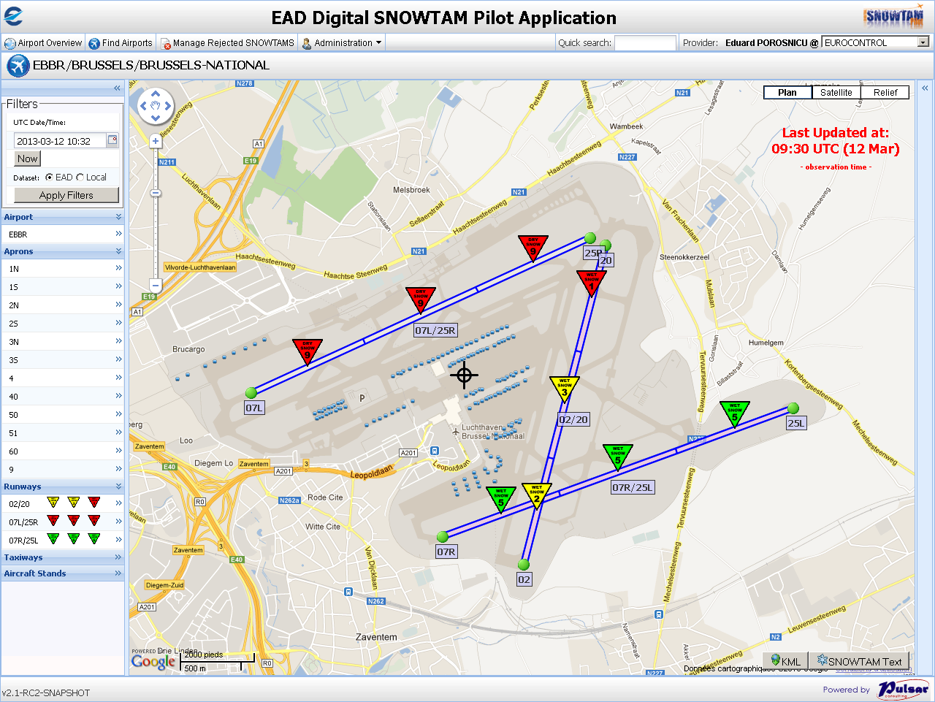
FAA vs. ICAO NOTAM – reconciliation through digital data

Slide 14
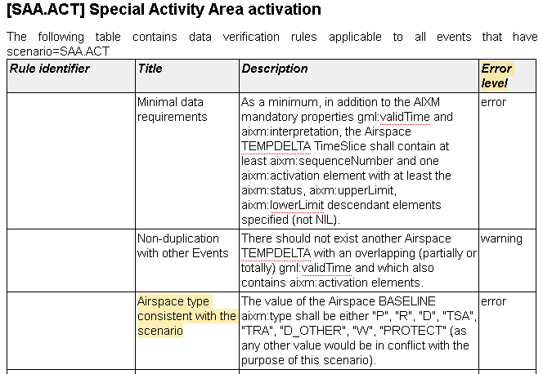
Data validation
Is it correct, complete, …
safe for intended use?

Slide 15
Using SBVR
SBVR = (OMG) Semantics of Business Vocabulary and Business Rules
  defines the vocabulary and rules for documenting the semantics of business vocabularies, business facts, and business rules.
  http://www.omg.org/spec/SBVR/1.1/PDF
Example
  “The geometry of operational airspace of type CTA, UTA and OCA shall be encoded as an aggregation of the corresponding operational SECTORS”
  Each Airspace.type equal-to ('CTA','UTA', 'OCA') shall have exactly one AirspaceGeometryComponent.operation equal-to 'BASE' and shall not have AirspaceGeometryComponent.operation equal-to ('INTERS', 'SUBSTR', 'OTHER') and shall have each AirspaceVolume.contributorAirspace.type equal-to 'SECTOR' and each AirspaceVolumeDependency.dependency equal-to 'FULL_GEOMETRY'
Free text
SBVR

Slide 16
Digital NOTAM – specific rules
“Notes contained in TimeSlice(s) associated with a Digital NOTAM Event shall be limited to the character set indicated in the Digital NOTAM Event Specification, Part 1, section ‘Character Set’”
Each Note that is-descendant-of FeatureTimeslice that has assigned descendant event:theEvent shall not have assigned translatedNote.note using a different character from {'A','B','C','D','E','F','G','H','I','J','K','L','M','N','O','P','Q','R','S','T','U','V','W','X','Y','Z', 'a','b','c','d','e','f','g','h','i','j','k','l','m','n','o','p','q','r','s','t','u','v','w','x','y','z','0','1','2','3','4','5','6','7','8','9','-','?',':','(',')','.',',',"'",'=','/','+'}.
Free text
SBVR

Slide 17
Digital NOTAM in Europe
SESAR
  Digital NOTAM Prototypes (Thales, Frequentis)
  Digital Briefing Prototype (Frequentis)
Other industry projects
  IDS, Comsoft, SnowflakeSoftware, etc.
  Likely to see on State going live in the next 12 months!
OGC OWS test beds
  See OWS-10 reports: visualisation, use of WFS, WS-N, etc.

Slide 18
Challenges
Baseline data availability
  Digital data correctness/completeness
Re-training of operators
  Stop thinking in ‘Q codes’
  No longer access to manually modify the text
Delegation of digitisation to data originators
  Availability of tools
  Fear of “loosing control”
Stability of specifications
  Early adoption comes with improvement

Slide 19

Conclusion
Digital NOTAM
  the only way forward
  has many benefits
  it is feasible world-wide
United States – Europe cooperation
  key for the success of the project
  FAA – Eurocontrol joint developments under Memorandum of Cooperation, Action Plan 20

Slide 20
Questions

Slide 21
Contact Information
Eduard Porosnicu, EUROCONTROL
  eduard.porosnicu@eurocontrol.int
  Phone: +32 (2) 729 3326
  http://www.eurocontrol.int/articles/digital-notam-phase-3-p-21
  www.aixm.aero

