Slide 1

Welcome
Glenn Sigley, FAA
Paul Bosman, EUROCONTROL
Notes:
Welcome – Intro Slide.

Slide 2
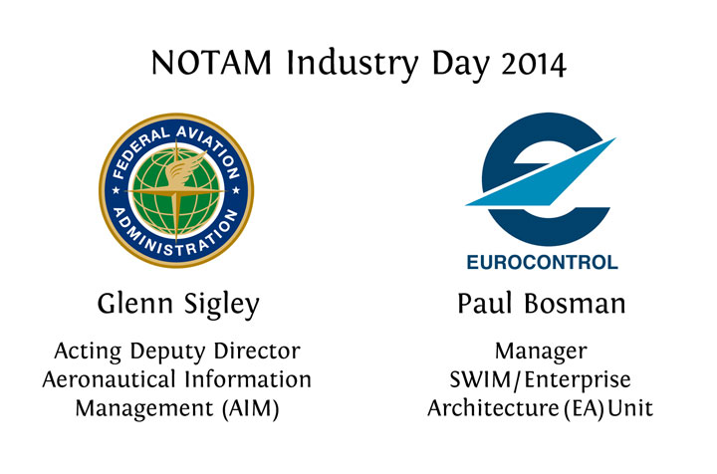
Notes:
Welcome
Welcome to the 2014 NOTAM Industry Day. We have a full day of presentations and panel discussions.
I also want to welcome Mr. Paul Bosman with EUROCONTROL.
Before we begin, I would like to go over routine information for everyone’s safety and security. (Next Slide)

Slide 3
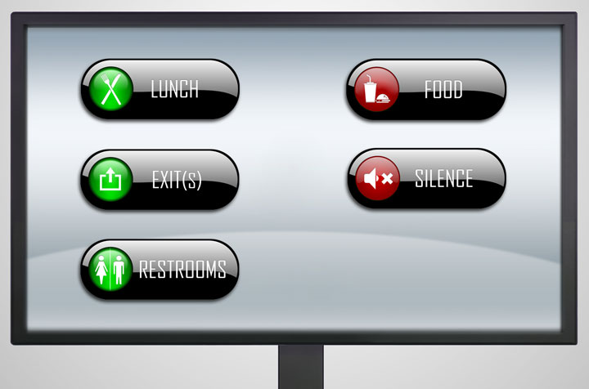
Notes:
Logistics
Walk through each icon here:
Lunch – 1:15 minutes – Explore the local establishments.
Please note the closets exits.
In case of emergency - within this auditorium there are exits behind you from the direction you walked into this auditorium. Once outside of this auditorium, turn left and look for the doors marked with exit signs. Proceed to a safe area. Please follow all instructions from the security team on-site here.
The restrooms are through the science center down the hallway.
Please – No food/ drinks in auditorium.
Please silence all of your iPhones, Droids, iPads, Laptops, etc… (Next Slide)

Slide 4
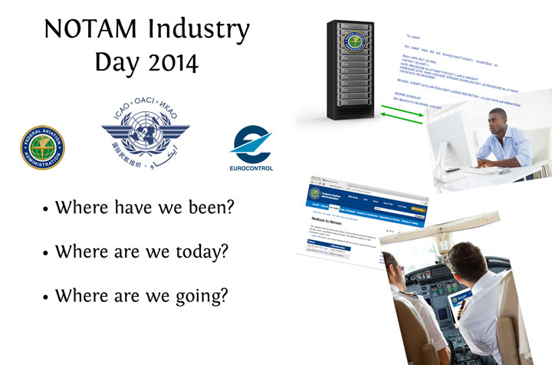
Notes:
Where have we been?
This NOTAM Industry Day forum first started 7 years ago in a much smaller room.
Previous NOTAM Industry Day presentations, vision - transition a teletype NOTAM system into the digital 21st century.
NOTAM system had remained largely unchanged for more than three decades, we knew vision would not be solved overnight.
FACTOID: On April 20th, 2010, the United States first digital NOTAM was issued for the Atlantic City airport. The NOTAM warned pilots of personnel and equipment working adjacent to a taxiway. This was the FAA’s first digital NOTAM, and first NOTAM Manager Airport.
Quick highlights of Digital NOTAM Benefits:
Created through drop down menu’s (versus free text entry)
Submitted with geo-referenced coordinates (enabling graphical depiction)
Machine-readable – (enhances filter/ sorting and searching capabilities)
What vision did we outline?
The Federal NOTAM System (FNS) - outlined with three primary components:
Collection of aeronautical Information.
Originate NOTAMs digitally at the source, with applications such as NOTAM Manager.
Manage, validate, and translate the aeronautical information according to business rules and global standards.
Distribution plan to deliver digital aeronautical information to our stakeholders.
Over the past many NOTAM Industry Day’s, progress has been reported towards each one of these components.
Where are today? - (Today’s Conference)
NOTAM Industry Day 2014 presentations will outline where the NOTAM developments have been progressing from, and where we are going in the future.
Although tremendous progress has been made, significant work lies ahead to transform the NOTAM system into a fully digital environment.
Where are we going?
Digital NOTAM Harmonization – Global Initiative
Working with the International Civil Aviation Organization (ICAO), as well as EUROCONTROL, FAA remains committed to the harmonization and the development of standards based exchange models.
The aeronautical information exchange model (AIXM), in addition to FIXM and WXXM, enables the collection, dissemination, and transformation of digital data.
Today, and the rest of this week is about understanding where we stand not just in the United States, but globally.
I would like to introduce Paul Bosman, Manager SWIM/Enterprise Architecture (EA) Unit Manager with EUROCONTROL. (Next Slide)

Slide 5

Notes:
Paul Bosman, EUROCONTROL
[EUROCONTROL introductory remarks]

Slide 6
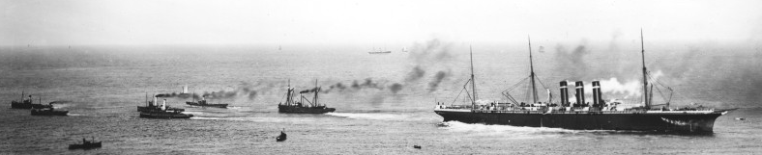
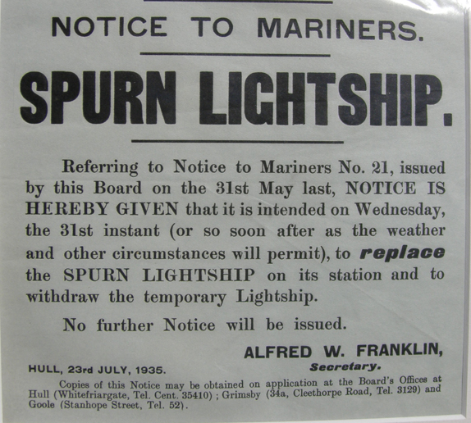
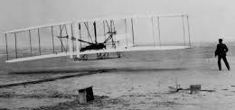
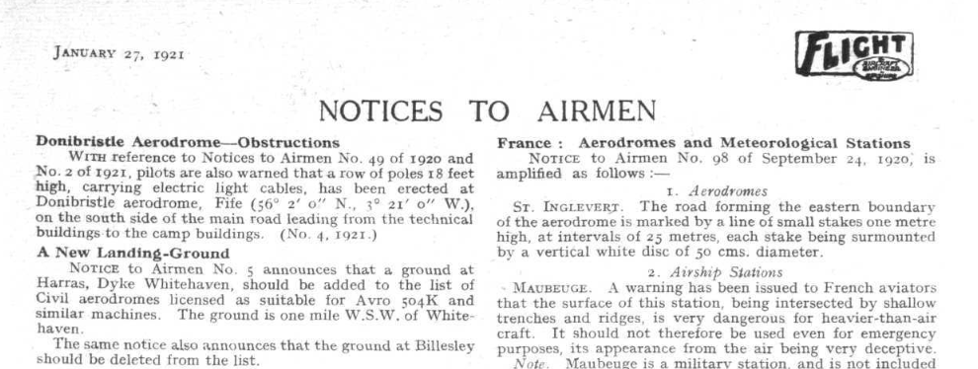
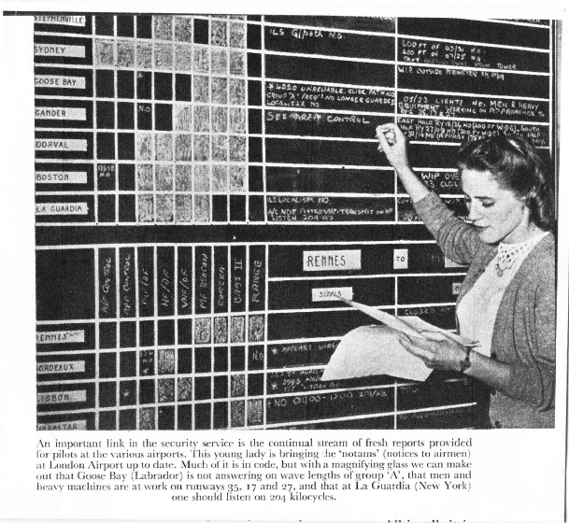

The history of NOTAM

Slide 7
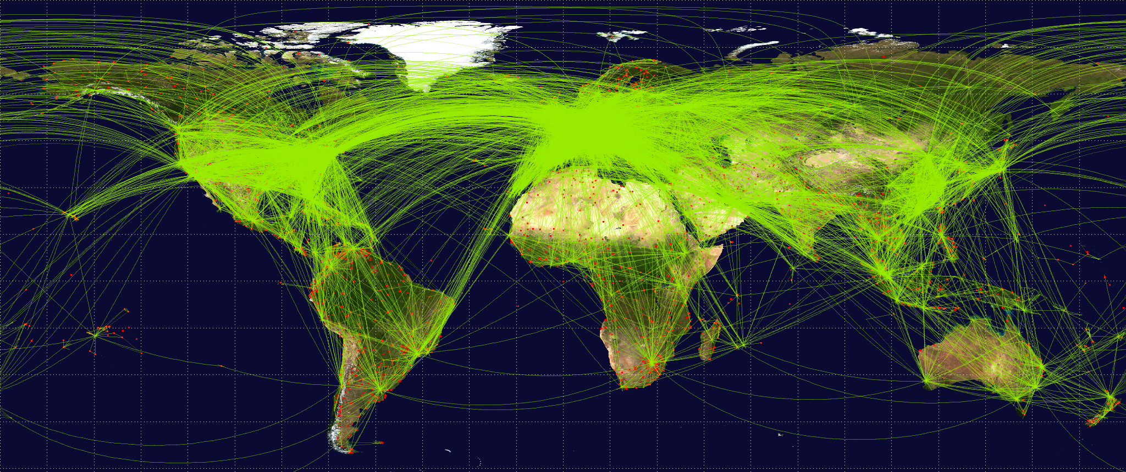
NOTAM – Usage going wild
Source : EAD

Slide 8

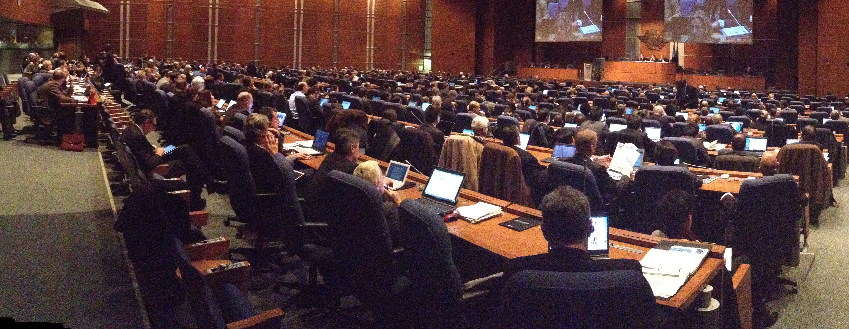
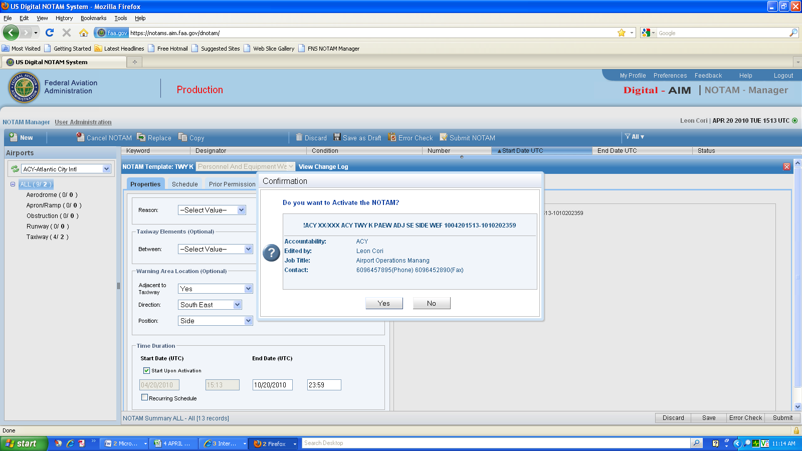
The road to Digital NOTAM
2002 – start of Eurocontrol/FAA AIM Cooperation
2003 – “xNOTAM” initial ideas
2008 – AIXM 5
2009 – ICAO AIS2AIM Roadmap
2012 – ICAO ANC ‘Review NOTAM – Build from Digital NOTAM’
2014 - Initial implementations

Slide 9
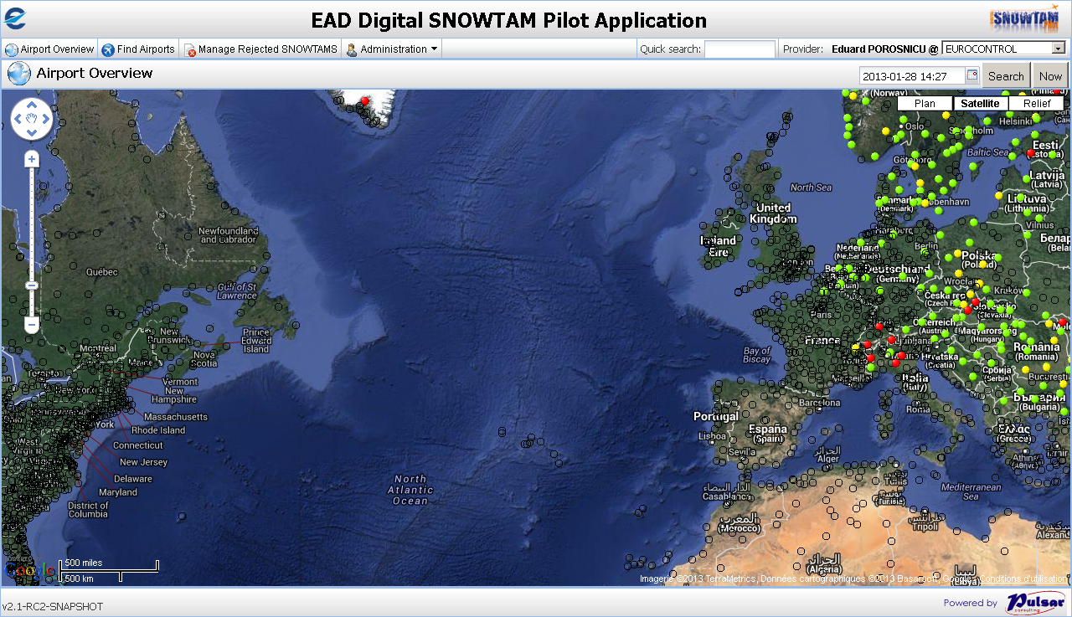
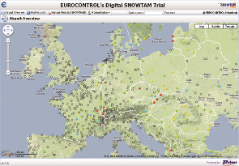
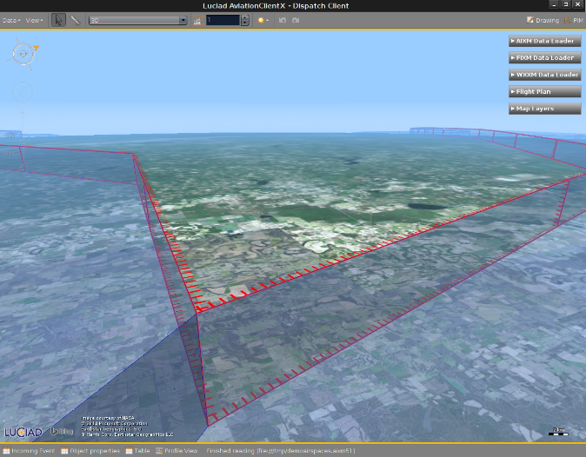
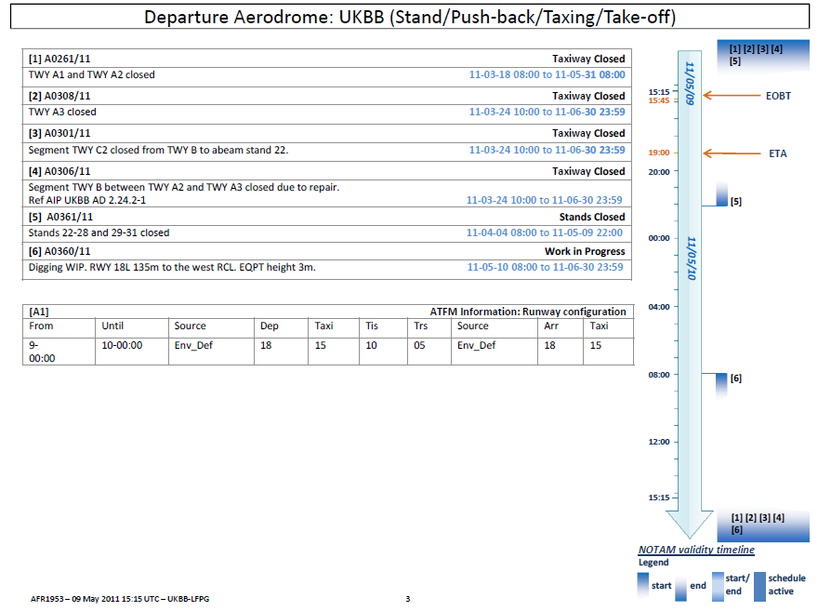
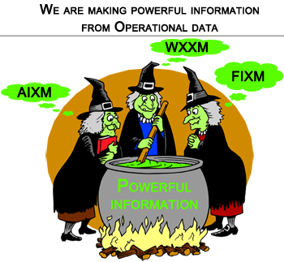

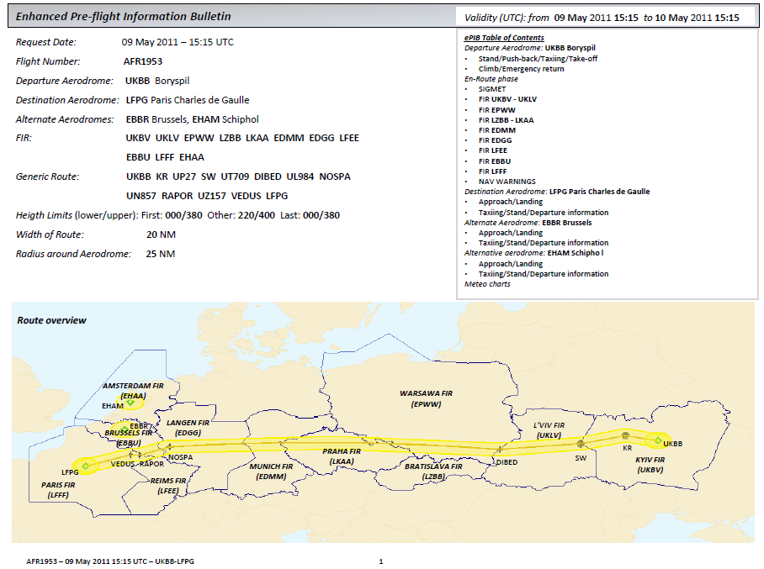
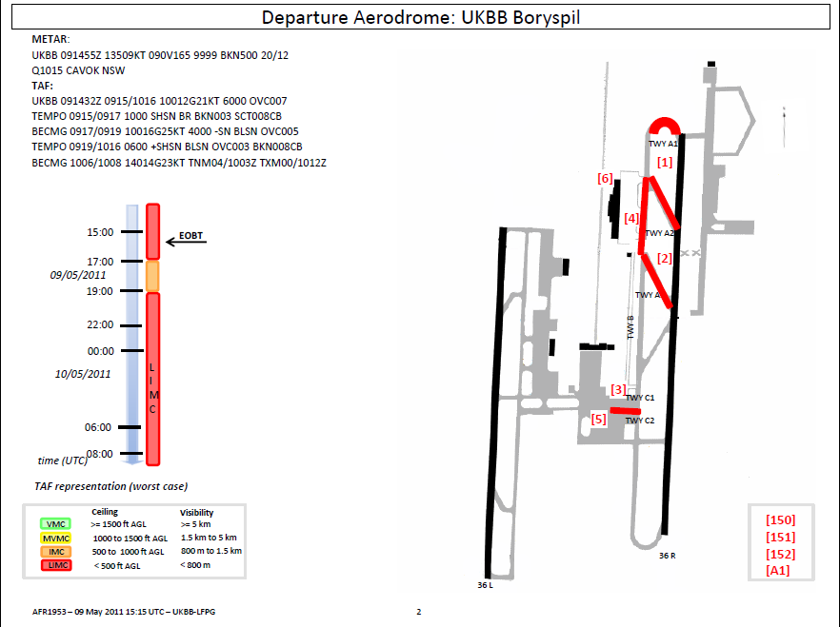
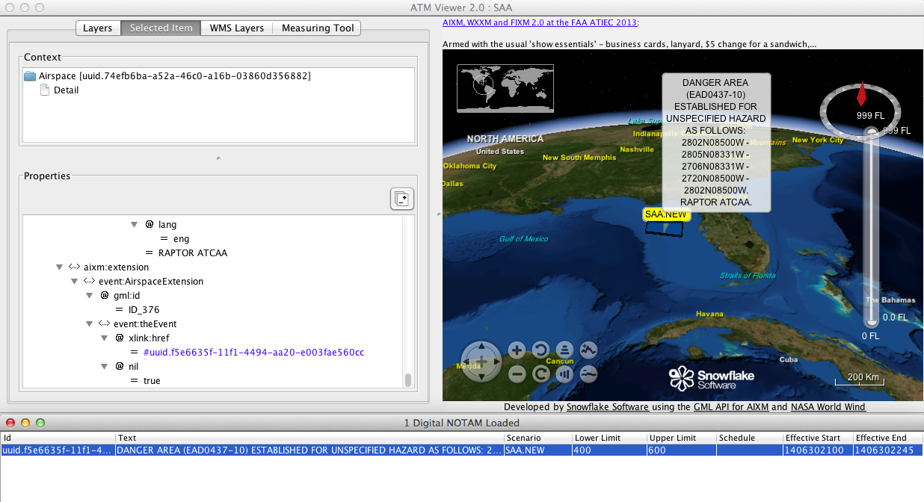
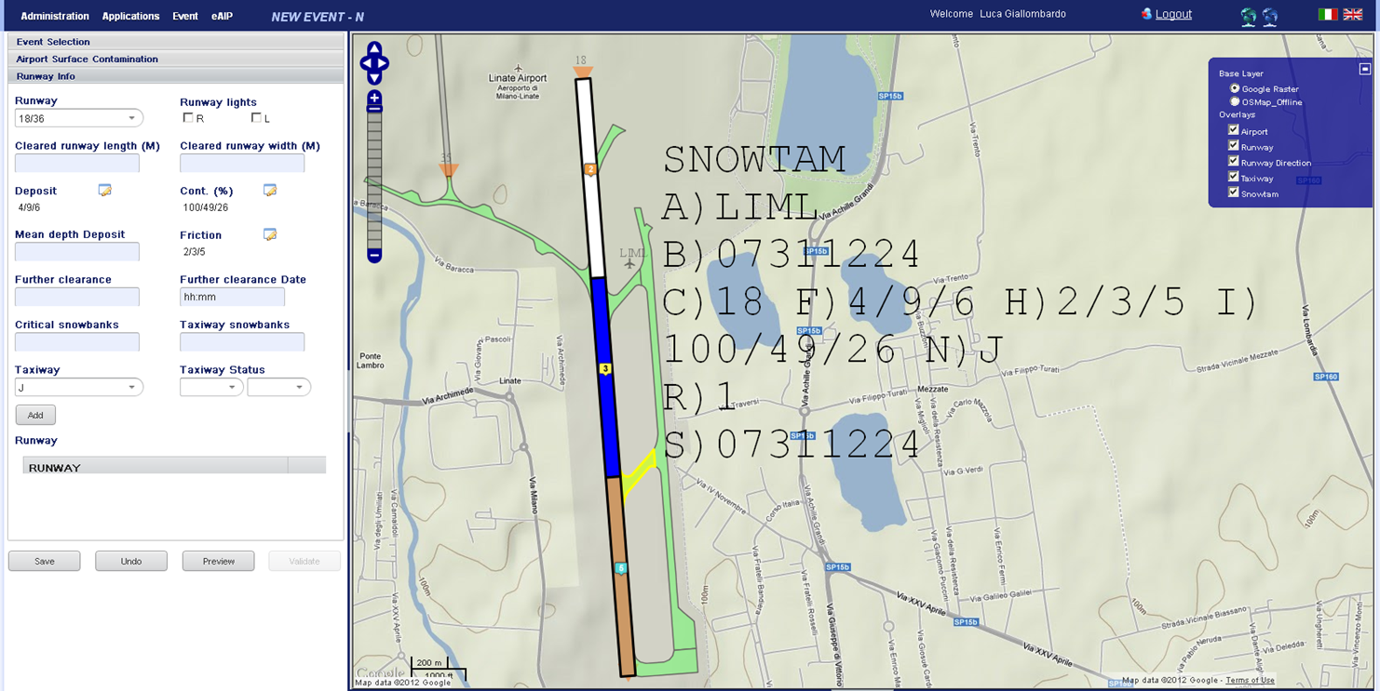
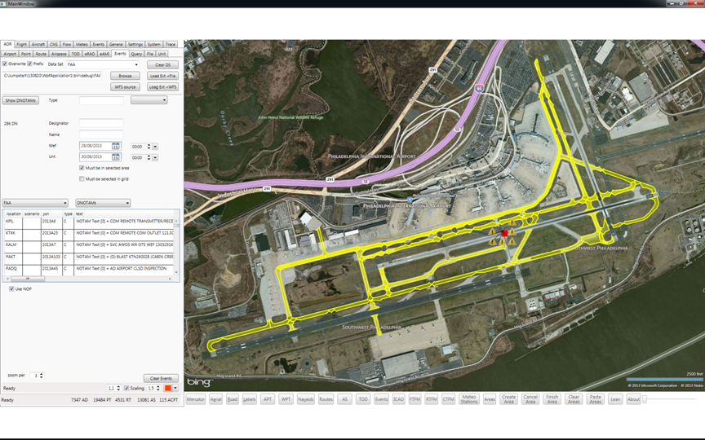
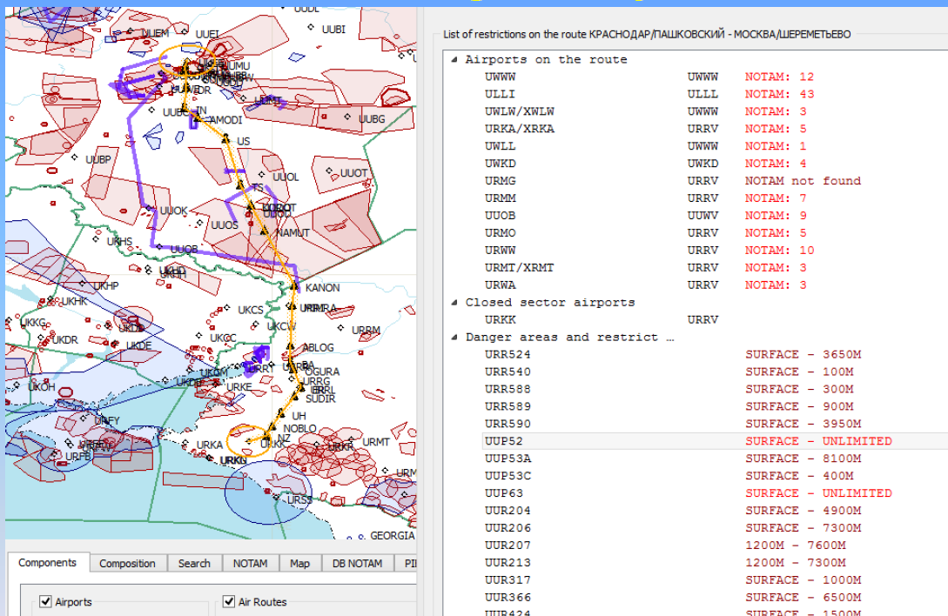
Future has started
Together we are improving ATM
Safer
More efficient
Notes:
Glenn Sigley (When Paul finishes Remarks – Glenn will introduce Abby Smith)
Next, I would like to introduce Abby, Director AJV-2/3.
Ms. Smith will provide an overview of today’s NOTAM Industry Day planned activities and where the organization stands today. Thank You.

Slide 10

Notes:
Welcome to the 2014 NOTAM Industry Day
I want to thank you for choosing to attend this conference.
Purpose of NOTAM Industry Day:
Update industry on where we are going and how we are going to get there.
Theme established for this year is delivering digital NOTAMs:
Today we will outline how major programs, like the Federal NOTAM System, are enabling a more efficient NOTAM system in the National Airspace System (NAS).
Today is also about getting the message out for applications like NOTAM Search, or services such as the NOTAM Distribution Services (NDS) over SWIM.
These tools and services are enabling the FAA to meet the provisions within the Pilot’s Bill of Rights.
Reiterate that digital NOTAM development is a global initiative, as we’ve heard from Mr. Bosman (EUROCONTROL) and Mr. Sigley.
Most importantly, NOTAM Industry Day is about interacting with industry and clearly communicating that our goals will only be accomplished through collaboration with you, our stakeholders. [Next slide]

Slide 11
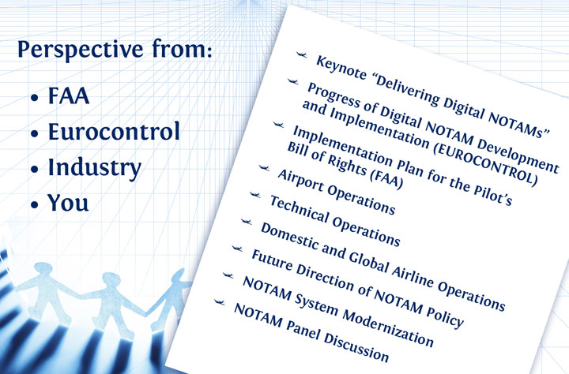
Notes:
Today’s Schedule – Agenda
First on the agenda:
Keynote address will be given by Ms. Elizabeth Lynn Ray, Vice President of the FAA’s Mission Support Services.
Lynn has been the VP of Mission Support since 2010. Ms. Ray will outline the FAA’s progress towards Delivering Digital NOTAMs and the Pilot’s Bill of Rights status.
Later this morning:
Will hear from leadership from both sides of the pond who are managing Digital NOTAM development work.
FAA and EUROCONTROL will provide presentations towards the progress of digital NOTAM development that occurred throughout 2014.
Finishing this morning’s presentations:
Stakeholder representing the airport operations perspective. The presentation will serve as a look-in on the operational demands users of the NOTAM system are facing in flight operations.
This afternoon:
Presentations to deliver information covering the FAA technical operational perspective and domestic and global airline operations perspective.
Also, this afternoon FAA Flight Services leadership briefings will outline the future direction of NOTAM policy.
To finish the 2014 NOTAM Industry Day:
I will be facilitating the NOTAM panel discussion. This year the panel is comprised of leadership from the FAA, EUROCONTROL, and stakeholders throughout the industry. We encourage everyone to stick around for this popular event and engage with our panelists. [Next slide]

Slide 12
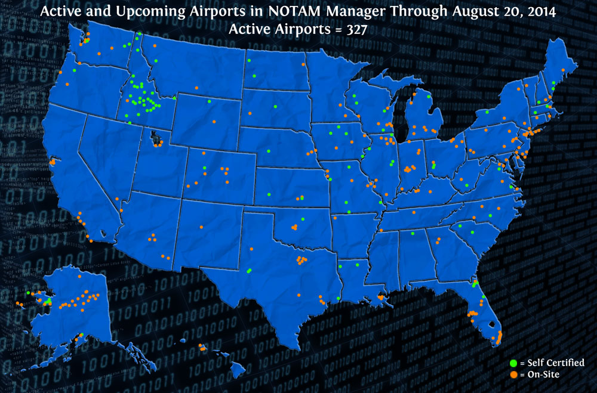
160+ of the top 250 NOTAM
producing airports are using
NOTAM Manager
Notes:
Takeaway from Today
FAA is operational in every component of FNS –origination, management, and distribution.
The future NOTAM vision started with one digital NOTAM and now, over 300 airports are using NOTAM Manager for the origination of direct entry digital NOTAMs.
Within the top 250 NOTAM producing airports in the NAS, more than 160 are using NOTAM manager.
On-site Certification vs. Self- Certification:
Efficiencies are being realized with the continued implementation of NOTAM Manger self-certification. This is a process where airports work through a structured, streamlined, and user-friendly method to onboard themselves to NOTAM Manager.
227 airports have been brought online via on-site, and 100 have completed the self-certification method as of this month (Total = 327).
NOTAM Manager application has already been extended to our Dept. of Defense and technical operations stakeholders.
With every new NOTAM Manager user, the FAA is one step closer towards a predominately digital NOTAM environment. [Next slide]

Slide 13
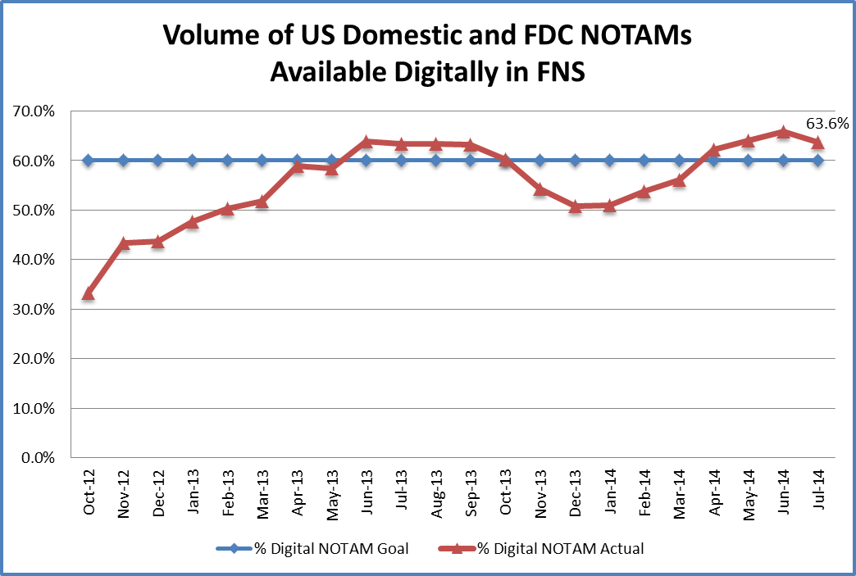

US Domestic and FDC NOTAMs
Available Digitally in FNS
63.8%
50.8%
66,357 NOTAMs
(Digital: 42,364)
78,926 NOTAMs
(Digital: 50,234)
33.3%
65,444 NOTAMs
(Digital: 21,784)
116,279 NOTAMs
(Digital: 59,103)
Notes:
Percentage of digital NOTAMs today:
As of July 2014, the digital percentage of US domestic and FDC NOTAMs is approximately 63%.
The digital NOTAM volume fluctuates when “non-NOTAM Manager” NOTAM originators submit an increased volume of NOTAMs –
For example, in the winter month’s from Nov. 2013 through Feb. 2014, northern airports with a large volume of field condition NOTAMs (due to snow/ ice) bring down the digital NOTAM percentage. Once these northern airports begin using NOTAM Manager, our digital NOTAM volume will surge in the winter month’s.
Summarizing - Within the FAA’s NOTAM distribution methods, the NOTAM Distribution Service (NDS) over SWIM and the FAA application NOTAM Search are each delivering digital NOTAMs today. This service and application will continue to be enhanced so that the evolving needs of our stakeholders continue to be met.
AIM/ AeroNav Products Directorate Organizational Update
As the Director of AeroNav products and AIM, I want to be the first person to update you on recent changes to our organization. [Update industry towards AJV-2/3 future direction] (Next Slide)

Slide 14

Over 400 Registered Attendees
More than 15 Countries Represented
15 Exhibitors*
Notes:
Thank You
Thank you for attending the 2014 NOTAM Industry Day.
We have over 400 attendees registered for the weekly events
More than 15 countries represented
15 exhibitors registered
Visit their booths throughout the week!
Specific Thank You:
EUROCONTROL - Eddie Porosnicu - Paul Bosman
My FAA Team - Glenn Sigley, Greg Pray, and Trish Gay. Without their efforts, today would not have been possible.
I ask that you listen to the presentations and panels planned for today. Listen to where we are. Listen to where we are going.
Most importantly, ask questions towards how we can complete our mission better.
Next, please welcome our Keynote Speaker, Elizabeth Lynn Ray – Vice President of Mission Support Services, FAA:
Ms. Ray has more than 25 years of experience with the FAA.
Joined the FAA as an Air Traffic Control Specialist at the Atlanta Air Route Traffic Control Center
She has held several positions including Air Traffic Manager.
Ms. Ray has also held various positions at FAA regional offices and headquarters, including National Air Traffic Evaluation Specialist and Air Traffic Planning Manager of En Route and Oceanic Services. Please join me in welcoming Ms. Ray. [Next slide]

Slide 15

Notes:
Where are we today?
FNS, is facilitating a safer and more efficient NOTAM system in the National Airspace System
Delivering the right information, at the right time, to the right person.
Goal remains the FAA’s focus because it is directed towards the people that rely upon the NOTAM system.
Pilots, controllers, technical operations, airport managers
Mission Support Services job is to deliver the NOTAM system these professionals must rely upon.
Today, I will outline progress that has occurred on the NOTAM Improvement Program under the Pilot’s Bill of Rights. (Next Slide)

Slide 16
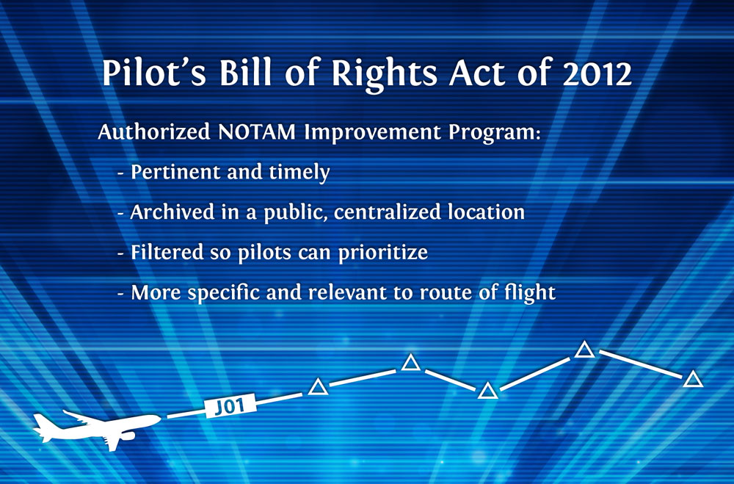
Notes:
What is the Pilot’s Bill of Rights?
Section three within the bill specifically addresses the NOTAM system:
provide airmen with pertinent and timely information
archive, in a public central location, all NOTAMs.
Provide filters so that pilots can prioritize critical flight safety information
Highlights of the goals of the NOTAM Improvement Program included:
Decrease the overwhelming volume of NOTAMs an airman receives
Make the NOTAMs more specific and relevant to the airman’s route of flight and in a format that is more useable to the airman;
Provide an interface that is easily searchable
Provide a filtering mechanism to manage NOTAM information.
RTCA Pilot’s Bill of Rights NOTAM Improvement Panel,
Comprised of stakeholders from general aviation, airlines, air traffic control, military, business aviation, and airports.
Key resource towards establishing a plan to meet the provisions within the Pilot’s Bill of Rights. Specific recommendations and metrics were established.
Results of the NOTAM Improvement:
Highlights include: promotion and support of NOTAM modernization, development of NOTAM filter capabilities, continued development of digital NOTAMs, communicate and educate users on sort, filter, search options, and development of a single flight information portal. (Next Slide)

Slide 17
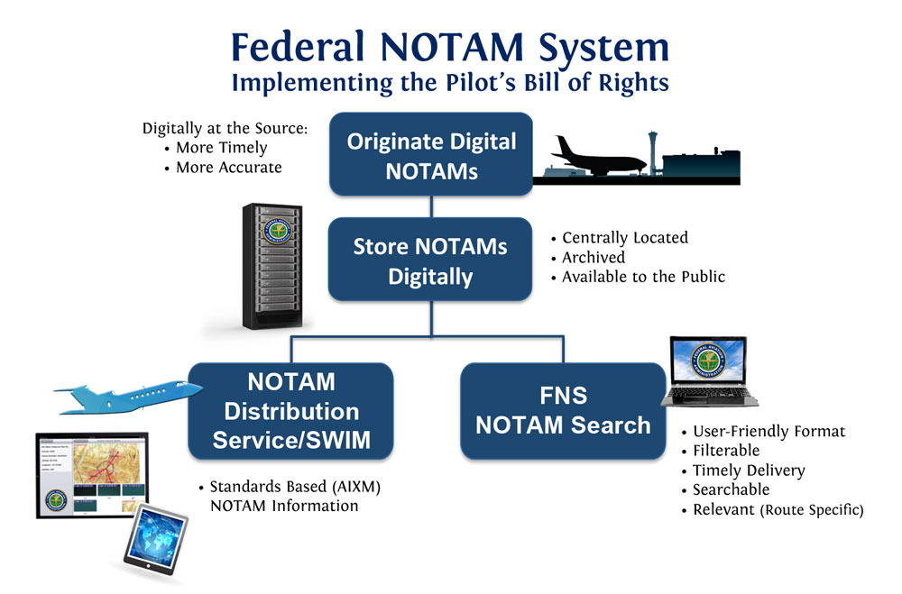
Notes:
The FAA Response and Implementation Plan
The FAA is carrying out an implementation plan to make several of the improvement recommendations a reality
One provisions was to archive NOTAM information.
This year the FAA met this goal, and today, NOTAM information dating back to three years are now easily accessible through the publically available NOTAM Search website.
RTCA proposed NOTAM Search enhancements will be implemented in the very near future.
NOTAM Search website is delivering digital NOTAMs today.
The Digital NOTAMs provided can be filtered, searched, or made available in ICAO or plain text formats.
Future Enhancements - Route of flight query capability. During the final phase of the implementation plan Pilotweb will be sunset.
FAA is committed to meeting the provisions within the Pilot’s Bill of Rights and NOTAM Search is playing an essential role.
Digital NOTAM Distribution Services
FNS NOTAM Distribution Service (NDS) is now operational.
NDS, over System Wide Information Management, SWIM, is now delivering digital NOTAMs to our Department of Defense stakeholders.
This request – response data pushing service is significant step forward, and in the near future, publication/ subscribe (Pub/Sub) services will be released to the industry. More information on these services will be presented from the SWIM program office latter this morning.
What does this mean to you?
For flight crews, controllers, dispatchers, general aviation pilots, and many other stakeholders, NDS over SWIM enables the delivery of relevant, pertinent, user-friendly NOTAMs.
Many of the technological barriers that have existed since the origins of the NOTAM system are being removed through the implementation of this distribution service.
Graphical NOTAMs, plain language NOTAMs, archivable NOTAMs, filterable NOTAMs – this is what our stakeholders want.
NDS over SWIM is one example of how the FAA is enabling a safer and more efficient NAS.
Still much work to be done, but the accomplishments to date should not be overlooked.
Accomplishments would not have been possible without constant collaboration with industry and our global partners abroad.
Outlined Today:
Programs outlined today put us one step closer to delivering the right information, at the right time, to the right person.
Next year, we hope to hear from you, the industry, on what you have done with this digital NOTAM data. Our goals will only be accomplished through collaboration and commitment. (Next Slide)

Slide 18

Notes:
Thank You/ Conclusion:
I want to thank you for attending this year’s NOTAM Industry Day.
Your attendance here demonstrates that you care about the safety and efficiency of the NAS.
Progress has been made towards modernizing the NOTAM system, but we continue to need your contributions to move forward.

