Slide 1

Delivering Digital
Services
Aircraft Access to SWIM (AAtS) Demonstration
Presented By: Melissa Shoemaker
Date: August 28, 2014

Slide 2
Discussion Topics
AAtS Overview & Description
Demonstration Phase 1
Demonstration Phase 2
Data Management Service (DMS): Roles & Requirements
Demonstration DMS: Responsibilities & Products
Application of Exchange Standards
AAtS Application – EFB & AOC/FOC

Slide 3

AAtS Overview
Aircraft Access to SWIM (AAtS)
  Uses an IP Data Link to perform functions and collaborate/coordinate flight activities.
  Supports global interoperability/harmonization with similar systems and capabilities.
  Establishes airborne component of ground based SWIM Service Oriented Architecture (SOA)
  Facilitates exchange of advisory level information among pilots and other National Airspace System (NAS) users
1
Notes:
Strategic flow planning
AIXM, WXXM, FIXM are the standards being coordinated; Speaking the same common language for easier gathering/distro of data
Broadband data link (internet/WiFi) services for data are being researched
SWIM terrestrially and in air working with others on an international level – global harmonization piece
SWIM nodes are located in 7 of the 21 ARTCC for distribution
Information is the cornerstone of collaboration

Slide 4
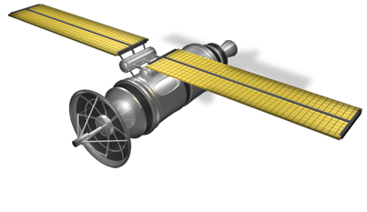






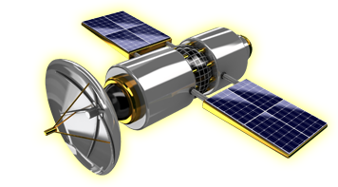



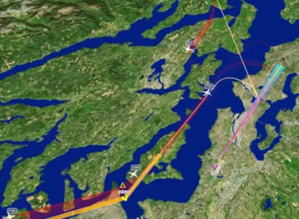


AAtS Objective
Advisory Commercial
Data Link
Command & Control
Voice, Data Comm,
ADS-B, ADS-C
Service Management
AOC / FOC
Data Link Voice
Third Party DMS
Air Traffic Management Systems
NAS Boundary Protection Services
AOC / FOC
Data Fusion
SWIM SOA Messaging Infrastructure
Weather Information
Sources
Aeronautical Information
Sources
Flight Information
Sources

Slide 5
Operational Node Descriptions
From AAtS Mid-Term Architecture Document
Node | Description
Aircraft | The aircraft in an AAtS context is a consumer and provider of data that is exchanged with NAS Data Service Providers through the Data Link Service Provider, DMS Provider, and SWIM Aircraft Equipment: -Electronic Flight Bag (EFB) Device -Apple iPad, NavAero (Windows XP) -Jeppesen Flight Deck Pro Application
Data Link Service Provider (DLSP) | This node provides the wireless data link that enables the aircraft to communicate with the DMS Provider. Data Link Service Provider (DLSP) Can either be terrestrial based or satellite based AirCell, Gogo, Panasonic, Row 44, Iridium, Inmarsat
Data Management Service (DMS) Provider | This node manages the communications links with the aircraft and SWIM, validates and filters data flowing in both directions, and monitors network performance. AAtS Data Management Service (DMS) Utilizes the Advanced Messaging Queuing Protocol (AMQP)
AOC/FOC | This node manages the initial subscription and data request configurations for the aircraft and monitors data that is sent to the aircraft. AAtS is not a primary provider of NAS Data Service Provider information to the AOC/FOC. That information comes through other channels
SWIM | This node enables the DMS Provider to connect to SWIM and further to connect to SWIM-enabled NAS Data Service Providers.
NAS Data Service Provider | This node represents SWIM-enabled NAS programs, e.g. Weather, Aeronautical, and Air Traffic Management, that have published data services that can be consumed by AAtS.
5
Notes:
Major nodes are a/c, DLSP, DMS, AOC/FOC, SWIM, NAS Data Service Provider
DLSP provides the data link capabilities for data exchange
DMS manages, validates, and filters data between a/c and SWIM, as well as monitors network performance

Slide 6
AAtS Demonstrations - Phase 1
NAS to Aircraft Data Distribution
COMPLETE
  Traditional Uplink of SWIM Enabled NAS Services Data via DMS Consumption (Outbound from NAS)
  Conforms to Existing and Developing Data Link Operational Use Policies, Processes and Standards
  Phase 1 AAtS demonstrations have utilized the following standards: Aeronautical Information Exchange Model (AIXM) and Weather Information Exchange Model (WXXM).
6
Notes:
Phase 1, which has been completed, served as a 1-way data connection from SWIM to the cockpit
Used for negotiation of desires with ATC strategically (i.e. querying available re-routes, flow strategies, Strategic updating as you move along the route
Provided PIREP digital publications to the cockpit, (updates ___?)

Slide 7
AAtS Demonstrations –
Phase 2 “IP Data Link”
NAS and Aircraft Data Exchange
  Aircraft information will be sent to SWIM with a focus on the incorporation of the Flight Information Exchange Model (FIXM) standard while continuing use of AIXM and WXXM data standards.
    SWIM Enabled NAS Services Exchange Information via the DMS
Data link 2-way Operational Uses, Policies, Processes and Standards Continue to Evolve
7
Notes:
Phase 2 begins the two-way data exchange between cockpit and SWIM
Focus is on FIXM data, including trajectory modification queries, available routes,

Slide 8
AAtS Phase 2-
Demonstration Teams
Team 1 – Business Jets (14 CFR Part 135/91)
    FlexJet / Flight Options
    Boeing Executive Fleet
Team 2 – Commercial Airlines (14 CFR Part 121)
    Virgin America
Federal Aviation Administration
    N47 Global Express – FAA Test Aircraft
    Table Top Simulations
8
Notes:
Both biz jets and commercial used in demonstration due to differences in operations and business models

Slide 9
Data Management Service (DMS)
9
Notes:
The “manager” of the data flow between SWIM and cockpit

Slide 10

DMS Roles
EFB
DMS
  Data Modeling & Typing
  Dataflow Routing & Delivery
  Data Filtering
  Transformation & Discovery
  Connectivity Monitoring
  Data-Centric Interactions
  Data Synchronization
Planning
Information
Structured
Data Models
AIXM, WXXM,
FIXM Data
SWIM
AOC
Data Fusion
11
Notes:
The SWIM connection with the DMS is VPN / Internet Connection. Could also use a direct connect if users decided to purchase that capability
2. Performance Requirements: Couple of T1s/T3s OR Fiber
3. Rockwell Collins / Honeywell companies are in the business of Data Discovery and Transformation

Slide 11
DMS Functional Requirements
Specify structured data models
  Allow for packaging of received AIXM, WXXM, FIXM information into a usable format for the aircraft cockpit and/or EFB and FOC/AOC
Ability to specify and control middleware resources
  i.e. Queues and buffering
Resiliency to individual node or participant failures
Performance and scalability with respect to number of nodes, participants, and data flows
10
11
Notes:
Data Models: ____________
Manages both data flow and data distribution
Disruption in one cockpit, fleet, or node would not disrupt the rest of the network, or the other users
Ability to meet both operational and business needs
Data Distribution occurs through the identification of the tail # OR through the EFB client log-in
Should the EFB client be used, the EFB would send the request to the DMS.

Slide 12
DMS Responsibilities for AAtS Demonstrations
Code Information Into WXXM / AIXM / FIXM Format
Support Request-Response and Publish-Subscribe
  Requests are made to pre-fetch data and configure the client session, while pub-sub is used to push updates
  Request-response can be supported via HTTP, or a socket using JSON-RPC, XML-RPC, etc…
  Pub-sub can be supported via AMQP or other similar technology
Efficiently Send Data to EFB Clients
  Minimize overhead and latency
13
Notes:
AMQP – Advanced Messaging Queing Protocol being used is based upon the Industry Standard
….
Many companies are going toward smaller start-up solutions for data processing; applications could be the data processor, rather than relying on own processing power

Slide 13
DMS Responsibilities for AAtS Demonstrations (cont’d)
Organize and Store Large Quantities of Data Efficiently
  Via a database, either in-memory, on secondary storage or both
  Data types include weather and other flight information products from SWIM
Support Multiple Clients Simultaneously
  Generally via a multi-process asynchronous execution pattern
14
Notes:
Certain items of data may need to be stored for entire duration of flight (PIREPS, NOTAMS, etc); DMS segments data pieces based on user needs and stores accordingly (i.e. access time, relevance at time of flight, etc)
Can support multiple EFBs/cockpits within a fleet, or multiple fleets, based on the DMS service type (i.e. in-house or application-served)

Slide 14
AAtS Demonstrations - DMS Products
WXXM Data Products
  METARs (Routine Aviation Meteorological Report)
  TAFs (Terminal Aerodrome Forecast)
  NEXRAD (Doppler Radar)
  PIREP (Pilot Reports)
  AIRMET/SIGMET (Airmen's Meteorological Information / Significant Meteorological Information)
  Terminal Wind Forecast
  Terminal Icing Probability and Severity Forecast
15
Notes:
**THESE ARE DEMO ONLY, not necessarily in the NAS today

Slide 15
AAtS Demonstrations - DMS Products
AIXM Data Products (AIXM 5.1)
  Aeronautical Information Management (AIM) Data
    NOTAMs
16

Slide 16
Exchange Standards Used in
Phase 1 AAtS Demonstrations
Service Product Data
Flight Data & Information (including metering information and times & TBFM/TFMS traffic flow data)
Aeronautical Information (including surveillance data, digital NOTAMs, &special use airspace data)
Met Data & Information (including terminal wx data, runway configuration/wind info, windshear/microburst data, & Echo tops data)
Standards
FIXM
AIXM
WXXM
Industry
FAA Access
Industry Access
Aircraft Cockpit
AOC/FOC
NESG
DMS
VPN
…
Analysis/
Application
SWIM
FAA Systems
17

Slide 17
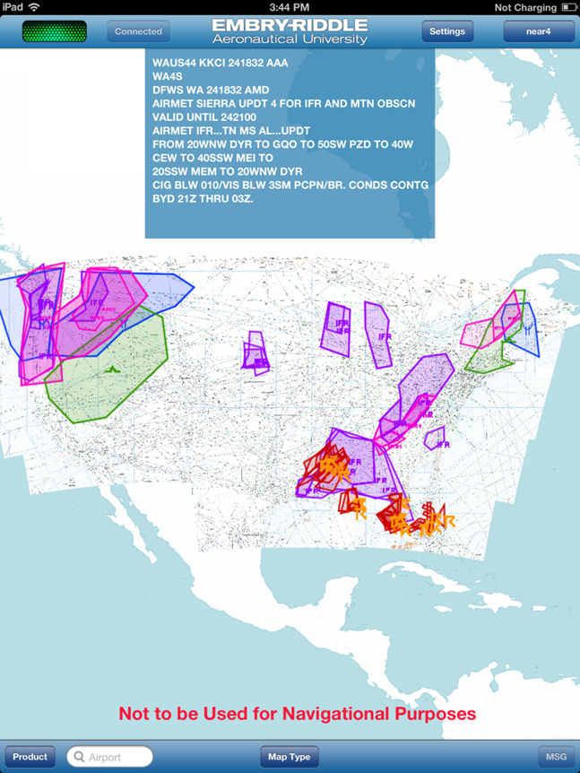
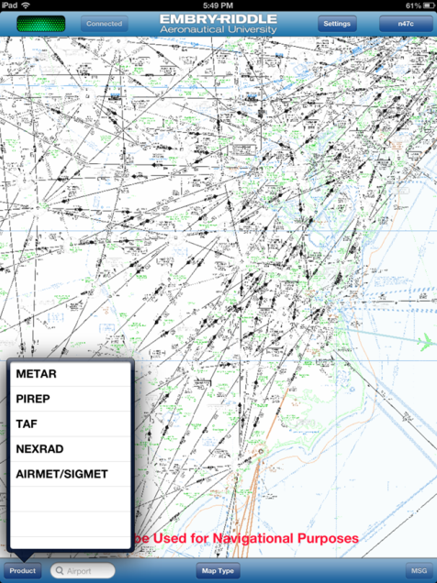
AAtS Application - EFB
Notes:
EFB view
**add notes

Slide 18
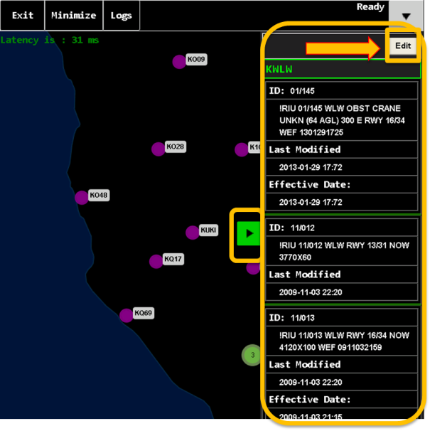
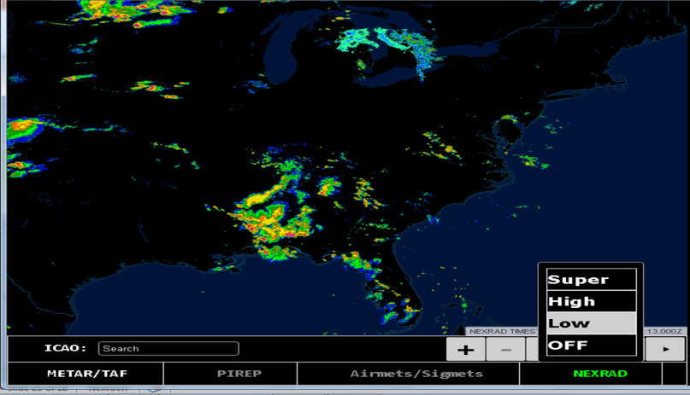
AAtS Application - EFB

Slide 19
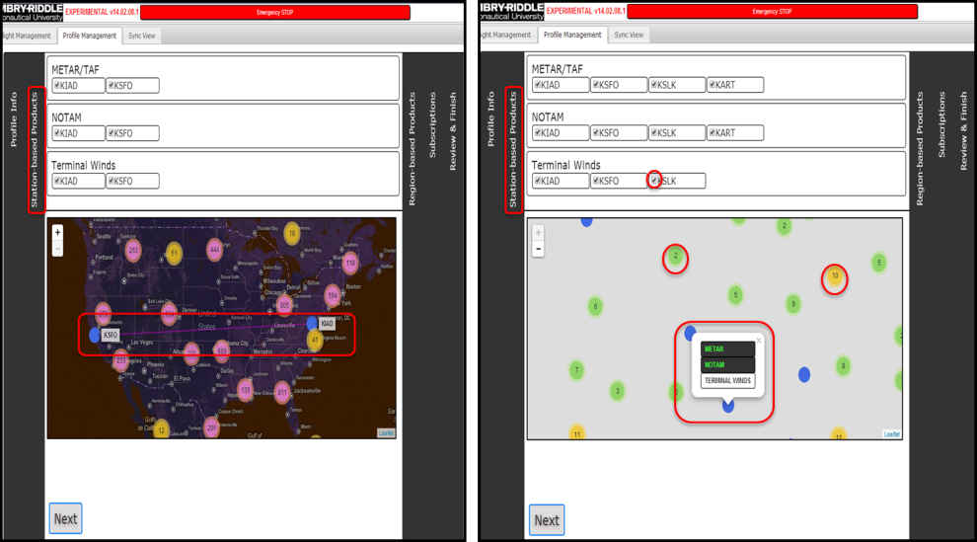
AAtS Application – AOC/FOC Interface

Slide 20
Contact Information
Points of Contact:
  Jonathan Standley, AAtS Demo Program Manager
  Have a Question for us?
  Email: 9-ANG-AAtS@faa.gov
23

Slide 21

Questions
22

Slide 22
AAtS General Terms
AIM–FAA Aeronautical Information Management
AIS–Aeronautical Information Services
AOC/FOC–Airline Operations Center/Flight Operations Center
CFR – Code of Federal Regulations
CSS-Wx–FAA Common Support Services-Weather
DLSP–Data Link Service Provider
DMS–Data Management Service
EFB–Electronic Flight Bag
ERAU – Embry-Riddle Aeronautical University
MET–Meteorological Information Services
NAS – National Airspace System
NESG – NAS Enterprise Security Gateway
NPN – NextGen Prototyping Network
21

