Slide 1

Delivering Digital
Services
FAA System Wide Information Management (SWIM)
Program Overview and Status Update
Presented By: Jim Robb
Date: August 28, 2014

Slide 2
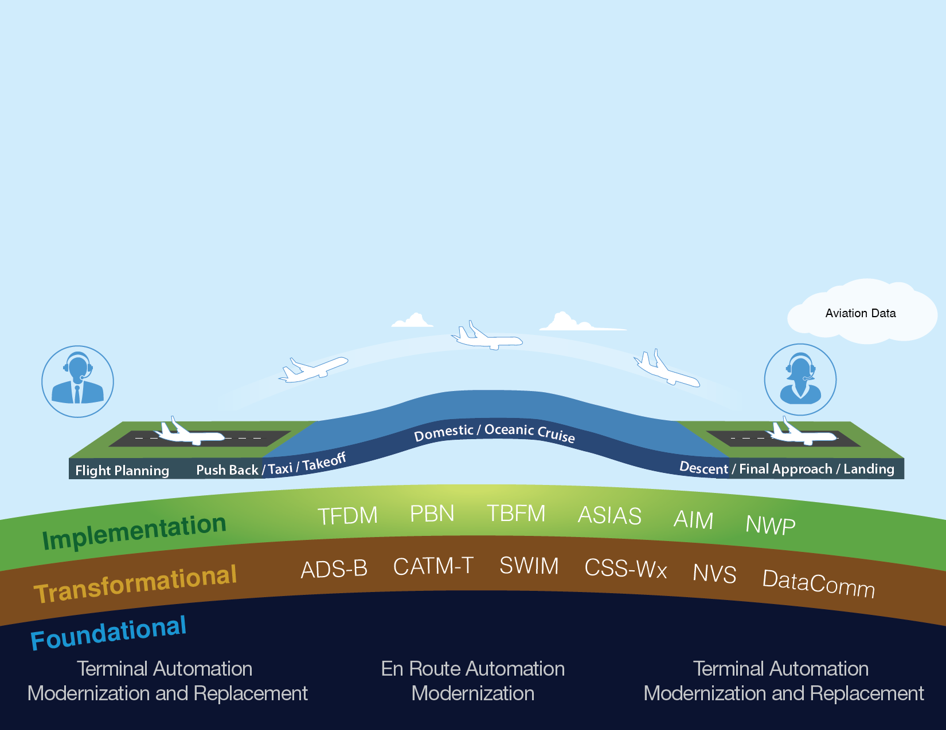
Delivering NextGen Improvements
Legacy System
NextGen
Radar
Inefficient Routes
Voice Communications
Disparate Information
Fragmented Weather Forecasting
Weather Restricted Visibility
Forensic Safety Systems
Nationwide Focus
Satellite
Performance Based Navigation (fuel savings)
Voice & Digital Communications
Automated Decision Support Tools
Integrated Weather Information
Improved Access in Low Visibility
Prognostic Safety Systems
Focus on Congested Metroplexes
2
Notes:
NextGen implementation is organized into foundational and transformational programs, and other activities that enable operational capabilities and improvements.
We will have much of our foundational infrastructure in place in the near future.
By 2015, the agency expects to have largely completed the infrastructure that will enable additional layers of operational improvements, with TAMR being completed at large TRACONs by May of 2016.
Think of this foundation as an iPad, on which NextGen “apps” can be loaded to provide benefit in the NAS.
The iPad, itself, is not NextGen, but the capabilities it enables are.
It is on this foundation that the FAA will continue to implement the transformational technologies that provide operational benefits to users throughout the NAS.
Performance Based Navigation (PBN) will improve operational efficiencies much like upgrades to the U.S. interstate system improved our highways. Because we have updated our automation systems, we can increase use of PBN to deliver benefits to users like savings in time, fuel, and reduced emissions.

Slide 3

3

Slide 4
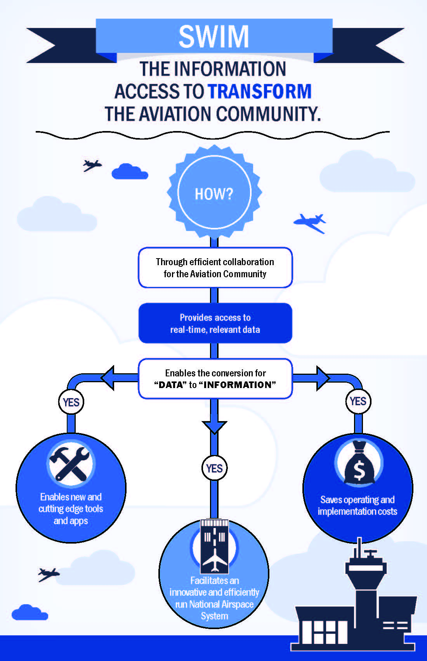
Replaces unique interfaces with modern standards-based data exchange
Provides SWIM users access to information without directly connecting to another system
Provides enterprise security for incoming and outgoing data
4

Slide 5
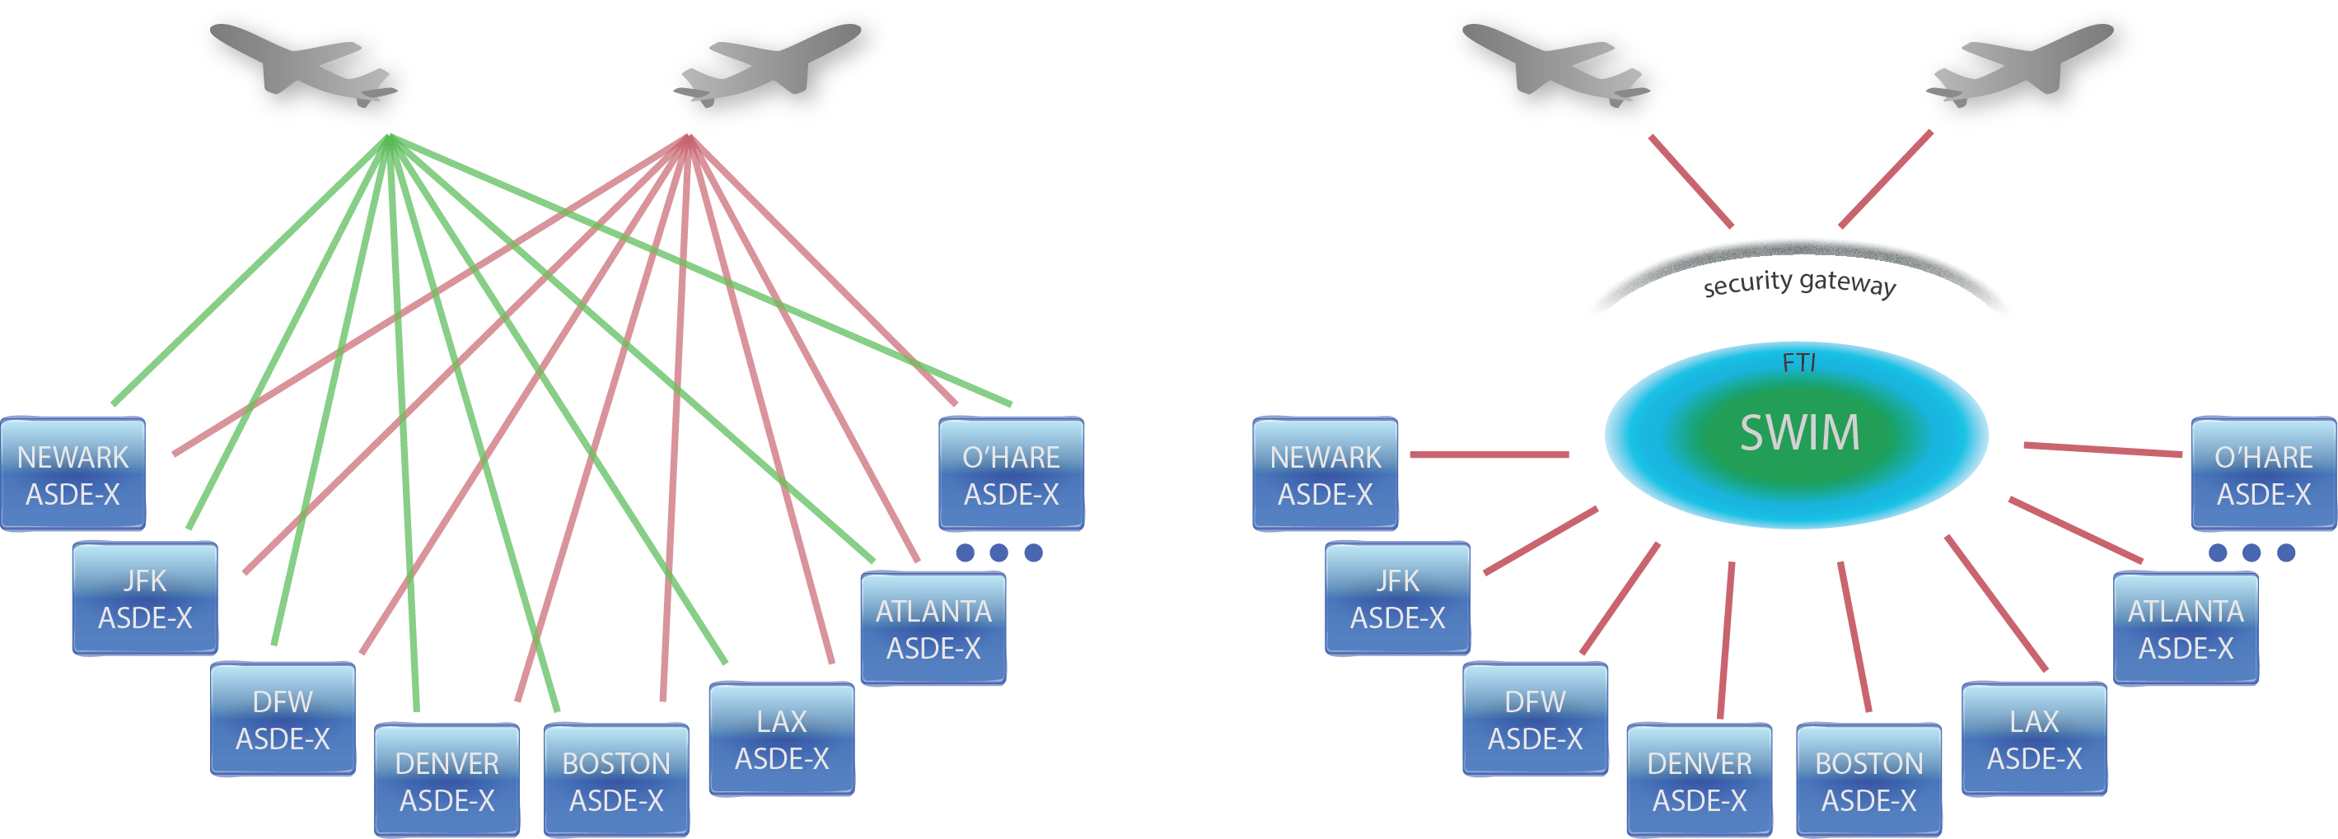
SWIM: Information Access to Transform the Aviation Community
Legacy operating environment:
Point-to-point connections
SWIM operating environment:
Data Exchange
(Published once, consumed by many)
5
Notes:
- SWIM is all about making important information easily accessible. The cost and time to develop SOA services has been reduced.

Slide 6
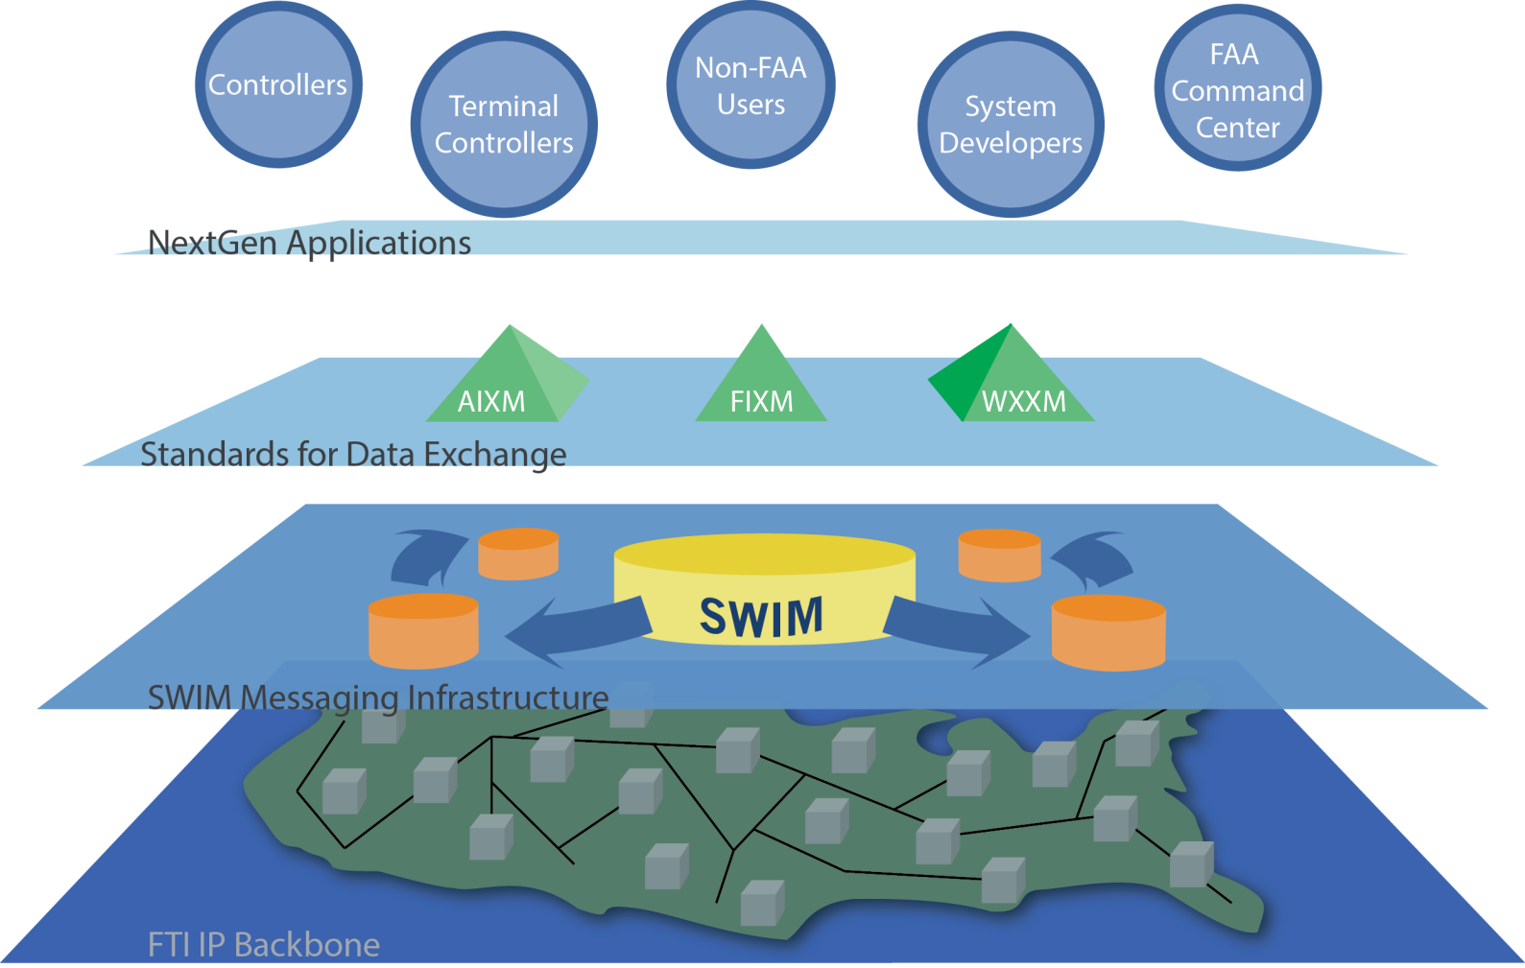
NextGen Information Sharing Architecture
Mission Services/
Application Layer:
FDPS, STDDS, ITWS, AIM, etc.
Common Support:
Data Standards &
Harmonization
Enterprise Messaging:
SWIM Core Services
Physical Network:
FTI Operational IP network provides secure transport
6
Notes:
Highlights:
To have a net-centric enterprise, a reliable, high-performance network is necessary
Having the all-digital, ubiquitous network for the FAA (FTI) creates ripe environment for realizing network centric milestones (inclusive of SWIM)

Slide 7
SWIM Infrastructure Deployment
NAS Enterprise Messaging Service (NEMS)
Existing NEMS Nodes
NEMS Gateway
R&D and FNTB Nodes
Planned NEMS Nodes 2015
Mission Support Nodes (Admin)
ARTCC Sites
FTI Operations Center
7

Slide 8
NEMS Advanced Mediation Services
Weather Information Producers
Flight & Flow Information Producers
Aeronautical Information Producers
Weather Information Producers
Flight & Flow Information Producers
Aeronautical Information Producers
Weather Information Producers
Flight & Flow Information Producers
Aeronautical Information Producers
External Consumers/
Producers
External Consumers/Producers
External Consumers/Producers
NEMS Enterprise Service Bus
NEMS Enterprise Service Bus
NEMS Enterprise Service Bus
NESG
Transformation Infrastructure
Internal NAS Consumers/
Producers
External Consumers/Producers
Advanced Mediation Capability
External Consumers/Producers
SWIM NEMS
Transformed, Governed, Standardized Content
Provides transformation of content from legacy data formats into new data standards.
Legacy Data
XML Data
WS Req/Reply
8

Slide 9
SWIM Data Exchange – Participating Programs
The following FAA systems publish products on the SWIM/NEMS
enterprise service bus today
SAA
Flow Publication Service
Aeronautical Situational
Display to Industry (ASDI)
STDDS
NDS
Sep’14
EWD
TFMS
SWIM Terminal Data
Distribution System
Special Activity Airspace
Nov’14
NOTAM Distribution
Service
WARP
Enhanced WINS
Dissemination
Traffic Flow Management System
TBFM
WMSCR
FDPS
Weather and Radar
Processor
ITWS
Time Based Flow
Management
Weather Message Switching
Center Replacement
Jun’15
Aug’14
Flight Data Publication
Service
SWIM
Integrated Terminal
Weather System
FTI
N E S G
- security gateway
CIWS
External Consumers
Corridor Integrated
Weather System
9

Slide 10
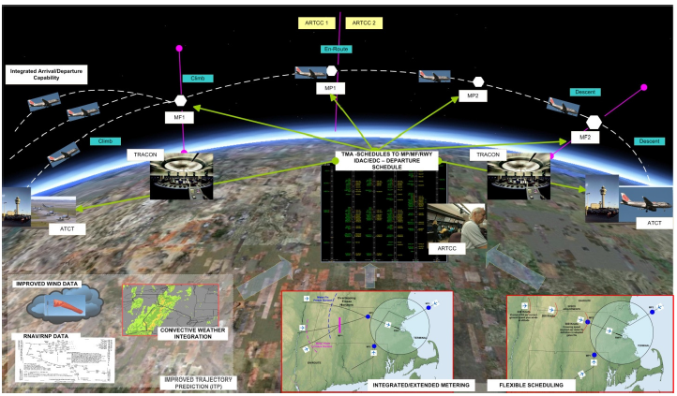
Time-Based Flow Management (TBFM) Information Sharing Service
TBFM optimizes the flow of aircraft into busy airspace. It was installed in all 20 En Route centers in July 2013 to meter aircraft through all phases of flight in order to deliver the correct number of aircraft to airspace sectors and down to the runway at the exact pace at which the aircraft can be accommodated.
JMS Publish/Subscribe connection of XML data to TBFM’s Information Sharing provides this metering information.
-
-
10

Slide 11
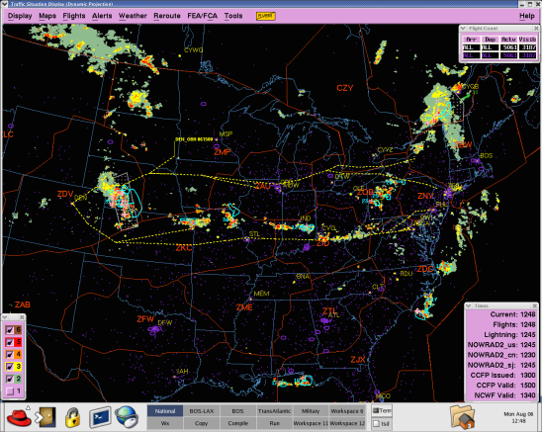
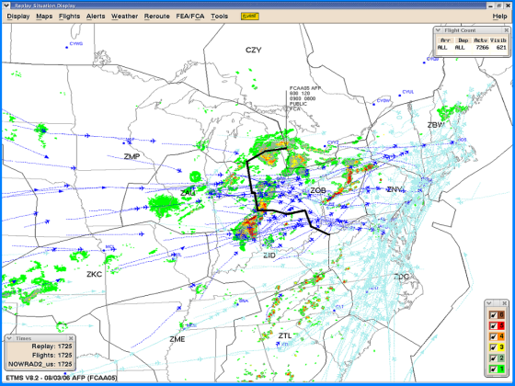
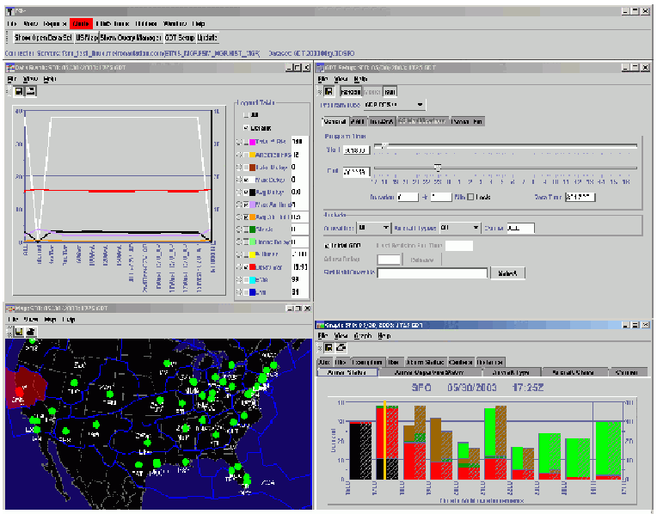
Traffic Flow Management System (TFMS):
TFMData Service
TFMS TFMData Service describes current and planned traffic flow initiatives in the NAS. This service will provide a means for information consumers to subscribe to traffic management data consisting of both Flight Data and Flow Information associated with the Traffic Flow Management domain.
Products include the following:
  Flow Constrained Area (FCA) / Flow Evaluation Area (FEA)
  Ground Delay Program (GDP) / Unified Delay Program (UDP)
  Airspace Flow Program (AFP)
  Collaborative Trajectory Options Program (CTOP)
  Route Availability Planning Tool (RAPT) time-line data
  ATCSCC Advisories
  Ground Stop (GS)
  Reroutes
  Airport runway config and rates
  Airport deicing
  Restrictions
Denver Reroute
Airspace Flow Program (AFP)
FSM Ground Delay Tools components
11

Slide 12

Release 10 October 2014
Collaborative Information Exchange (CIX)
  Via NAS Enterprise Messaging Service (NEMS)
  System-Wide Information Management (SWIM) compliant interfaces
  Publish TFMData Service
  Subscribe to TBFM Control Times
  Subscribe to RVR
  Subscribe to Special Use Airspace

Slide 13

Release 10 TFMData
Flight Data
  ASDI
  FTM_Connect deltas
Flow Information
  All TMI definitions
    Reroutes, GS, GDP/UDP, AFP, CTOP
  FEA/FCA definitions
  ATCSCC advisories
  Restrictions
  Airport configuration and rates
  Airport Deicing status
  RAPT timeline forecast data
Notes:
TFMData has two sets of data: flight and flow info
Flow Info Refreshes every 15 min except initial RR flight list in case client was disconnected when new info sent (TFMDI supports a get request).
RAPT updates every 5 minutes
Highlight new info now available in data feed, not just on website.
Please pay close attention to next slide.

Slide 14
Time to Talk FIXM / AIXM
FAA commitment to adopt international standards
  Working on migration plan with the Operational Concepts, Validation & Requirements Directorate (AJV-7)
Aeronautical Information Exchange (AIXM)
  Currently covers, airports, routes, NAVAIDs, airspace sectors
  http://www.aixm.aero
Flight Information Exchange Model (FIXM)
  Evolving data format for flight specific life-cycle info
  http://www.fixm.aero/
Notes:
AIXM primarily CCU NAS element definitions

Slide 15

Possible Migration Strategy
Translation Service
Baseline Upgraded
Baseline Interface
New / Revised Standard
Working toward having a process defined by 2015
Notes:
We intend to minimize frequency of schema changes to minimize impact to industry

Slide 16
SWIM Terminal Data Distribution Service (STDDS) Deployment
Tower Data Link Services
(TDLS) Runway Visual Range
Airport Surface Detection Equipment, Model X
Airport Surface Surveillance Capability
Electronic Flight Strip Transfer System
16

Slide 17
SWIM Terminal Data Distribution System (STDDS)
JMS Publish/Subscribe connection of XML data (Airport Surface Detection Equipment-Model X (ASDE-X), Airport Surface Surveillance Capability (ASSC), Electronic Flight Strip Transfer System (EFSTS), Tower Data Link Services (TDLS), and Runway Visual Range (RVR))
ASDE-X and ASSC
  Event date/time for each flight:
    Spot Out (departure aircraft crosses from ramp to surface movement area)
    Spot In (arrival aircraft crosses from surface movement area to ramp)
    Off (wheels up)
    On (wheels down)
  Category 11 data and Generic Flight Plan data
Tower Departure Event Data
  Aircraft parking gate and Departure runway
  Clearance delivery time (date/time at which clearance was issued)
  Taxi start time (date/time at which taxi start was issued)
  Takeoff time (date/time at which takeoff clearance was issued)
RVR Data
  Visual range in hundreds of feet at touchdown, midpoint, and rollout
  Visibility trend (steady, increasing, decreasing) at touchdown/midpoint/rollout
  Runway edge light and center light setting intensity from 0 (off) to 5 (maximum)
17

Slide 18
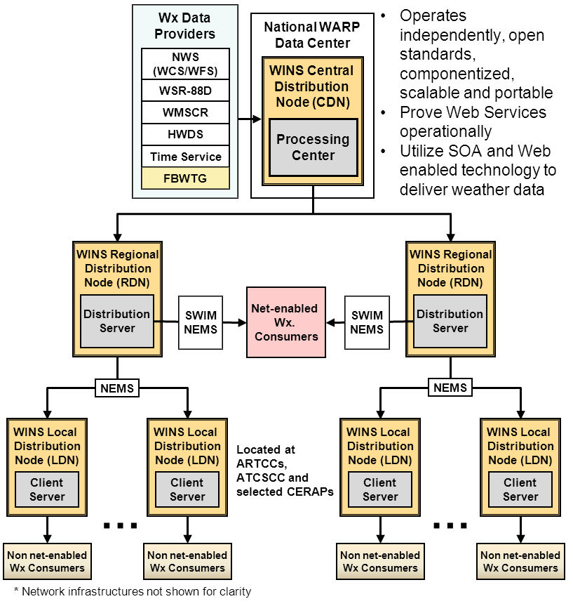
Enhanced Weather Information Network Service (WINS) Dissemination (EWD)
Web Service and JMS Publish/Subscribe connection to XML and binary data on adverse weather, forecasts and other meteorological advisories.
Current products:
Harris Weather Data Service (HWDS)
Weather Surveillance Radar – 1988 Doppler (WSR-88D)
Aviation Routine Weather Report (METAR)
Weather Research and Forecasting-Rapid Refresh (WRF-RR) 40km Resolution Model Data
North American Mesoscale (NAM) Model Data
Global Forecast System (GFS) Model Data
Planned products:
Weather Research and Forecasting-Rapid Refresh (WRF-RR) 13km Resolution Model Data
Current Icing Product (CIP)
National Convective Weather Forecast (NCWF)
National Convective Weather Diagnostic (NCWD)
Significant Meteorological Information (SIGMET)
Collaborative Convective Forecast Product (CCFP)
Airmen's Meteorological Information (AIRMET)
18
Notes:
HWDS - this feed has data in several formats: GRIB 1 (binary), alphanumeric (ASCII), images (JPG, GIF, etc.). I'm sure I'm forgetting some.
WSR-88D - this is a small subset of 5 products that WARP/EWD currently ingests - they are binary-encoded
METAR - These are encoded in XML 1.0 using the Weather Exchange Model (WXXM) 1.0
RAP 40km, NAM, GFS - All binary in GRIB1
Future:
RAP 13km, NAM, GFS, CIP, NCWD - All binary in NetCDF-4
MDCRS, NCWF, AIRMET, SIGMET, CCFP - All in XML 1.0 using either Aviation Weather Exchange Model (AVWX) 1.0 or North American Weather Exchange Model (NAWX) TBD versions

Slide 19
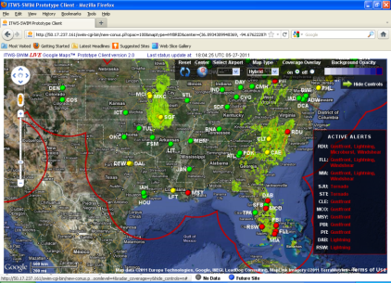
Integrated Terminal Weather System (ITWS)
Publication of XML data (weather data products available to TRACONs and Tower Controllers) using SWIM compliant JMS Publish/Subscribe capabilities
Terminal Areas with ITWS:
ITWS provides data to consumers externally via SWIM in Industry Standard XML format
ITWS processing capability will be subsumed by NextGen Weather Processor (NWP) in 2017 timeframe
ITWS publishing capability will be subsumed by Common Support Services – Weather (CSS-Wx) in OGC formats in 2017 timeframe
Miami, ASO (MIA)
Kansas City, ACE (MCI)
St. Louis, ACE (T75)
Houston, ASW (I90)
Chicago MCF, AGL (C90)
Potomac, AEA (PCT)
Boston, ANE (F90)
Minneapolis/St. Paul, AGL (M98)
Charlotte, ASO (CLT)
Denver MCF, ANM (D01)
New York, AEA (N90)
Dallas/Fort Worth MCF ASW (D10)
Orlando, ASO (MCO)
Memphis, ASO (MEM)
Detroit/Wayne, AGL (DTW)
Cincinnati, ASO (CVG)
Pittsburgh, AEA (PIT)
Phoenix, AWP (P50)
Philadelphia, AEA (PHL)
Salt Lake City, ANM (S56)
Cleveland, AGL (CLE)
Tulsa, ASW (TUL)
New Orleans, ASW (MSY)
Las Vegas, AWP (LAS)
Nashville, ASO (BNA)
Indianapolis, AGL (IND)
Oklahoma City, ASW (OKC)
Wichita, ACE (ICT)
Louisville, ASO (SDF)
Columbus, AGL (CMH)
Atlanta, ASO (ATL)
Raleigh-Durham, ASO (RDU)
San Juan, ASO (SJU)
Northern Cal, AWP (NCT)
ITWS Data Products:
Airport Lightning Warning Configured Alerts Forecast Accuracy Forecast Contour Forecast Image Gust Front TRACON Map Microburst TRACON Map Precipitation 5nm Precipitation Long Range Precipitation TRACON | Storm Motion (SM) Storm Extrapolated Positions (SEP) 5nm SM SEP Long Range SM SEP TRACON Terminal Weather Text Normal Tornado Alert Tornado Detections Wind Profile Anomalous Propagation (AP) Indicated Precipitation AP Status Gust Front Estimated Time to Impact |  | Hazard Text 5nm Hazard Text Long Range Hazard Text TRACON ITWS Status Information Microburst Automatic Terminal Information Service (ATIS) Runway Configuration Storm Motion 5NM Storm Motion TRACON Terminal Weather Text Special Wind Shear ATIS
19

Slide 20
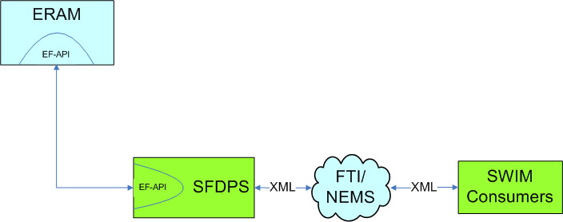
SWIM Flight Data Publication Service (SFDPS)
Phase 1 - operational in 2015 – flight data, airspace data, operational data, and general information messages
SFDPS Phase 1 Services include the following:
En Route Flight Data Publication
En Route Airspace Data Publication
En Route Operational Data Publication
En Route General Information Message Publication
Services available using FIXM standard V1.x
SFDPS Phase 2 Services include the following:
Flow Management Service
Terminal Flight Data Manager (TFDM) Service
Flight Data Service in FIXM standard (V2.0 & V3.0)
Other services in XML V1.0 fifth edition
ERAM
CMS
EDDS
CMS
Legacy
(HADDS)
Clients
CMS
SFDPS
XML
FTI/
XML
SWIM
NEMS
Consumers
20

Slide 21
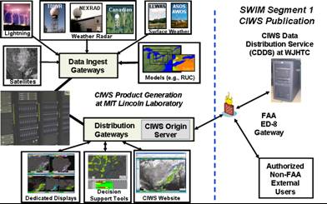
Corridor Integrated Weather System (CIWS) – Data Distribution Service (CDDS)
Web Service and JMS Publish/Subscribe connection to XML data (three-dimensional weather tracking system that focuses on high-volume “corridors” representing the combination of specific en route and terminal airspaces throughout the NAS)
CIWS Products
CIWS will be subsumed by NWP in the 2017 time frame
CDDS will be subsumed by CSS-Wx in 2017 time frame
Vertically Integrated Liquid (VIL) Mosaic (1km resolution)
VIL 2-hr. Forecast
Echo Tops Mosaic (1 km resolution)
Echo Tops 2-hr. Forecast
Satellite Mosaic
Storm Info: Echo Top Tags
Storm Info: Leading Edges
Storm Info: Motion Vectors
VIL Forecast Contours (Std. Mode)
VIL Forecast Contours (Winter Mode)
Echo Tops Forecast Contours
Growth & Decay Contours
Forecast Accuracy: Echo Tops
Forecast Accuracy: Std. Precip
Forecast Accuracy: Winter Precip
21

Slide 22
Aeronautical Information Management (AIM) Special Use Airspace (SUA) Automated Data Exchange
SUA is an area designated for operations such that limitations may be imposed on aircraft not participating in those operations.
AIM SUA Automated Data Exchange improves civilian access to current SUA schedules, and changes in SUA scheduling are captured and distributed in AIXM 5.0 compliant format as they are made.
AIM Modernization improves SAA capabilities and includes Temporary Flight Restrictions, Altitude Reservations, and Military Training Routes and integrating SAA/SUA data with Notices to Airmen and airport data.
22

Slide 23
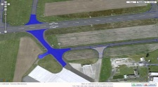

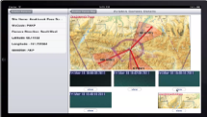


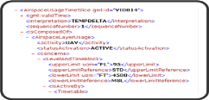
Federal NOTAM System – NOTAM Distribution Service Overview
Provides distribution of Notices to Airmen (NOTAMs)
Data feed that uses OGC WFS web-services
  Enables graphical NOTAM representation
Standards: Aeronautical Information Exchange Model (AIXM) 5.1 format
ALL or Some: Query and select types of data
External Market: Enables 3rd party app development
Standards: Include info needed for fusing data
Request/
Reply
FNS
NEMS
Pub/Sub
23

Slide 24
SWIM Product Portfolio
SWIM Products
AIM SUA Data Exchange* Provides notification and status regarding airspace | SUA data, dynamically provided in the Aeronautical Information Exchange Model (AIXM) standard | AIXM SUA definitions
ITWS Data Publication* Provides specialized weather products in the terminal area | Airport Lightning Warning Configured Alerts Forecast Accuracy Forecast Contour Forecast Image Gust Front TRACON Map Microburst TRACON Map Precipitation 5nm Precipitation Long Range Precipitation TRACON | Storm Motion (SM) Storm Extrapolated Positions (SEP) 5nm SM SEP Long Range SM SEP TRACON Terminal Weather Text Normal Tornado Alert Tornado Detections Wind Profile Anomalous Propagation (AP) Indicated Precipitation AP Status Gust Front Estimated Time to Impact | Hazard Text 5nm Hazard Text Long Range Hazard Text TRACON ITWS Status Information Microburst Automatic Terminal Information Service (ATIS) Runway Configuration Storm Motion 5NM Storm Motion TRACON Terminal Weather Text Special Wind Shear ATIS
CIWS Data Publication* Provides specialized 3D storm related weather information in the Enroute area | Vertically Integrated Liquid (VIL) Mosaic (1km resolution) VIL 2-hr. Forecast Echo Tops Mosaic (1 km resolution) Echo Tops 2-hr. Forecast Satellite Mosaic | Storm Info: Echo Top Tags Storm Info: Leading Edges Storm Info: Motion Vectors VIL Forecast Contours (Std. Mode) VIL Forecast Contours (Winter Mode) | Echo Tops Forecast Contours Growth & Decay Contours Forecast Accuracy: Echo Tops Forecast Accuracy: Std. Precip Forecast Accuracy: Winter Precip
WMSCR Publications Provides NWS textual aviation weather products | Transmission of voice PIREPs to WMSCR | Stored PIREPs | Altimeter settings
STDDS* Collects and publishes data from 100+ airports | ASDE-X streaming data service and Runway visibility data | Surface Movement Events (SME) RVR Data | Tower Departure Events (TDE)
*Service in development and on-ramping process
24

Slide 25
SWIM Product Portfolio (cont.)
Enhanced WINS | Current Icing Product (CIP) Weather Research and Forecasting-Rapid Refresh (WRF-RR) Model Data North American Mesoscale (NAM) Model Data Global Forecast System (GFS) Model Data Airmen's Meteorological Information (AIRMET) | National Convective Weather Forecast (NCWF) National Convective Weather Diagnostic (NCWD) Aviation Routine Weather Report (METAR) Significant Meteorological Information (SIGMET) Collaborative Convective Forecast Product (CCFP)
WARP Publications | Harris Weather Data Service Product Set (HWDS) WARP Maintenance and Sustainment Services (WMSS) | Next Generation Weather Radar (NEXRAD)
NOTAM Distribution Service* | Digital NOTAMS AIXM 5.1
Time Based Flow Management (TBFM) Information Service* | TBFM Information Service | Provides metering information about an aircraft: flight plan (relevant subset), Scheduled Time of Arrival (STAs), Estimated Time of Arrival (ETAs), Meter Reference Elements (MREs) Assignments, airport configuration information, per TRACON, satellite airport configurations, etc.
TFMS Flow Information Publication* | Flow Constrained Area (FCA) Airspace Flow Program (AFP) Aeronautical Situational Display to Industry (ASDI) | Ground Delay Program (GDP) Ground Stops (GSs) | Reroutes Advisories
Flight Data Publication* | Flight Data Publication Service - Flight Plan information, Flight Amendment Information, Converted Route Information, Cancellation Information, Departure Information, Aircraft Identification Amendment information, Hold Information, Progress Report Information, Flight Arrival Information, Flight Plan Update Information, Expected Departure Time information, Position Update Information, Tentative flight Plan Information, Tentative Aircraft identification Amendment information, Tentative flight Plan Removal, Tentative Flight Plan Amendment Information, Track Information, Drop Track Information, Interim altitude information, Automated Radar Terminal System (ARTS) Flow control Track/Full Data block Information2, Beacon Code Reassignment, Beacon Code Restricted, Flight Plan Data Bank (FDB) Fourth Line Information, Point Out Information, Inbound Point Out Information, Handoff Status. Airspace Data Publication Service - Sector Assignment Status, Route Status, Special Activities Airspace (SAA), Altimeter Setting Operational Data Publication Service - Traffic count Adjustment, Instrument Approach Count Adjustment, Sign In Sign Out, Beacon Code Utilization, Geographic Beacon Code Utilization General Information Message Publication Service - General Information
*Service in development and on-ramping process
25

Slide 26
SWIM Service Planning
Program | Discovery | Architecture, Requirements | Qualification (Data Arch, Design, HSV test) | Operations Rollout / Cutover
Terminal Automation Modernization and Replacement (TAMR) | In Progress | In Progress | TBD | Sep’15
Data Comm Network Services (DCNS) Monitoring Service | In Progress | In Progress | TBD | 2015
NAS Information Display System (NIDS) Consumer | In Progress | In Progress | TBD | 2015
Aeronautical Information Management (AIM) Segment 2 | In Progress | In Progress | TBD | 2015+
Common Support Services –Weather (CSS-Wx) | In Progress | In Progress | TBD | 2015+
Terminal Flight Data Manager (TFDM) | In Progress | In Progress | TBD | 2015-16
1 - ITWS
May 2011
Status Review 15Dec2011
Jun 2011 Kickoff
26
Notes:
26

Slide 27
Summary of Current SWIM Consumers
Consumer | Data Type / Subscription |  | Consumer | Data Type / Subscription
Airlines |  |  | Research & Development
American Airlines | ASDE-X / LGA, BOS, MIA |  | Kent State | CIWS / all products
Delta Airlines | ASDE-X / LGA |  | MIT - Lincoln Labs | ASDE-X / all airports, WMSS NEXRAD
Fedex | ASDE-X / MEM |  | MITRE | ASDE-X / all airports
JetBlue | ASDE-X /all airports |  | Volpe | ASDE-X / all airports
United Airlines | ASDE-X / all airports
USAIR | ASDE-X / PHX, DCA |  | Industry
 |  |  | Alliance | ASDE-X / MEM, ATL, JFK
Airports, FAA Facilities, & FAA Programs |  |  | ARINC | CIWS / all products
Atlanta Airport Authority | ASDE-X / all airports |  | Lockheed Martin | ASDE-X/ ATL, CLT, MSP, DTW, BOS, IAD, LAS
San Francisco (SFO) Airport Authority | SFO Airport Surface Surveillance Capability (ASSC) data |  | MOSAIC ATM | ASDE-X / LGA, JFK, BOS, ATL, PHL, EWR, ORD, IAD, CLT; ITWS / all products
Southern California TRACON | ASDE-X / San Diego, Los Angeles, Long Beach airport data |  | Passur | ASDE-X / all airports / STDDS
CIWS | WMSS NEXRAD /all radar sites |  | Rockwell Collins | CIWS / all products
CRCT | ASDE-X / LGA, EWR, JFK |  | Sabre | ASDE-X / all airports; ITWS / all products
OASIS | HWDS / all products |  | Sensis | ASDE-X / ATL, JFK
WARP | Enhanced WINS |  | Veracity | ASDE-X / LGA
27
Notes:
FAA Consumers: CIWS, WARP. Others are on the horizon.

Slide 28
How to become a user of SWIM services
Getting started…
  Email your request to:
  9-AJM-312-EnterpriseEngineeringServices@faa.gov
  Contact Andy Isaksen, FAA Manager
    Enterprise Infrastructure Services Team, AJM-312
    Phone: 609-485-4296 (desk), e-mail: Andy.Isaksen@faa.gov
Two things are needed:
  Establishing an IP service connection to an FAA network security gateway; and
  Ensuring your application follows the FAA’s governance policies and standards for producing/consuming SWIM data products
  Take advantage of FAA-published user documentation
    Listed on the next slide →
28

Slide 29
FAA Documents Available to SWIM Consumers*
FTI OPIP User Guide (for External Connections)
SWIM User Guide
SWIM Jump-start Kit
*Available on:
www.faa.gov/NextGen/SWIM
29

Slide 30

Questions
30

Slide 31
Contact Information
Jim Robb, SWIM Program Manager
email: jim.robb@faa.gov
Linda Chen, SWIM Flight Data Publication Service Lead
email: linda.chen@faa.gov
Jeri Groce, SWIM Terminal Data Distribution System Lead
  email: jeri.groce@faa.gov
  Andy Isaksen, Enterprise Engineering Lead
  email: andy.isaksen@faa.gov
31

Slide 32
SWIM Related Acronyms
ABRR: Airborne Reroute
ADS-B: Automatic Dependent Surveillance-Broadcast
AFP: Airspace Flow Program
AIM: Aeronautical Information Management
AIRMET: Airmen's Meteorological Information
AIXM: Aeronautical Information Exchange Model
ANSP: Air Navigation Service Provider
AP: Anomalous Propagation
ARTCC: Air Route Traffic Control Centers
ARTS: Automated Radar Terminal System
ASDE-X: Airport Surface Detection Equipment-Model X
ASDI: Aeronautical Situational Display to Industry
ASSC: Airport Surface Surveillance Capability
ATIS: Automatic Terminal Information Service
CCFP: Collaborative Convective Forecast Product
CDDS: CIWS Data Distribution Service
CIP: Current Icing Product
CIWS: Corridor Integrated Weather System
CMS: Common Message Set
CSS-Wx: Common Support Services – Weather
DCNS: Data Comm Network Services
DHS: Department of Homeland Security
DoD: Department of Defense
EDDS: En Route Data Distribution Service
EFSTS: Electronic Flight Strip Transfer System
ERAM: En Route Automation Modernization
ETAs: Estimated Time of Arrival
FCA: Flow Constrained Area
FDB: Flight Plan Data Bank
FDIO: Flight Data Input / Output
FTI: FAA Telecommunications Infrastructure
GDP: Ground Delay Program
GFS: Global Forecast System
GSs: Ground Stops
HADDS: Host ATM (Air Traffic Management) Data Distribution System
HWDS: Harris Weather Data Service
ITWS: Integrated Terminal Weather Service
IP: Internet Protocol
JMS: Java Message Service
32

Slide 33
SWIM Related Acronyms (cont.)
METAR: Aviation Routine Weather Report
MREs: Meter Reference Elements
NAM: North American Mesoscale
NCWD: National Convective Weather Diagnostic
NCWF: National Convective Weather Forecast
NDS: NOTAM Distribution Service
NEMS: NAS Enterprise Messaging Service
NESG: NAS Enterprise Security Gateway
NEXRAD: Next Generation Weather Radar
NIDS: NAS Information Display System
NOTAMs: Notices to Airmen
NVS: NAS Voice System
NWP: NextGen Weather Processor
OGC: Open Geospatial Consortium
PDRR: Pre Departure Reroute
PIREP: Pilot report
RVR: Runway Visual Range
SAA: Special Activities Airspace
SEP: Storm Extrapolated Positions
SFDPS: SWIM Flight Data Publication Service
SIGMET: Significant Meteorological Information
SM: Storm Motion
SME: Surface Movement Events
STAs: Scheduled Time of Arrival
STDDS: SWIM Terminal Data Distribution System
SUA: Special Use Airspace
TAMR: Terminal Automation Modernization and Replacement
TDE: Tower Departure Events
TBFM: Time-Based Flow Management
TDLS: Tower Data Link Services
TFDM: Terminal Flight Data Manager
TFMS: Traffic Flow Management System
VIL: Vertically Integrated Liquid
WARP: Weather and Radar Processor
WFS: Web Feature Service
WMSCR: Weather Message Switching Center Replacement
WMSS: WARP Maintenance and Sustainment Services
WRF-RR: Weather Research and Forecasting-Rapid Refresh
WSR-88D: Weather Surveillance Radar – 1988 Doppler
XML: Extensible Markup Language

Slide 34
Backup Slides

Slide 35
SWIM Terminal Data Distribution System (STDDS)
Deployed to 38 sites:
  Y90 (Yankee TRACON)
  MIA (Miami)
  SCT (Southern California TRACON)
  SLC (Salt Lake City TRACON)
  D10 (Dallas)
  N90 (New York TRACON)
  C90 (Chicago TRACON)
  T75 (St. Louis)
  PVD (Providence)
  NCT (Northern California TRACON)
  IND (Indianapolis)
  JAX (Jacksonville)
  PCT (Potomac)
  P50 (Phoenix)
  M98 (Minneapolis)
  MKE (Milwaukee)
  D21 (Detroit)
  MEM (Memphis)
  D01 (Denver TRACON)
  BUF (Buffalo/ Niagara)
  MCO (Orlando)
  R90 (Omaha)
  PHL (Philadelphia)
  HCF (Honolulu)
  A90 (Boston)
  SDF (Louisville)
  90 (Houston TRACON)
  MCI (Kansas City)
  S46 (Seattle TRACON)
  CLT (Charlotte)
  ABQ (Albuquerque)
  CMH (Columbus)
  PIT (Pittsburgh)
  P80 (Portland)
  TPA (Tampa)
  ANC (Anchorage)
  RDU (Raleigh/Durham)
  A80 (Atlanta)
35

