Slide 1
ATIEC – SWIM Technology Theme
Notes:
Good afternoon everybody.
Thank you Steve for that thought provoking keynote. One more round of applause for Steve everybody. Steve has been a steadfast champion of driving ATM to a digitally connected more collaborative future.
This session is devoted to SWIM technology. So you will now hear from the folks who have been at the forefront of deploying SWIM technology about the latest SWIM deployments and demonstrations. You will also hear about some of the future plans.

Slide 2
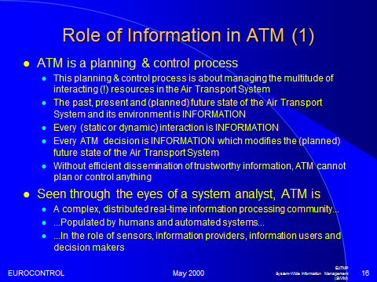
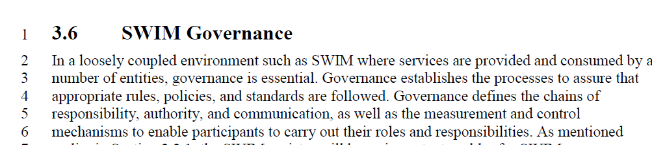
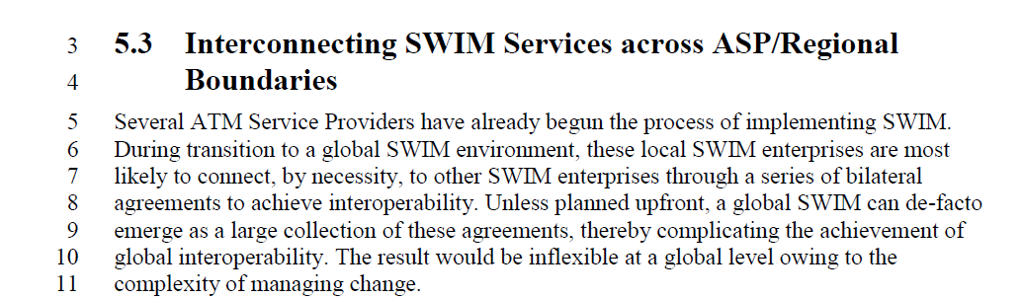
SWIM Theme
Notes:
To continue the tone set by Steve Bradford – I took this slide from a presentation dated May 2000 by Hartmut Koelman of Eurocontrol. In some ways it is encouraging to know that this community has been on this path longer than 15 years and the we are benefitting from the fruits of your labor.

Slide 3
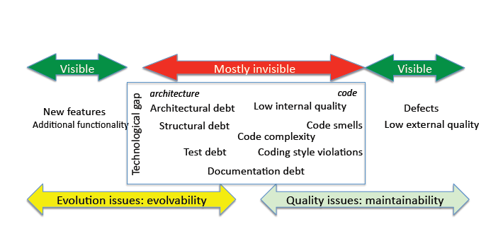
SWIM Theme
Trustworthy Information
Technical Debt – How much are we incurring?
Governance Challenges
* Source: Kruchten et al, IEEE Software, Special issue on Technical Debt, Technical Debt: From Metaphor to Theory and Practice
Nov.-Dec. 2012 (vol. 29 no. 6)
Notes:
To continue the tone set by Steve Bradford – I took this slide from a presentation dated May 2000 by Hartmut Koelman of Eurocontrol. In some ways it is encouraging to know that this community has been on this path longer than 15 years and the we are benefitting from the fruits of your labor.

