Slide 1

Delivering Digital
Services
International Collaboration -Towards the 4DT for FF-ICE Step 1
Presented By: Dr. Stéphane Mondoloni
Date: August 27, 2014

Slide 2


























Global Applicability
ATMRPP (Air Traffic Management & Performance Panel)
*ATMRPP comprises members from a wide variety of organizations (not all organizational logos could be obtained)
1
Notes:
As articulated in the FF-ICE Concept, FIXM Core is intended to be “globally applicable”. Achieving such global applicability requires coordination amongst international partners. The Global ATM Operational Concept, and the more detailed Manual on Flight and Flow Information for a Collaborative Environment, provided the basis upon which the FIXM standard was to be developed. These were developed through ICAO under the ATMRPP. As you can see, the panel comprises members and advisors from a wide variety of stakeholder organizations.

Slide 3

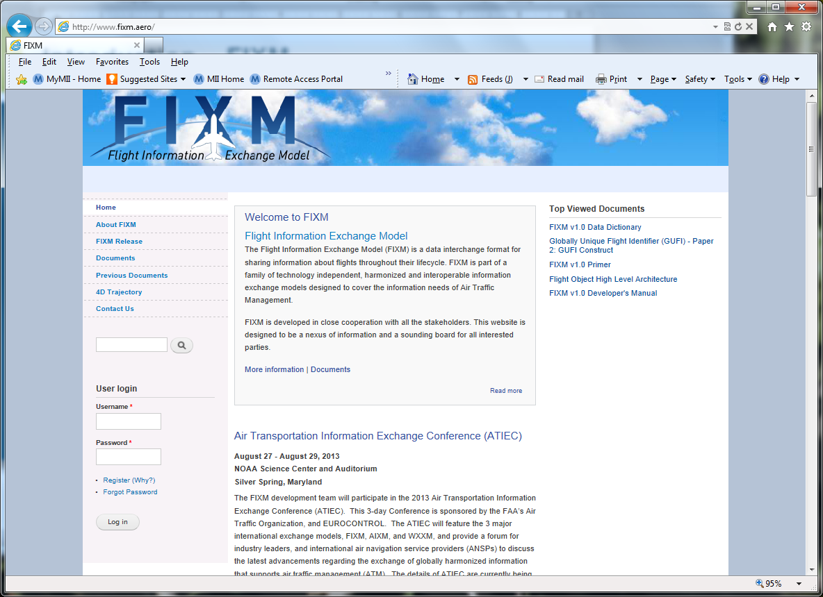
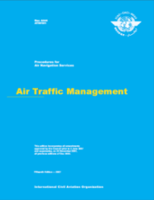
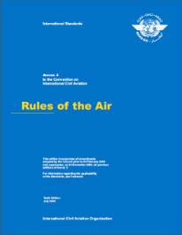
Getting to the 4DT – ASBU Block 1
Multi-level coordination
Agree
FF-ICE/1 Scope for 4DT
Concepts, Plans
4DT Operational Scenarios*
4DT Data Items & Structure
4DT FF-ICE/1 Provisions
*Scenarios must be compatible, not identical
Seek agreement on core 4DT data items and provisions
Notes:
While the introduction of new items for FIXM in support of the 4DT requires coordination to achieve global applicability, some structure and division of roles & responsibilities is necessary to make progress and achieve convergence.
Beginning with the ICAO Concept, plans and Aviation System Block Upgrades
Mention Mixed-mode, mixed-equipage

Slide 4



Multi-Level Coordination
Share
Discuss
Harmonize
Internal
US Stakeholders
Concepts, Plans
.
.
.
.
.
.
SJU Stakeholders
Other ATM Service Providers
& Stakeholders
Notes:
When we speak of multi-level coordination, this is what we mean

Slide 5
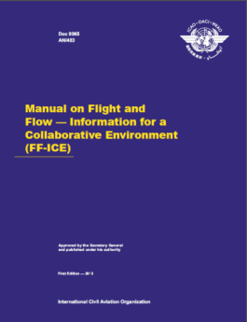

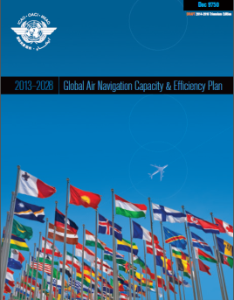
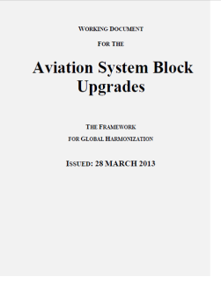
Initial 4DT Scope - Example
“expressed its full support for the Concept”
Consistency with FF-ICE Concept
Alignment with GANP & ASBU modules
Initial scope – more detail needed

Slide 6
Detailing Scope - Example
Plans, capabilities, roadmaps, systems, interfaces
Block 1 capabilities
Block 1 capabilities
Internal / stakeholder coordination
Joint Working Paper
Agreement on Scope
Notes:
Mention that ICAO panel provides feedback, comments

Slide 7
Scope – FF-ICE Block 1
Focus on Pre-departure exchange
No “big-bang”
Include movement messages: FPL, CHG, CNL, DLA, DEP, ARR
  DEP – end of pre-departure phase
  Inclusion of ARR – this is post-departure, might simplify to include
Include supplementary messages: RQP, RQS, SPL
Mixed-mode compatibility
  Translate to/from these messages
  Compatible with present-day provisions
Coordination maintains present-day provisions:
  No GUFI for these
Information updated in flight may be shared, including 4DT
  Provisions do not describe
  Present-day messages are used to update internal flight information
  Bilateral agreements may develop for coordination

Slide 8



Scope – Pre-Departure
Early Information (e.g. scheduling)
Pre-departure
Constraint Information
Flight Information & Desired 4DT
Feedback on 4DT (Negotiating)
Agreement on 4DT
Others
Ranked 4DTs
Verification of 4DT
Distribution consistent with 4DT
AU
ASP
Optional – Provisions do not describe
Provisions will describe
FIXM, AIXM, WXXM all apply

Slide 9
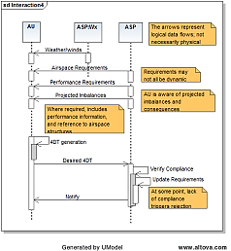
Scenarios
Pre-departure:
  4DT provision, negotiating, verification, cancellation, failure recovery
    Emphasis on effect of constraints
  Mixed-mode
  4DT Prediction for legacy operators
  4DT items improving in-flight prediction
Post-departure
  Treatment of post-pushback / pre-flight events
  In flight trajectory updates & revisions

Slide 10
Next Steps
Draft 4DT scenarios have been shared
Compatible 4DT scenarios under development:
Considering agreed scope
Define proposed FIXM core 4DT items
Scenario coordination & revision:
4DT items w/ FIXM partners
Provisions with ICAO partners
Notes:
Emphasize – we seek agreement on provisions and core items – scenarios are a means to the end

Slide 11

Questions
2

