Slide 1

NEXTGEN and SESAR: Making ATI Services Discoverable and Understandable
Presented By: Mark Kaplun, FAA/SWIM
Date: August 27, 2014

Slide 2
Agenda
Motivations
SDCM (Service Description Conceptual Model)
  Background and Motivations
  Objectives
  Design Principles
  Use Cases
SCR (SWIM Common Registry)
  Where SCR meets SDCM
Contacts, References and how to find more Information
1

Slide 3
Motivations
To further expand SWIM concepts among international communities, it is necessary to make ATI services commonly understandable and discoverable.
To address this goal, NextGen and SESAR (Single European Sky ATM Research Programme) are currently working together on two tasks:
  establishing a common conceptual vision of a service description with shared semantics (SDCM);
  developing a flexible mechanism for cataloging, locating, and accessing information in diversified service registries (SCR).
2
Notes:
A service description is an artifact, often document-based, that defines or references the information needed to use, deploy, manage and otherwise control a service. [2]
A service registry is a mechanism that manages, shares and tracks information about services (service descriptions) and allows it to be retrieved as a result of a query.

Slide 4
SDCM
3

Slide 5
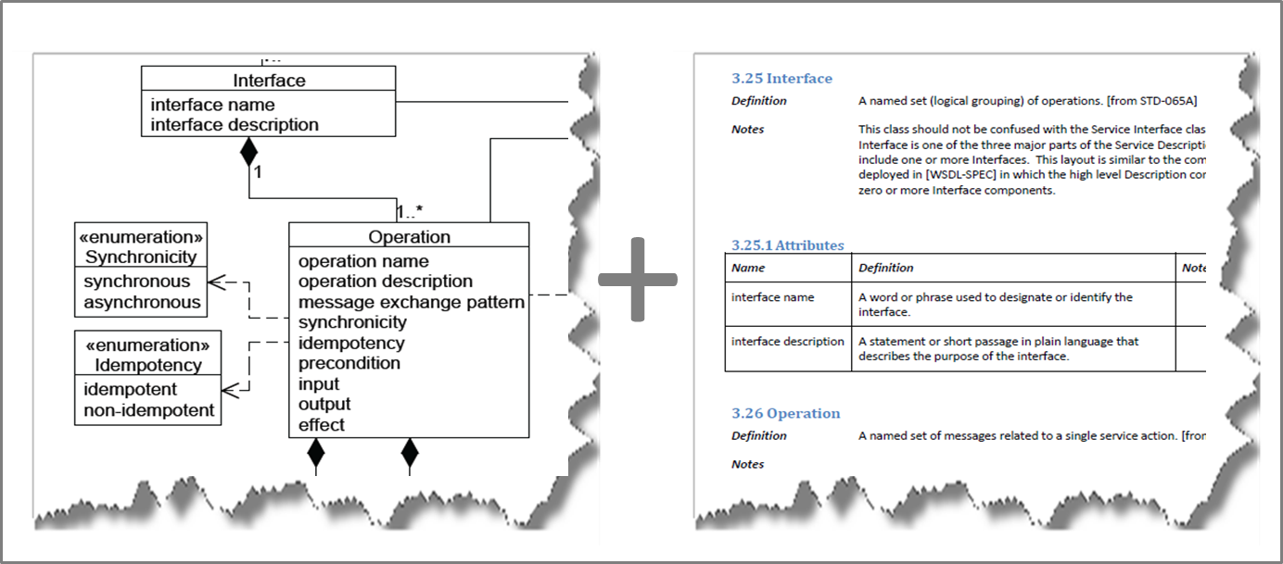
What is SDCM?
The Service Description Conceptual Model (SDCM) provides a graphical and lexical representation of the properties, structure, and interrelationships of all service metadata elements, collectively known as a service description.[1]
4

Slide 6
Background and Motivations
As part of NextGen/SESAR Joint Undertaking (SJU) CP 2.1 activities, SESAR was looking for an approach to describing SOA-based services that is similar to the approach used in FAA.
The material that FAA made available to SESAR for study and consideration did not prove to be effective enough to create a commonly shared understanding of a service description and led to recognizing the need for a conceptual, semantic-rich model.
FAA Service Description Documents
WSDD WSRD JMSDD
NSRR
FAA Service Description Standards
FAA-STD-065 FAA-STD-070 FAA-STD-073
Service Description Conceptual Model (SDCM)
FAA Documenting Standards
FAA-STD-025
FAA-STD-068
FAA Semantic Models
WSDOM SWIM Controlled Vocabulary (SWIM CV)
FAA Documenting Standards
FAA-STD-025
FAA-STD-068
Industry Standards and Models
OWL-S WSDL UDDI OASIS SOA RM
5

Slide 7
Background and Motivations (cont.)
Further analysis by SESAR demonstrated that the “SESAR document stack” can be connected through a common structural and semantic model.
SESAR Service Description Documents
ISRM Model SDD SWIM-TI Profile
FAA Service Description Documents
WSDD WSRD JMSDD
SESAR Registry
NSRR
SESAR Service Description Standards
SESAR Modeling Guidelines ISRM Foundation Rulebook
FAA Service Description Standards
FAA-STD-065 FAA-STD-073 FAA-STD-070
SESAR ATM Architecture
EATMA Framework
SESAR Working Method on Services
Service Description Conceptual Model (SDCM)
FAA Documenting Standards
FAA-STD-025
FAA-STD-068
SESAR Service Semantics
SESAR Integrated Dictionary
FAA Service Semantics
WSDOM SWIM CV
Industry Standards and Models
NATO Architecture Framework OWL-S WSDL UDDI OASIS SOA RM
6

Slide 8
SDCM Objectives
Define a conceptual model of a service description based on consistent application of Service-Oriented Architecture (SOA) principles.
Establish adequate and consistent semantics for concepts used in documentation for SOA-based services.
Advance a common and shared understanding of SOA concepts among international partners.
Promote a technological means for describing all relevant aspects of a service in a manner suitable for both human-readable and machine-processable representations.
7

Slide 9
SDCM Design Principles
Shall be based on widely-used industry service description standards and models (e.g., WSDL, OASIS SOA Reference Model[2], NATO Architecture Framework).
Shall be extensible to allow deriving and adding more elements to address organization-specific tasks.
Shall be neutral to any organizational governance model (e.g., in SESAR or FAA SWIM programs).
Shall be service technological solution agnostic (e.g., it shall not be tailored to method, message or resource oriented implementations).
Shall be vendor neutral (e.g., it shall not support any proprietary implementation of UML and/or vocabularies).
8

Slide 10
SDCM Use Cases
SDCM is expected to be serialized as an XML Schema with an intent to use it for exchange of service description data in machine-consumable format.
SDCM is already being used for developing requirements for enhancement of the NAS Service Registry/Repository (and possibly during design of the SESAR Registry).
SDCM will be used for developing and/or updating FAA/SWIM standards for service description and requirements documentation.
SDCM will be used as a basis for future work in the area of the Semantic Web (e.g., controlled vocabulary, taxonomies).
More…
9

Slide 11
SCR
10

Slide 12
What is SCR?
The SWIM Common Registry (SCR) is a joint effort of FAA and EUROCONTROL SWIM with the goal of enabling the exchange of information between two SWIM registries: FAA NAS Service Registry/Repository (NSRR) and EUROCONTROL Registry and Repository.
SCR, from a SWIM stakeholder perspective, should provide the appearance of a "single organization" registry, while allowing participants to comply with their organization-specific governance regulations.[3]
11

Slide 13
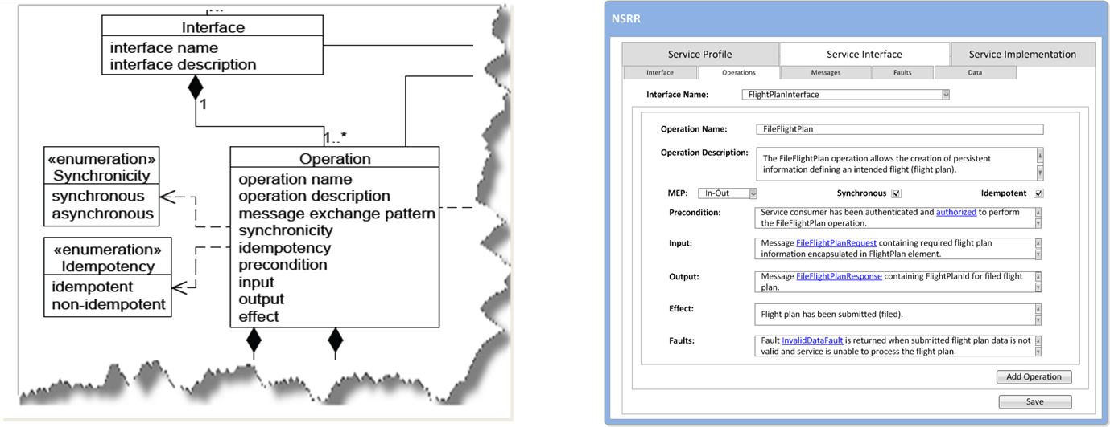
Where SCR meets SDCM
SDCM will be used in SCR as a basic information model and for supporting shared semantics.
SDCM can also be used for development of exchange models for SCR-affiliated registries.
12

Slide 14
References
[1] | Service Description Conceptual Model (SDCM), Working Draft, SESAR CP 2.1, March 28 2014 https://www.faa.gov/about/office_org/headquarters_offices/ato/service_units/techops/atc_comms_services/swim/governance/servicesemantics/view/SDCM%20March%2028%202014/SDCM%20March%2028%202014.html
[2] | Reference Architecture Foundation for Service Oriented Architecture Version 1.0, OASIS, December 2012 http://docs.oasis-open.org/soa-rm/soa-ra/v1.0/cs01/soa-ra-v1.0-cs01.pdf
[3] | SWIM Common Registry: Concept, Architecture, and Implementation, Pedro Fernandez-Sancho et al, FAA/SESAR, June 2014 https://www.faa.gov/about/office_org/headquarters_offices/ato/service_units/techops/atc_comms_services/swim/governance/outreach/media/SWIM%20Common%20Registry%20Concept%20Architecture%20and%20Implementation.pdf
13

Slide 15
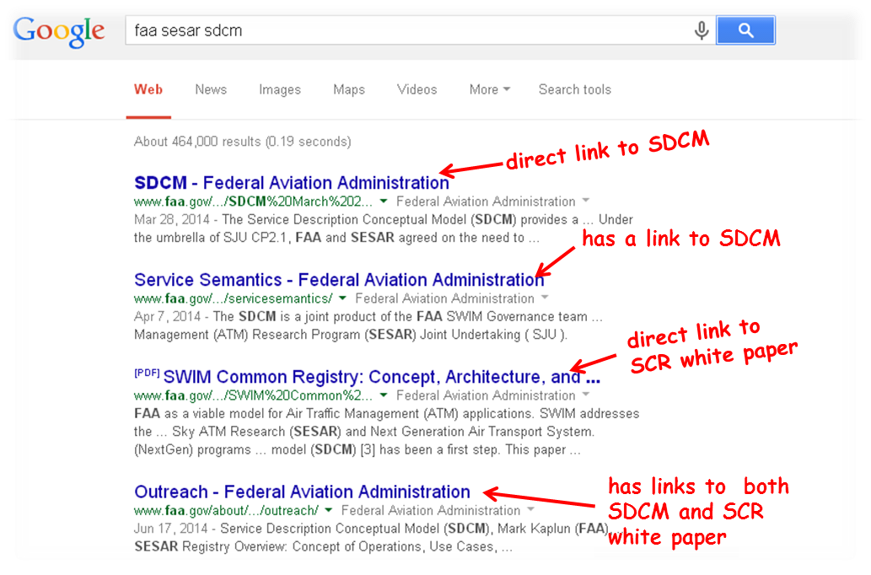
Where to find more Information
14

Slide 16
Contact Information
SESAR
FAA
Pedro Fernandez-Sancho (SCR)
pedro.fernandez-sancho@eurocontrol.int
Peder Blomqvist (SDCM)
peder.blomqvist@telia.com
Mark Kaplun (SDCM, SCR)
mark.kaplun@faa.gov
15

Slide 17

Questions?
16

