Slide 1

Delivering Digital
Services
Cooperation with International Partners and
Industry
Presented By: Richard Jehlen, FAA
Date: August 26, 2014

Slide 2
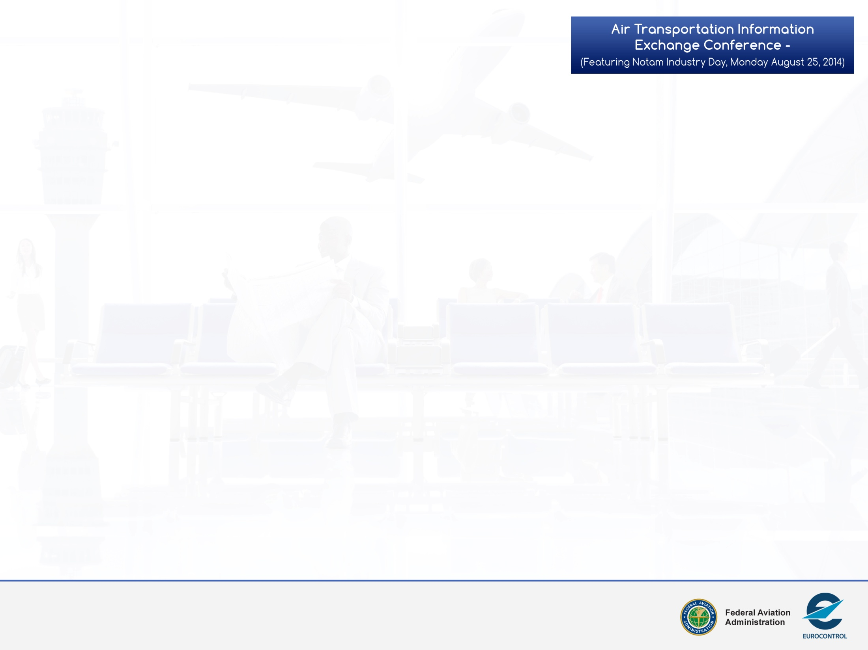
Why Cooperate????
Basically, we are all in this together….
Throughout the conference each presentation speaks to, or about, the criticality of sharing information.
Each of us recognizes the challenges – and promise – of having the right information when we need it.
No member of the community can gain access to all the information they need without the support of the rest of the ATM community – Airports, ANSPs, Operators, ATM Vendor Industry, etc.
What happens if we don’t plan, implement, and share in a coordinated manner?
AIRM
ATM Information Reference Model
2

Slide 3
No One Succeeds!!!!!
Benefit of transitioning from point-to-point to SWIM has been well documented and is underway internally at ANSPs/Regions across the globe
FAA Systems
ETMS
WARP
AIM
ERAM
IDS/
ERIDS
TFMS
ASDE-X
CIWS
To NAS SWIM
TDDS
ERAM
ATOP
FTI
ATM Information Reference Model
STARS
STARS/
ARTS/
TAMR
CIWS
CARTS/
ITWS
TBFM
Inter-
Agency
WMSCR
DOTS
TMA
TFM
3

Slide 4

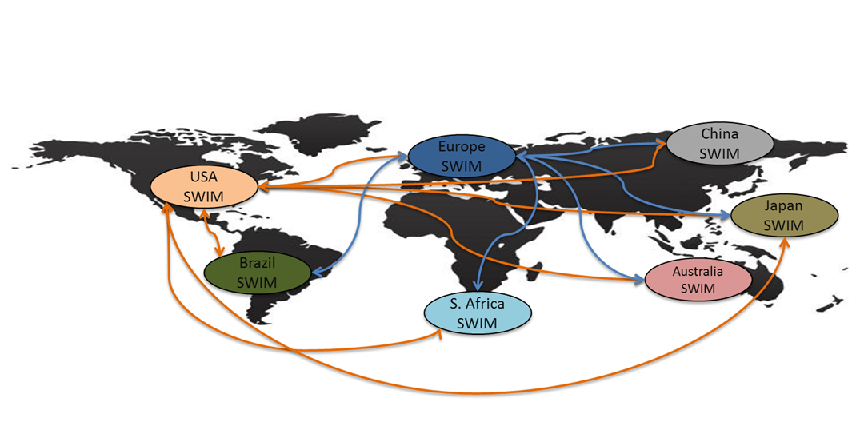
FAA Systems
AIM
ERAM
TFMS
Local SWIM Clouds
Connect to First
Movers Via
Point-to-Point
CIWS
TDDS
SWIM
SWIM
SWIM
FTI
SWIM
SWIM
STARS
ITWS
CARTS/
TBFM
SWIM
WMSCR
DOTS
AIRM
SWIM
SWIM
SWIM
SWIM
SWIM
Which evolve into
global Point-to-Point
SWIM connections?
ATM Information Reference Model
Or…..
4

Slide 5
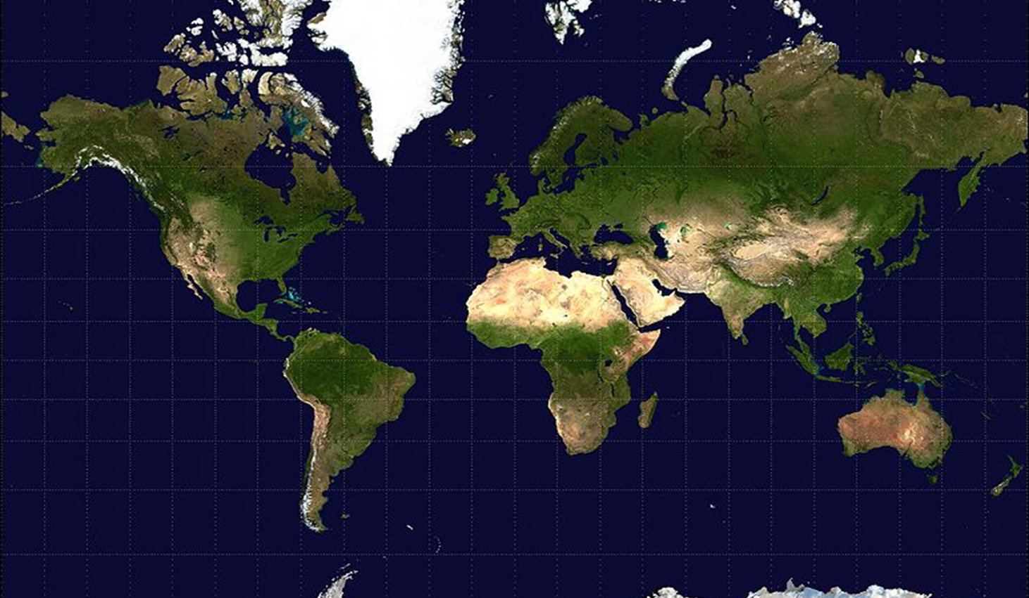


Global Cooperation
AIRM
SWIM
Global SWIM
SWIM
ATM Information Reference Model
SWIM
SWIM
5

Slide 6

Global Partnership
AIRM
ATM Information Reference Model
6

Slide 7

Questions
AIRM
ATM Information Reference Model
7

