Slide 1

Delivering Digital
Services
Weather Data Services
---------
NOAA: NGITWS
FAA: CSS-Wx
Presented By:
Ryan Solomon (NOAA)
Alfred Moosakhanian (FAA)
Date: August 27, 2014

Slide 2
Overview
FAA-NOAA Web Centric Data Sharing
NOAA
  NextGen IT Web Services (NGITWS)
    Data Access & Exchange
    Challenges
FAA
  Common Support Services-Weather (CSS-Wx)
    NextGen Wx Vision
    Data Access Services & Products
Joint FAA-NOAA Capability Evaluation

Slide 3
It’s about the data
Discoverable
Interoperable
Accessible

Slide 4







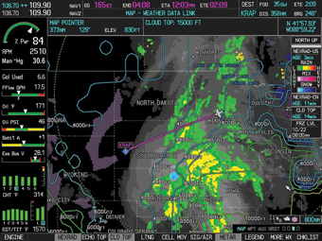
Revolutionary Change
F
T
S
P
B
L
D
N
D
B
N
e
M
t
Data silos
Net-centric
Proprietary
Open
Platform-specific
Platform-agnostic

Slide 5



How do we get there?
NetCDF
IWXXM
Standard data formats
OGC compliant services
State of the art
data centers
Experience

Slide 6
Challenges
Transition from TAC to XML
Bandwidth
System resources
$$
Centralized distribution (TOC)
Governance
Change management

Slide 7
Web-Centric Data Sharing
Long-Standing Cooperative Exchange
FAA-NOAA building web services
  NOAA: NextGen IT Web Services (NGITWS)
  FAA: Common Support Services-Weather (CSS-Wx)
FAA CSS-Wx will be:
  Single Source for weather to support FAA NAS Systems
    NOAA / NGITWS provides NOAA weather data to CSS-Wx
    FAA NextGen Weather Processor (NWP) provides aviation-specific weather products to CSS-Wx
FAA EWD: First ops web-enabled FAA-NOAA exchange
[Enhanced Weather Information Network Server (WINS) Dissemination]
FAA-NOAA Conducting Joint Capability Evaluations (CEs)

Slide 8

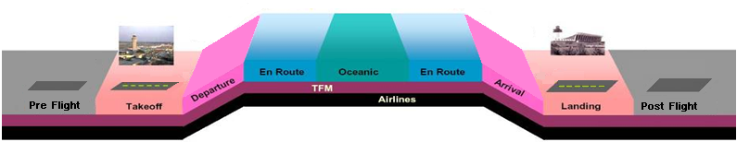



NextGen Wx Vision:
Providing Weather as Needed
  CSS-Wx provides weather information for every phase of flight
    Tactical and Strategic time frames
  Data may be filtered by:
    Location, Time and Weather parameters as requested by user
Thunderstorms
Lightning
Crosswinds
Wind Shear
Freezing/Frozen Precipitation
Low Ceiling & Visibility
Surface Icing
Thunderstorms, Jet Stream, Volcanic Ash, Turbulence,
In-Flight Icing, Winds,
Mountain Waves
Thunderstorms
Lightning
Crosswinds
Wind Shear
Freezing/Frozen Precipitation
Low Ceiling & Visibility
Surface Icing
T+1
T+2
T+3
Arrival Forecast Weather
Alternate Forecast Weather
Flight Winds
T+0
Post-flight observed weather archives
8
Notes:
Why is FAA considering CSS-Wx? [animated slide]
The weather parameters listed above the flight path are not weather events actually impacting the flight, but the user is requesting data on these different parameters to enquire as to whether or not there is the threat of any of the wx parameters actually impacting the flight.

Slide 9
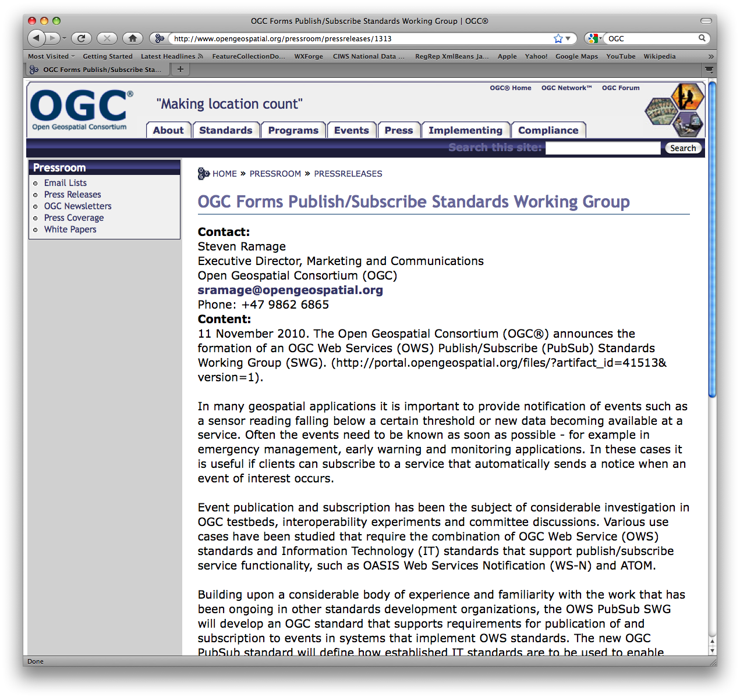
CSS-Wx Geospatial
Data Access Services
Web Feature Service (WFS):
  Filtered access to non-gridded data formatted as XML/GML
  Provides Common Geospatial constructs for other NAS data (aeronautical, air traffic)
Web Coverage Service (WCS):
  Filtered access to gridded data formatted as NetCDF4
  Uses OGC Reference Model
Web Map Service (WMS):
  Image of Weather data formatted as gif, png, jpeg, etc.
Web Map Tile Service (WMTS):
  Image of Weather data as set of tiles formatted as gif, png, jpeg, etc.
Notes:
What services does CSS-Wx provide?
Correspondence between Services and their Data Formats

Slide 10
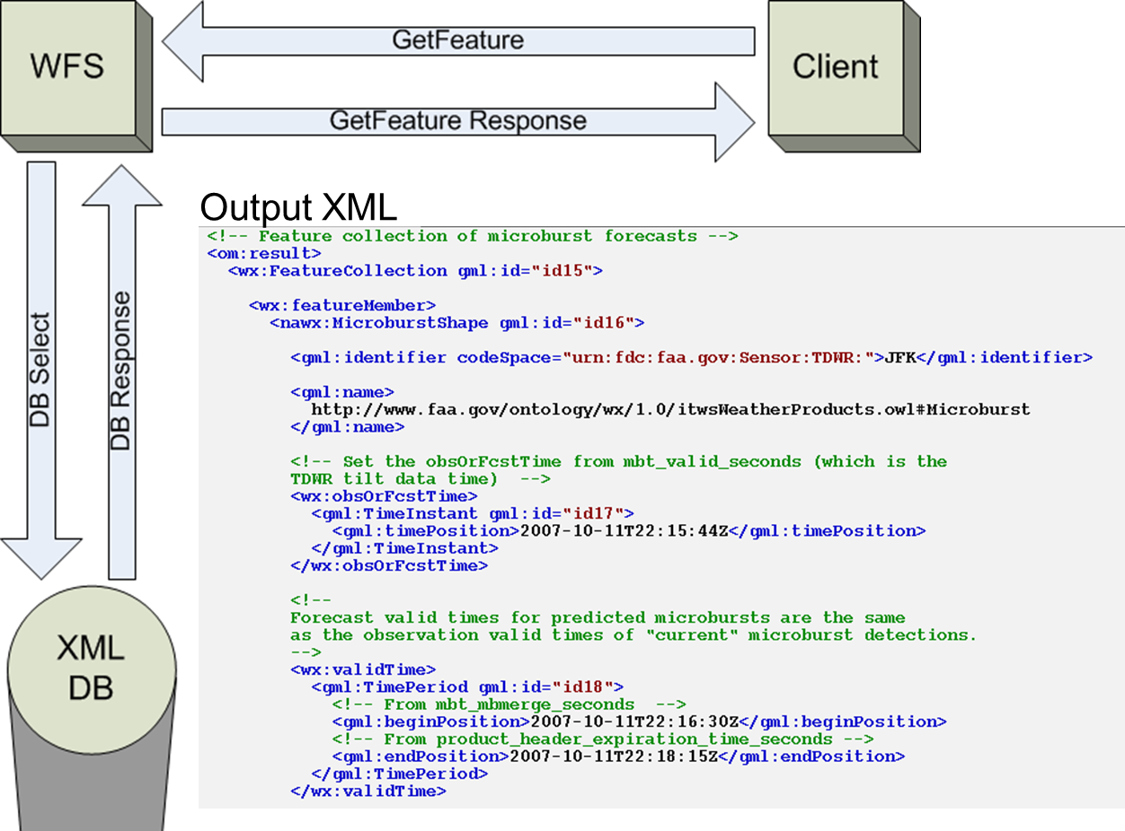
Web Feature Service (WFS)
Notes:
What services does CSS-Wx provide?

Slide 11
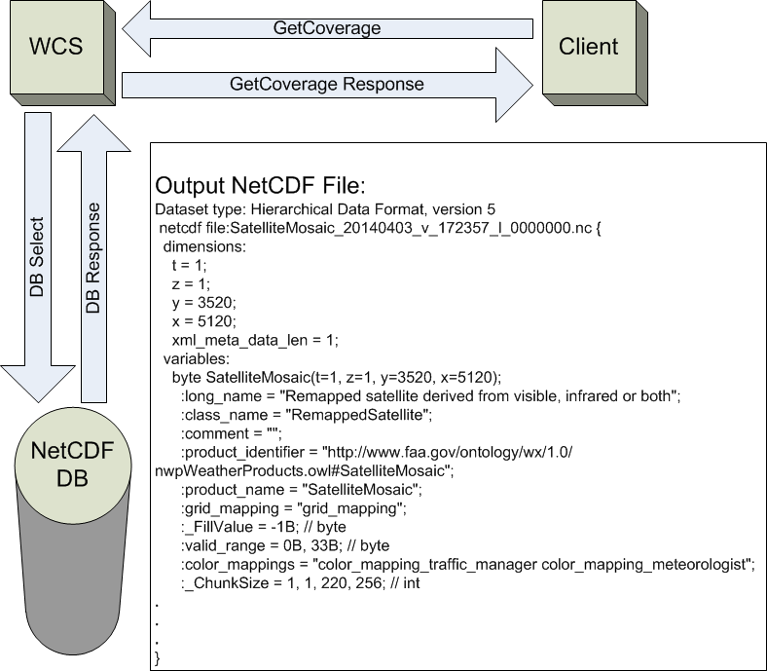
Web Coverage Service (WCS)
Notes:
What services does CSS-Wx provide?

Slide 12
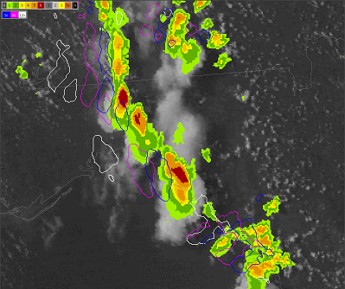
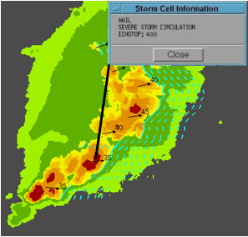
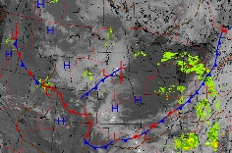
Non-Gridded Data Products
Non-gridded products express singular or sparsely distributed geospatial sets of observations or forecasts
  Contours, point products, text products
XML format and extensions used to represent non-gridded data
  Geography Markup Language (GML), Weather Information Exchange Model (WXXM), etc.
Geo-reference coordinates (latitude, longitude) used to represent data locations
Precipitation Contours
Storm Motion Vectors, Extrapolated Positions, Hazard Text
Fronts and Fronts Forecast
Notes:
What data formats does CSS-Wx use?

Slide 13
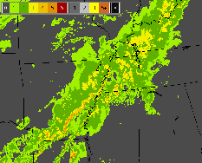
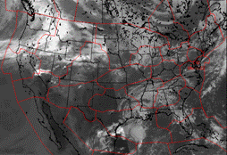
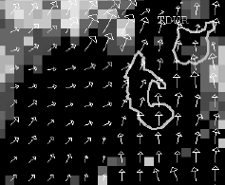
Gridded Data Products
Gridded products represented as uniformly spaced observations or computed values on rectangular arrays
Mapping projection needed to map data grid to earth’s surface
  Examples: Lambert Conformal, Lambert Azimuthal Equal Area
Network Common Data format (NetCDF4) used to model gridded data products
Precipitation (VIL) Mosaic
Satellite Mosaic
Terminal Winds
Notes:
What data formats does CSS-Wx use?

Slide 14
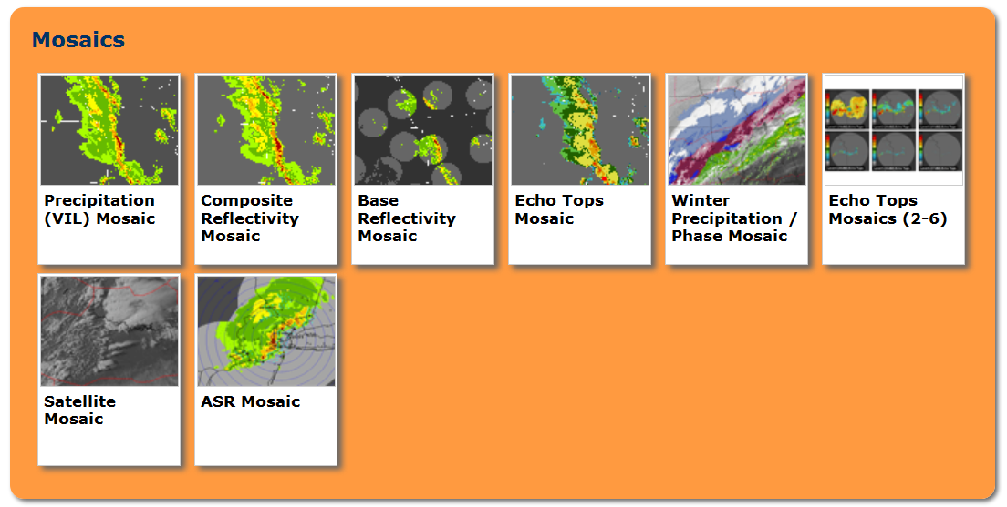
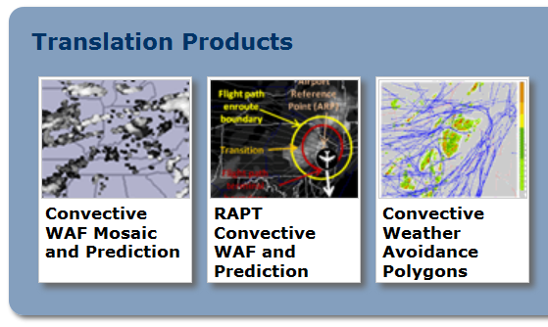
NWP Mosaics &
Translation Products
14
Notes:
What weather products does CSS-Wx provide?

Slide 15
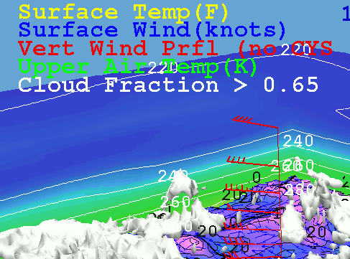
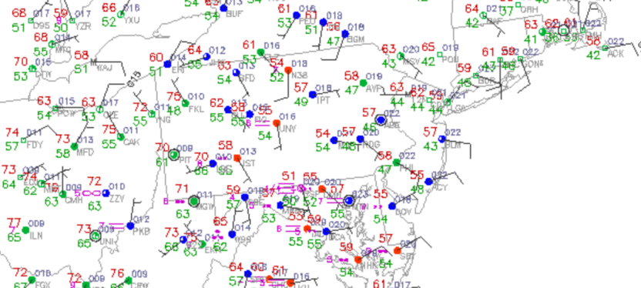
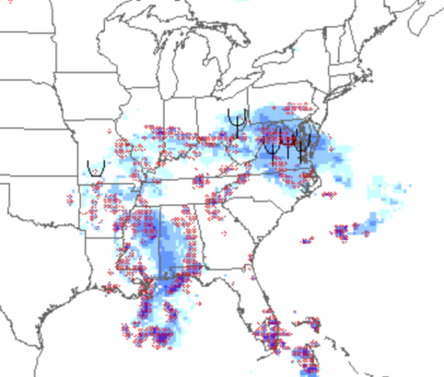
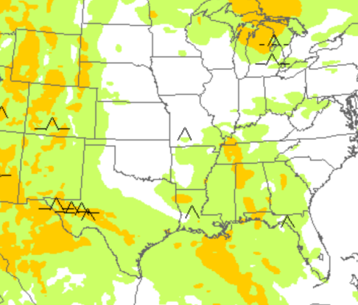
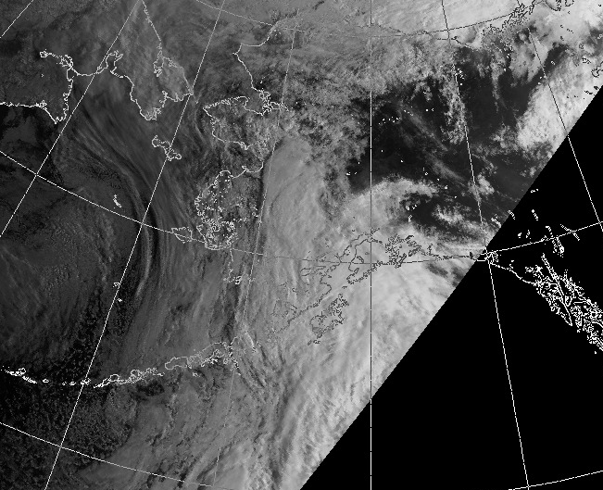
CSS-Wx Products from NOAA
Numerical Forecast Model Data
METARS, TAFS
and other alphanumeric
Icing and Turbulence Forecasts
Satellite Images
15
Notes:
What weather products does CSS-Wx provide?

Slide 16
Joint Capability Evaluation (CE)
Demonstrated capability for data exchange:
  Ground-Ground between NOAA and FAA
  Air-Ground between FAA and Aircraft
    FAA CSS-Wx published weather data to Aircraft:
      NOAA Web Services
      WTIC turbulence research
    Aircraft accessed via AAtS Data Management Service (DMS)
Demonstrated NextGen Weather Capabilities
  Providing common weather picture to aircraft as well as ground users
  Enabling more proactive Pilot-ATC interaction

Slide 17
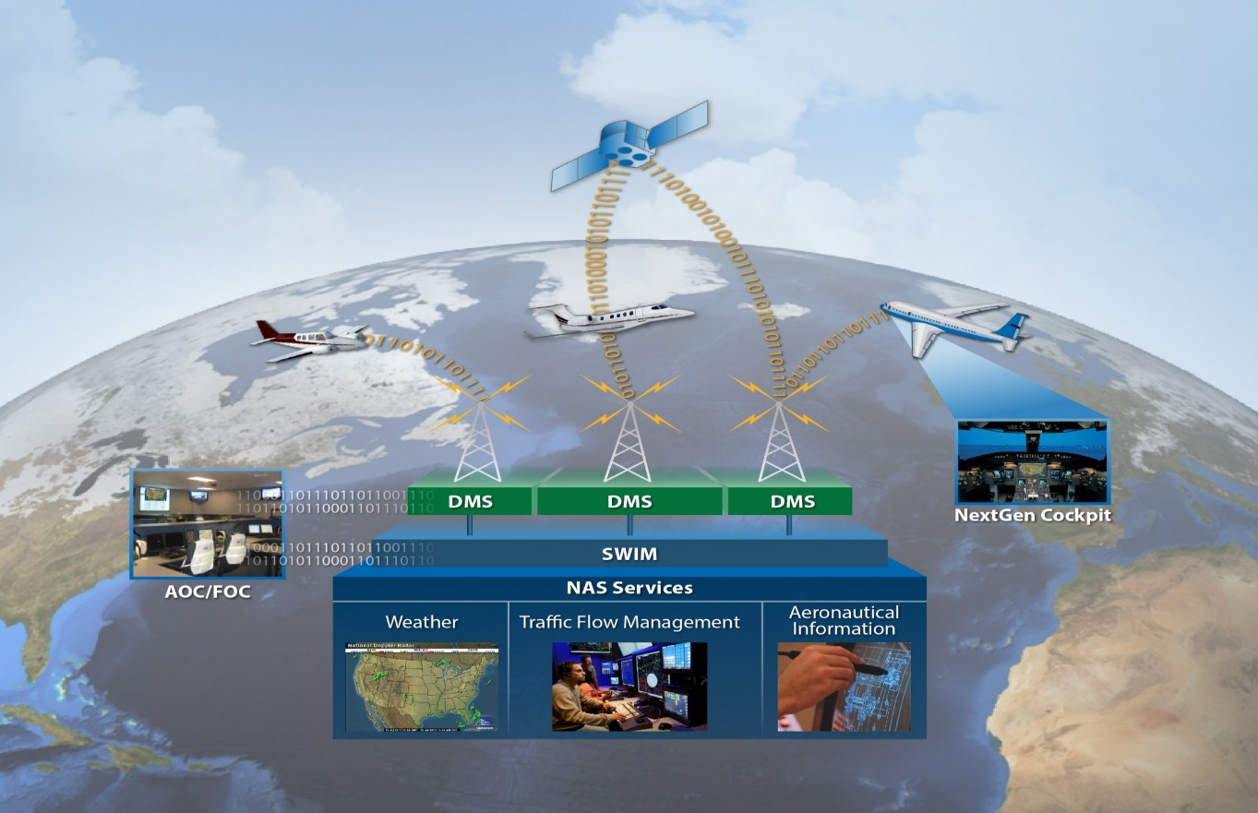
Joint CE-NextGen Concept Demo
10111100
NOAA Data
Web Exchange
10111011011001100111011
CSS-Wx
CSS-Wx
17

Slide 18



FAA-NOAA Common Goal of NextGen Web Services
The right information
to the right people
at the right time

Slide 19
Contact Information
Alfred Moosakhanian, FAA
Program Manager
FAA Common Support Services-Weather (CSS-Wx)
alfred.moosakhanian@faa.gov
Ryan Solomon, NOAA
Project Manager
NOAA NextGen IT Web Services (NGITWS)
ryan.solomon@noaa.gov

Slide 20
Questions?

