Slide 1

Delivering Digital
Services
SWIM
Flight Data Publication Service
(SFDPS)
Presented By: Linda Chen
Date: August 27, 2014

Slide 2
SWIM Flight Data Publication Service
(SFDPS)
First to publish flight data via FAA System Wide Information Management (SWIM)
Early adopter of FIXM and AIXM standards
Built with reusable services:
    Flight Matching & GUFI
    FIXM & AIXM translators
    Historical database
Leverages the FAA NAS Enterprise Messaging Service (NEMS) for connectivity

Slide 3
SFDPS Highlights
Produces NAS flight data in SWIM compliant formats
Makes using flight data easy in modern applications like Google Earth
Supports a key element of NAS Enterprise Architecture
Includes flight matching and GUFI
Enhanced feed eliminates redundant and conflicting data
Supports FIXM and AIXM standards
Current and historical databases provide snapshots and reconstitution
Consumer customizable data feed
Publish/Subscribe and Request/Response
Built on a modern and scalable infrastructure

Slide 4
Benefits of Using FIXM
FIXM is the international standard solution to the perennial problem of data sharing
Traditionally, a large amount of effort is spent each time a system wants to share data with a partner, translating data from the other systems format into its own and back again
This effort is typically repeated each time a new exchange is desired
As the FIXM standard evolves, systems wishing to exchange data will only need to build a single interface: one which translates their data to and from FIXM format

Slide 5
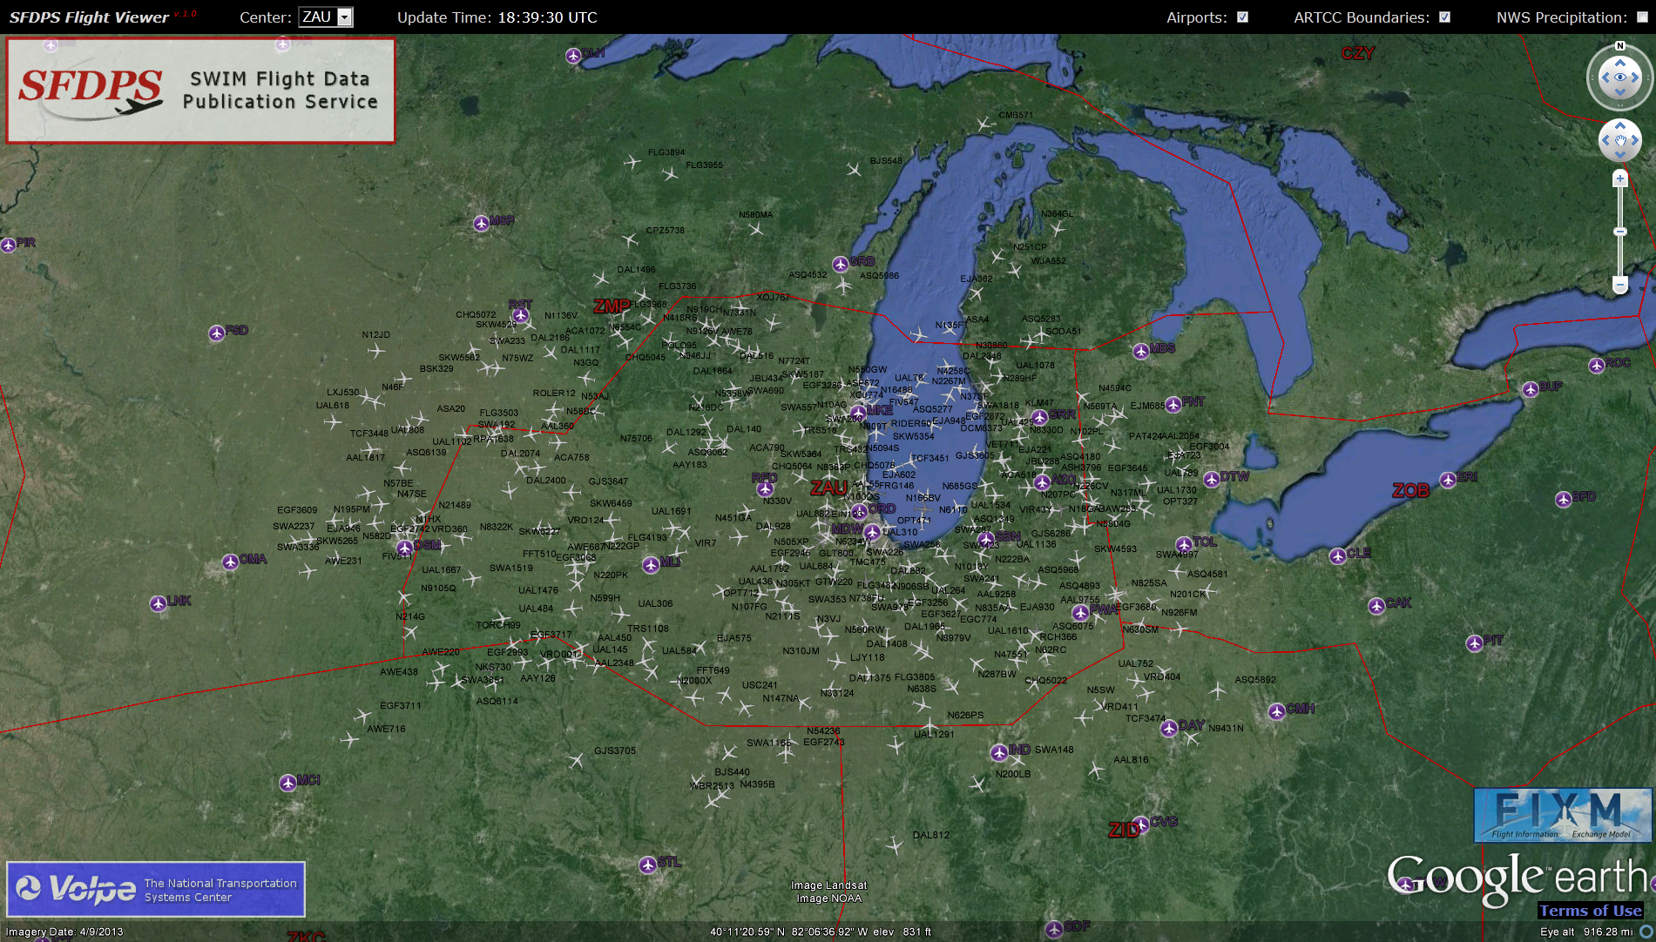
SFDPS Flight Viewer

Slide 6
SFDPS Publish/Subscribe
Consumer receives a stream of standardized XML messages by connecting to a topic with any JMS client
The system and infrastructure use industry standard protocols to make client development easy
XML message formats make complex information accessible as easily understood data structures
This information can easily be converted to KML to be viewed in any GIS software (including Google Earth or Google Maps)

Slide 7
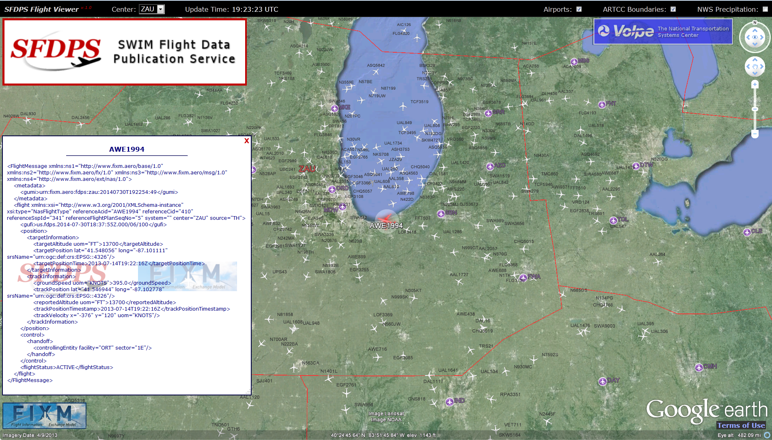
SFDPS Publish/Subscribe
Track messages from ZAU translated from FIXM XML to KML

Slide 8
What Value Does SFDPS Publish/Subscribe Bring to Users
Standards-based data format
Customizable feed including:
    Flight Status
    GUFI
    Airspace, Operational Status
Enhanced feed eliminates redundant and conflicting data
Loosely coupled services enable simple integration, consumption and reuse

Slide 9
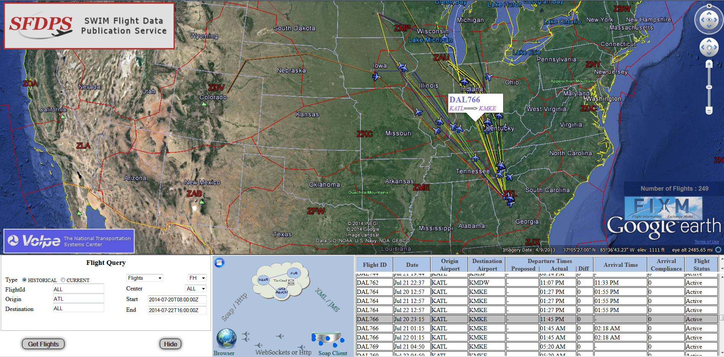
SFDPS Flight Queries

Slide 10
SFDPS Request/Response
Consumer can use standard SOAP-over-HTTP clients to request a rich combination of SFDPS data
Loosely coupled scalable design supports wide variety of queries ranging from one flight to thousands of flights
Common use cases (such as single flight history lookup) engineered to run with very fast performance

Slide 11
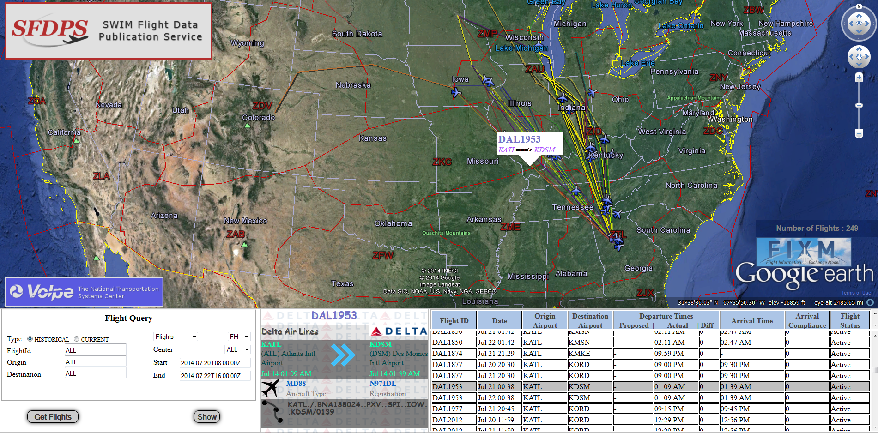
SFDPS Request/Response

Slide 12
What Value Does SFDPS Request/Response Bring to Users
Standards-based, flexible query capability
Supports fast user start-up with a snapshot of all current active and planned flight data
Supports ad-hoc queries for current and historical data including:
    Flight Status
    Sector Configuration

Slide 13
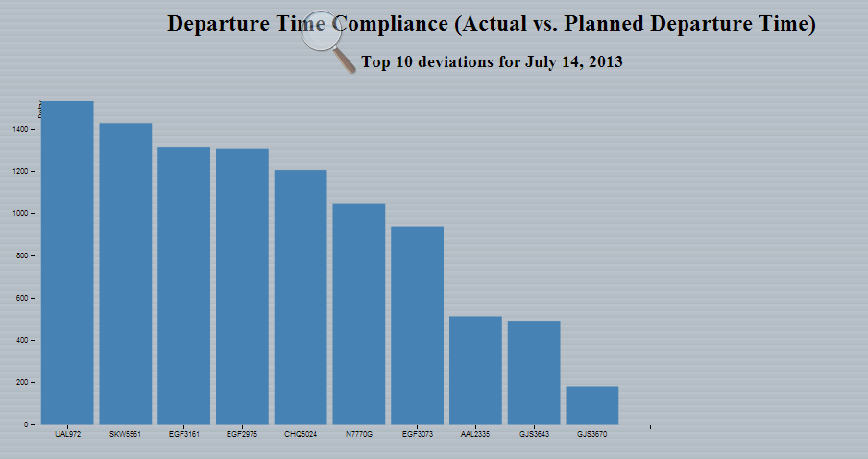
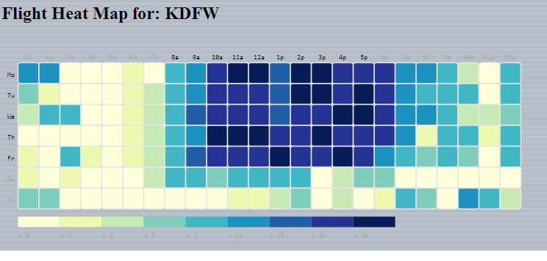
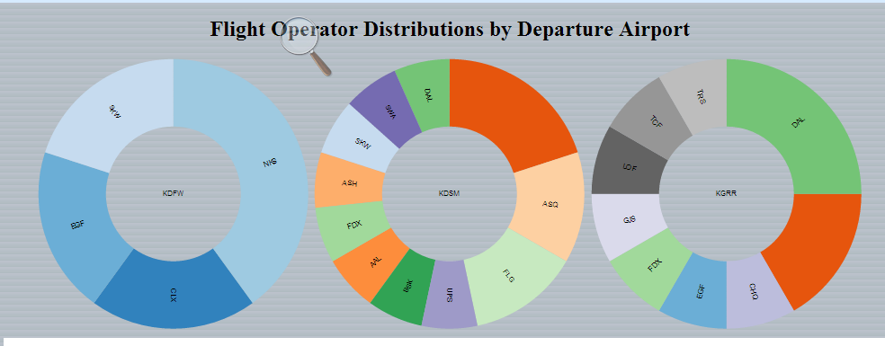
Big Data Analytics
SFDPS Database
Supports both current and historical data storage and retrieval
Enables fast and accurate Flight Matching
Built-in support for Big Data Analytics

Slide 14
SFDPS Current Status
Currently in Operational Testing (OT)
Scheduled for deployment in 2015
Future enhancements being planned

Slide 15
Questions?

Slide 16
Contact Information
Jim Robb, FAA SWIM Program Manager
  (202)-2678357, email: jim.robb@faa.gov
Linda Chen, FAA, SFDPS Project Manager
  (202)-2677566, email: linda.chen@faa.gov

