Slide 1

Delivering Digital
Services
Aeronautical Information
Services in Europe
Presented By: Eduard Porosnicu, EUROCONTROL
Date: August 26, 2014

Slide 2
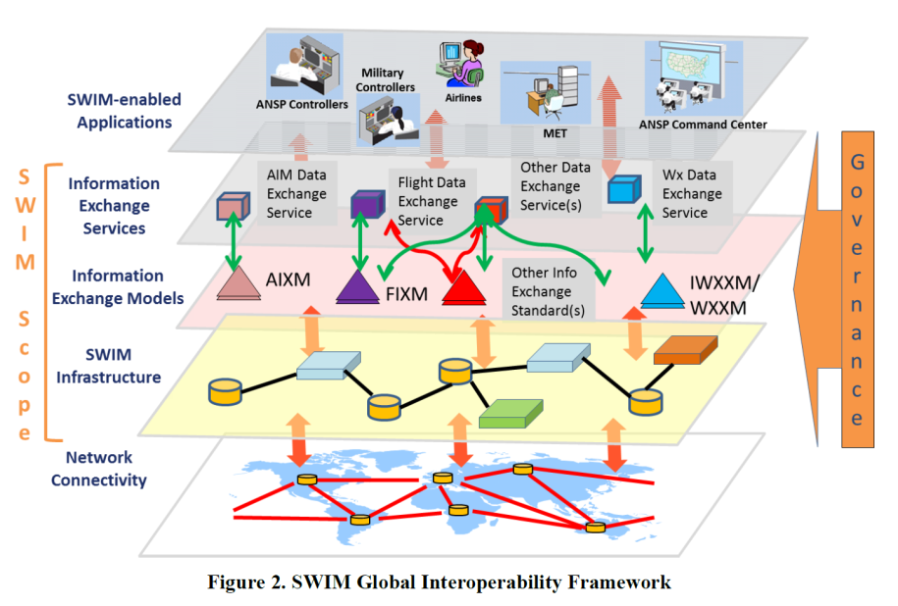
1

Slide 3
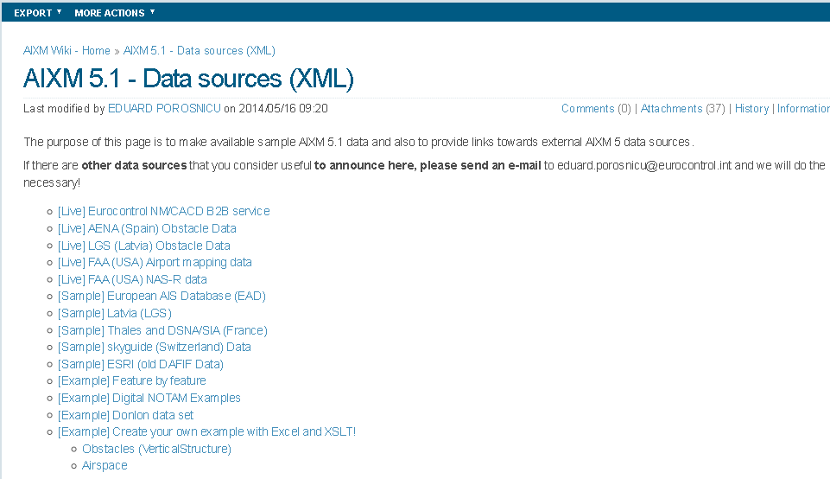
AIXM 5.1 Data Sources
Which are / will become available as SWIM services?

Slide 4
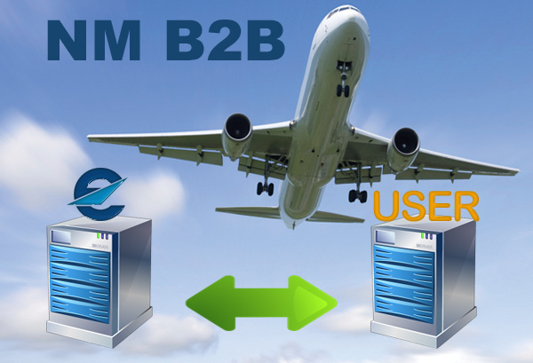
Eurocontrol/NM/B2B
Eligible operational stakeholders access web services for direct interfaces with the Network Manager's operational systems and data.
Open web service technologies
  SOAP web services and REST-like web services.
  Payload is always XML, standard data models when available.
  All services make use of HTTPS.
  Strong authentication with digital certificates (PKI)

Slide 5
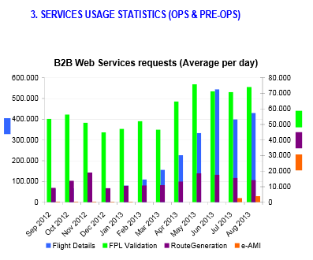
Eurocontrol/NM/B2B
Flight Services
  Flight Plan Preparation/Validation
  FPL Filing/Updates
  Flight Data Retrieval
Airspace Services
  Airspace Data in AIXM 5.1 (points, navaids, routes, airspace, aerodromes and E-Restriction)
  FUA Service for the creation and update of AUP/UUP
  eAMI (electronic Airspace Management Information)
Further info:
  https://www.eurocontrol.int/services/nm-b2b

Slide 6
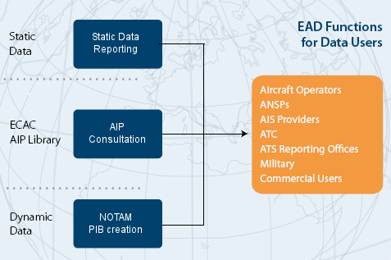
European AIS Database
Initial B2B access through the
EAD/ESI (custom interface)

Slide 7
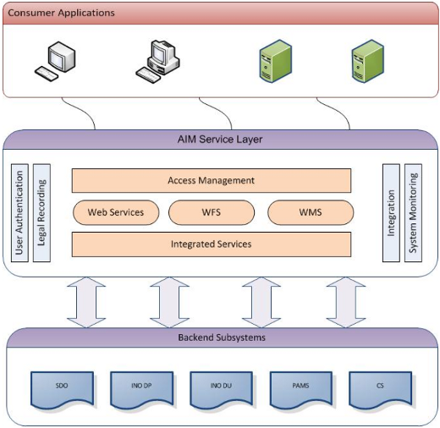
EAD - AIMSL
Currently supports:
INO (NOTAM, PIB)
PAMS (AIP)

Slide 8

Future EAIMS (CS#5)

Slide 9
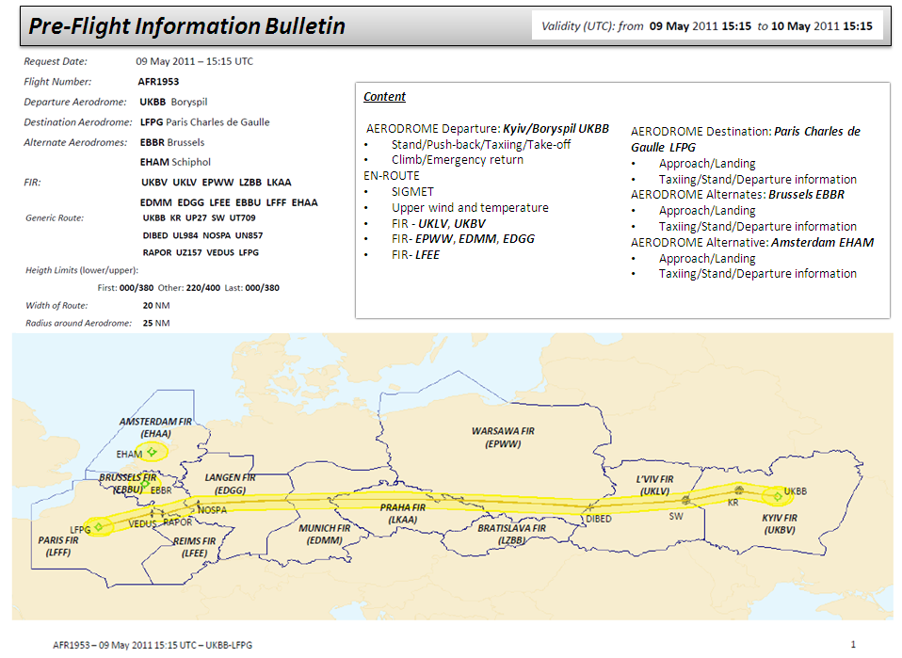
SESAR - ePIB
Trial
Phase of flight

Slide 10
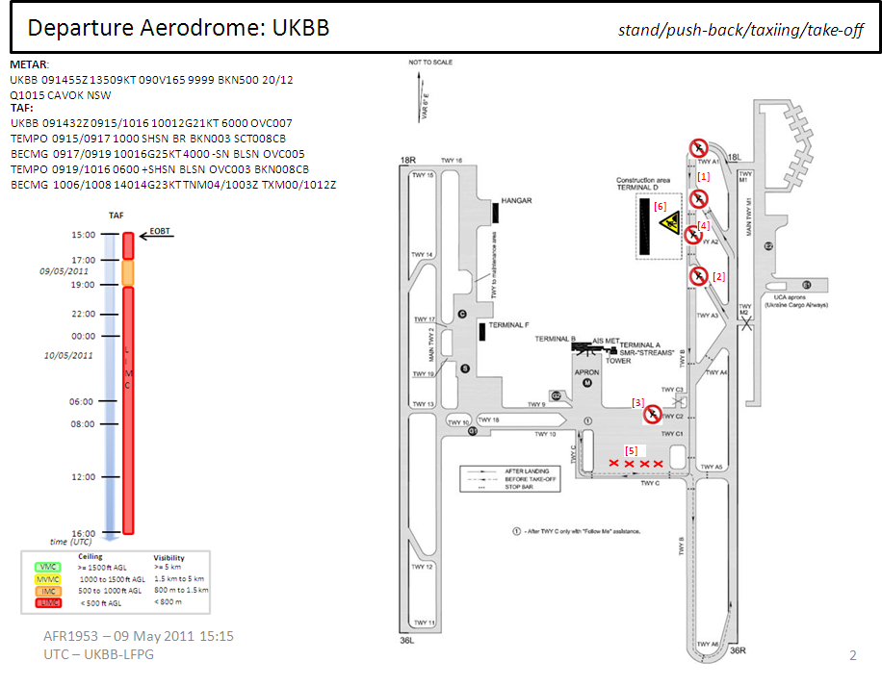
SESAR - ePIB
Trial

Slide 11
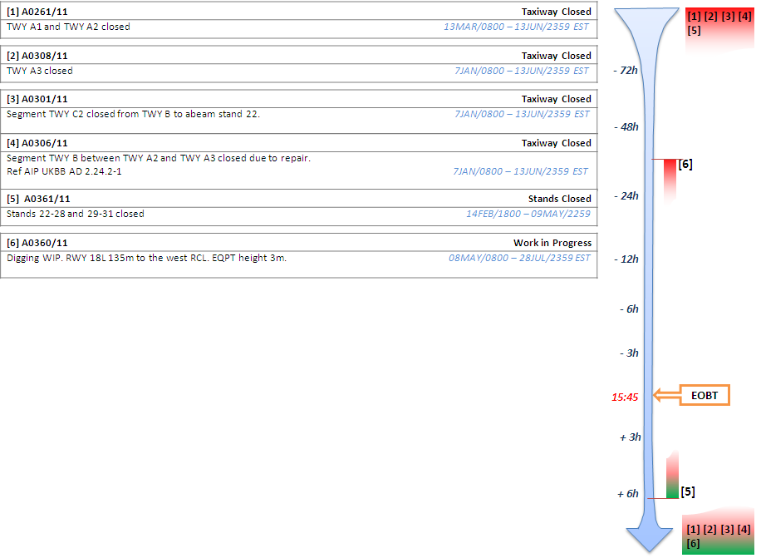
SESAR - ePIB
Trial

Slide 12
SESAR - ePIB
Validation Exercise – Technical Specification
ePIB Prototype (Frequentis)
ISRM Defined Services
Implemented with OGC services – WFS, WMS

Slide 13
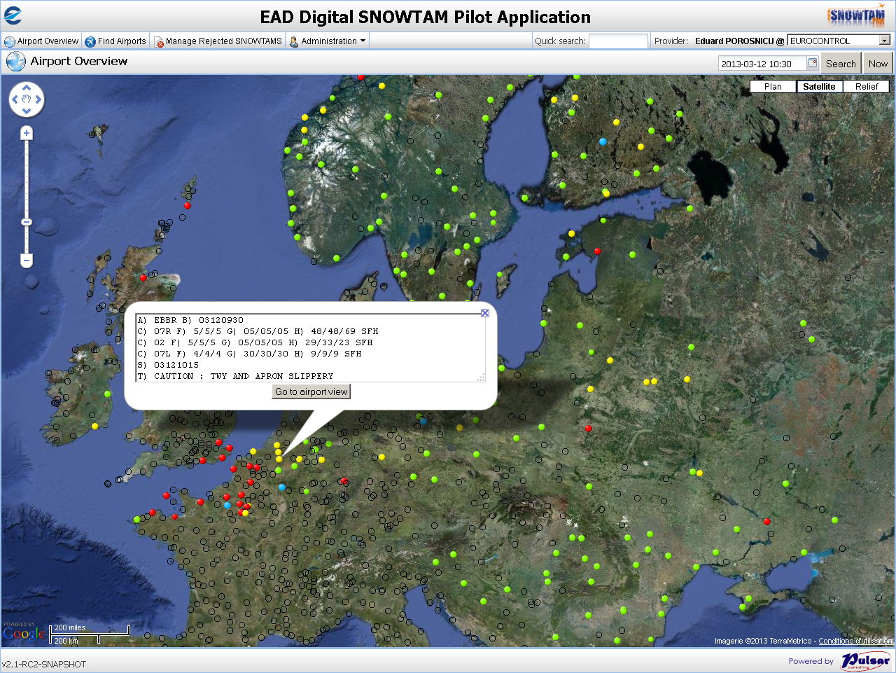
Digital SNOWTAM
Trial

Slide 14
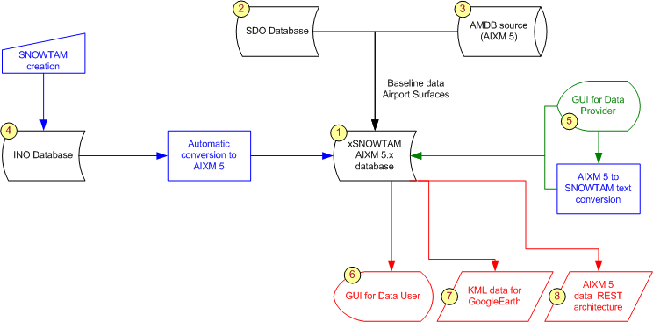
Digital SNOWTAM
Trial
AIXM 5.1 data
WFS

