Slide 1
Aeronautical Services
Aeronautical Information Management Modernization and Improving Information Infrastructure
Presented by: Bob McMullen, Program Manager,
Aeronautical Services, AJM-336

Slide 2




Enterprise Aeronautical Services
AIM Modernization
Aeronautical Information Management Modernization (AIMM)
NAVAIDs
Airports
Procedures
Airspace
Modernizing the collection, delivery, and use of AI in the NAS & supporting systems through the implementation of the Aeronautical Common Service (ACS), enabling NextGen Air Transportation System.
DATA CAPTURE & INGESTION
INFORMATION MANAGEMENT & INTEGRATION
Validate
Transform
Publish
INFORMATION DISSEMINATION & PUBLISHING
Maps
Text
AIXM
XML
AIMM takes a segmented approach to these infrastructure enhancements to get critical capabilities implemented earlier and reduce overall risk

Slide 3
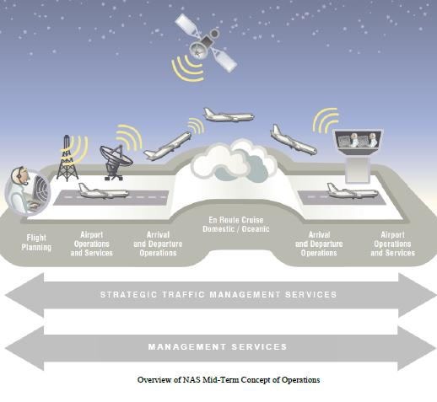

NextGen Overview
On Demand NAS Info Mid-Term Concept
Operations
  Strategic Traffic Management
  Flight Planning
  Airport Operations
  Arrivals & Departures
  Cruise Operations
  Oceanic Operations
  Support Management
System Wide Enhancements:
  Net-enabled information access
  Weather Assimilated into Decision Making
  Enhanced Safety
  Security
  Environmental Management
  “The On Demand NAS Information Portfolio provides Net-enabled information access for NextGen Mid-Term Operations.”

Slide 4


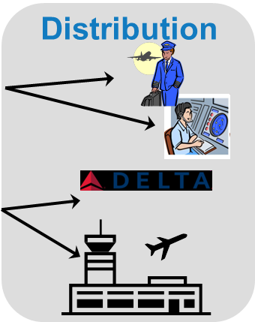

Federal NOTAM System
An Example in Action
Web
Web
Web-
service
Web-
service
Originate NOTAMs at the Source
Digitally Capture Temporary Hazard Information
Integrate Permanent and Temporary Information
Apply Business Rules, Validate Data,
Translate, and Publish
Distribute NOTAMs to the Users
Electronic Distribution to FAA customers, Computer Readable
NOTAM Manager and
NOTAM Origination Service
NOTAM Search and
NOTAM Distribution Service
Federal NOTAM System
Notes:
4

Slide 5










AIM Sourced NAS Information Dissemination
- Bravo (2017)
AIMM
One Stop Shop
National Geodetic
Data Center (NOAA)
Magnetic Declination Data
NAS/Operations Network
NESG
Aeronautical Common Services (ACS)
SWIM/NEMS
Airlines
NAS/Mission Support
Network
NAVLean
Business Rules
Business Rules
Web Feature Service
General
Aviation
NAVLean Data Capture Portal
Airport Survey Data
Business Process
Web Notification Service
Airports
Survey
Airport Data
Airports
FIX, Waypoint, etc.
Points
Data Collection
Web Mapping Service
Integrated
Aeronautical
Information (AI)
Holding Patterns
Holding Patterns
DoD
NavAid
Navigational Aids
Data Validation
Data Transforma-tion
Obstacles Data
NAS/Mission Support Network
Obstacles
Data Metrics
Data Analytics
Mission Support Systems
(e.g. NAVLean, NASE)
SAA Configuration Definitions
Sectional Charts
Location Identifiers
Weather Stations
FSS & Comm
Class Airspace
ARTCC Sectors
NAS/Operations Network
NAS/Ops Network
SAMS/MADE
SAA Schedules
ANSP Systems [e.g. TFMS (ESIS/IDSR)]
FNS
Digital NOTAMs
NASR
Authoritative Sources
AIM Systems
ACS “Services”
Integrated AI includes fused SAA Schedules, SAA Definitions, NOTAM, Airport Configuration, and NAVLean data
AI Consumers
NAVLean Initiative

Slide 6
AIMM Infrastructure
AIMM Segment 2
  Modernizing the ingestion, integration and distribution of Aeronautical Information (AI)
  Building the Aeronautical Common Service (ACS), an enterprise-based service-oriented architecture that is the trusted source in the NAS for AI for both internal and external consumers
  Capabilities
    Aeronautical Information Integration (AII)
    Aeronautical Information Query and Subscription Service (AIQS)
    Aeronautical Information Data Analytics (AIDA)
    Spatial Information Mapping (SIM)
  Located at the National Enterprise Management Centers (NEMC) in Atlanta and Salt Lake City (To the cloud in FY19)

Slide 7










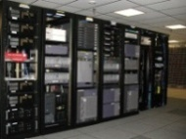









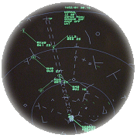


On Demand NAS Information Context
ACS – Aeronautical Common
Service
NEMS – NAS Enterprise Messaging
Service
NESG – NAS Enterprise Security
Gateway
IAP – Internet Access Point
ACS
AIM Data Collection
And Information Management
AIM FNS
AIM Systems
AIM Data Sources
(External to NAS)
e.g. Airspace Data
NOTAMs
SAA
AIM Consumers
(Federal Agencies)
NAS Infrastructure
Federal
Agency
System
(e.g. AF/CSE)
Information Out
Data In
TRACONs
FIS-B
TIS-B
Servers
Boundary
Protection
(NESG)
Aeronautical
and NAS
Information
Dissemination
FAA Surveillance
Broadcast
Network
Federal
Agency
Networks
(e.g. DoD)
Pilots
ARTCCs
FAA Mission Support Network
NEMS (SWIM Core)
Internet
FAA Mission
Support
Consumers
Boundary
Protection
(NESG/IAP)
FTI
Airspace Data
NAVAID Data
AOCs/FOCs
AIM Data
Sources
(Internal to NAS)
e.g. Airport Data
Reference Data
Procedure
Development
Data
En Route
(ERAM)
AIM Consumers
(External to NAS)
Flow
Management
(TFMS)
Terminal
AIM Consumers (NAS)

Slide 8
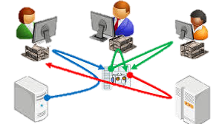

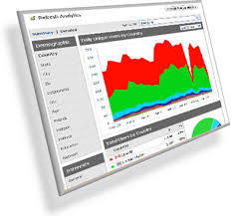

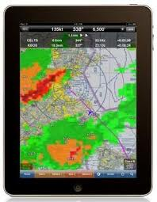
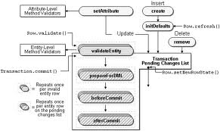
Working with the Data
Workflow
Analytics & Reporting
Displays
Business Rule Validation
Digital Data Layers

Slide 9
AIMM Roadmap – A Multi-Segment Approach
Legacy
AI is alphanumeric – charts, paper products, PDFs.
NOTAMs and SUA are digitized
AIMM S2
Infrastructure Overhaul
And Beyond…
Welcome to the internet age…
Charts and Paper…
AIMM S1
AIM/SWIM S1
NAVLean Enabler
Standardized AI
Distributed through SWIM Infrastructure
Proprietary exchange protocols
AIXM arrives
Standardized SUA and NOTAM data
Not enterprise
Some data exchange standards
Not enterprise
Internationally recognized data standards
OGC and SWIM service standards
Enterprise Integration…
Internationally Harmonized AI Standards Across NAS
Integrated System Architecture
Hairball System Architecture
Point to point
Enterprise Infrastructure
Realize benefits of common data and exchange protocol standards across the NAS
Common Support Services for NAS Users
SWIM connectivity to NAS automation
Data is richer for users
NAS internal consumers adapt to the benefits of richer data
External users adapt quickly to the benefits of richer data
Common operating picture with consistent view of AI across NAS
Proprietary data structures
Hub and spoke/distributed hardware solutions
Most of AI is digital

Slide 10


AIMM S2 Schedule
AIMM S2 Market Survey
08/2012
AIMM S2 SIR Release
01/2014
AIMM S2 Contract Award
2014
AIMM S2 IOC
12/2015
AIMM S2 FOC
2017
✓
✓
✓
CRD Phase
Initial/Final Investment Analysis
Development and Testing
✓
✓
AIMM S2 IARD
02/2013
AIM IID
11/2013
AIM FID
08/2014
FAT Release 1
2015
FAT Final Release
2016

