Slide 1






Delivering Digital
Services
Presented By: Eduard Gringinger
Date: August 27, 2014
Notes:
First of all I have to thank Deborah Cowell for inviting me and of course I have to thank you all for joining my presentation of semantic based prioritization of DNOTAMs.
My Name is Eduard Gringinger and after a short introduction about myself, I want to show you
what the benefits of semNOTAM are, beginning with the foreground we already established within European‘s SESAR.
Then I’ll give you a brief overview about the research results so far,
followed by futures steps to come.
But before getting started, I kindly ask you to do some workout with me to get back concentration!

Slide 2
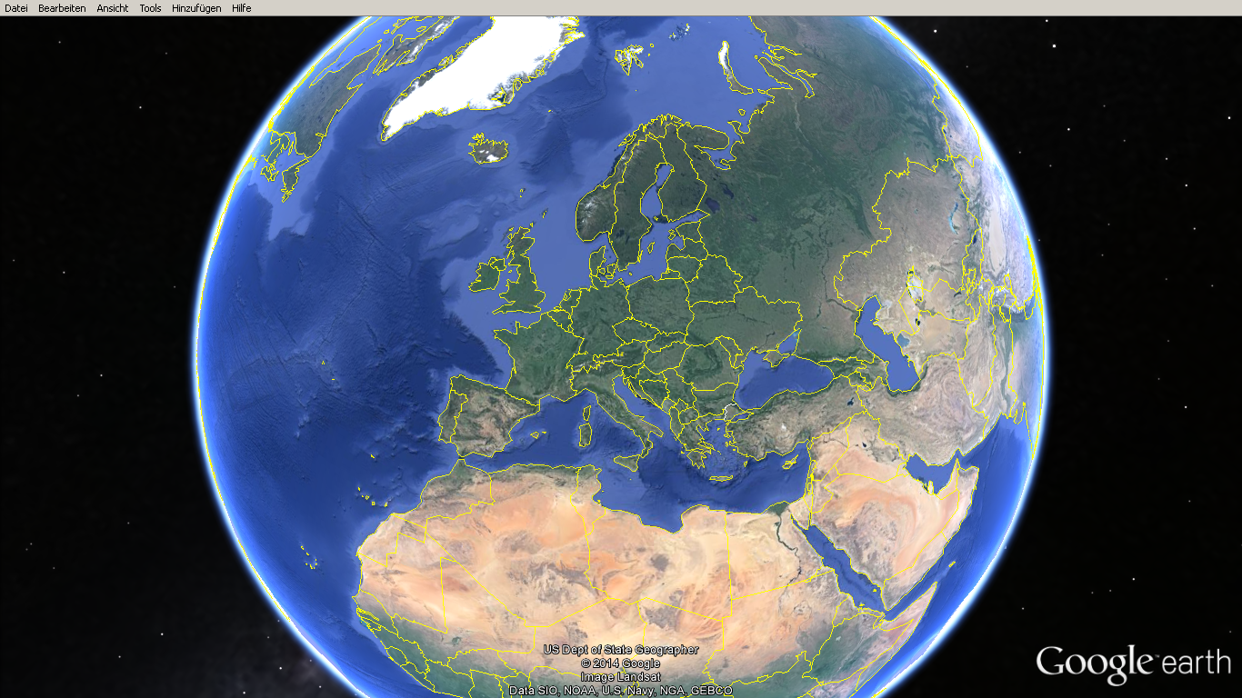
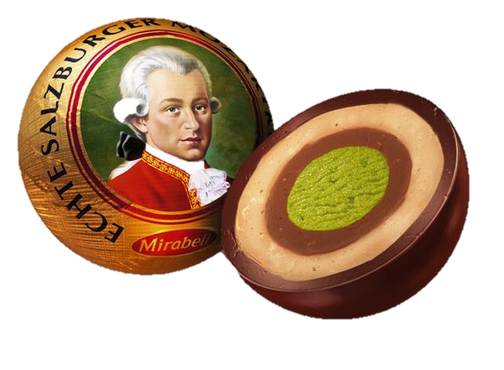
Notes:
I was born in Austria & Austria is located in the heart of Europe.
Which is also the birth place of Mozart. please grab a chocolate balls at our booth outside.
I work @ Frequentis and its headquarter is located in Austria.

Slide 3

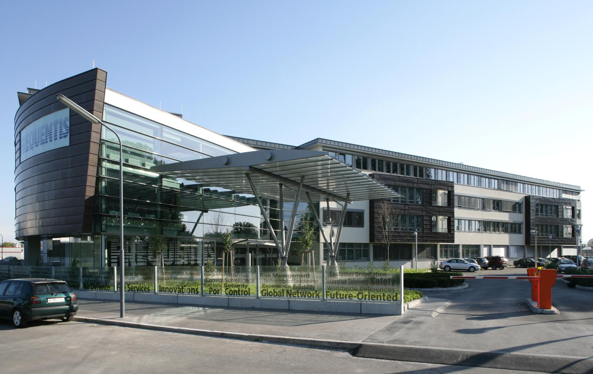
Notes:
Actually this is a picture of the main building in Vienna.
But FRQ has offices around the globe as well as in Washington DC, California or Brisbane, Australia.

Slide 4


Notes:
Frequentis is one of 16 partners involved into the Single European Sky ATM (Air Traffic Management) Research Program and I’m Quality assurance leader of the AIRM. the ATM information reference model.

Slide 5
Semantic DNOTAM
Ontology-based representation & querying of DNOTAM
  SWIM enabled component which you can add to any application
Industrial research & experimental development project founded by the Austrian Research Promotion Agency (FFG)
Started 2014, duration 3 years
Joint Undertaking of FREQUENTIS & University of Linz
Supported by AustroControl, Jet Aviation, FAA - FNS NDS & Eurocontrol
Notes:
semNOTAM extends semantic technologies fine-grained, intelli­gent filtering and querying of Digital NOTAMs
using a wide range of criteria, based on event types, types of aircraft or flight, as well as location in space and progress in time
semNOTAM is SWIM enabled by the means of the SESAR compliance framework for easy application integration. It started this year, will end 2016 and is a JU of FRQ and DKE
DKE: deep knowledge on Semantic systems, Business process modelling and integration, Business intelligence

Slide 6
University Linz
Department of Business Informatics – Data & Knowledge Engineering, Johannes Kepler University of Linz
Research areas:
  Semantic systems
  Business process modelling and integration
  Business intelligence
  Web-based information systems
Relevant previous projects:
  Dynamic Semantic Interoperability of Business Processes
  Semcockpit: An Ontology-Driven, Interactive Business Intelligence Tool for Comparative Data Analysis
6

Slide 7
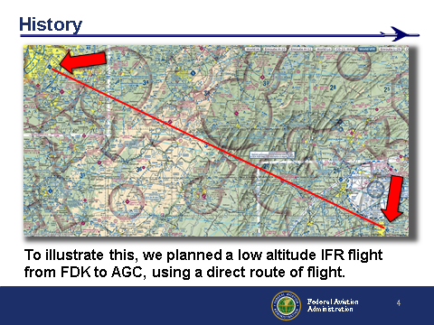
After closer evaluation of 389 NOTAMs, only 68 were applicable.
After fine-grade filtering only 32 NOTAMs affect the route of flight.
*presented by Ernie Bilotto during the NOTAM industry day
Notes:
So what are the user expectations and needs when it comes to PIB. I collected some REQ that where mentioned during the last days. I have to thank Ernie Bilotto for sharing his slides with me.
This exactly matches the outcome of the REQ analyzes we did for semNOTAM.

Slide 8
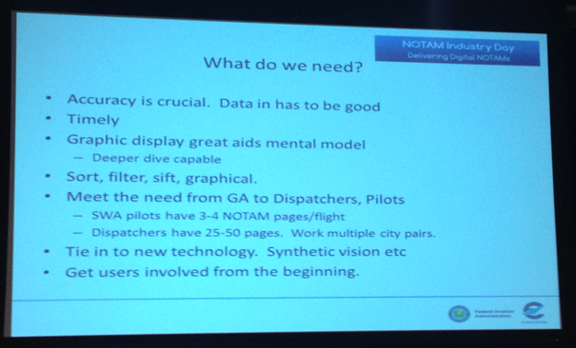

Meet the need from GA to Dispatcher, Pilots
8
Notes:
Another REQ I discovered during the sessions is that we have to Meet the need from GeneralAviation to Dispatcher, Pilots!

Slide 9
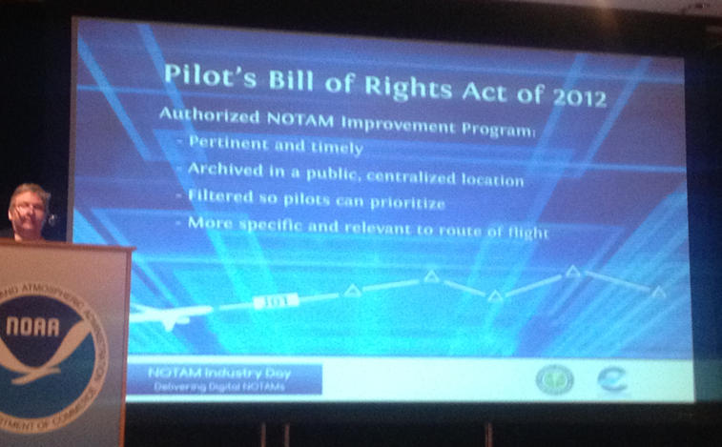
Filtered so pilots can prioritize
More specific and relevant to route of flight
9
Notes:
and even the Pilot’s Bill of Rights Act of 2012 is delivering REQs:
Filtered so pilots can prioritize
More specific and relevant to route of flight

Slide 10
User expectations
Shorter PIB
Prioritize DNOTAM data by relative risk
PIB organization to aid readability
10
Notes:
During the first WP we derived a lot of User Requirements from interviews, SESAR foreground and other documents which led to the following:
relevant NOTAMs for the planned route are displayed prioritized.
Filtered information is displayed in a separate section
Prioritizing NOTAMs based on operational requirements
business rules based on an underlying model of risk assessment
events that contain similar subjects (e.g. runways) listed together and summarized in list- or bullet-styled format
Pre-flight Information Bulletin

Slide 11
Challenges
Capture implicit knowledge from OPS
Filtering rules are not known in full a priori
Generic AIXM event schema, independent of DNOTAM event scenarios
Large set of filtering/prioritization rules
11
Notes:
Filtering Process, Complexity Management & Conceptual Design of Knowledge Base

Slide 12
Roadmap
we are here ☺
2014
2015
2016
2017
Notes:
Right now WP 2 & 3 just started which are dealing with the knowledge base and the rules (the core of semNOTAM). Prototype development will start next year.

Slide 13
SWIM, the Fantastic 3
TI
ISRM
AIRM
Notes:
The SWIM TI transports, validates, etc. the information defined by standardized data models exchanged by services in a secure way. Those are the three layers of SWIM: data, services & TI. I would definitely say it is more than a cable ;-)
AIRM: QA task leader,
ISRM:
TI: Authorization, Message Broker, Security, Data Mediator, Validation, Recording

Slide 14
Digital Briefing
14
Notes:
to be more precise, let’s have a look at a specific service like the DBriefing Service.

Slide 15
semNOTAM prototypes
15
Notes:
One for Dispatcher Briefing and one for the Air-Ground Data-Link to bring DBriefing into the cockpit/EFB.

Slide 16
16

Slide 17
Technology Choices
Protégé
  OWL concepts: Classification of DNOTAMs
  SWRL: Filtering rules
  SWQRL: Closed-world queries
Business Rule Engines
  Oracle Business Rules
  Drools
KR-languages and ontologies
  Datalog (DLV)
  F-logic (Flora-2, ObjectLogic)
17
Notes:
Knowledge Representation (KR)
Datalog; declarative logic programming language

Slide 18
OWL/SWRL/SQWRL
Approach
  OWL concepts: Classification of DNOTAM
  SWRL: Filtering rules
  SWQRL: Closed-world queries
Implemented mini-prototype
  Representation of selected AIXM elements in OWL
  Demonstrates conceptual feasibility of approach
18

Slide 19
Business Rule Engines (BREs)
Approach
  DNOTAMs correspond to business cases
  Filtering rules correspond to business rules
But notice the following mismatch:
  BREs usually support business cases with simple structure and multiple types of BRs
  DNOTAMs have complex structure of a single type
19

Slide 20
KR-Languages
Datalog: DLV
  No support of complexity management in KR: Flat predicates (leads to n-ary predicates with large n), no abstraction capabilities (later additions require change of arity of predicates)
  Limited extension facilities
F-logic
  Frames (complex object structures)
  ObjectLogic and Flora-2 come with extension support
20

Slide 21
Summary
Conceptually Protégé and KR-languages suitable
BREs with conceptual mismatch
21
Notes:
Knowledge Representation (KR)
BREs usually support business cases with simple structure and multiple types of BRs
DNOTAMs have complex structure of a single type

Slide 22
Knowledge Base Overview
22
Notes:
Shows SemNOTAM Knowledge Base and the necessary extensions to existing ontology-, rule- and query-languages for dedicated support in the Digital NOTAM domain. The grey-shaded elements are pre-existing, the others are contributed in the project; the light-grey shaded elements have been gained by transformation of pre-existing information (Explanations on these elements will follow.)

Slide 23
Filtering & Prioritization
Data Preparation
  Prepare data such that subsequent filtering effort can be reduced
Pre-filtering
  Coarse filtering in order to reduce DNOTAMs set
Filtering
  Relevance: discard irrelevant DNOTAMs
  Priority: e.g. scenario-based, for a specific flight phase
23
Notes:
The core of SemNOTAM is the filtering of relevant Notams and the derivation of their priorities.
Retrieving Notams
Ontology Mapping
Pre-processing
Bounding Box Calculation
Resolving Notam Schedules (XQuery/Java)
First filtering according to location and time
Schedule Filtering
Time Filtering
Spatial Filtering
Fine-grained filtering according to location and time
Spatial Filtering
Flight Assignment
Segment Assignment
Time Filtering
Feature Filtering
Prioritization

Slide 24
DNOTAM Rule Set
24
Notes:
The number of rules should not exceed the intersection of the curves “rule set complexity” and “result set”.

Slide 25
Rule Classification
25
Notes:
To solve this issue the rules have to be classified. Primary goal is to identify all key rules, nice to have are the secondary rules.

Slide 26

Future Steps
Acquire more operational input
  Involve pilot associations
Integration of FIXM 3.0
Mini Global Demo 2015
  Dispatcher briefing prototype
EFB prototype afterwards
Notes:
are to listen to the advice of the OPS people to acquire more operational input!

Slide 27

Questions
27
Notes:
Thank you for your attention, if you have any questions please get in touch with me at our FRQ booth!

Slide 28
Contact Information
eduard.gringinger@frequentis.com
semNOTAM.frequentis.com
28
Notes:
Last but not least my contact information details!
there is nothing more to say than: ENJOY THE LUNCH!!!

