Slide 1
AAtS Information Exchange Vulnerability Assessment
Threat-Scenario-Based
Hazard Analysis and Risk Assessment
Notes:
Good morning.
I am Robert Klein – the Technical Lead for Aircraft Access to SWIM.
You may know my counterparts:
Mr Jon Standley – Demo Lead, and
Mr Angel Morales – Operational Lead.
I am here today to discuss the AAtS Data Exchange Vulnerability Assessment.

Slide 2
Data Exchange Comparison Reference
Data Exchange Reference Model
DATA Format | AIXM | FIXM | WXXM
Information Product | NAS Standard Templates | Individual Flight Objects | NAS Standard Weather
Cal / Val | Geospatially Corrected with Occasional Updates | Geospatially Corrected with Dynamical Updates | Geospatially Corrected with Dynamical Updates
Authentication | FAA | Operator – to NESG (pub.) FAA - to NESG (pub.) | Operator - to NESG (pub.) FAA - to NESG (pub.)
Data & Information Description | Airport / Surface Templates OCS, ICA, etc. Flow Constrained Area Standard Terminal Arrival Route (STAR) Standard Instrument Departure (SID) RNP Approaches, J-Routes, Q-Routes, etc. Temporary Flight Restriction (TFR) Special Use Airspace (SUA) eNOTAMs Traffic Management Initiatives (TMIs) Air Traffic / Traffic Flow Management | Flight Plan(s) Approved RNAV Routing RTAs Flight History Flight Object Trajectory Option Set (TOS) FF-ICE (Flight & Flow Information for a Collaborative Environment | METARs SIGMETs and Convective SIGMETs TAFs Winds and Temps Aloft AIRMETs Real-time Surface Winds / Wind Field Profiles PIREPs
Primary Source | FAA | Operators | NWS, FAA, and Operators
Notes:
This chart provides a comparative cross-reference table for the various data and information products, both planned and currently available
Aircraft Access to SWIM is based on using this convention for SWIM data exchange formats:
This column references the composition of the Aeronautical Information Exchange Model or AIXM
This includes the static geospatial templates for the NAS.
This column references the composition of the Flight Information Exchange Model or FIXM
This includes the time-dependent parameters for a given flight.
And this column references the composition of the Weather Information Exchange Model or WXXM.
As you would expect- this contains the past, present, and projected weather information.

Slide 3
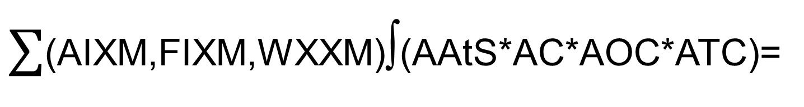
So what-? Why do we care?
Because . . .
$∑$(AIXM,FIXM,WXXM)∫(AAtS*AC*AOC*ATC)=
Collaborative Decision Making (CDM)
CDM = Operational Efficiency (η)
And . . .
η = $$$
Notes:
OK-
So what ?? Why do we care??
Well, because if we provide the combined information from AIXM, FIXM, and WIXM,
Through AAtS into the integrated operational environment of the flightdeck, dispatcher, and controller-
We get Collaborative Decision Making or CDM
And as we all know: CDM Equals-(Pause here)
So CDM sounds pretty good, right?
Then what are we concerned about?

Slide 4


The Concern . . .
Notes:
(May seem like a lengthy pause for animation)
Does anyone recognize our ace?
It looks like he may be on the last leg of a 10-hour day;
Or maybe he is thinking about a steak dinner for two;
But meanwhile- (pause)

Slide 5
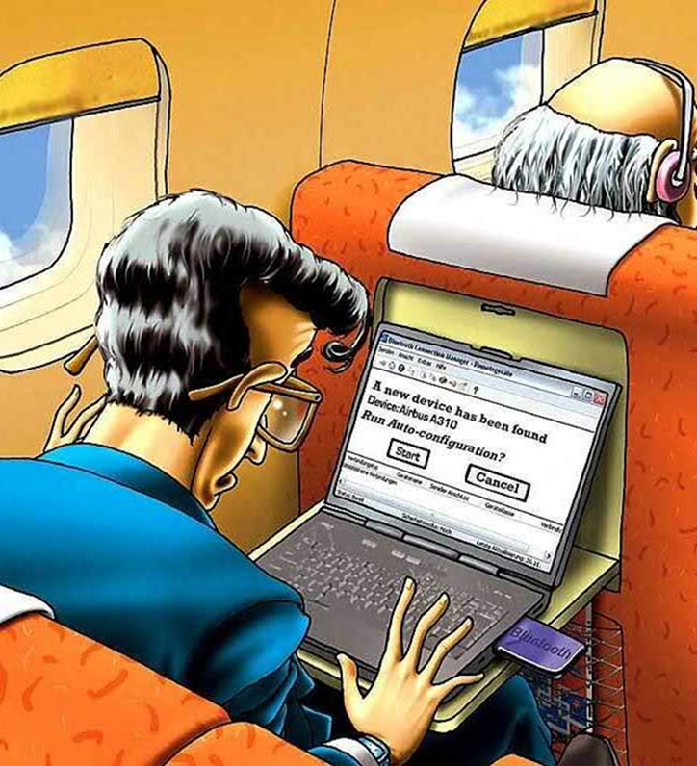
Meanwhile, in 12-A . . .
Notes:
(Pause for the animation)
‘Joe Hacker’ seems to have just found his way to the Electronic Flight Bag (EFB) in the Cockpit.
(Pause for gasps…or groans)
So, is this far fetched?
Is this something ridiculous to consider?

Slide 6
Airborne WiFi in the News
Notes:
Apparently, the Wall Street Journal did not think so-
This article ran earlier this month.
It describes a how a cyber security researcher claims to have figured out how to hack the satellite communications equipment on passenger jets through their WiFi and in-flight entertainment systems.
The article claims that the researcher can use a plane’s in-flight Wi-Fi and entertainment system to hack into its avionics equipment.

Slide 7

‘Original Article’
Notes:
This is the Reuters article that provides the complete article, including both the Research’s claims to be able to hack the avionics-
As well as a rebuttal from several avionics manufacturers relative to the likelihood of this occurring, and
creating hazardous risk to the flight operation

Slide 8
AAtS Threat Portals
Elevation of privilege
Spoofing identity
Denial of service
Tampering with data
Information disclosure
Repudiation
Notes:
In the threat research study we looked at various threat portals. These were:
Spoofing Attack – is a situation in which someone successfully masquerades as another by falsifying data and gaining illegitimate access;
Tampering with Data - means unwanted actions to corrupt or modify a database;
Repudiation - when a hacker gains surreptitious access with falsified credentials or certificates without traceability;
Information disclosure - is the intentional or unintentional release of secure information to an untrusted environment;
Denial of Service - attack is an attempt to make a machine or network resource unavailable to its intended users; and
Elevation of Privilege - is the act of gaining elevated access with the intent of performing unauthorized actions.

Slide 9
Threat Categories & Descriptions
Threat Number | Category | Description
TS-1 | D | Improper traffic originating from the EFB
TS-2 | E, D | Cabin gaining unauthorized access to DLS
TS-3 | E, T | Cabin user gains unauthorized access to Wireless Access Point
TS-4 | D | Consumption of DLS Bandwidth
TS-5 | S, I, D | Unauthorized Network Mapping by Authenticated User
TS-6 | S, E, D | External Attacks with IP Address or Hostname
TS-7 | D | Wireless Access Point/Router DoS
TS-8 | S, E, I | Rogue access point impersonating Wireless Access Point
TS-9 | S, D | EFB may make excessive queries, conducting a DoS
TS-10 | I | User in the cabin sniffing flight deck traffic
TS-11 | S, T, I, E | Attack on the Certificate Authority and Rogue Certificates
Notes:
This chart illustrates our threat categories and how they map to the model we just discussed.
You will see three columns that catalogue:
A threat number that we use as a reference for the specific scenario,
The threat portal or portals most susceptible to this scenario, and
A general description of the threat.

Slide 10
FAA Risk Assessment Matrix
Safety Risk Assessment Matrix from FAA ORDER 8040.4A
Notes:
This is the Risk Assessment Matrix from the FAA’s “Safety Risk Management Policy” otherwise known as FAA ORDER 8040.4A
This ORDER contains the definitive overarching policy doctrine for Safety Risk Management for the FAA and operations conducted within the NAS.

Slide 11
Threat Scenario Risk Assessment
 | Assessed Risk | Number of Threats
 | Unacceptable risk | 0
 | Acceptable Risk with Mitigations | 5
 | Acceptable risk | 6
Notes:
This slide contains our summary risk assessment for the threats considered.
We found that of the 11 Threat Scenarios considered, there were:
No Scenarios with Unacceptable Risk;
Five (5) Scenarios with Acceptable Risks with Mitigations; and
Six (6) Scenarios with Acceptable Risk

Slide 12
Conclusions
The ERAU report presents several interesting network security threat scenarios.
There may be others . . .
Threat Scenarios 1 thru 11 do not represent either Hazardous or Catastrophic risk severity from an operational perspective.
We are continuing to evaluate this important issue.
Notes:
[Read each conclusion – verbatim]

