Slide 1


Service Provider - Turning Data Into Solutions
Daniel Baker
CEO, FlightAware
August 27, 2014

Slide 2
About FlightAware - Overview
Flight tracking service and data provider to airlines, business aviation, cargo, airline service providers, military
Customers include ARINC, United Airlines, SITA, Virgin Atlantic
15,000 commercial customers, 8,000,000 consumer users
Largest aviation site in the world (>300MM page views/mo)
40 employees at offices in Houston and New York City
Data centers in Houston, Washington, San Francisco, New York, Dallas, London, Amsterdam, Singapore, and Hong Kong

Slide 3
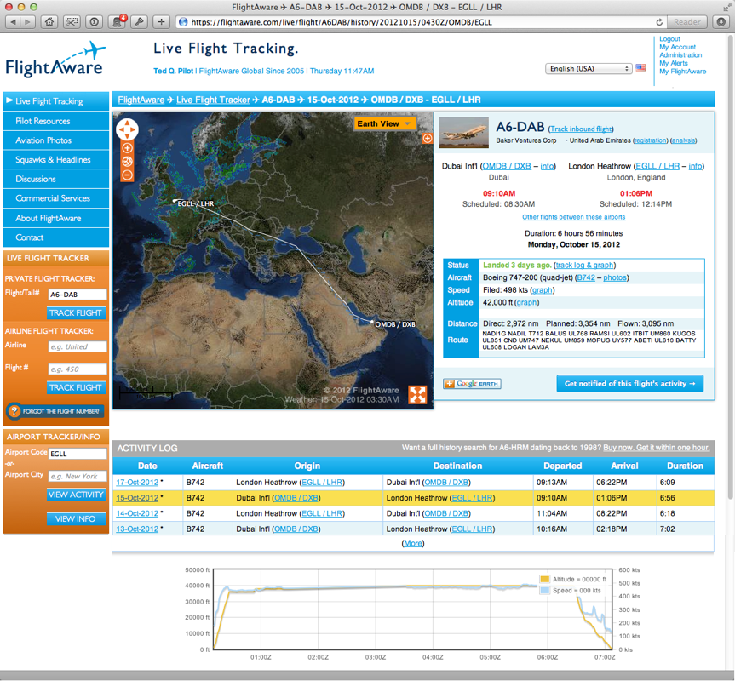
Next-Generation Flight Tracking

Slide 4
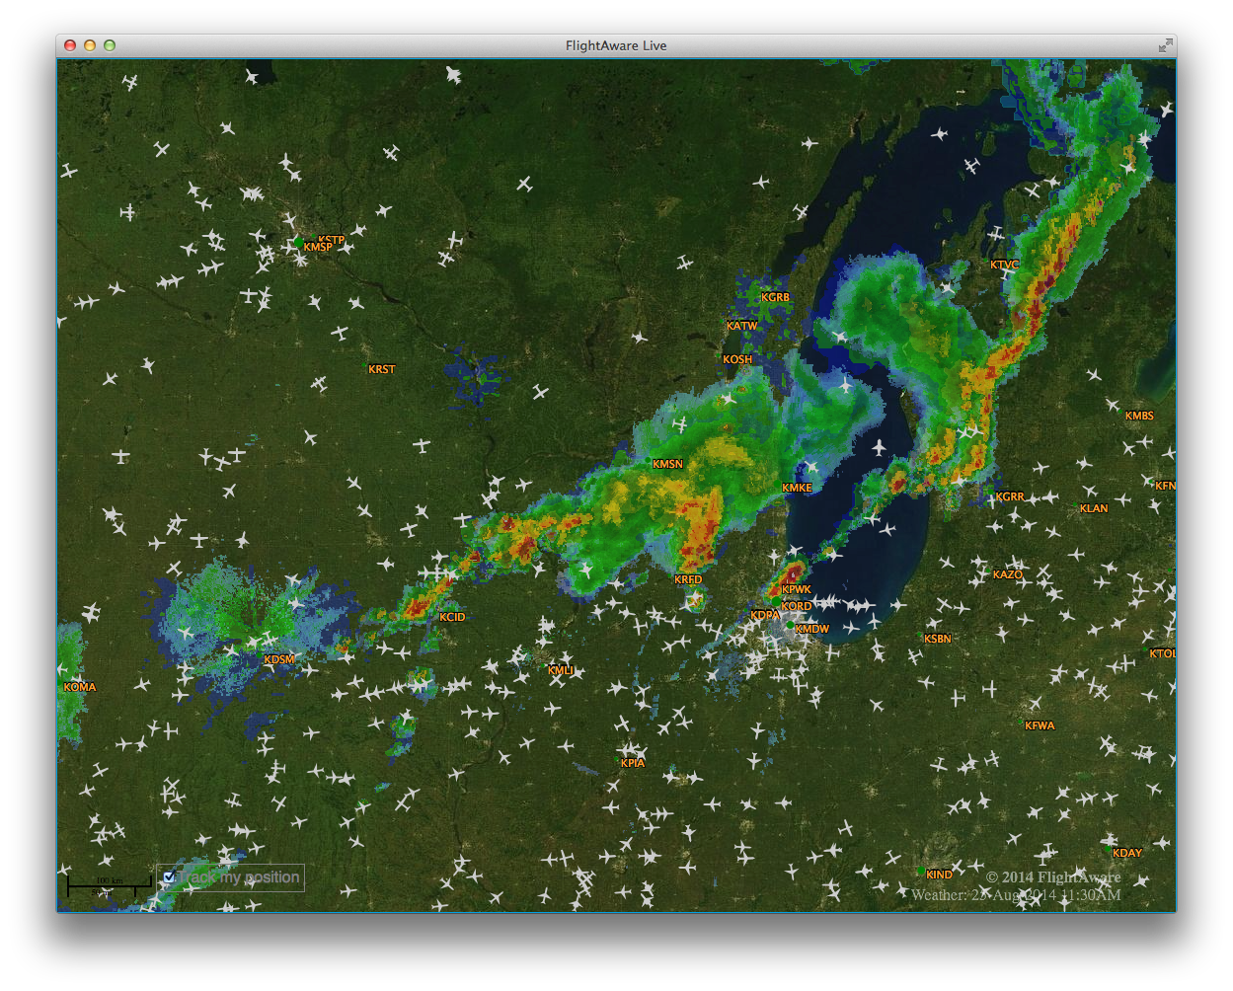
Next-Generation Flight Tracking

Slide 5
About FlightAware - Brief History
Founded in 2005 by pilots, based in Houston
First data feed was Aircraft Situational Display to Industry (ASDI) from the FAA
Availability of data allowed us to fill a niche and industry need
Notes:
Story of calling the FAA
We got started because of the work done by groups like this today

Slide 6
Gateway to Industry & The World
FlightAware aggregates over 50 real-time data feeds from government sources including FAA, Eurocontrol, NOAA, Airways New Zealand
Data is fused with private industry data like flight plan data, ACARS, ADS-B
It is not practical for each end-user (e.g., an airline) to aggregate so many sources
FlightAware then integrates into over a dozen products

Slide 7
Gateway to Industry & The World - Examples
Web-based, graphical flight tracking system used by over 10,000 business aviation aircraft operators
Fused data feed provided to SITA for use in operational flight tracking system used by airline operations
In-flight tool providing connecting gate and delay information to Southwest Airlines passengers via Row44
“MiseryMap” delay map and forecast used by NBC’s “Today” show
Downlinking pre-departure route amendments and delay programs to cockpit (pilot EFBs)
Notes:
The beauty of open data is that the disseminator of data doesn’t have to come up with a list of the potential solutions. Leave that to industry to demand that from us.

Slide 8
Value of Data
Aircraft operators are facing data overload and “portal” overload
FlightAware breaks through this and creates efficiencies by:
  Aggregating data sources
  Creating tools that answer questions
  Leveraging historical data to predict the future

Slide 9
Availability of Aviation Data
Little Known Secrets
ANSPs are full of gems of information that are rarely published. Public, organized registries are the key to ensuring they’re leveraged as much as possible.
Notes:
311 example
Often when data isn’t included where it should be (reg in FP is US) it’s hard to know where to get it

Slide 10
Availability of Aviation Data
Usage Restrictions
Even simple restrictions have enormous impacts on the usability of the data.
Notes:
AU example

Slide 11
Availability of Aviation Data
Chicken or Egg?
Many government data sources require a customer in order to establish restricted data (e.g., CDM, ASDE-X, ASDI Class 1, DDS to AO, etc)

Slide 12
Availability of Aviation Data
Release Early, Release Often
Distribute what’s possible now or you will never be done.
Notes:
ot trying to get too grandiose
this world is built on a foundation of strategic ATC systems, not ATM tactical
efficiency critical (a phrase we heard at the last FAA meeting in DC) not safety critical, and that should shift the model more toward early/often

Slide 13
Availability of Aviation Data
Prioritize API over Portal
CDM is the future, but even with standards, it will require an industry solution to aggregate every ANSP and airport CDM solution.
Notes:
If you really want a portal, you can get someone in industry to do it for free.

Slide 14
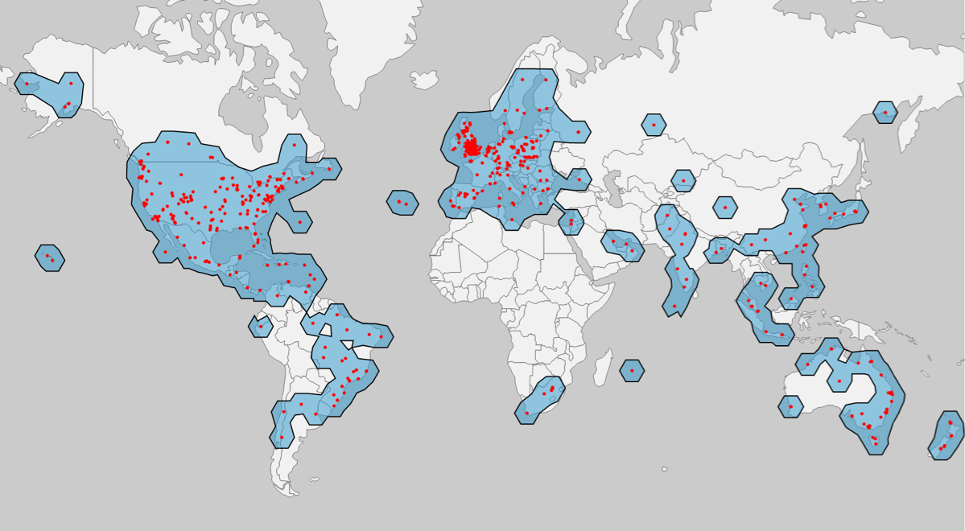
FlightAware ADS-B Network
Available in Eurocontrol SWIM Registry
Notes:
We’ve learned about the importance of getting data out there
Over 500 ADS-B sites in over 60 countries
Currently used by Eurocontrol to demonstrate their SWIM services and provided to nearly a dozen SWIM participants for free. Also available for commercial implementations by license.

Slide 15

Public/Private Partnership
These government organizations, this group and this industry demonstrates what’s possible.
How can we expand that around the world?
Notes:
Amazing success, more than I ever thought possible
What I do now is travel around touting this success

Slide 16
Let’s improve aviation with more open data
Daniel Baker
CEO, FlightAware
dbaker@flightaware.com
+1 713 877 9005
Notes:
Want a beta tester?
Want free data?

