Slide 1
Delivering Digital
Services
Information Management
Theme
Presented By: Deborah Cowell,
FAA, AIT
Date: August 27, 2014

Slide 2
Overview
The Global View
The FAA Enterprise Information Management (EIM) Initiative
Our Speakers today
1

Slide 3
Global Information Management
Trust Relation-ships
Flexible,
Adaptable,
Scalable
Information
FAA Enterprise Information Management (EIM)
Business Information Domains
Risk Information Domain (Safety and Security)
Supports Risk Based Decision Making (RBDM)
Aviation Data Exchange (AVDEX); and Dynamic Regulatory System for Regulations and Guidance
Capabilities to Access “Relevant” Information
Capabilities for Predictive Analytics
Global Information Standards

Slide 4
Global Factors Driving EIM
There are five major business drivers pushing for a global information management approach:
Globalization where information is an enabling commodity for new ATM systems.
Reducing/removing the human intervention in the production and delivery of business information, replaced by automation.
Exponential change in technology provides individuals and groups with new capabilities and “An analysis of the history of technology shows that technological change is exponential, contrary to the common-sense “intuitive linear” view. So we won’t experience 100 years of progress in the 21st century — it will be more like 20,000 years of progress (at today’s rate).”
Interoperability Requirements include building semantics into current capabilities enabling access to structured, semi-structured and unstructured information. “The exponential increase in data, combined with emerging capabilities to analyze and correlate it, will give unprecedented capabilities to individuals and connected networks in nearly every part of the world well before 2030.”
Constrained Resources require doing more with less, therefore, relying on collaboration with others to define common solutions.
The Law of Accelerating Returns. http://www.kurzweilai.net/the-law-of-accelerating-returns. (March 7, 2001)
National Intelligence Council. Global Trends 2030: Alternative Worlds. September 2012 (p. 52)

Slide 5
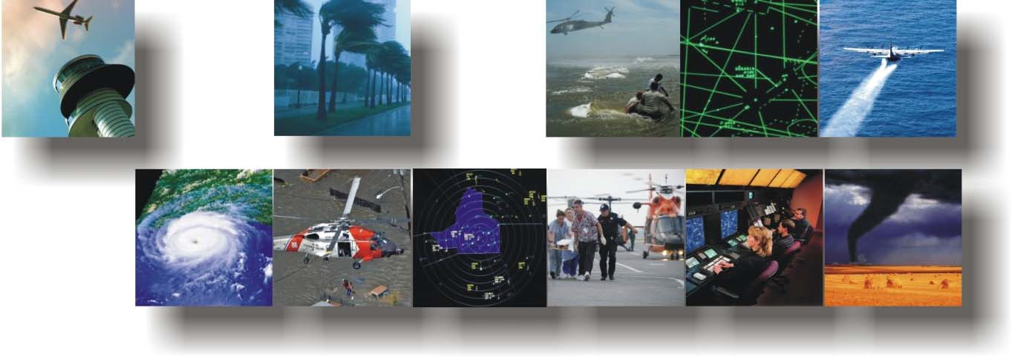
FAA EIM Objective
Transform FAA to a Information-Driven Agency
Build an “actionable” Enterprise Information Management (EIM) strategy and roadmap
Apply an “Information-centric” approach that delivers information as a service (total access)
Maintain leadership in Global Aviation

Slide 6
FAA Enterprise Information Management (EIM)
Vision: Transform the FAA into an Information-Driven Enterprise
Goals
Manage data and information as assets to create business value and contribute to enterprise goals
Provide relevant, trusted, and actionable information to the right people at the right time and in the right format.
Provide the capabilities to enable informed decision making and quickly adapt to changing business conditions.
Guide organizational culture to cultivate an information-centric enterprise.
Expected Outcomes
Holistic approach to EIM that supports mission services.
Transformation to focus on high-value information.
Information management drives efficiencies, reduces costs, and enables confident decision making.
Stakeholders
Information is an asset that affects everyone
FAA lines of business / staff offices (LOB/SO)
International community
Other government agencies
Citizens
Industry Partners
Roadmap
FY2014:
Develop a strategy and vision, including a roadmap for implementation.
Update governance framework and provide supporting standards, guidance and tools.
Scope proofs of concept.
Conduct Discovery to understand stakeholder needs, user requirements and existing assets, infrastructure and processes.
FY2015:
Deliver initial enterprise information governance.
Deliver metadata standards and tools.
Deliver proofs of concept.
Update and maintain an enterprise architecture repository as a primary authoritative resource
Engage stakeholders to:
Understand in-progress data and information-related efforts.
Create an information-centric culture.
Develop a vision and strategy roadmap to deliver information as a service.
Deliver a governance framework that enables FAA to manage data as a resource and information as an asset.
Approach
Create proofs of concept to demonstrate the possibilities and benefits of EIM.
Align strategy with FAA policies and processes.
Apply Enterprise Architecture principles and Information Exchange standards to establish an information sharing environment.
Graphic
Tim Perez
EIM Program Manager
Email: Tim.Perez@faa.gov
O: (202) 493-5069
Enterprise: it’s about the organizational mission Information: it’s what we provide Management: of information as an asset

Slide 7
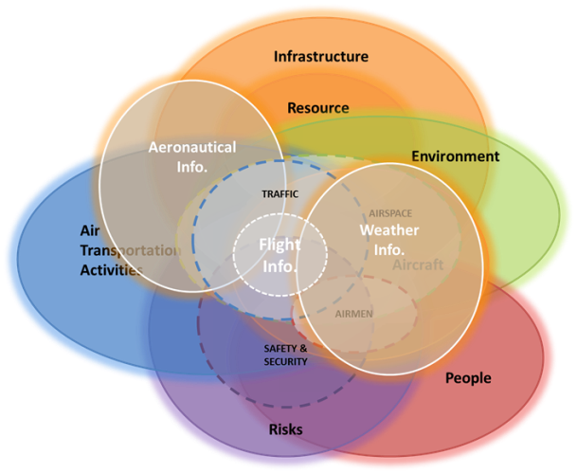
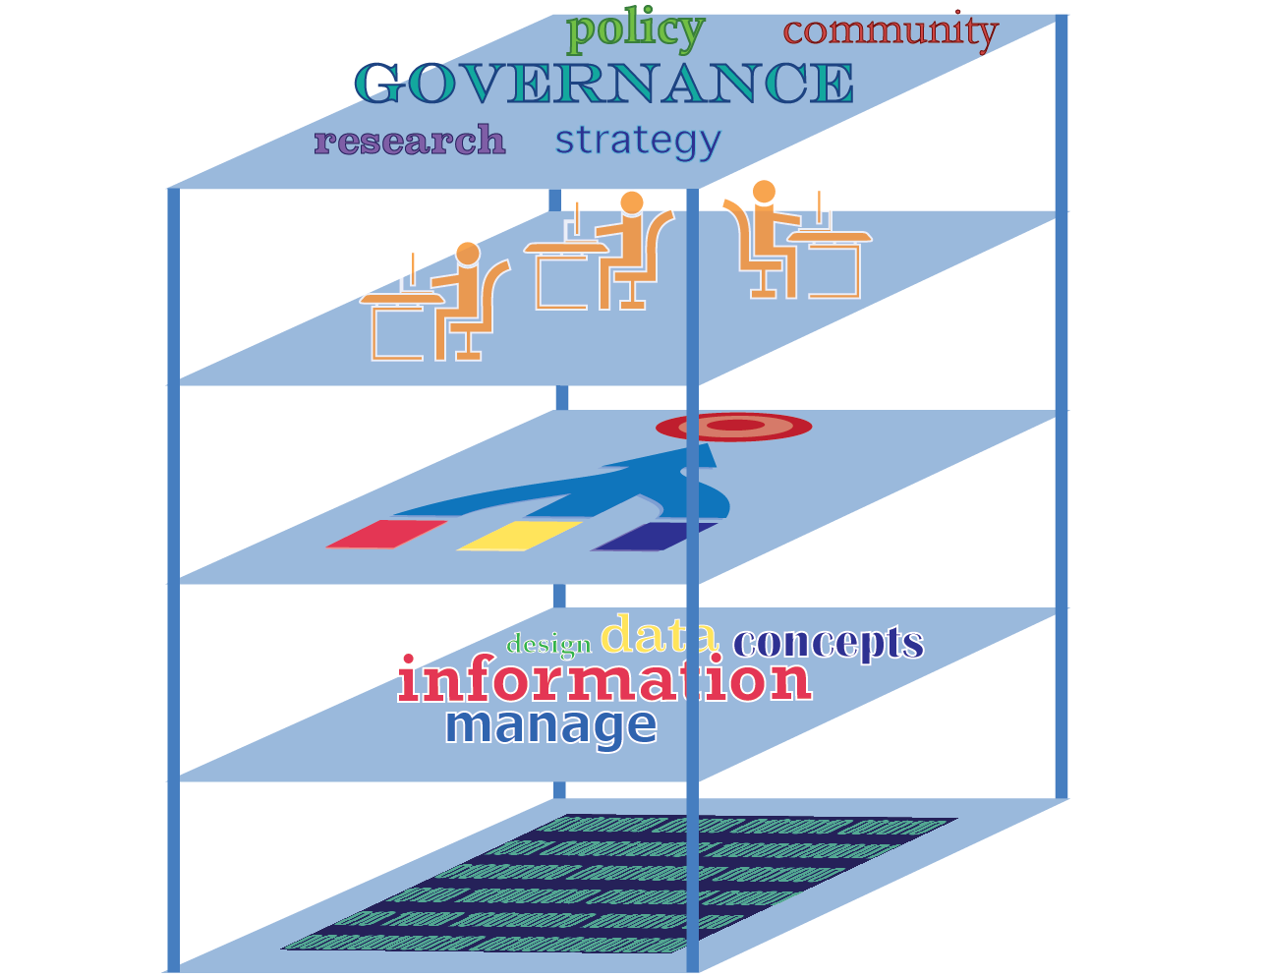
The Value that EIM Delivers
Workforce
Transformation
Enterprise Transformation
From Data Silos into Information Domains
Enterprise-wide Capabilities
Enable New Concepts, Advanced Analytics, and Dashboards,
Authoritative Data
Through the Information Center
Delivering Information as a Service, to the Enterprise
Information Assets
Performance
Management
FAA Enterprise Information Management (EIM) – One Pager

Slide 8
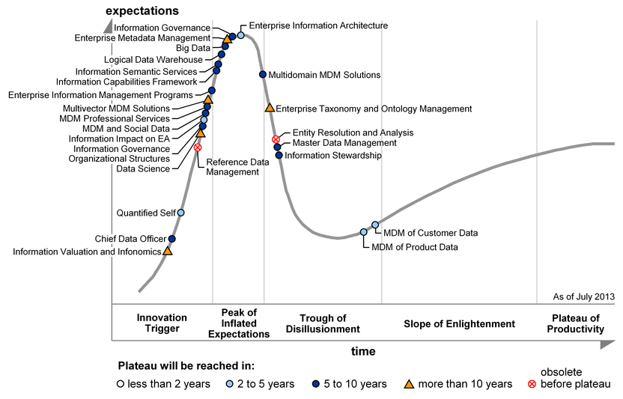
EIM Hype Cycle
Source: Gartner (2013)

Slide 9
What will the Witches stir up next?
POWERFUL
INFORMATION

Slide 10
Our Speakers Today…
Daniel Baker
Roland Baumann
Robert Klein

