Slide 1
IATA views on Information management
JF Grout Assistant Director ICAO relations

Slide 2

What is IATA?
The International Air Transport Association (IATA)
is the trade association of airlines.
Our 240 members generate 84% of the total air traffic.

Slide 3
Our Role in ATM
IATA collaborates hand-in-hand with ICAO, CANSO, ACI and other industry stakeholders to help airlines to operate safely, securely, efficiently, and economically under clearly defined rules.
We provide professional support to all industry stakeholders with a wide range of products and expert services.

Slide 4

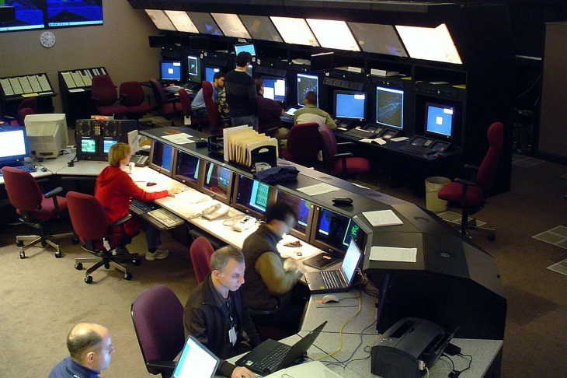


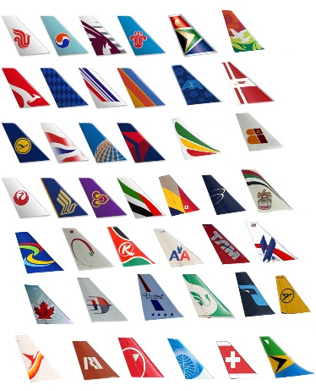
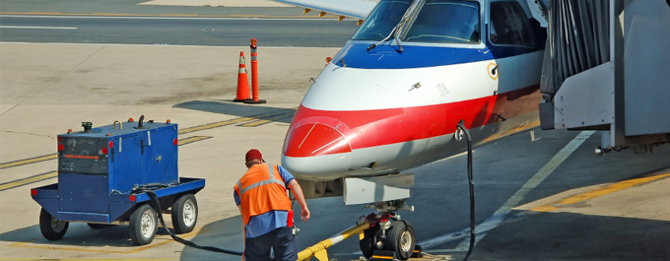

Air transport actors

Slide 5
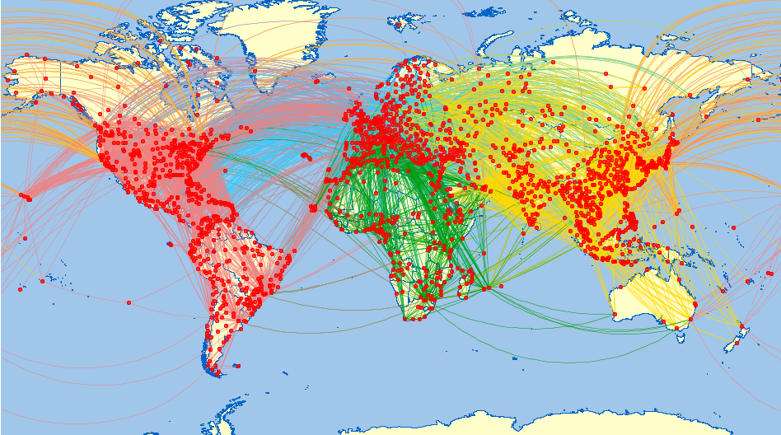
Airlines…
… move people
… move goods
… drive economies
… have very small margins
… need accurate and timely
INFORMATION

Slide 6
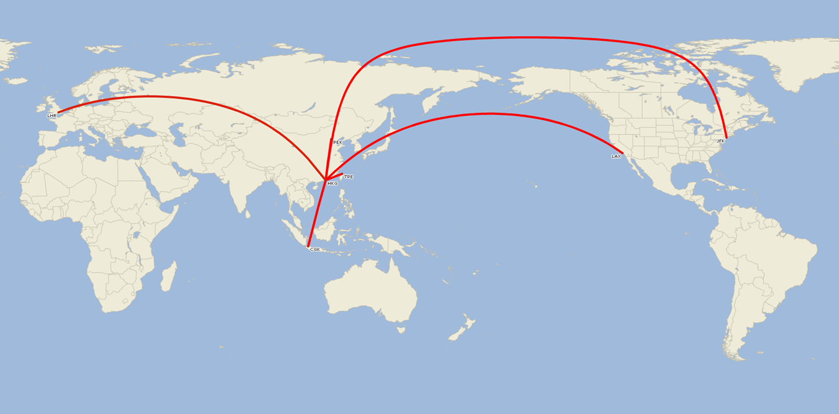
Interoperability & Harmonization
Up to very long range flights
  17+ hours
Prime altitudes FL290-390
1 aircraft – 7 days

Slide 7





Information domains
Airline domain
  Flight, Pax, cargo, schedules, code-sharing…
Airport domain
  Gates, security, field maintenance, movements…
ANSP domain
  Aeronautical information, weather, flight information…

Slide 8

Airlines Information exchange needs
Internally
With other airlines
With the ANSPs
With the airports
With the passengers
With travel agencies
With ground-handling
…

Slide 9
Airline Information characterization
Some is proprietary (business related)
Some is already standardized:
  AIDX to exchange information between airport and airlines
  FPL (etc.) to inform ANSP (fire and forget)
Some is not shared (minor delay decisions, etc.)
Some is duplicated
  Aircraft identification (AFR = AF – LFPG = CDG – B773 = B77W -- …)
Some is missing
  Tracking information…

Slide 10
Information exchange deficiencies
Flow of information is not always guaranteed
  A Flight plan submitted in Africa may not reach all intended recipients
Information is not always up-to-date in all locations
Information exchange too often based on:
  point-to-point message protocols
  Proprietary or non standard mechanisms
Information is not shared and when shared not in a timely manner
ATM and airline/airport information may not be connected (e.g. aircraft status)

Slide 11
Where are we today?
Recognition by industry that data harmonization is a MUST
ICAO introduces in the GANP System Wide Information Management (SWIM) that provides the foundation for managing information globally in support of operational improvements
  Collaborative Decision Making
  Regional Air Traffic Flow Management
  Collaboration between airlines and ANSP to facilitate Airline trajectories
The ICAO Information Management Panel is being created to address issues such as information management, security, etc.

Slide 12
How to progress
Flight Info (FIXM)
Aeronautical Info (AIXM)
Weather Inf (WXXM)
Airline commercial / airport operation (AIDX)
Make the best use of existing standards and on-going development
Do not reinvent the wheel
Recognize that what is efficient today should be used
Clearly identify the common areas
Determine how the information domains can be interrelated

Slide 13

Recommendations
Define the requirements
    Based on operational benefits not simply because it can be done technically
Provide mechanisms to connect the different data domains
  Ensure information flows
  Minimize investment – must be cost effective and based on business cases
  Protect information integrity and confidentiality
Properly manage the information
Allow timely migration to new technologies
Start by quick wins to gain support
  E.g. Digital NOTAMs, A-CDM

Slide 14

Thank You!

