Slide 1
SOLITEC Company Profile
History
More than 17 years in the IT business
Working with AIXM since 2000
References
European AIS Database (EAD)
Development of the Static Data Operations (SDO) (i.e. the central repository of EAD based on AIXM)
SIGMA development (Online User Handbook for EAD/SDO)
AIXM 4.5 <-> ARINC 424 Mapping
FAA Dataloader
Etc.
Static Data Completeness (SDC) tool
ADQ compliancy

Slide 2
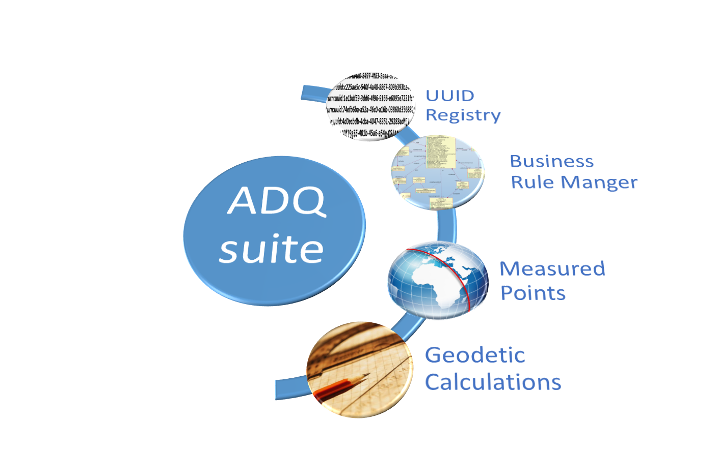
Aeronautical Data Quality („ADQsuite“)
Package of software tools and services to support the exchange of aeronautical data along the whole data chain from the data originator to the end user
The “ADQsuite” contains the following components:
UUID Registry
AIXM Business Rule Manager
Measured Points
Geodetic Calculations

Slide 3
Stay tuned….
adq-suite.aero

Slide 4
“Give us your NATURAL KEY
and get the UUID for free!”

