Slide 1

Snowflake Software
Helping you “SWIM” into the future
Nadine Alameh

Slide 2

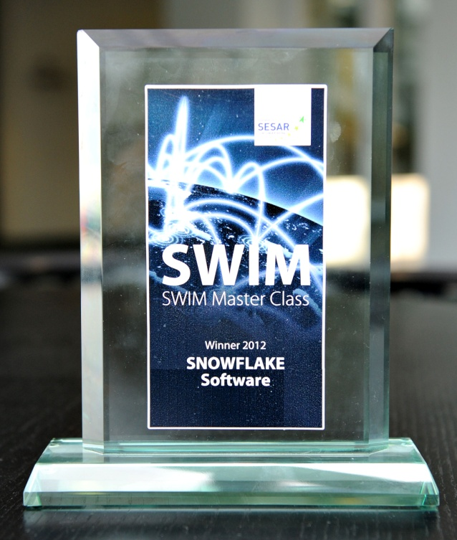

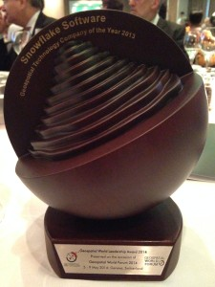
Company Overview
Self-financed, private company
Working with Enterprise data providers and users since 2001
Scalable, Open, Data Exchange solutions
Enabling legacy and new systems to be good SWIM citizens
Notes:
Snowflake Software are a self-financed, profitable company based in Southampton, UK. We were establishing in 2001 and have 10 years operational experience providing software, consultancy and training to develop Open data exchange solutions within Europe, North America and Asia.
We have experienced year on year growth and are expanding and aiming to establish a network of global partnerships with service providers to extend use of our solutions within our 4 target markets:
Aviation
Defence and Security
Data Providers
INSPIRE

Slide 3
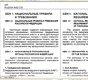
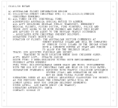
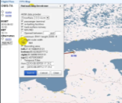
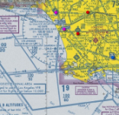
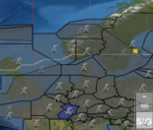

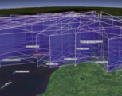
Get Ready/Set/Go
Product Centric Architecture (Existing)
Applications coupled to datastores
Procedure
Design
NOTAM
Obstacles
Charting
Met
Flight
Man
Airspace
Datastores vendor and application specific
Data extensively duplicated across applications
Integration between applications is often bespoke and custom engineered
Notes:
Obstacle data example; replicated across systems; using …

Slide 4


The End Zone
Net Centric Architecture (NextGen)
Procedure
Design
NOTAM
Obstacles
Charting
Met
Flight
Man
Airspace
Applications decoupled from datastores
System Wide Information Management
Datastores vendor and application agnostic
Data stored once used many times

Slide 5

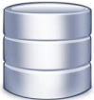




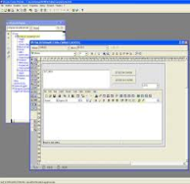
Our Service Wrapping Approach
AIXM
Web
Services
  Wraps existing systems
  Graphical configuration
  Flexible transformations
  Generic approach/Schema-aware
    Any data exchange models
    Multiple extensions
    Multiple versions
  Proven in the enterprise
    Multiple publication options
    Highly secure
    Service orchestrable
WXXM
Data
Download
Loader
Publisher
FIXM
Publish &
Subscribe
????
Notes:
(Click) The FAA has lots of data, stored in lots of database
(Click) It also has lots of systems and users updating those databases on a daily basis
(Click) It also has lots of stakeholders and other system connected into those database
But the data is locked up and only available these tightly coupled systems.
To free that data up data and move to the net-centric vision of NextGen data must be made available and freely exchanged
But to make data available is often a large software engineering exercise
Here at Snowflake we take a ‘Service Wrapping’ approach where we facilitate NextGen data exchange without impacting existing systems
(Click) Data can be loaded into an existing from SWIM using our GO Loader product
(Click) Data can be published out to SWIM using our GO Publisher product
(Click) … talk through the bullets on the right

Slide 6





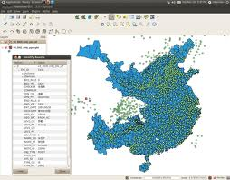





Many Examples
NASR
NOTAM Distribution Service
Subscriber File Static AIXM Data
Data Mapping & Create Database
Visualize in GIS
Polling Scripts
NOTAM AIXM Data
Agent Data Load
User Query
SQL>
Web Services
Data Ordering

Slide 7
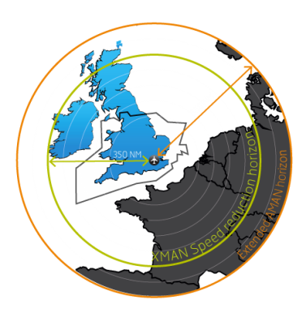
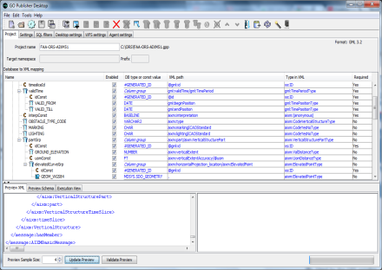
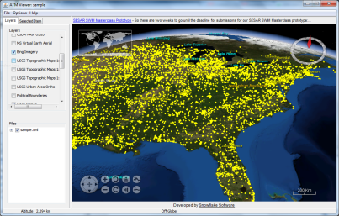
Many Examples
NATS XMAN
ORS Proof of Concept
Operational Trial
to reduce stack holding
at Heathrow airport
  Pub / Sub and Webservices
  Estimated $50 million per year in fuel saving
  32,000 tons of CO2 reduced
  Increase in safety
  Holding cut by 1 quarter
  Deployed operationally in NATS
  Mapping between ORS and AIXM using GO Publisher
  Successful deployment of WFS 2.0 on top of ORS
  Fully Spatial Query
  Visualization of 10,000 ORS obstacles in ATM Viewer
ALL in ONE Day!
Notes:
Two minute holding at heathrow is the target

Slide 8
To sum up …
Benefits
Realize existing investment
Features
Service wrapping
Schema mapping
Short development timescales
Support any XML standard
Support multiple versions
Standards-based
Open approach
GUI and model-driven interfaces
Schema Aware
OGC & SWIM standards
Mainstream technology

Slide 9

Rules
  Real data (with some structure)
  Real problem
  Clear scope
Real Data
Real Problem
Clear Scope
http://www.snowflakesoftware.com/2014/08/faa-atiec/

Slide 10


www.snowflakesoftware.com
nadine.alameh@snowflakesoftware.com
@sflakesoftware

