Slide 1
The Smart Way of Managing Aeronautical Information
www.smartAIM.net
August 2014
Hannes Brunner

Slide 2

smartAIM Architecture Overview

Slide 3
Who is Frequentis

Slide 4








More than 65 years of innovation & expertise in mission critical applications
We develop and market high reliable communication and information systems for mission critical applications in the fields of Air Traffic Management and Public Safety & Transport.
ATM
PST
Air Traffic Management
Public Safety & Transport
ATM Civil
Defence
Public Safety
Public Transport
Maritime
Worldwide Control Centres develop towards the same standards.

Slide 5



Company Overview Frequentis Group 2013 preliminary figures
Established in 1947
195 Mio. EUR Turnover 2013
Corporate headquarters in Vienna
  Subsidiaries and regional offices in over 50 countries
about 1,215 Employees
Outstanding Engineering Capacity
  more than 600 highly-qualified engineers (HW/SW/PM)
  at FREQUENTIS headquarter and subsidiaries
Export Quota > 90%
R&D Quota > 12%
First Air Traffic Control System in Austria,
Vienna / Schwechat, 1955
Breakthrough in the US: FAA Command Centre / Herndon, Virginia, 2003
Company Headquarters on Wienerberg,
relocation in 2006
Global Market Leader in ATC Voice Communication Systems

Slide 6
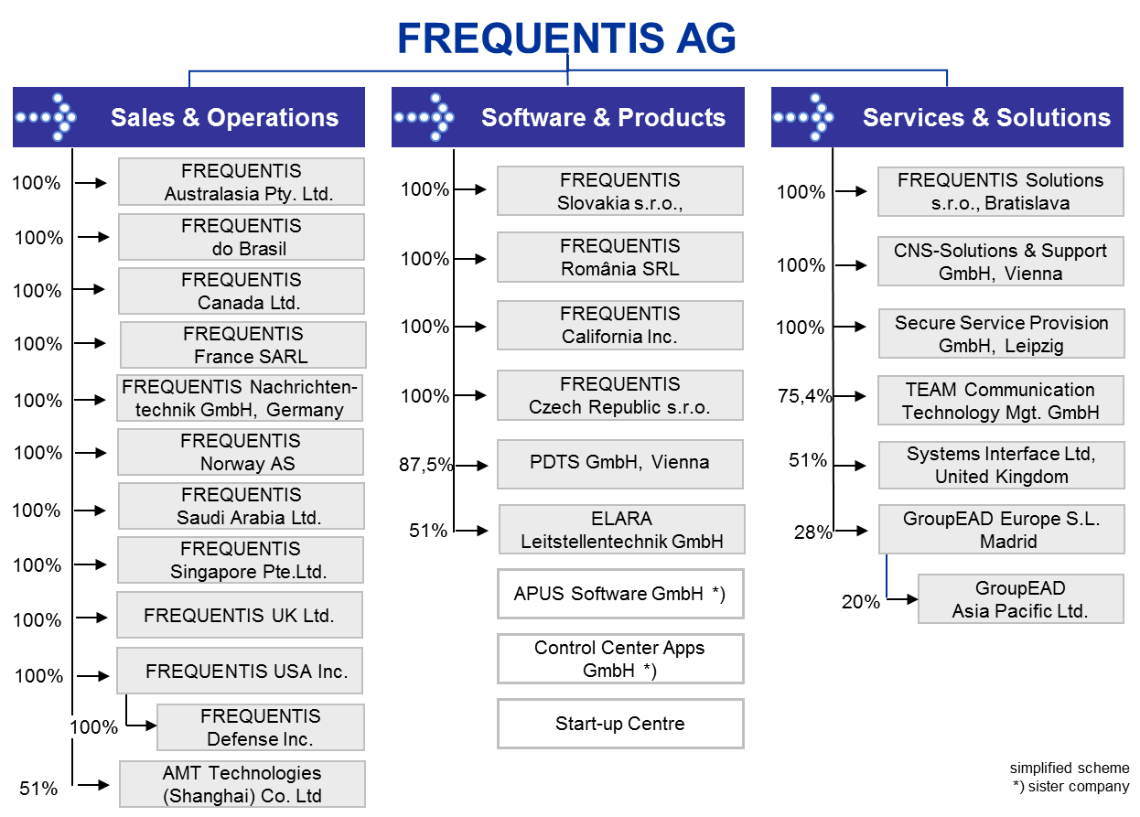
FREQUENTIS Group
simplified scheme
*) sister company
Global network of subsidiaries, offices and representatives in over 50 countries.

Slide 7
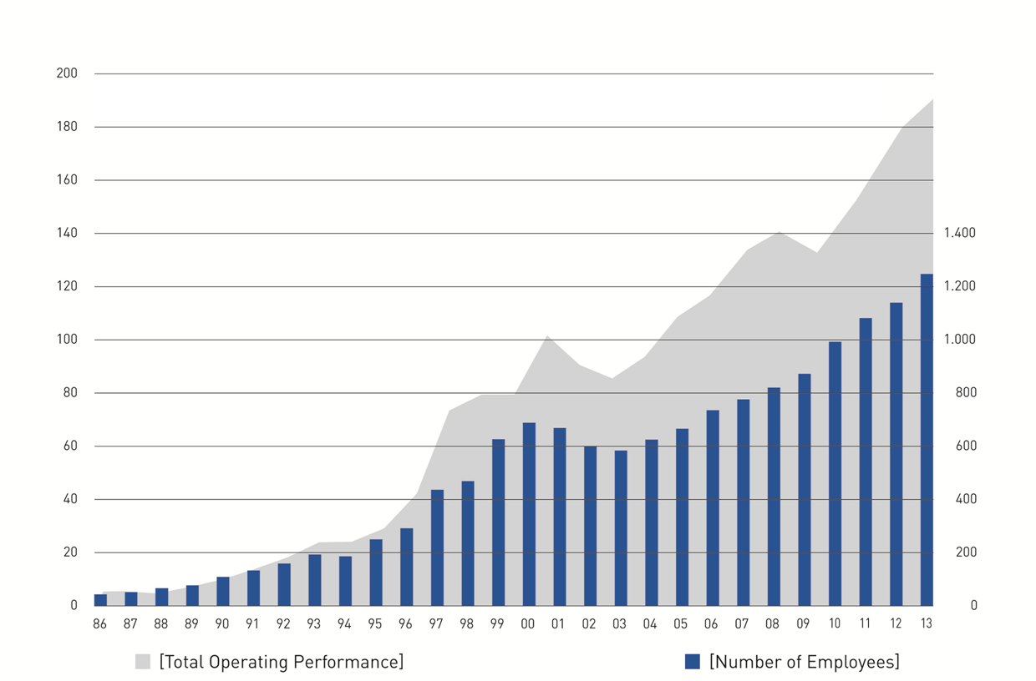
Development Operating Performance & Employees
Start Internationational
Sales
FAA Command Centre
London MET Police
Canadian
Coast Guard
Eurocontrol
LACC (UK)
Artemis (F)
Telenor
DFS
9/11
NASA
(preliminary figures as of: 02/2014)
Continued sustainable growth over more than 25 years.

Slide 8




FREQUENTIS Core Competencies
Technology Leadership
  We set standards.
Project & Program Management
  We deliver on time and in budget.
Usability Engineering
  We excel with our domain know how.
Integrated Quality & Safety Management
  ISO 9001:2008 at all corporate production facilities
  Development according to standards for safety
  critical applications. (DO-278/ED-153, ISO/IEC 12207)
Life Cycle Management
  In-field support of our systems for 20+ years
SESAR Joint Undertaking Partner –
Shaping the Future European Sky
UCMP / Royal Airforce –
MCA Award for Outstanding Project Management
ATCSCC in Herndon / Virginia – FAA
Acknowledgment Award for User Interface Design
We always strive to find the best solution for our customers.
Notes:
8
SESAR
Eine große Auszeichnung und auch inhaltlich von strategisch hoher Bedeutung ist die offizielle Einladung an Frequentis, im EU-Zukunftsprojekt SESAR („Single European Sky ATM Research Programme") mitzuarbeiten. Der "Call for expressions of interest to become members of the SESAR Joint Undertaking” erreichte Frequentis im Oktober 2007, aktuell wird an der Konkretisierung der Vorhaben gearbeitet. Schwerpunktmäßig wird sich Frequentis hier mit seinen Tower-Lösungen und seiner Expertise im SWIM(System Wide Information Management)-Bereich einbringen – das zeigt auch die hohe Anerkennung von Seiten der ATM Community für die Innovationskraft von Frequentis.
Project & Programm Management - UCMP
UCMP ist die Abkürzung für UKADGE Capability Maintenance Program und bezeichnet eine komplexe state-of-the-art Kommunikationslösung für das Luftverteidigungssystem Großbritanniens. Es umfasst die Einrichtung von zwei Control and Reporting centers (CRCs), einem Combined Air Operations center (CAOC) und mehrerer Remote Radio Sites (RRSs). Sämtliche Systeme sind über ein von der British Telecom betriebenes Wide Area Netzwerk auf der Basis von 2 Mbit/s Leitungen verbunden.
Gemeinsam mit Prime IBM UK wurde Frequentis mit dem MCA-Award für seine tolle Projektmanagement-Leistung im Rahmen des UCMP-Projektes ausgezeichnet. Die MCA ("Management Consultancies Association") ist eine bereits 1956 gegründete, hoch renommierte Vereinigung britischer Consulting-Unternehmen. Die hoch angesehen MCA Management Awards zeichnen Leistungen bzw. Arbeiten mit ausgezeichneter Projektperformance aus - wesentlicher weitere Imagegewinn für Frequentis.
Zu FAA / Herndon:
Eine Usability Design Studie war der Türöffner zum ersten Auftrag der amerikanischen Flugsicherungsbehörde FAA für das Air Traffic Control Command Center in Herndon, Virginia. In mehreren Workshops und Präsentationen überzeugte das UIC-Team den Kunden, so dass Frequentis nicht nur den Auftrag für das Center in Virginia erhielt (Auftragseingang 2003), sondern dass auch der verantwortliche Frequentis-Mitarbeiter direkt von der FAA ausgezeichnet wurde, und zwar mit einem „FAA acknowledgment award“ für sein für die FAA entwickeltes User Interface Design. Der Auftrag für das ATCSCC stellt gleichzeitig auch den Durchbruch von Frequentis in den USA dar.

Slide 9
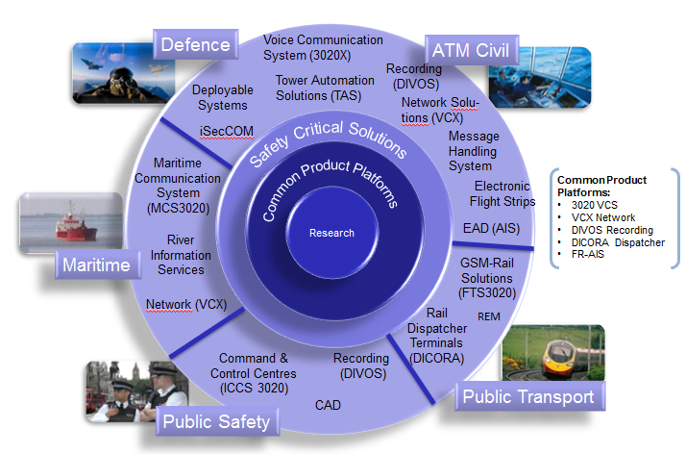
Frequentis Product Portfolio

Slide 10
Customer Satisfaction
“ … outstanding professionalism and commitment … “ [MET Police, UK]
“ … high standards of quality and reliability of systems
and of Frequentis support services … “ [Flemish Government, Belgium]
“ … comprehensive know-how … combined with their
reputation to deliver in time and on budget … “ [EADS Defence & Security, Germany]
“ … a reliable and dependable supplier with a
strong customer focus …” [Boeing Australia Limited]
Utmost customer satisfaction as basis for long running customer care.

Slide 11
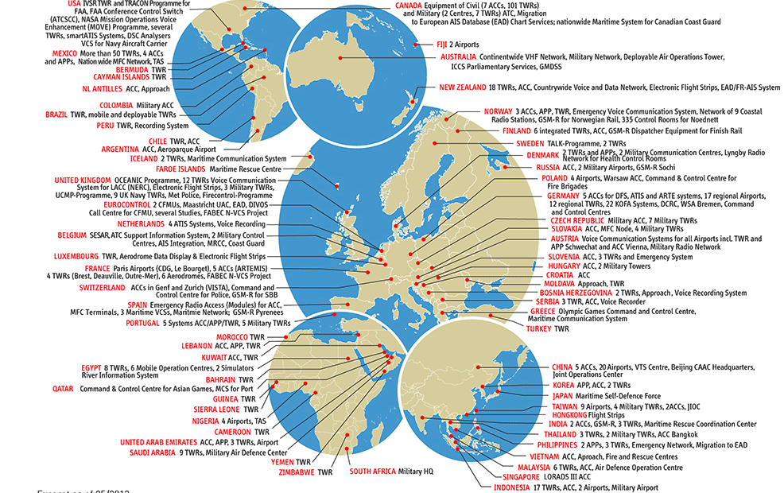
Worldwide References
[Excerpt 05/2013]

Slide 12
Frequentis and AIM

Slide 13
Frequentis and EAD
Frequentis has developed the EAD for Eurocontrol
  EAD is the largest AIM system in the world
  Operated and maintained on behalf of Eurocontrol
  Constantly being updated and modernised
  providing services to approximately 60 organisations in around 50 countries
  10 years anniversary
EAD is the first AIM cloud service
  system-to-system connections (B2B) or
  system-to-client connections (B2C) are possible
  First SWIM implementation in Europe

Slide 14
The Frequentis AIM Framework
AIM platform delivery Frequentis delivers AIM solutions worldwide, hardware and software; major examples: EAD, Canada, South Africa, New Zealand, DFS, Hong Kong, Philippines, Morocco, Austrocontrol
AIM platform/system operation Frequentis offers operation of the IT platforms of AIM solutions; major examples: EAD, Internet Briefing Websites of NATS, NavPortugal, LVNL, etc
Data Migration services Frequentis offers initial data migration services for customers changing from AIS to AIM (usually in co-operation with GroupEAD); major examples: all EAD customers, CAD Hong Kong, ATNS
Migration services Frequentis offers initial further migration services for customers who want to connect to a major AIM data repository like EAD. Frequentis plans that together with the customer and co-ordinates all technical pre-requisites that the migration process is successful

Slide 15
The Frequentis AIM Framework
AIM Training Frequentis provides training, in many cases with it’s subsidiary GroupEAD, but also directly (e.g. for Charting, AIP or AIM system operation)
Operational SupportFrequentis offers initial support in the phase from acceptance to cut-over and beyond
24/7 Frequentis offers 24/7 Helpdesk services for it’s AIM customers
Error/Incident Reporting and Change Management Frequentis provides an online platform for it’s customers for incident and error management as well as for change management
AIM Consulting Services Frequentis offers AIM consulting services from its daughter company TEAM

Slide 16
The Frequentis AIM Framework
Safety Frequentis develops the AIM product following modern development standards and is used to fulfil complex Safety Case requirements;
  Frequentis has dedicated and certified safety engineers in the AIM team
Development Maturity The development processes follow highest standards and are compliant with the Software Assurance Levels (SWAL) required for AIM

Slide 17
Highlights
Only Regional AIM Solution in the market The Frequentis smartAIM has initially been designed for the shared use by several ANSP’s and other customers and separates responsibilities between the ANSP’s by it’s functionality
Proven Concept It is a proven fact that the smartAIM solution can serve a regional concept (EAD is the best showcase)
Large AIM Framework Frequentis can not only deliver an AIM platform but can provide a large AIM Framework including, solutions, operations and services, training and also experience in contracting and legal issues.
Target Global AIM Network The Frequentis concept aims at the global integration of large AIM data repository, automatic data exchange in-between them and provision of services based on high-quality global AIM data. That is unique

Slide 18
Highlights
Integration between large AIM data repositories The Frequentis smartAIM solution is not only unique as it provides the capability of shared regional use of an AIM solution but also because it has proven in practice that it is possible to connect large “AIM data Hubs” and exchange data automatically (examples: EAD and NavCanada, South Africa and others)
Integration of Regional AIM Hubs and systems of different suppliers The Frequentis regional smartAIM solution is able to integrate AIM solutions of other suppliers. That has been proven by the “MyEAD” concept in Europe. That has not been done elsewhere so far. The integration will be improved by the introduction of SWIM adapters.

Slide 19
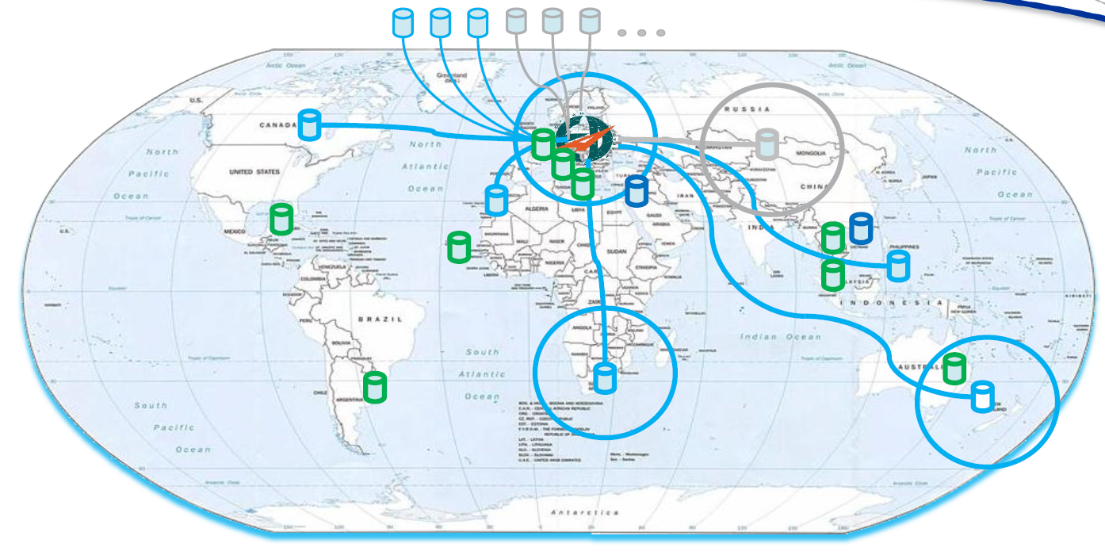
Global smartAIM

Slide 20

smartAIM Functional blocks
smart™ AIM
Short Term Information
(digital) NOTAM
AIXM
(digital) Weather
WXXM
Long Term Information
Publications
Communication
(digital) Flight Plans FIXM
AIXM Information Management
Reporting
GIS
AIP
Charting
Publication Management
AFTN / AMHS
smartINMO NOTAM Mgt
(digital) Briefing
smartINMO Briefing
smartWeather
smartINMO Flight Plan Management
smartDM
smartDM Reporting
smartDM GIS
smartAIP
smartCharting
smartWebClient
PAMS
smartMessenger
Traceability
Workflow Management
smartWFM
Terrain / Obstacle
smartETOD

Slide 21
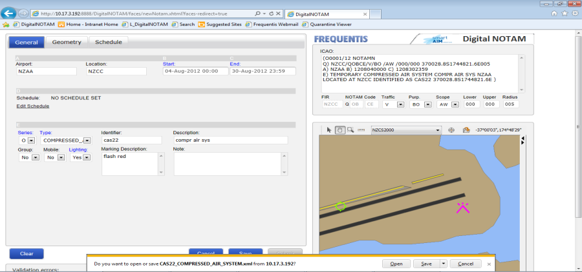
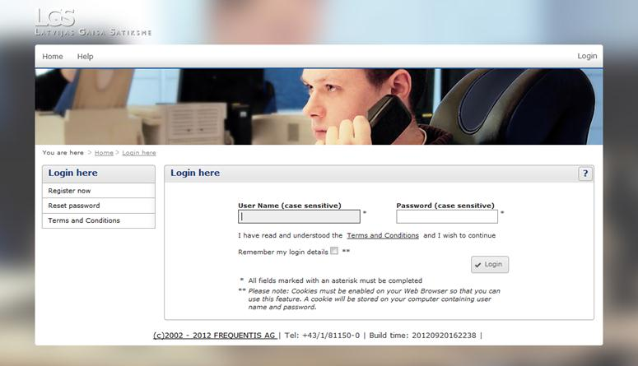
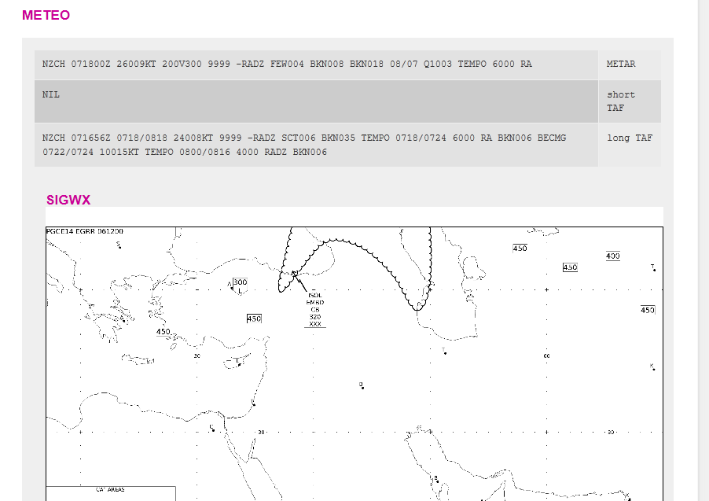
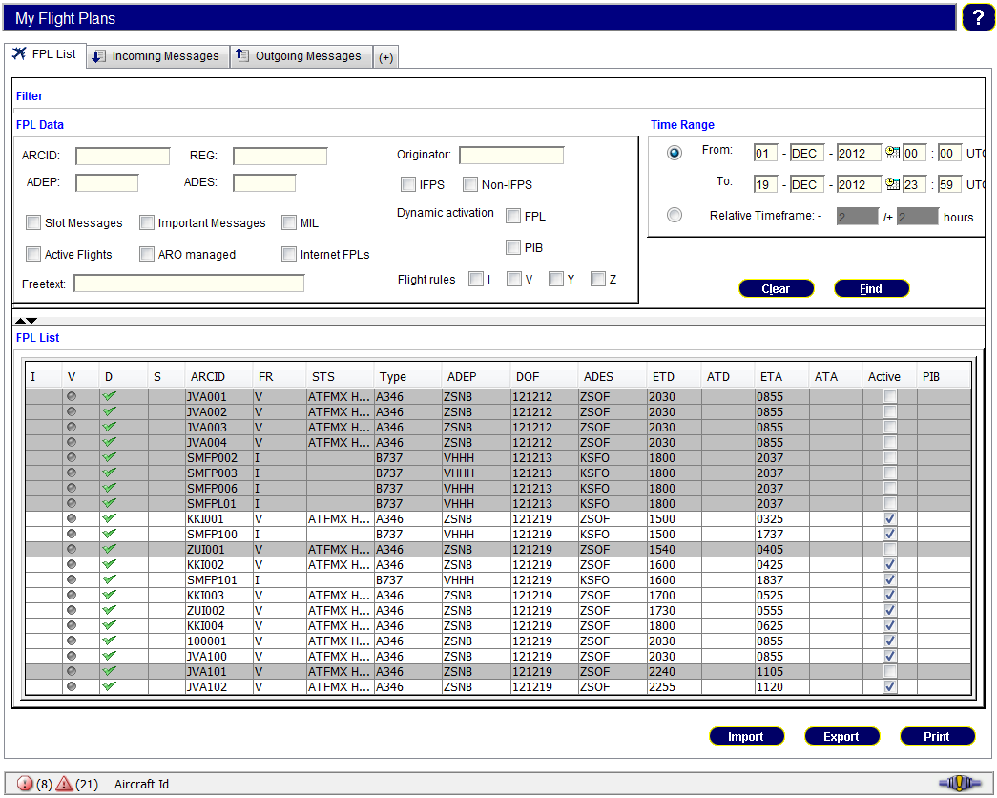
Short Term Information Management
NOTAM / Digital NOTAM – AIXM: smartINMO – NOTAM Management
Weather – WXXM: smartWeather
Flight Plan Management – FIXM: smartINMO Flight Plan Management
Briefing: smartINMO Briefing and smartIBS (Internet Briefing)

Slide 22
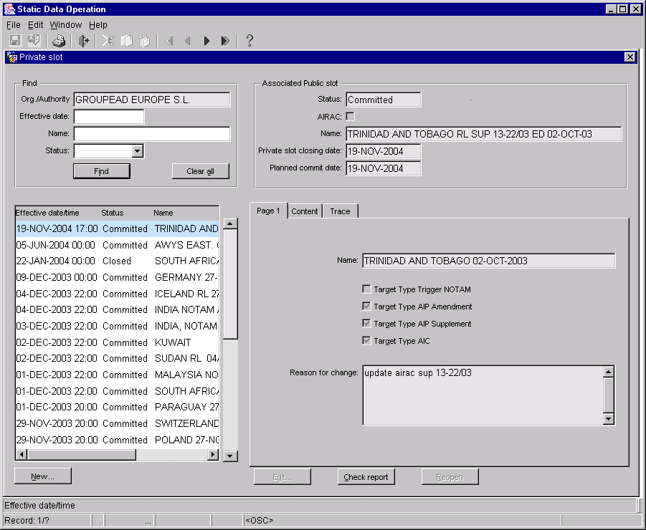
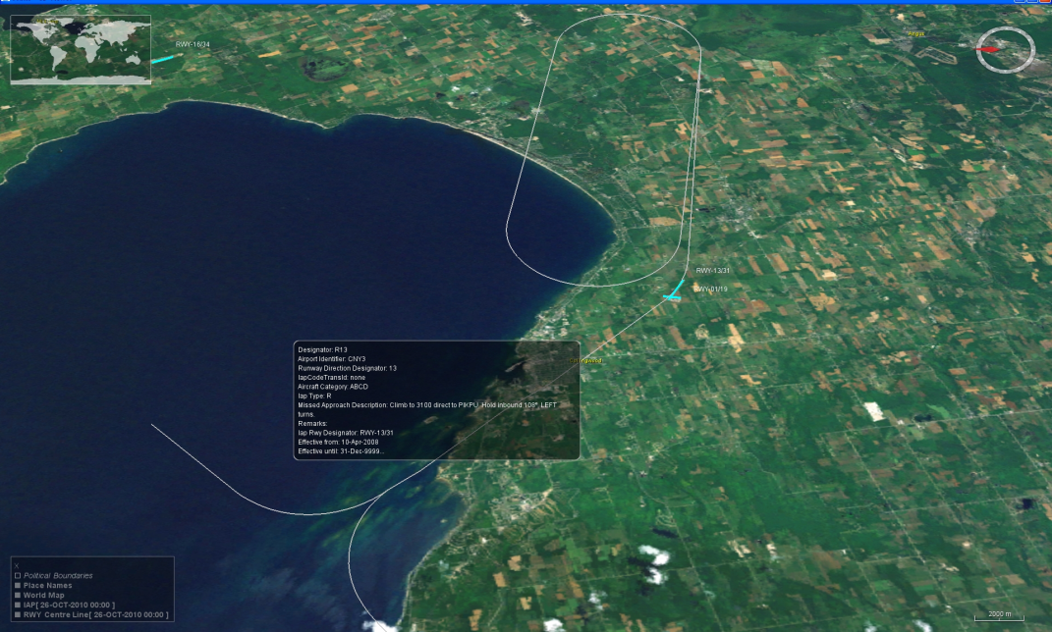
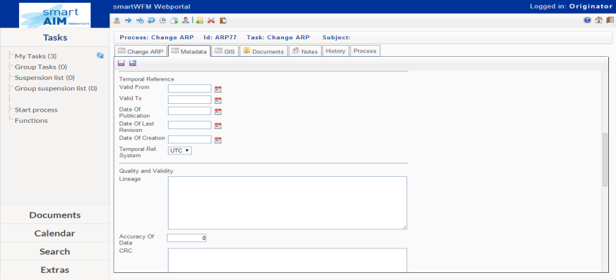
Long Term Information Management
AIXM data management: smartDM
GIS Visualistion: smartDM GIS
eTOD: smartETOD

Slide 23
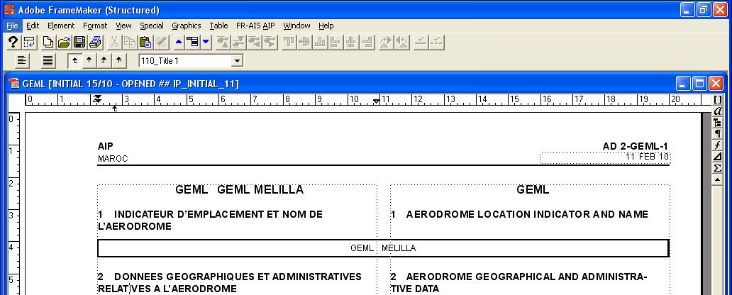
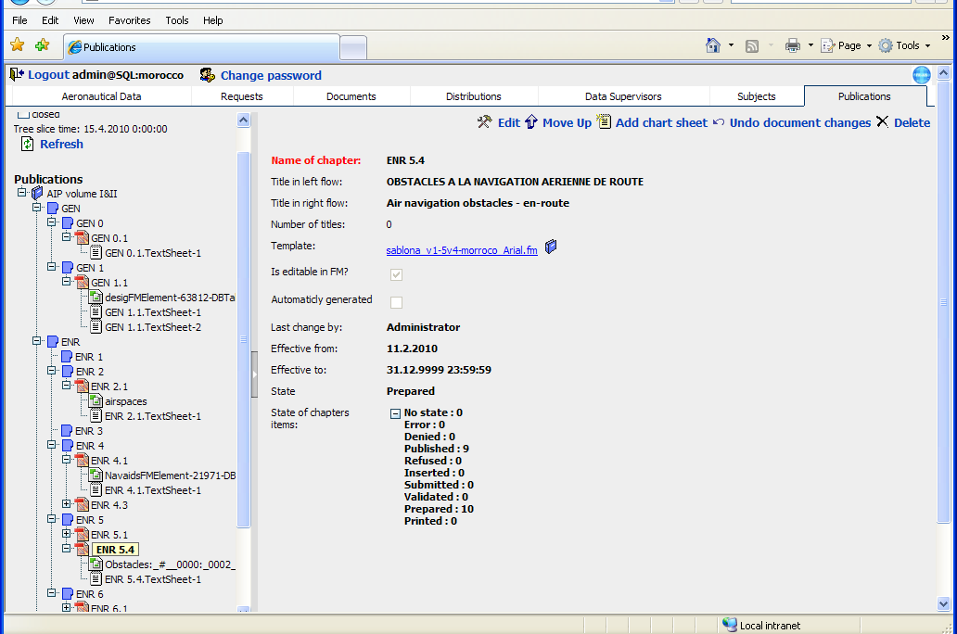
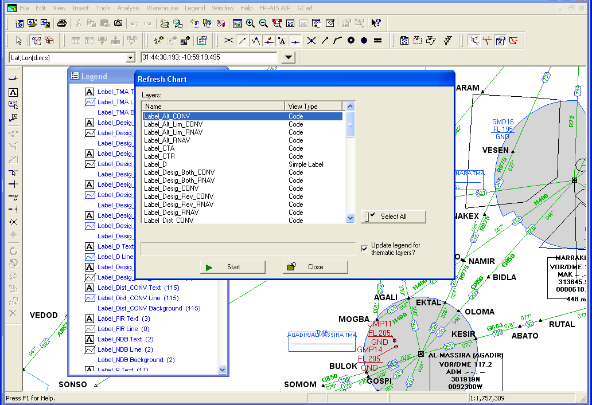
Publications
Charting: smartCharting
AIP Authoring: smartAIP
Document Management: smartWebClient

Slide 24
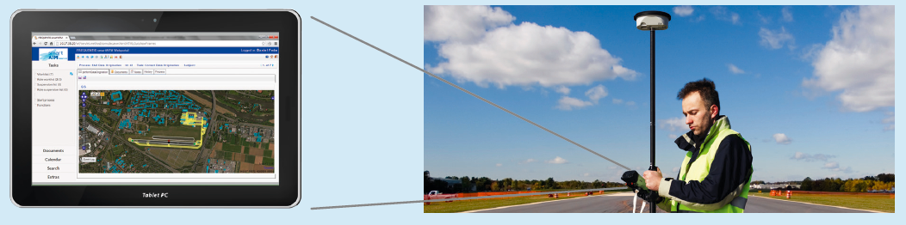
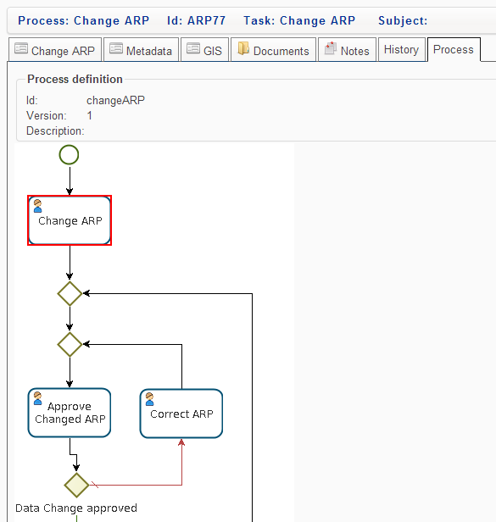
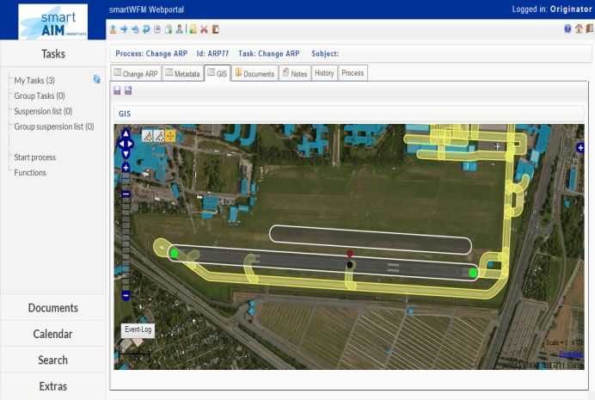

Workflow Management – Flow automation
Data chain automation from originator to end-user: smartWFM

Slide 25
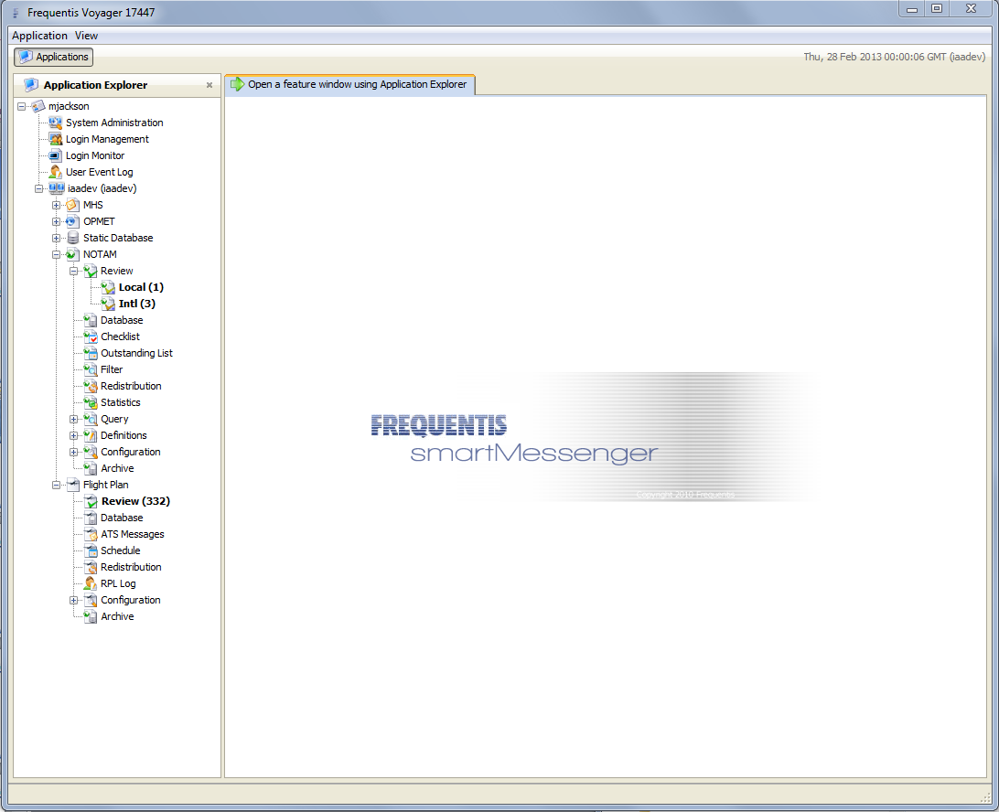
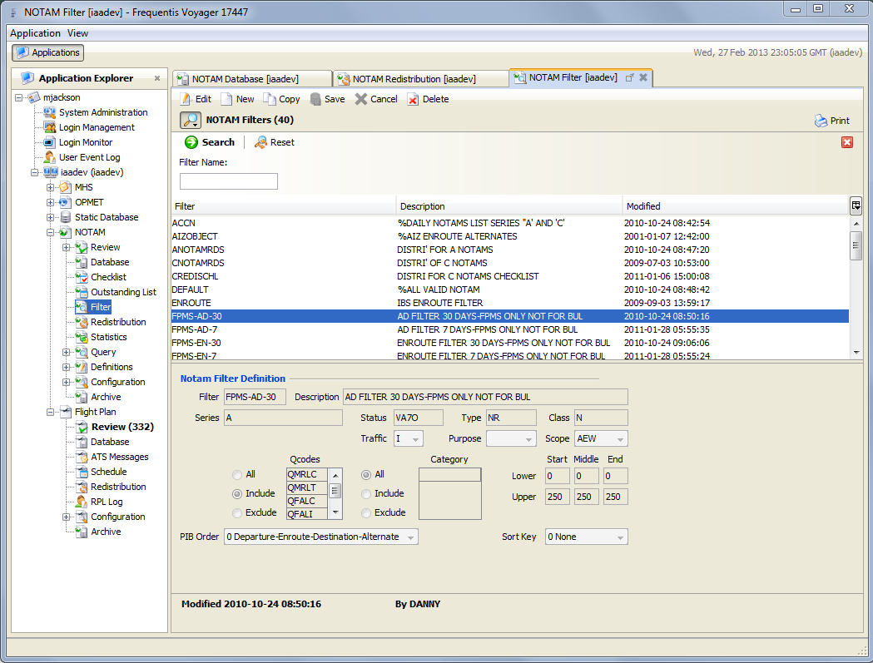
Messaging
AMHS, AFTN, SWIM Gateway: smartMessenger

