Slide 1
FAA Airport Data Visualization
Mike Evanoff and Louis Simonen
Google’s FAA Cloud Mapping Team

Slide 2
Currently Available FAA Google Visualization Tools
Google Maps API - Internal Use and External Use
Google Earth Professional - 45,000 Users
Google Maps Engine - Cloud GeoSpatial Database (Developer Kit)

Slide 3
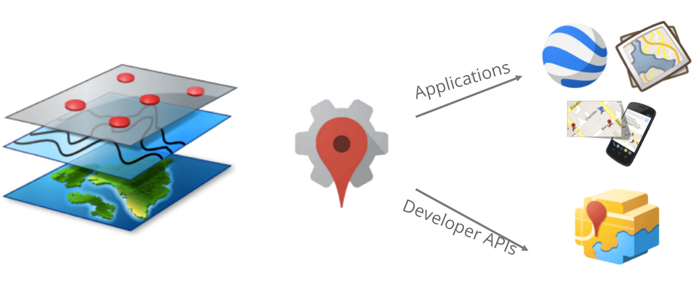

Slide 4
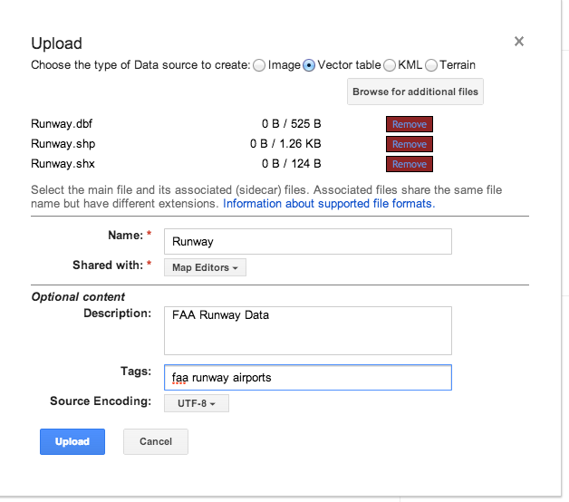
Upload Your Data

Slide 5
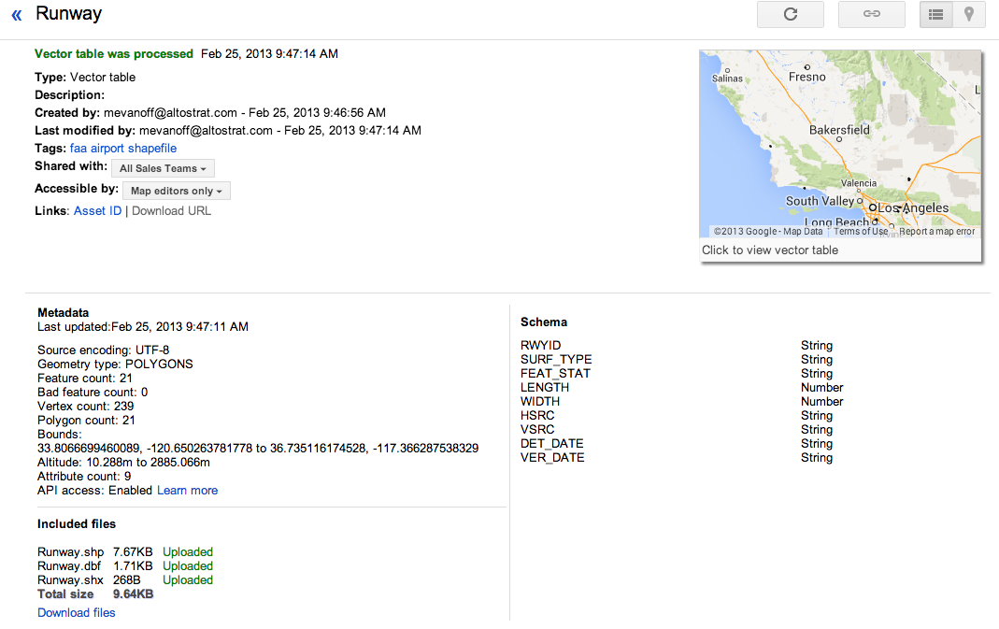
View the Uploaded Data Details

Slide 6
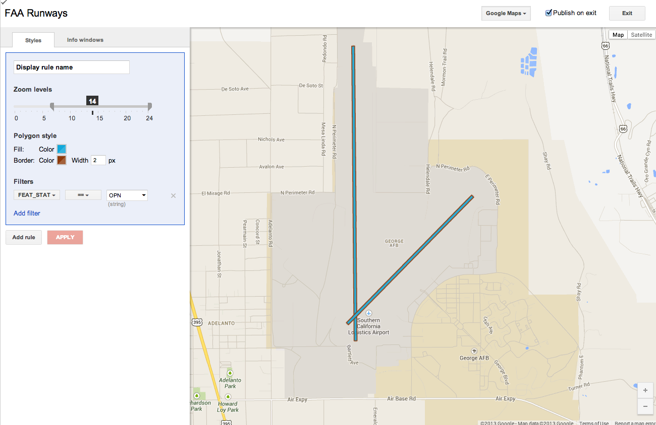
Apply a Style

Slide 7
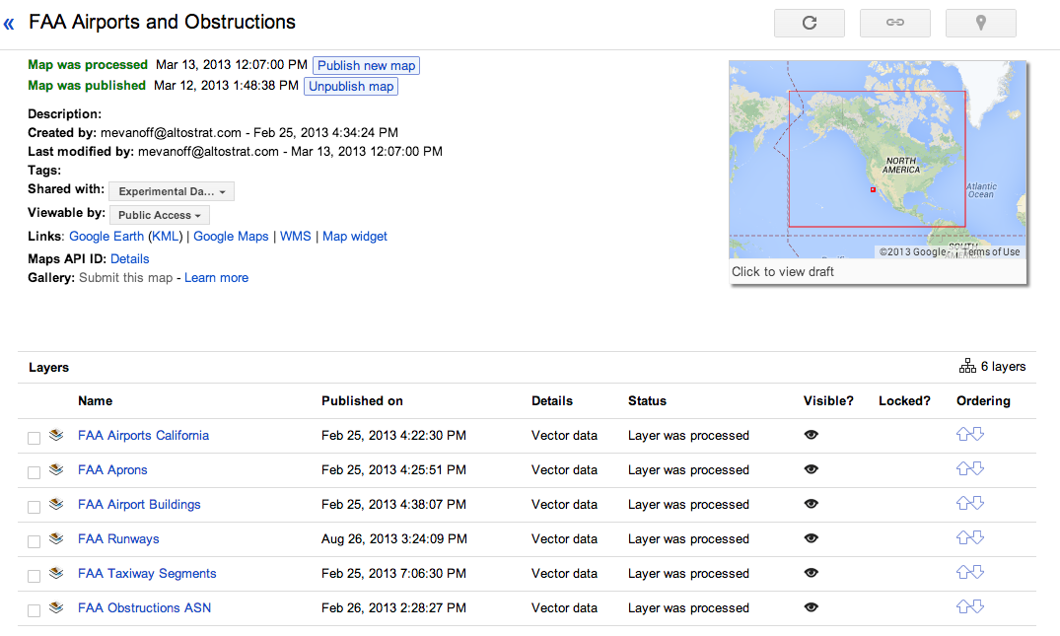
Add Your Layers to a Map

Slide 8
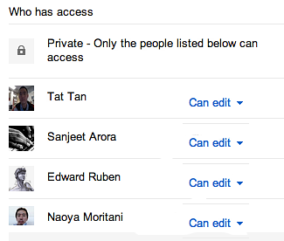
Establish Sharing

Slide 9
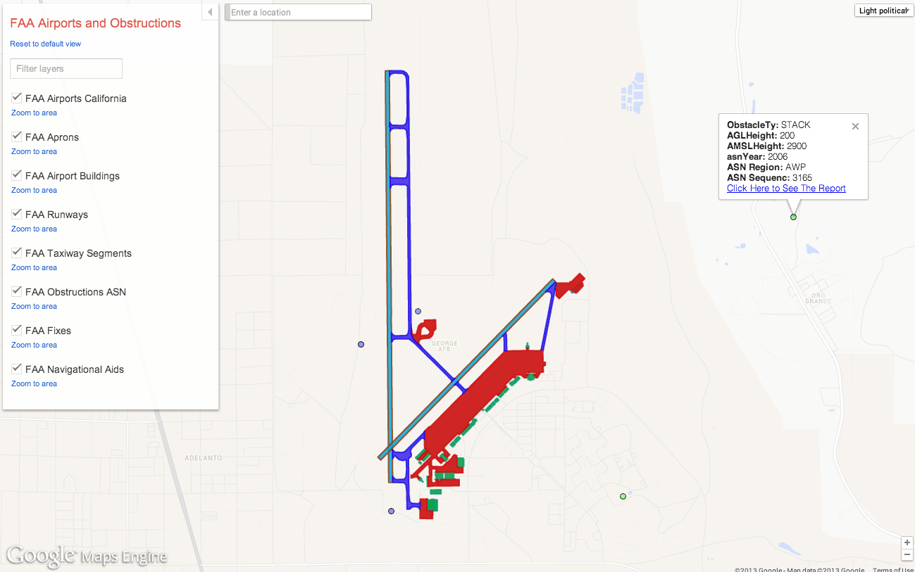
View the Map

Slide 10
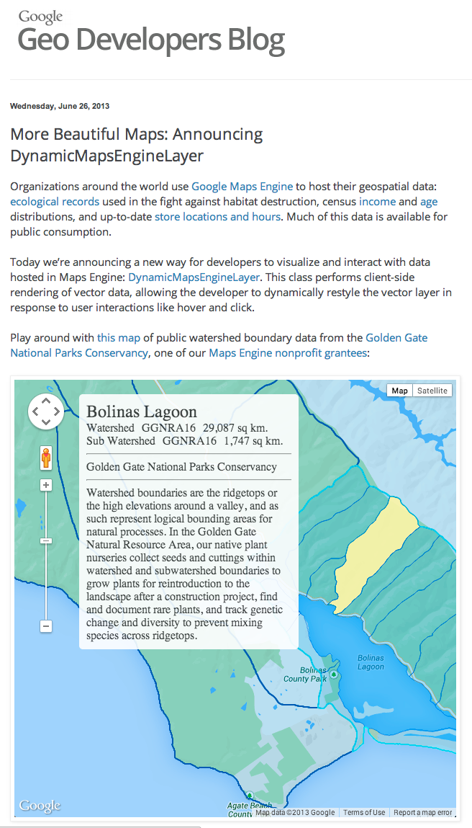
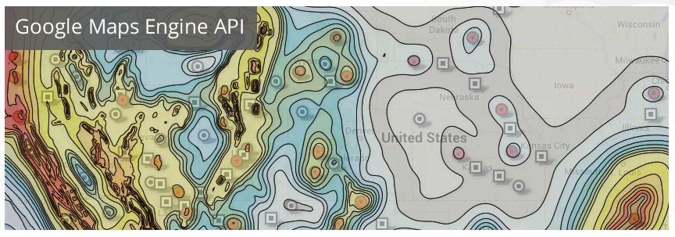
Customize with API access

Slide 11
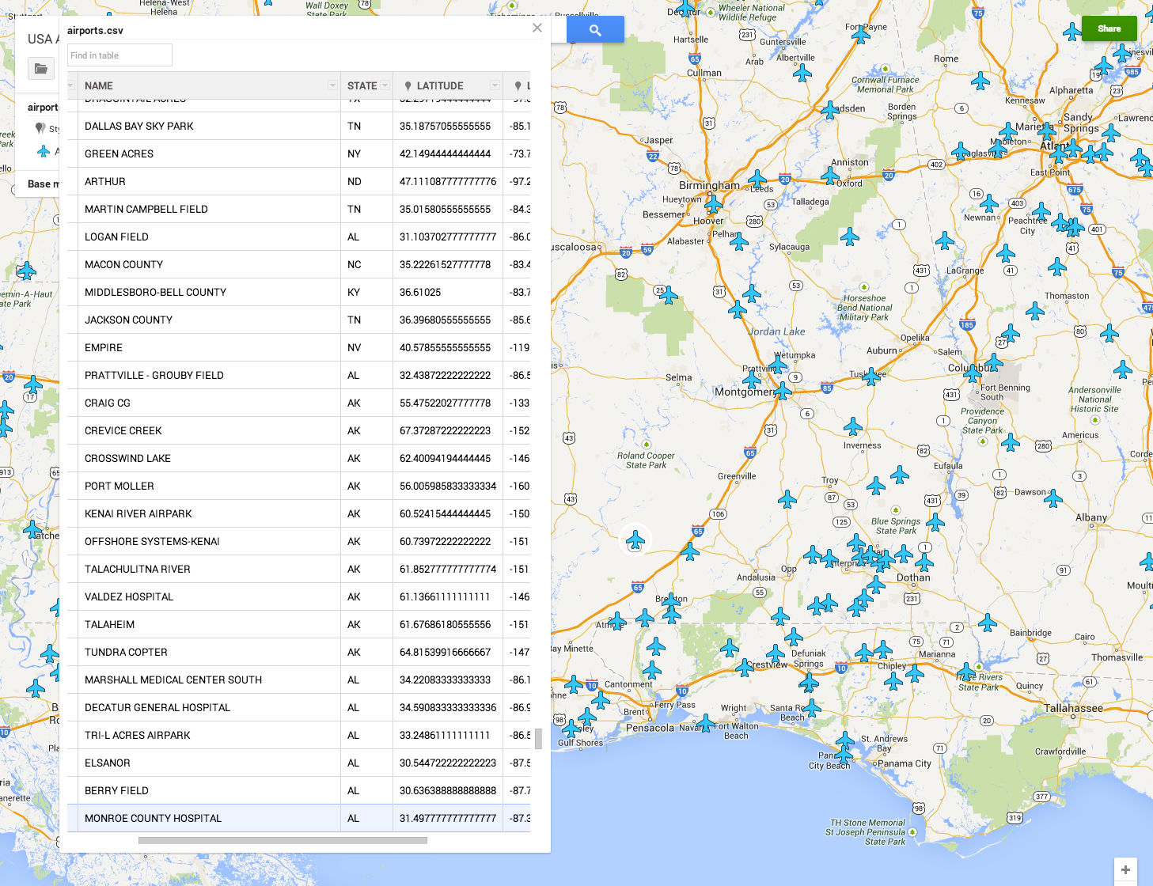
Simple GUI for Adding/Editing

Slide 12
What does this mean for business?
Thank you

