Slide 1
Visual NOTAM
By: Abhilaash Velamati
Intern at CGH Technologies

Slide 2
About Me
Rising Junior
Thomas Jefferson High School for Science and Technology
Interested in
Mobile App Development
Artificial Intelligence
Robotics & UAV Systems

Slide 3
Internship
Started: 8/6/2014
Project Scope
Develop native android NOTAM search app
Display graphical NOTAMs
Utilize data from FAA’s NDS Web Service
Make NOTAMs user friendly

Slide 4
Progress
Three weeks
Understood Android app framework
Learned design process
Understood Graphical NOTAM objectives
Preliminary design of an Android NOTAM search app

Slide 5
Challenges
Complexity of Android framework
Designing compelling user interfaces
Initial complexity of Graphical NOTAMs
Multiple threads

Slide 6
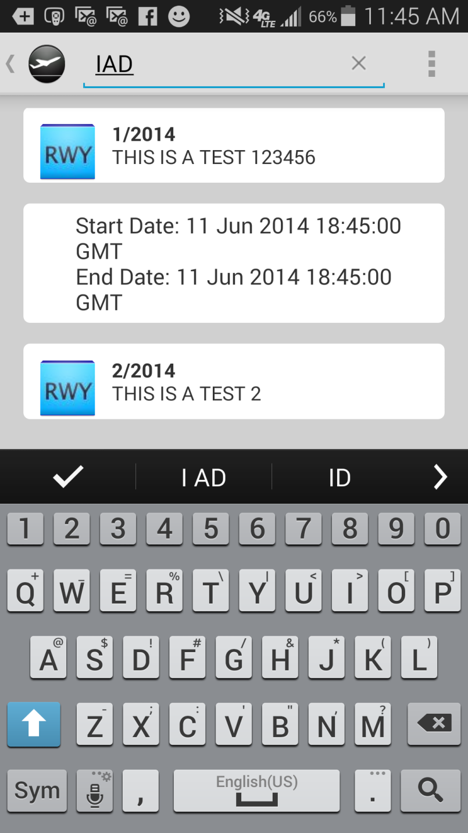
Current State
Search for NOTAMs using Airport Designator
List NOTAMs In a User Friendly View
Expands to show start date and end date when clicked
Shows the NOTAM number and NOTAM text in the main view

Slide 7
Next Step
Complete app implementation
Improve Search
Display NOTAMs on map where possible
Filtering NOTAMs etc
Make it fun to use like Twitter or Facebook
Improve Performance
Release on Google Play Store
Its all possible because of the availability of Digital Data like NDS’s AIXM Service

Slide 8
Contact Information
Contact Information
Name: Abhilaash Velamati
Email: Abhilaash.Velamati@Gmail.com
Phone Number:
Cell Phone Number: 757-672-2244
Home Phone Number: 703-449-1008
App Name: Visual NOTAM

