Slide 1
ArcGIS for Aviation
Sean Grant
ArcGIS for Aviation Product Manager
Notes:
Esri Visual Template V2
16:9 version - Oct 4, 2013
See http://arczone/resources/presentations.cfm for more sample files and help.

Slide 2
ArcGIS Platform
More than just a desktop solution
Knowledge Workers
Executive Access
Public
Engagement
Work Anywhere
Enterprise
Integration
ArcGIS
Professional GIS
ArcGIS transforms the role of GIS
across your organization
Notes:
Fundamentally, our work is about ArcGIS; that's where we focus most of our attention, which we define as a complete system for geographic information. It has clients; web clients; mobile clients; desktop clients; servers; enterprise servers; and increasingly, clients in the cloud and a new dimension called ArcGIS Online.
ArcGIS supports multiple implementation patterns, and these patterns leverage all the popular computing architectures, the desktop with file-based systems, client server with datacentric things, and servercentric work. And now this emerging pattern of web GIS.

Slide 3
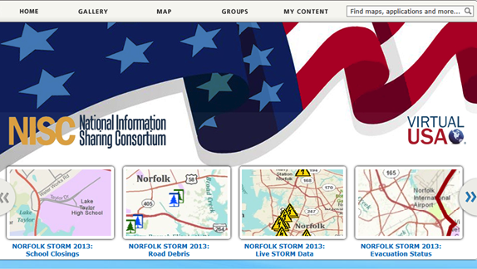
Web GIS Integrates Organizations and People
Breaking Down the Barriers
Creating New Relationships
Sharing Resources . . .
. . . Supporting Collaborative Approaches
Notes:
Primary person icon is orange; secondary person is blue.

Slide 4
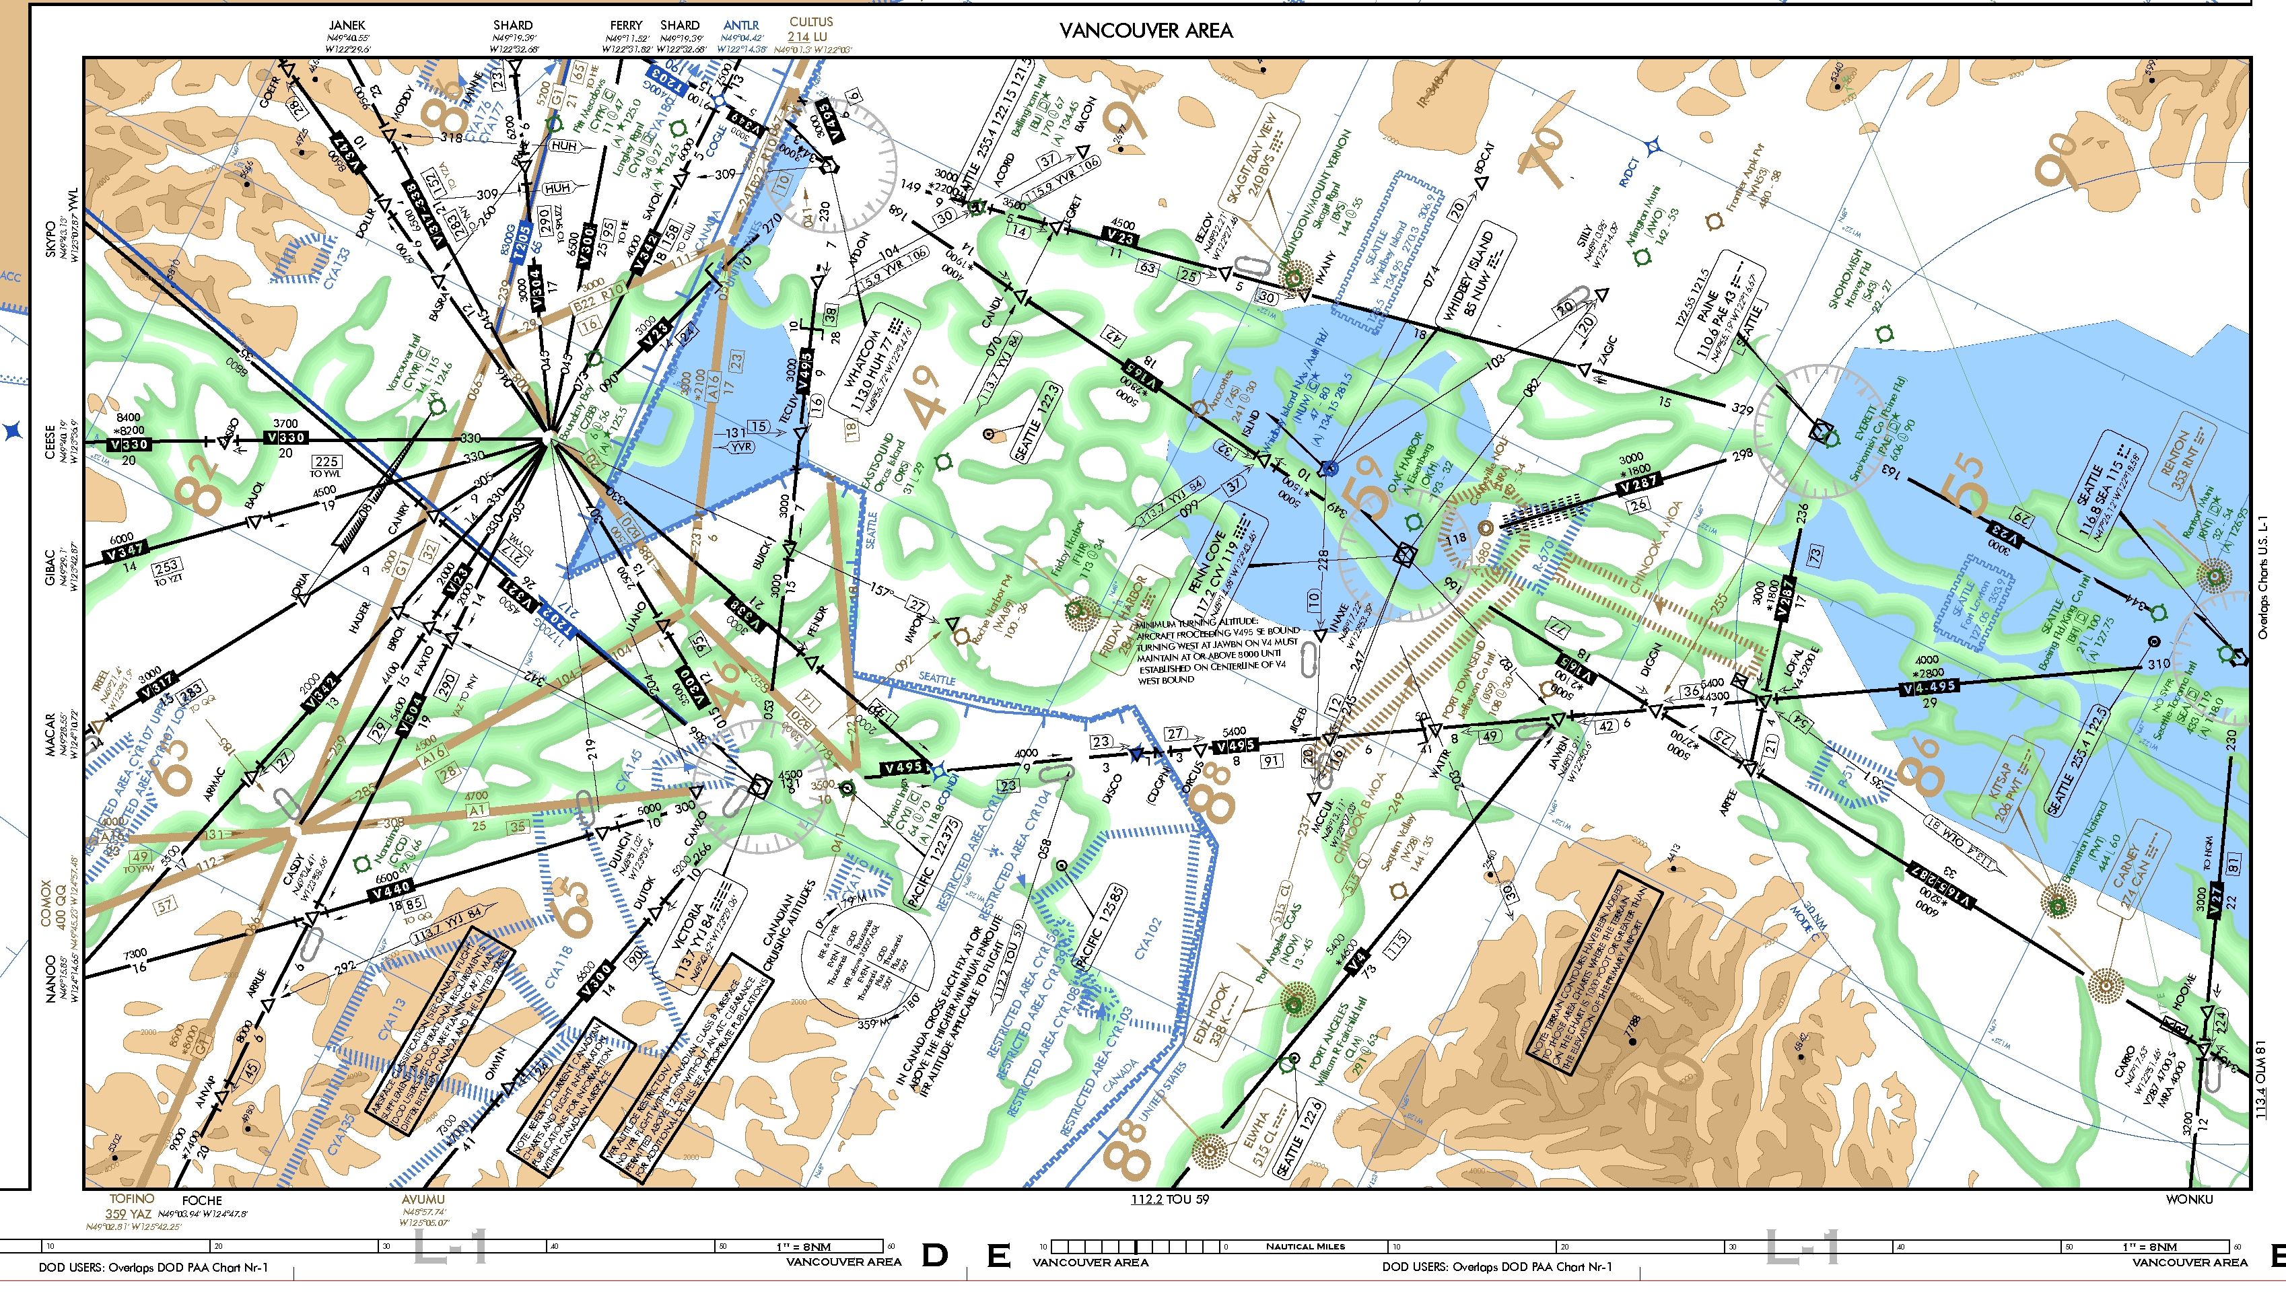
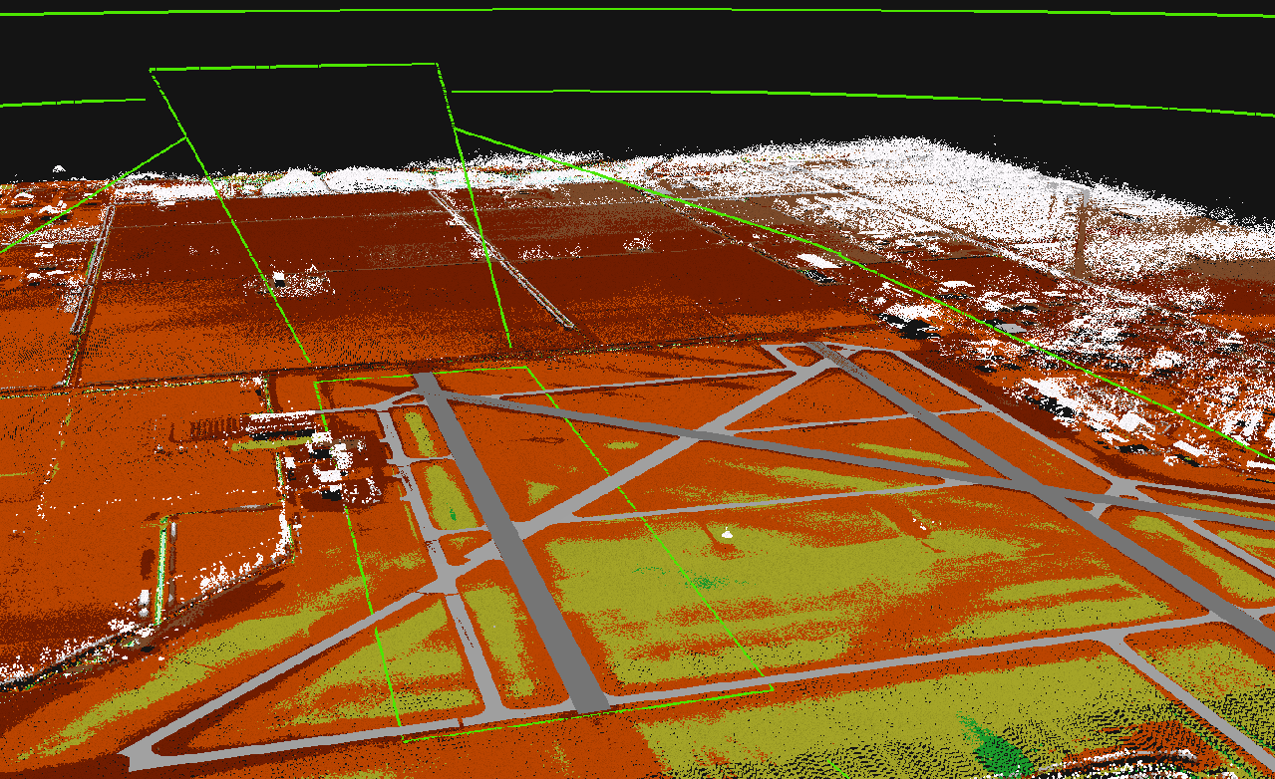
ArcGIS for Aviation
Chart Production
Regulatory Compliance
Data & Product Standards
Analysis & Visualization
Charting
Airports
Aviation GIS Analyst
and
Cartographers
Air Navigation
Airport Ops Infrastructure
Notes:
Fundamentally, our work is about ArcGIS; that's where we focus most of our attention, which we define as a complete system for geographic information. It has clients; web clients; mobile clients; desktop clients; servers; enterprise servers; and increasingly, clients in the cloud and a new dimension called ArcGIS Online.

Slide 5
Aviation Standards
Just To Name a Few….
OGC
(WFS, WMS,WCS)
FAA AC150/5300
(13A, 18B)
ISO 9001 Certified
EU 73/2010 (ADQ)
ICAO (Annex 4, 14, 15 [eTOD])
ArcGIS
AIXM (4.5 & 5.x)
DO-272/ED-99 (AMDB)
. . . Plus more and more

Slide 6
Stop by our booth in the exhibit hall!
Sean Grant – sgrant@esri.com

