Slide 1
Delivering Digital
Services
Aeronautical
Data
in Airline Operations
Presented By: Reinhard Thanhäuser
Lufthansa Systems
Date: August 26, 2014

Slide 2
Airline IT
Flight Planning
Charting
Network Planning
FMS
Aircraft Perf
Load Control
OPS Control
Crew Planning
Check-In
Sales Ticketing
1

Slide 3
Flight Planning
Strategic Planning
Operational Planning
Tactical Planning
Inflight Support
Postflight Analysis
Route
Evaluation
Overflight
Clearance
Route
Optimization
Latest
Changes
Statistics
Network
Planning
Performance
Data
Fuel
Optimization
NOTAM
Watch
Fuel Policy
Operational
Flight Plan
Weather
Watch
Baseline Data
Baseline Data
Baseline Data
Baseline Data
Fuel Consumption
Statistics
Temporal Data
Temporal Data
Flight Time
Long Term
Short Term
Actual Flight Event
During Flight
After Flight
2

Slide 4
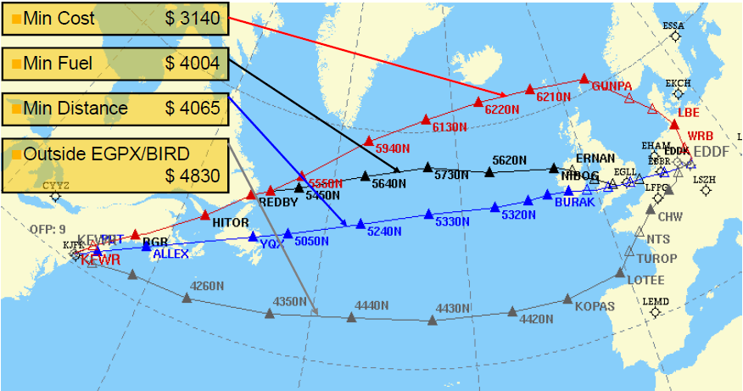
Operational Planning
Goals
Legal flight plan
Safe flight
Economic flight
Pilot (End User) Support
Briefing package
Routing
Fuel calculation
Weather
Restrictions
NOTAM
Consistent information
Operational flight plan
FMS
Charting
Inflight support
3

Slide 5
Required Data
Temporality
Tailoring
Navigation Data
Operational Data
Weather Data
5

Slide 6
Navigation Data
Common Data
Static data
NOTAM
Restrictions
Rules
Regulations
Tailored Data
Customers ask for data tailoring
Different view on the world
Operational reasons
Operational risk
Equipment
Political reasons
Local agreements
Flight restrictions
6

Slide 7
Operational Data
Flight Event Data
Aircraft rotation
Crew rotation
Booking data
ATS flight plan
Aircraft performance
Aircraft equipment
Customer Policies
Fuel policy
Special procedures
Airport authorization
Traffic rights
Crew qualification
Statistics
Cost index
7

Slide 8
Weather Data
Airport Weather
METAR
TAF
Runway conditions
Evaluated for
Departure
Destination
Alternates
ETOPS alternates
Enroute Weather
Upper Air Data
Significant weather charts
Other weather phenomena
8

Slide 9
Other Data
Flight Planning
Cosmic radiation
Environmental data
Special flight planning data
Life vest airspace
Directs
Artificial waypoints
Non-published data
Fuel price
Admin
System configuration
User rights
Dispatch offices
9

Slide 10
Temporality
Validity
Lifecycle
Time schedules
Changes during lifecycle
Short term changes (NOTAM)
No overlaps in temporality
Flight Planning Impact
Flights „between“ AIRAC cycles
Complex evaluation
Determination of current state
Manual evaluation of NOTAM may be required
Data integrity
10

Slide 11
Data Tailoring
0 7
2 5
700 m
1000 m
3900 m
4000 m
NOTAM
2900 m
Micro - Air
3900 m (FPL)
3900 m (FPL)
4000 m
3900 m (FMS)
3900 m (FMS)
4000 m
Mega - Air
3200 m (FPL)
4000 m
3200 m (FPL)
3900 m (FMS)
3900 m (FMS)
4000 m
Data Provider
3900 m
3900 m
4000 m
AIP
9300 m
9300 m
3900 m
4000 m
3900 m
AIRAC
AIRAC
AIRAC
AIRAC
11

Slide 12
Data Sources
Navigation Data
AIP
Amendments
Supplements
Circulars
NOTAM
Military publications (if available)
ATC
Customer Data
Customer policies
Customer manuals
Contracts
Communication
Weather Data
Weather providers
Other Sources
Topography/Terrain
Charts/Satellite images
Independent organizations
12

Slide 13
Data Maintenance
Lido/Flight
24/7 data provider
Worldwide coverage
Quality assurance
More than 2500 documents per year
Increasing amount of data
Manual editing process
Huge manpower
Application related
Partly automated NOTAM parser
Automated WX import
Mostly automated OPS data import
13

Slide 14
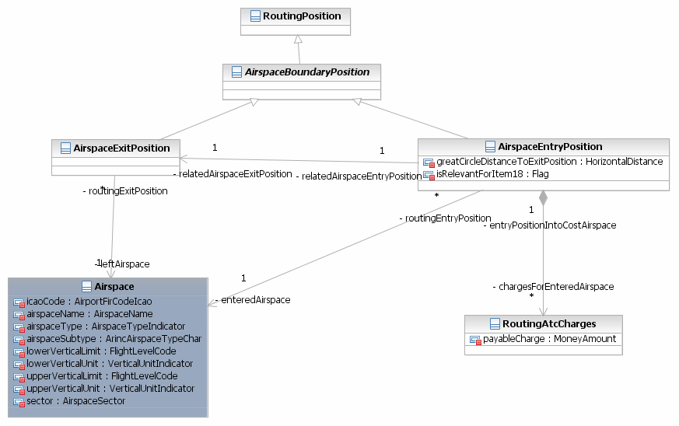
Data Structures
16

Slide 15
Life is not always easy …
Data Quality
Inconsistent data
Incomplete data
Untrusted data
Ambiguous data
Flight Planning
Insufficient data
Unspecified NOTAM
Handling of complexity
Briefing
Different processing time
Flight planning
Charting
FMS
Different data providers
17

Slide 16
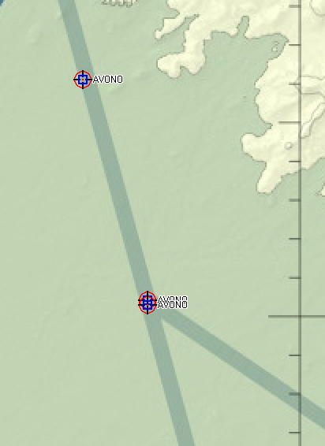
Example
Inconsistent Data
Three definitions of the same waypoint
Two countries
6 NM
18

Slide 17
Example
Ambiguous Data
There is no stopway .
Which LMM ?
O0186/14 NOTAMN
Q) ****/QFAXX/IV/NBO/A/000/999/4146N****E****
**** B) 1408180700 C) 1410180400
E) RWY 09L: METAL FENCE HGT 2M INSTL AT DIST 160M FM RWY EXTREMITY
TOWARDS LMM. RWY SHOULDER AND STOPWAY REDUSED BY 240M.
STRIP DIMENSIONS: 3260 X 202M.
CREATED: 18 Aug 2014 07:13:00
RWY | TORA | TODA | ASDA | LDA
09L | 2600 | 3000 | 2600 | 2700
27R | 2600 | 3000 | 2600 | 2700
LMM
LMM
662 R
662 V
19

Slide 18
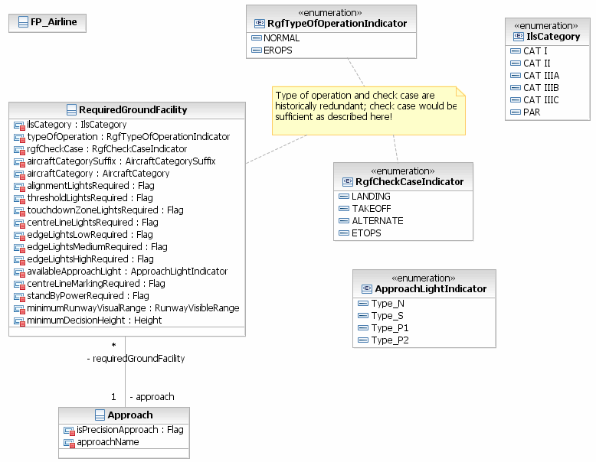
Example
Complexity
How does a bulb affect flight operations ? A case study…
Airport Suitability Check
Lido/Flight checks destination and all possible alternates for suitability
At the ETA
Weather forecast
Weather minima
Fire fighting category
NOTAM situation
…
A Broken Light Bulb
May downgrade the approach lights
May close and approach procedure
May close the airport
May force the aircraft to divert
May cause a delay
May cause that the crew exceeds allowed duty times
May cause an additional night for the passengers
…
20

Slide 19
Requirements
Advantages of digital data
Automated processing
Unique data
Timely availability
Ready for visualization
Digital data shall be
Compliant with standards
ISO
ICAO/IATA
DO 200
Quality assured
Business rules
ADQ
Unique and identifiable
Consistent
Complete
Static data (Baselines)
Temporal data (Delta)
Extendable
Reliable
21

Slide 20
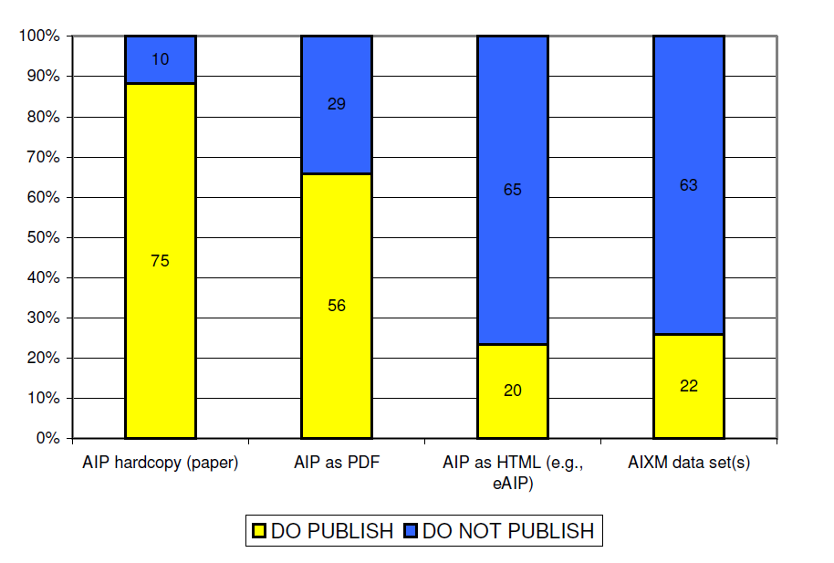
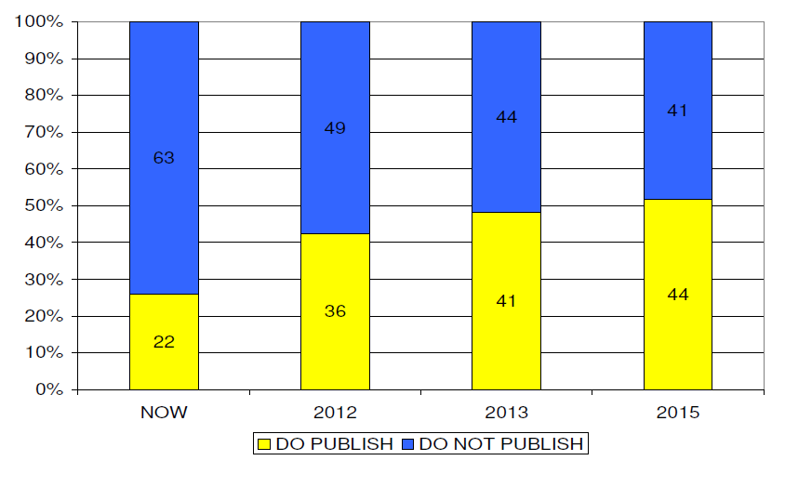
Paper versus AIXM
ANSP Survey (2011)
Survey was contacted by Lufthansa Systems FlightNav
85 of 169 organizations answered the survey
How is aeronautical data published today?
How will aeronautical data be published in the future?
Today
AIXM Usage
22

Slide 21
Vision
If I could make a wish …
XMs would become a common „language“ between all airspace users
XMs would be fully implemented in SESAR and NextGen
ANSP world would be merged with the airline world
ANSPs would provide a one stop shop for aeronautical data
Flight planning systems would be able to connect to different data providers
The entire AIP would be available in AIXM
Data would be available without delay
Data would be quality assured and always consistent
Data changes would be applied directly to the database
23

Slide 22
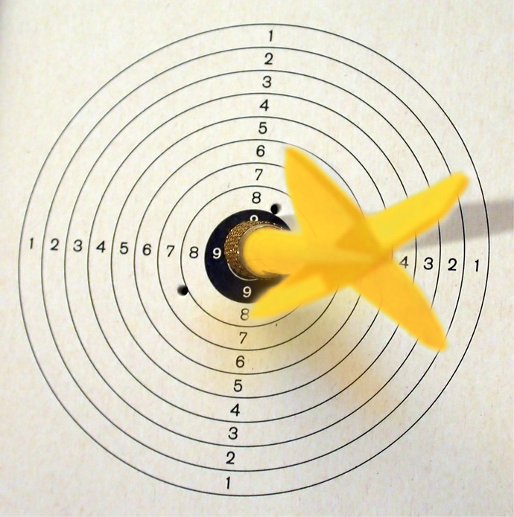
Conclusion
AIXM
AIXM is a mature data model ready for use
Data content is still only available marginally
Please provide not only NOTAM, but also static data
Quality assurance has to be implemented
XMs
are the right way to answer our challenges
are more than an interface
can be fully utilized, if the philosophy behind is consequently implemented
Should be further enhanced in close cooperation with airspace users
Thank you !
24

Slide 23
Contact Information
Reinhard Thanhaeuser
Performance and Operations Engineering
Lufthansa Systems AG
FRA AF/L-SP
Am Prime Parc 2
D-65479 Raunheim
Germany
Tel.: +49 69 696 90922
E-mail: Reinhard.Thanhaeuser@lhsystems.com
25

