Slide 1
Delivering Digital
Services
Digital Services and Vision
Practicalities
Presented By: Paul BOSMAN
Date: August 26, 2014

Slide 2
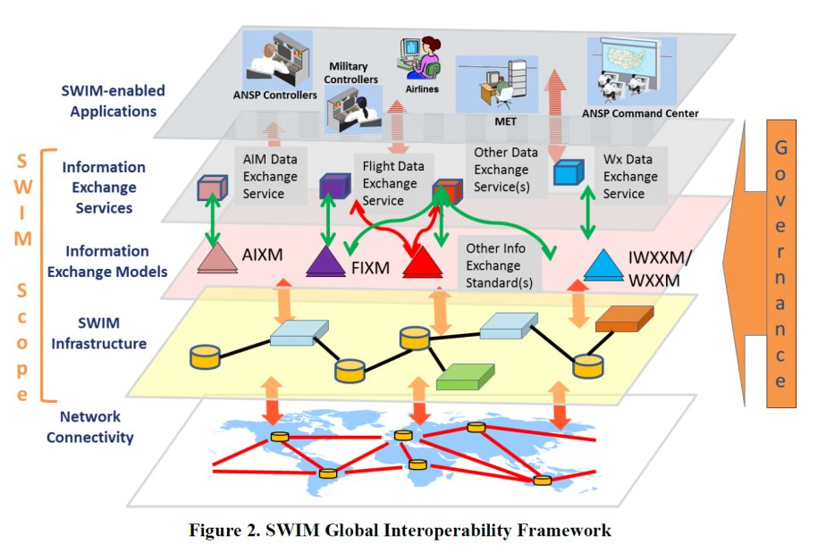
Digital Servcies - Vision
And then what ?

Slide 4
Key questions
How far are we ?
What are the stumbling blocks ?
What are the lessons learned ?
Wishlists ?!

Slide 5
Three presentations
Global Services OGC/OWS 10 Test Bed George Percivall (OGC)
Information Management Panel Michael Hohm (ICAO)
Aero Data in Airline Ops – The need for Digital Data Reinhard Thanhäuser (Lufthansa)
NB: Thanks

