Slide 1

Delivering Digital
Services
Status Report WXXM
Presented By:
ALFRED MOOSAKHANIAN, FAA
Date: August 26, 2014

Slide 2
Overview
International Development Effort
NextGen Weather CONOPS
ICAO
  Roles and Model Packages
  Annex 3 Timelines
  GANP Support
  Met Divisional
WXXM and IWXXM Status
Future Work

Slide 3
International Development Effort
IWXXM
WXXM
Managed by ICAO and WMO (international meteorological authorities)
Represents internationally-agreed meteorological products from ICAO Annex 3 / WMO No. 49 (currently METAR, SPECI, TAF, SIGMET)
Managed by FAA, Eurocontrol, and other partners
Represents aviation-related meteorological products beyond ICAO and WMO requirements
Intended to be used in “next-generation” aviation systems in concert with other aviation models – AIXM, FIXM, etc.
Both models meet different requirements but are technically similar:
UML and XML components
Based on GML 3.2.1
Make use of the Observations and Measurements model

Slide 4
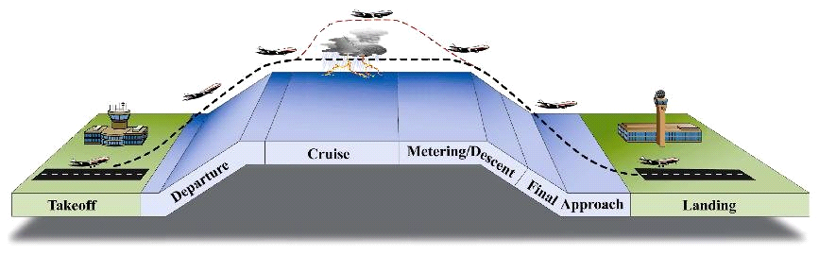




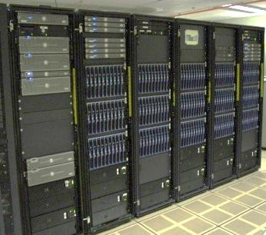
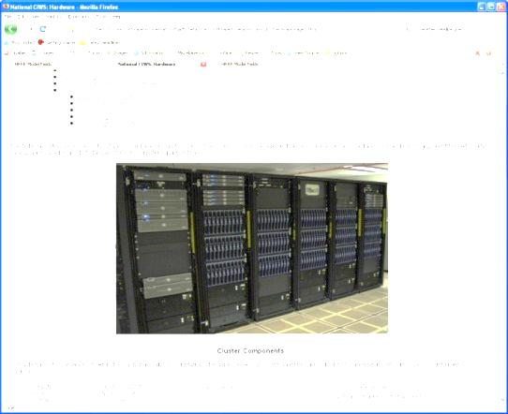

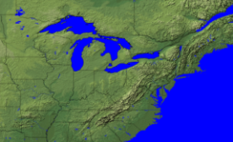
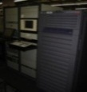

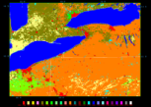

NextGen Weather CONOPS
As-Is Weather
      Aviation Weather information is limited by inconsistencies across domains, unique data types, and fixed time, space resolution, range, and latencies
      User must mentally process multiple information sources to assess the potential impact to their operations
To Be Weather
      Consistent weather information across domains and externally by the implementation of a common weather exchange model (i.e., WXXM)
  Improved aviation weather information
  Reduced avoidable air traffic delays and maximized available runway and airspace usage
Efficient, Flexible Routing
Reduce Weather Impact
All-weather
Departures
All-weather Approaches
ERAM, ATOP, Micro-EARTS,
DOTS+, FDP2K
TFMS, TBFM
IDS-R
FTI / SWIM
NAS Enterprise Security Gateway (NESG)
CSS-Wx
AIMM
NWP
External Users
NOAA Data Source
ASOS
AWOS
AWSS
Canadian
radar
NEXRAD
TDWR
ADAS
WMSCR
ASR-9 ASR-11
CSS-Wx
& NWP
Initial Investment
Decisions (IIDs) 2013
Screening Information Requests (SIRs)
Release 1/2014
Final Investment
Decisions (FIDs) 9/2014
Contract Awards
9/2014
Complete Key Site IOCs
2017

Slide 5
Key to ICAO GANP Support
The ICAO Global Air Navigation Plan (GANP) establishes internationally agreed phased implementation of new technologies and capabilities through Aviation System Block Upgrades (ASBUs)
    SWIM and Data Centric exchange are key implementers
Upgrades include using WXXM/IWXXM for weather information exchange
  Current Capabilities : ASBU 0
  New Capabilities introduced by:
    2018: ASBU 1
    2023: ASBU 2
    2028 & Beyond: ASBU 3

Slide 6
Roles and Responsibilities
ICAO and WMO have joint responsibility for operational meteorological activities, including IWXXM and ICAO Annex 3
“What is done”
“How it is done”
Identify requirements
Technical Work
Infrastructure

Slide 7


Model Packages
ICAO Weather Information Exchange Model (IWXXM)
METAR, SPECI, TAF, and SIGMET representations
Simple Aviation Features (SAF)
Simplified features from the aviation domain, such as aerodrome and runway (relationship to AIXM)
Meteorological Community Exchange Model (METCE)
WMO logical data model, specifically Observations and Measurements (O&M) specializations
Observable Property Model (OPM)
Qualifications and constraints on observed properties

Slide 8
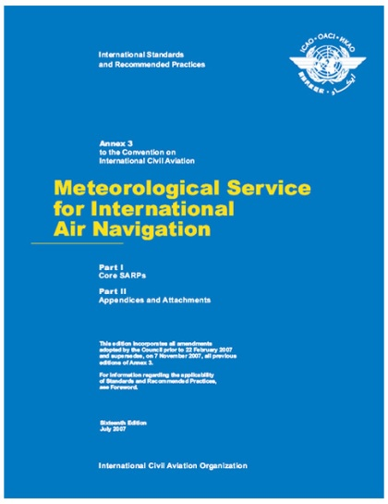
ICAO Annex 3
Amendment 76 – Nov 2013
…under bilateral agreements between States in a position to do so, states may exchange METAR, SPECI, SIGMET and TAF in a digital form (XML/GML) in addition to TAC forms

Slide 9
ICAO Annex 3
Amendment 76 – Nov 2013
…under bilateral agreements between States in a position to do so, states may exchange METAR, SPECI, SIGMET and TAF in a digital form (XML/GML) in addition to TAC forms
Amendment 77 – Nov 2016
  METAR, SPECI, SIGMET and TAF should be exchanged in a digital form”

Slide 10
ICAO Annex 3
Amendment 76 – Nov 2013
…under bilateral agreements between States in a position to do so, states may exchange METAR, SPECI, SIGMET and TAF in a digital form (XML/GML) in addition to TAC forms
Amendment 77 – Nov 2016
  METAR, SPECI, SIGMET and TAF should be exchanged in a digital form
Amendment 78 – Nov 2019
  METAR, SPECI, SIGMET and TAF shall be exchanged in a digital form

Slide 11

ICAO MET Divisional Meeting
ICAO hosted in July 2014
Representations from 95
States and 7 International
Organizations
Wide-ranging discussions on many topics including WXXM/IWXXM

Slide 12
Key Related ICAO MET Div Topics
Migration of weather (MET) into SWIM needs to consider all stakeholders
  Shifting from product centric to data centric exchange
  Increased automation (machine to machine) applications
IWXXM development and implementation
  Do in close relation with other data domains (AIXM and FIXM)
  Governance is a prerequisite

Slide 13
Status: WXXM / IWXXM
WXXM
  WXXM 2 to be released December 2014
  Being released as a major update to WXXM 1.1
    Utilizes design, modeling approaches and concepts from IWXXM
    Additional ICAO Annex 3 products (e.g., AIRMET, SigWx)
    Use of GML standard units and measures
IWXXM
  ICAO and WMO jointly released IWXXM V 1.0 in 2013
  WMO No. 306 Manual on Codes Vol I.3 (Newly drafted)
    Provides technical guidance on Model Driven Code Forms (XML)
    Distributed for approval by WMO Commission of Basic Systems (CBS) at September 2014 meeting in Paraguay
  Resulting changes will be released as IWXXM 1.1

Slide 14
Future Work
Bi-lateral prototyping activities (essential to assessing whether requirements are being met)
Assess the utility of “open content” models and their viability
Note: Details on WXXM / IWXXM during Break Out Sessions

Slide 15
Summary
WXXM / IWXXM development and planned implementation are progressing
  ICAO Annex 3 maps progressive XML implementation
  WMO 306 to include technical guidance on model driven codes (XML)
ICAO MET Community support to the ICAO GANP and the transition to data centric exchange

Slide 16
Contact Information
Alfred Moosakhanian, FAA
alfred.moosakhanian@faa.gov
More Information:
http://www.wxxm.aero
https://wiki.ucar.edu/display/NNEWD/WXXM

Slide 17
Questions?

