Slide 1

Delivering Digital
Services
AIXM
Status Report
Presented By: Eduard Porosnicu, EUROCONTROL
Date: August 26, 2014

Slide 2
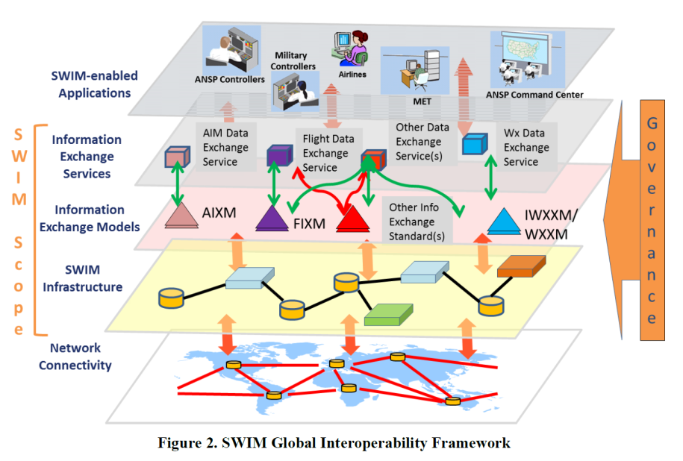
1

Slide 3
Content
AIXM versions in use
Resources and support to implementation
AIXM 5.1 Extensions
AIXM Change Control Board activity
Other work in progress
  Coding/mapping guidelines
  Business rules
2

Slide 4
AIXM 4.5
Published: 2005
  Entity/Relationship
  Custom XML schema
  Core AIP data
Usage:
  European AIS Database (EAD) and European national systems
  Estimated 20+ national systems world-wide…
3

Slide 5

AIXM 5.0
Published: MAR 2008
UML Model
GML Schema
Full AIP/NOTAM data
  Including obstacle, airport mapping, etc.
Metadata
Extensibility
Usage:
  Partially, by FAA and NGA
4

Slide 6

AIXM 5.1 (latest)
Published: FEB 2010
Update of AIXM 5.0
  Usage/availability model
  Notes vs. descriptions
  Other adjustments to facilitate Digital NOTAM encoding
Usage
  see AIXM Wiki (www.aixm.aero/wiki)
    Data Sources
5

Slide 7
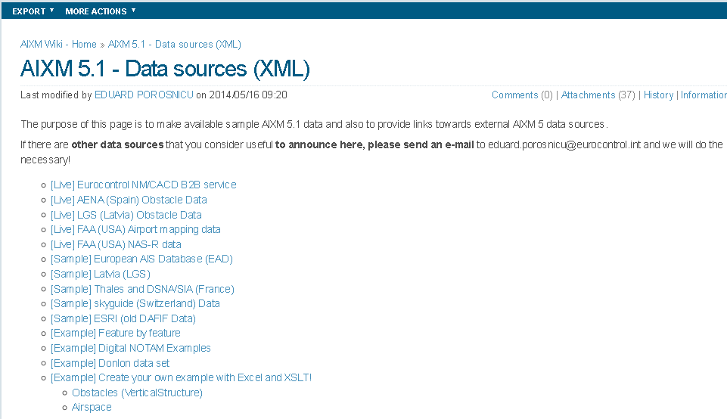
AIXM 5.1
A partial inventory only …
6

Slide 8

www.aixm.aero
  Downloads
  AIXM Wiki (www.aixm.aero/wiki)
  AIXM Forum (around 2000 members)
    See recent posting about OGC OWS-10 Engineering Reports
  See also
    Training resources
    Industry implementations/support
7

Slide 9
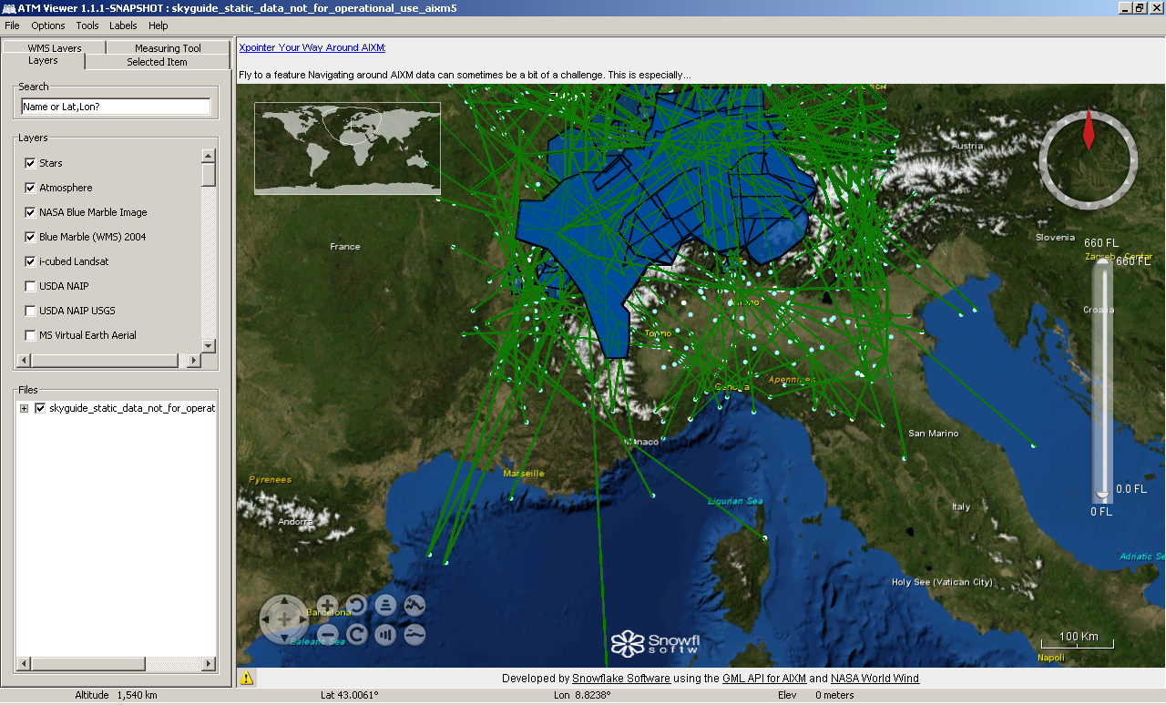
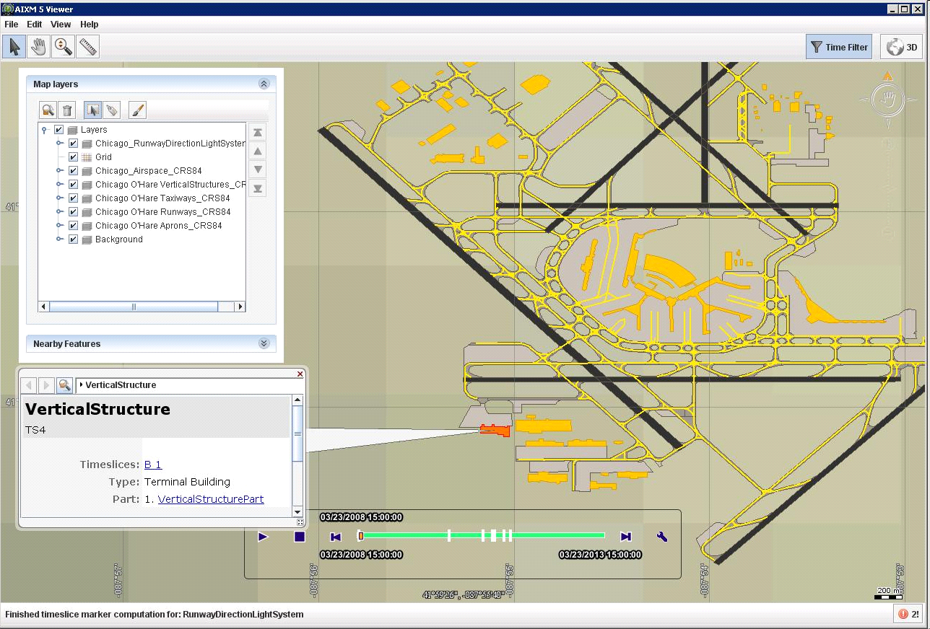
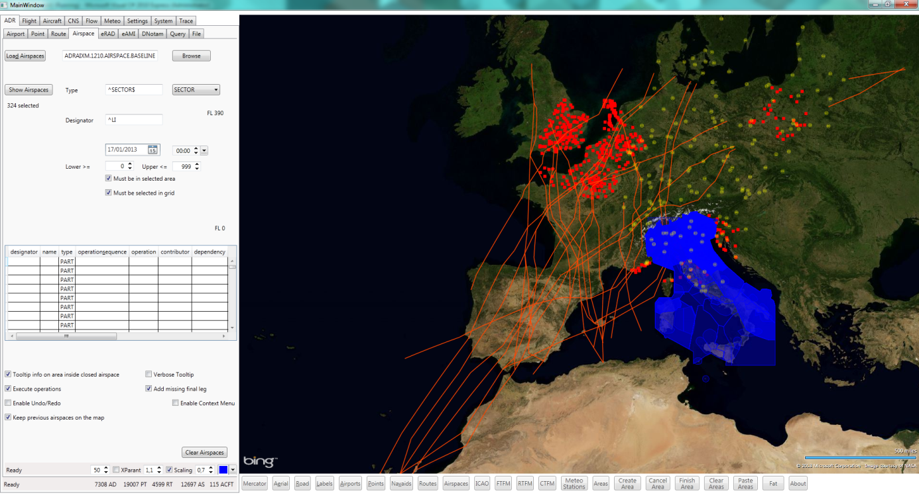
Free Tools
See also AIXM Wiki: Excel macros for generating some data samples
8

Slide 10
AIXM 5.1 Extensions
9

Slide 11
AIXM 5.1 Extensions
Direct (no additional schema necessary)
  All code lists allow
    “OTHER”
    “OTHER:MY_VALUE”
Schema extension mechanism
  additional features/properties
  UML -> scripts -> additional XML Schema
    Separate namespace
10

Slide 12
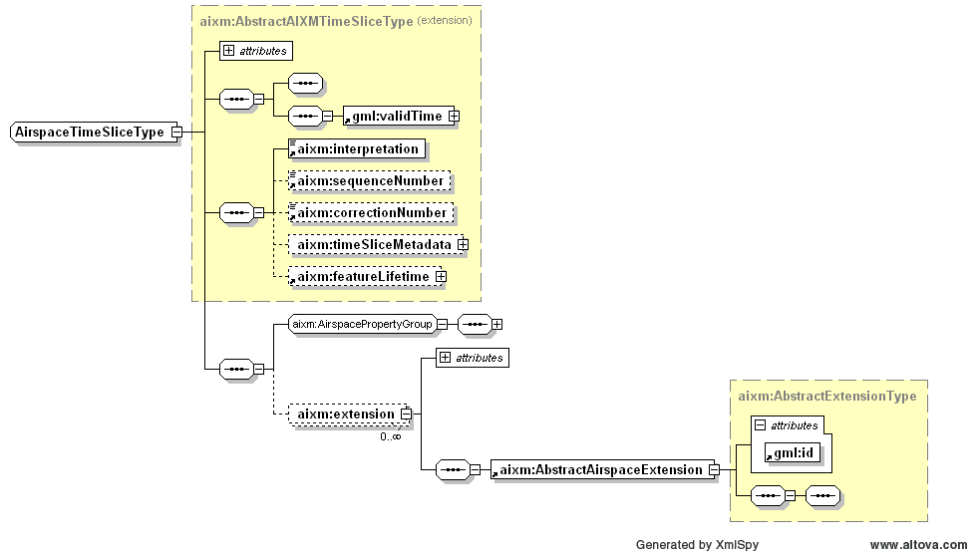
AIXM 5.1 Extensions
What for
data/processes of local/regional interest
backwards mapping
R&D
Also used
adapt model to local views…
11

Slide 13
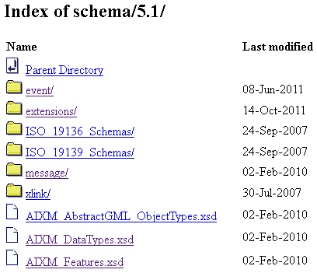
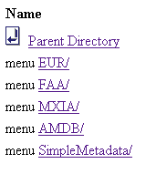

AIXM 5.1 Extensions
http://www.aixm.aero/schema/5.1
To be done:
scope/purpose/usage documentation
items of global interest -> CCB
12

Slide 14
AIXM CCB
See Charter and application form
  http://www.aixm.aero/public/standard_page/aixm_ccb.html
  Currently 60 members:
    industry, service providers, ANSP, Eurocontrol, FAA…
  Open for participation to any true AIXM stakeholder
Currently 46 issues recorded
  21 Bugs
  23 Possible enhancements
  2 possible new features
13

Slide 15
Future AIXM versions
Need to protect investments
Desire to progress
14

Slide 16
AIXM 5.1.1
Intended for Release by November 2014
  Migration to EA (Sparx)
    Including support for extensions migration
  Minor corrections only: spelling errors, schema bugs, UML/XML discrepancies, lists of values
  GML Profile update + schema
  Definitions improvements
  Fully bidirectional conversion scripts between versions 5.1 and 5.1.1!
  Change Proposals:
  9 ready for review in JIRA
  5 to be drafted
  1 external dependency – OGC, Aviation DWG, GML Profile

Slide 17
Other work in progress
Coding guidelines
  OGC Aviation DWG -> GML Guidelines for Aviation
    Document update
    Provision of profile schema
  Europe, ADQ
    Simplified metadata schema
    AIP – AIXM 5.1 mapping
  Data domains coding guidelines
    obstacles (eTOD working group)
    to be re-started: procedures encoding interest group
16

Slide 18
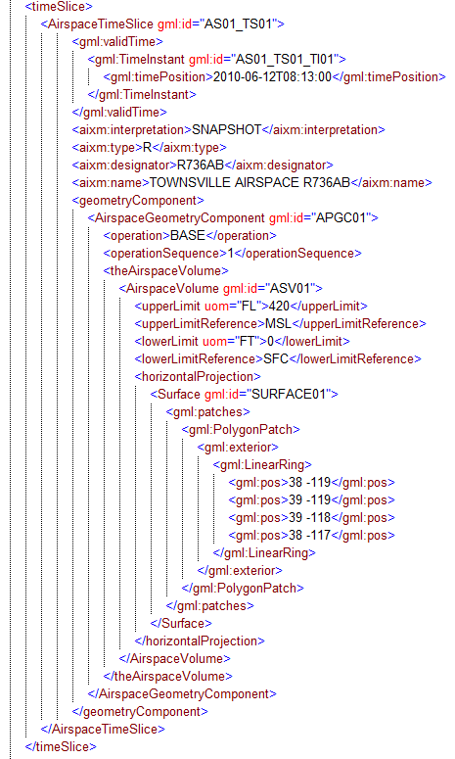
Business Rules
- Does the data make sense?
- Is it compliant with international standards ?
Do I respect recommended practices?
Is it safe to use?
- …
17

Slide 19
Using SBVR
SBVR = (OMG) Semantics of Business Vocabulary and Business Rules
  defines the vocabulary and rules for documenting the semantics of business vocabularies, business facts, and business rules.
  http://www.omg.org/spec/SBVR/1.1/PDF
Example
  “The geometry of operational airspace of type CTA, UTA and OCA shall be encoded as an aggregation of the corresponding operational SECTORS”
  Each Airspace.type equal-to ('CTA','UTA', 'OCA') shall have exactly one AirspaceGeometryComponent.operation equal-to 'BASE' and shall not have AirspaceGeometryComponent.operation equal-to ('INTERS', 'SUBSTR', 'OTHER') and shall have each AirspaceVolume.contributorAirspace.type equal-to 'SECTOR' and each AirspaceVolumeDependency.dependency equal-to 'FULL_GEOMETRY'
Free text
SBVR
18

Slide 20
Business Rules
See www.aixm.aero/wiki -> Business Rules
  Conceptual document “AIXM 5.1 - Business Rules - using SBVR and Schematron”
  First set of revisited AIXM 5.1 Business Rules is available in the form of an Excel file (600 rules)
    mandatory feature properties (based on the AIXM 4.5)
    GML profile restrictions
    mandatory use of the WGS-84
    consistency between certain properties, such as navaid type versus associated equipment, etc.
  Step 2: mid Sep 2014 (~ 800 rules)
  Step 3: end 2014 (~ 1500 rules)
Demo web-based validation service available from MClick
19

Slide 21
Digital NOTAM
Event Specification – version 2.0 to be finalised
Increment 1 scenarios
Increment 2 scenarios
Published special activity area – activation
Displaced threshold
Published ATS airspace - activation or deactivation
Declared distances changes
Ad-hoc special activity area – creation
Runway portion closure
Ad-hoc ATS airspace – creation
Airport Usage limitation
Route portion closure
Runway usage limitation
Route portion opening
Taxiway usage limitation
Aerodrome closure
Approach lights unserviceable
Runway closure
Approach lights downgraded
Navaid unserviceable
Runway lights unserviceable
New obstacle
Obstacle lights unserviceable
Taxiway closure
Visual Approach slope indicator unserviceable
Surface contamination (SNOWTAM)
Taxiway lights unserviceable
Other Event (any other situation that does not have a dedicated scenario)
Including Business Rules in SBVR
20

Slide 22
Break-out session
Day 3, Proposed Agenda
12:30 - 12:40 welcome/introduction
12:40 - 1:10 AIXM CCB work in progress
1:10 - 1:40 Business Rules work in progress
1:40 - 2:25 Free tools
  Luciad AIXM Viewer
  SnowflakeSoftware ATM Viewer
--------------------------------------------
2:25 - 2:45 afternoon break
--------------------------------------------
2:45 - 3:10 Feature identification and reference (UUID)
3:10 - 3:30 Data processing standards - RTCA DO-200A/B update
3:30 - 4:00 Open slot (any proposals?)
4:00 closing
21

Slide 23
Contact Information
www.aixm.aero
www.aixm.aero/wiki
Eddy Porosnicu (EUROCONTROL)
  eduard.porosnicu@eurocontrol.int
  +32 (2) 729-3326
Diana Young (FAA)
  diana.young@faa.gov
  +1 (202) 385-7445

