Slide 1

Delivering Digital
Services
Introduction to
Exchange Model
Status Report
Presented By: Richard Jehlen, FAA
Date: August 26, 2014

Slide 2
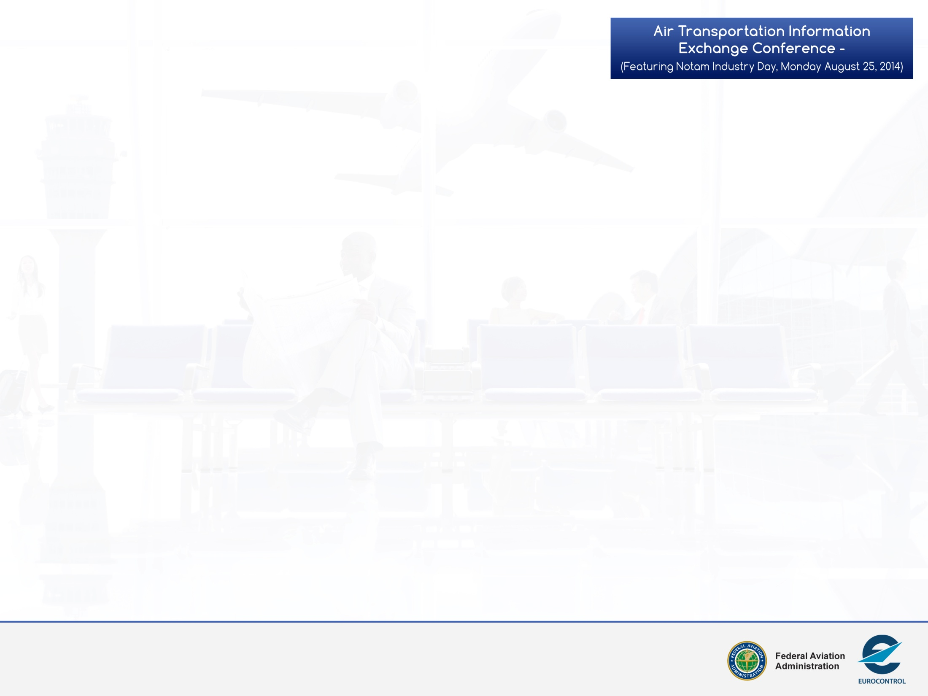
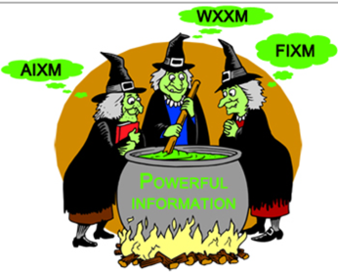

Where are we?
Information has been recognized as critical to realizing the shared global vision for the future.
The pace of operational changes leveraging new technologies continues to accelerate – stressing the current information infrastructure.
Implementation of globally interoperable and flexible data/information standards will support a revolution in the ability of Air Traffic Management (ATM) System to evolve in the future.
So, what is the status of the revolution?
ATM Information Reference Model
2
Notes:
Earlier speakers spoke of the needs and visions.
Information is the “soft infrastructure”
Advantage of only doing the introduction to the model status is – NO QUESTIONS!!!

