Slide 1
Delivering Digital
Services
SESAR /… IM Status
Presented By: Paul BOSMAN
Date: August 26, 2014

Slide 2
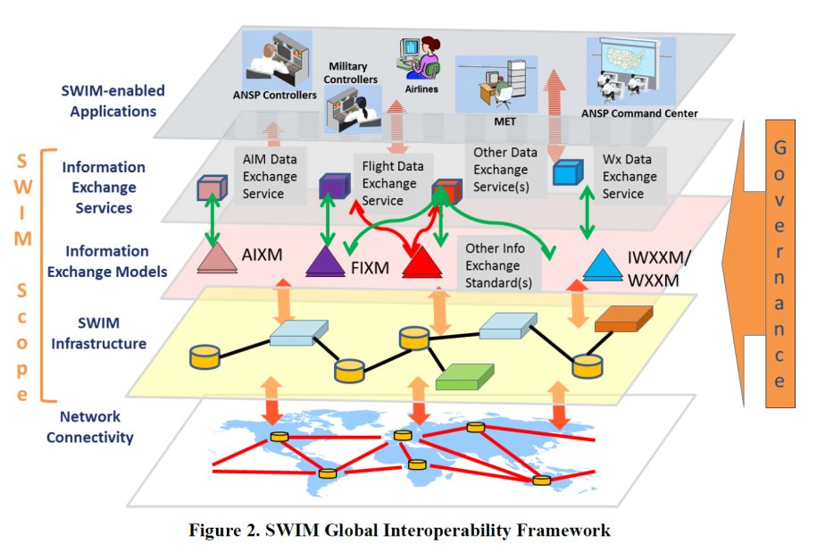
Global progress
Definition : SWIM consists of
standards, infrastructure & governance
enabling the management of ATM information
and its exchange between qualified parties
via interoperable services.”

Slide 3
Information
AIXM
ICAO & Increasing implementations
Digital NOTAM
Lessons learned
WXXM
I(CAO)WXXM
Reality mapping
Data coming (really)
AIRM
Usage starting
FIXM
V3 / CCB
Towards implementation – V4
What about me ?
AIDX, AMDB, Asterix, Inspire, ED133, NIEM, …

Slide 4
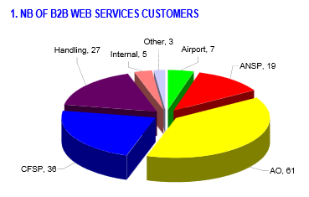
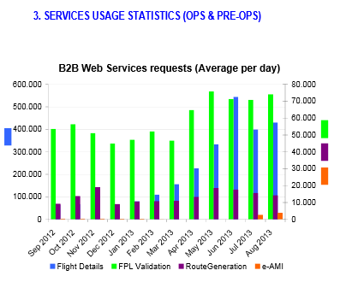
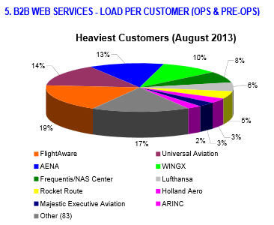
Services
More and more being Developed & Deployed
Towards a true business transformation !
Need for more Practical Global Coordination
(Service Harmonisation, Registry Discovery, …)

Slide 5
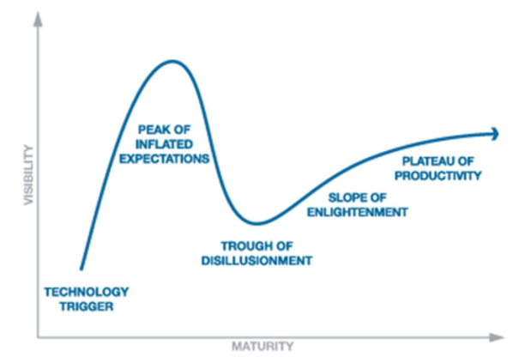
Technical Infrastructure
IT is found to be mature
Mostly an issue of agreeing on used (open) standards
Through so called Technical Profiles (Yellow / Blue / …)
E.g. Yellow = SOAP1.1/1.2, WSDL1.1/2.0, WSI1.2/2.0, WS-Security1.1, SSLv3/TLS1.0/1.1/1.2,
PKI x.509v3, XML-Encryption, XML-Signature, ECRYPT II, XML 1.0/1.1, XML-Schema,
WFS/WMS/…, HTTP/1.1, HTTP-GET/POST, MTOM, … (Red is core, rest is optional for Provider)
IT in ATM
Pub/Sub : AMQP1.0

Slide 6
Governance
SWIM Compliance
Supported by automated tools. E.g. AIXM Business Rules validator
Increased focus on security
ICAO Global Interoperability Framework (ICAO GIF)
Legacy
New SWIM Services
 | Ready | Compatible | Compliant
AIRM | Entities | +Properties & Relations | + Constraints
Services | Increased Service Description mapping
Techno | Partial Profile | Full Profile

Slide 7
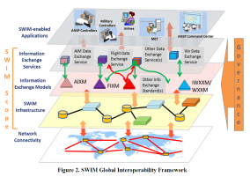
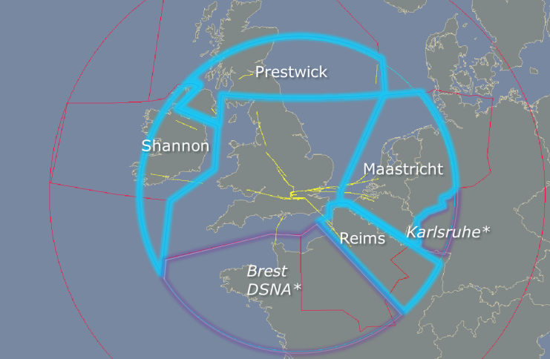
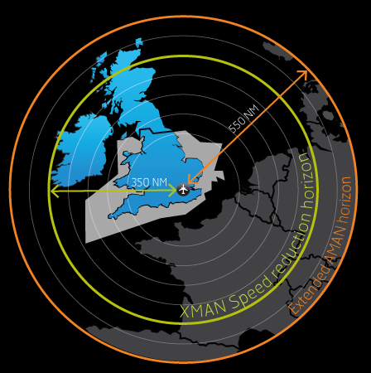
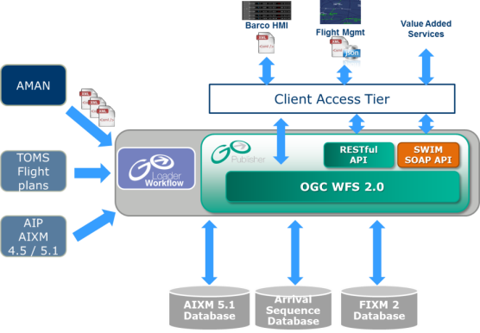
Enabled applications - I
Extended Arrival Sequence Service
Benefits (/year!)
33.5 M€ fuel saving
32.000 ton of CO2 reduction

Slide 8
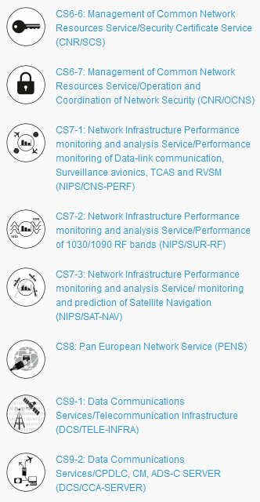
Enabled applications - II
Centralised Services
A Centralised Service is a pan-European ANS support service or function performed at central network level for harmonisation and cost-efficiency purposes avoiding parallel investments
Outsourced, Market Mechanisms & Competition, Cost-efficiency gains
SWIM enabled where relevant
Just a first set
More Common Services are coming
Work on Virtual Centre(s) has started !

Slide 9
Regulated SWIM implementation
Initial SWIM (iSWIM)
EU initiative to move towards SESAR Deployment
Aeronautical, Meteorological, Flight & Network Information Services
Carrot/Stick approach
Introduces notion of SWIM Foundation
Standards on AIRM, Service rulebook, XMs, Profiles
Registry usage
Standards to be published 2016+

Slide 10
Conclusions
SWIM is a reality with impressive Benefits
AIRM/XMs/… : Foundation of it all
ICAO IM Panel ++
Services :
Need for more cooperation
More global trials / demos will further de-mistify and obtain more benefits

Slide 11
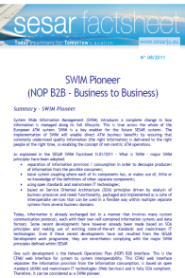
Questions &
Contact Information
SESAR Joint Undertaking
www.sesarju.eu/swim
http://www.linkedin.com/groups?gid=3748809&trk=hb_side_g
Email swim@sesarju.eu
Registry
http://eur-registry.swim.aero/soa/web/service-catalog/
Data Exchange models
Aviation Information Data Exchange www.aidx.aero
AIXM - Aeronautical Information Exchange Model www.aixm.aero
WXXM – Weather Information Exchange Model www.wxxm.aero
FIXM - Flight Information Exchange Model www.fixm.aero
AIRM http://im.eurocontrol.int/wiki/index.php/AIRM
Some additional info
www.eurocontrol.int/im & im.eurocontrol.int/wiki

