Slide 1
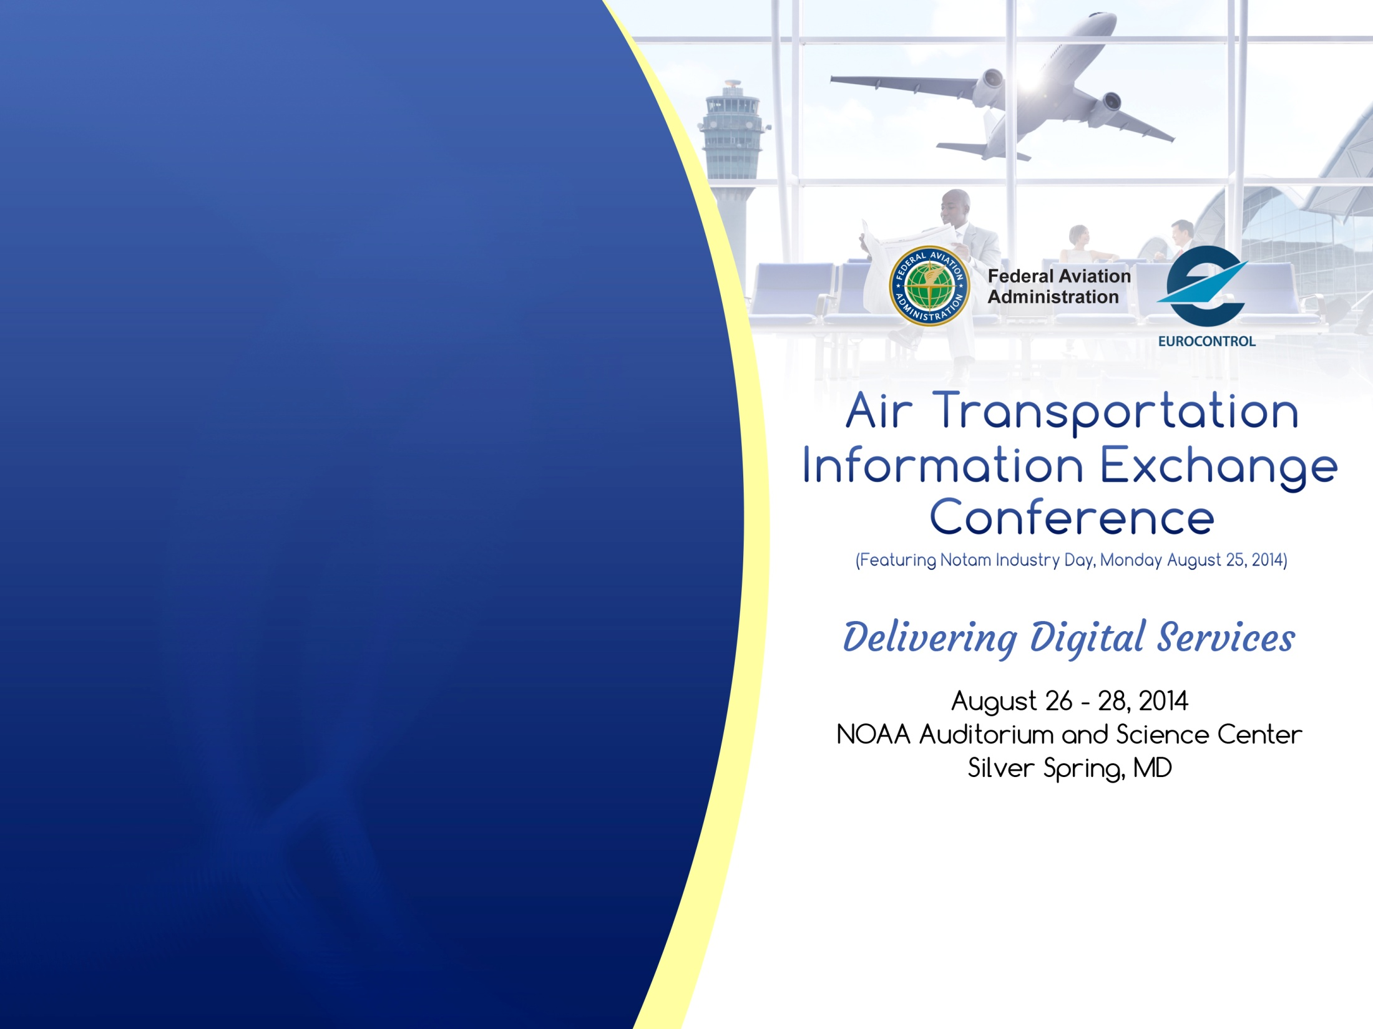
Delivering Digital
Services
Status in Support of Information Management - NextGen
Presented By: Pamela Whitley, FAA
Date: August 26, 2014

Slide 2
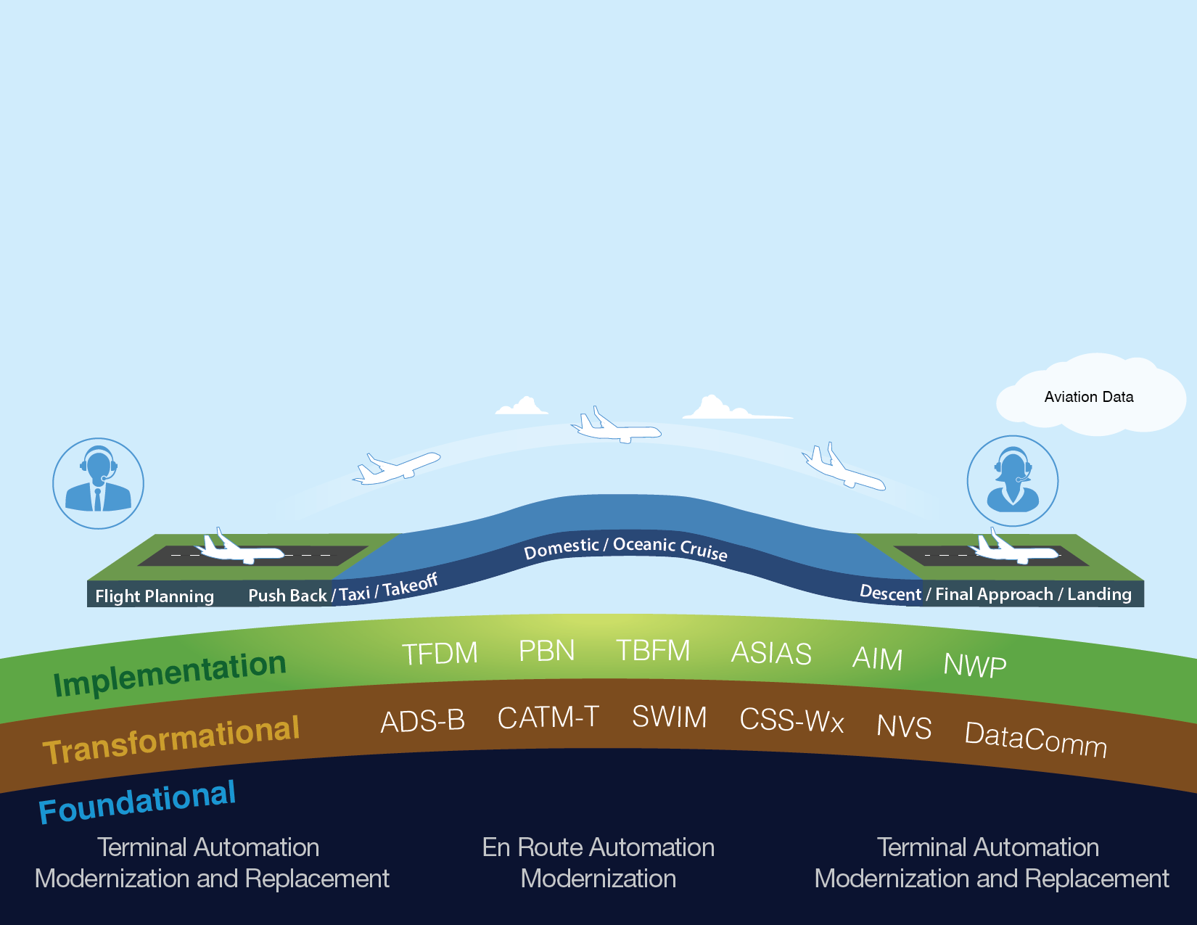
Delivering NextGen Improvements
Legacy System
NextGen
Radar
Inefficient Routes
Voice Communications
Disparate Information
Fragmented Weather Forecasting
Weather Restricted Visibility
Forensic Safety Systems
Nationwide Focus
Satellite
Performance Based Navigation (fuel savings)
Voice & Digital Communications
Automated Decision Support Tools
Integrated Weather Information
Improved Access in Low Visibility
Prognostic Safety Systems
Focus on Congested Metroplexes

Slide 3




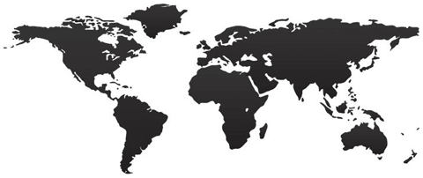
Information Standards & Interoperability
SWIM-enabled application used to request information
SWIM Enabled Applications
SWIM Enabled Applications
Uses Information exchange service to request
Uses exchange model for content and format
Common Standards
SWIM core services provide security, messaging, addressing
Encoded and transmitted over global IT network

Slide 4
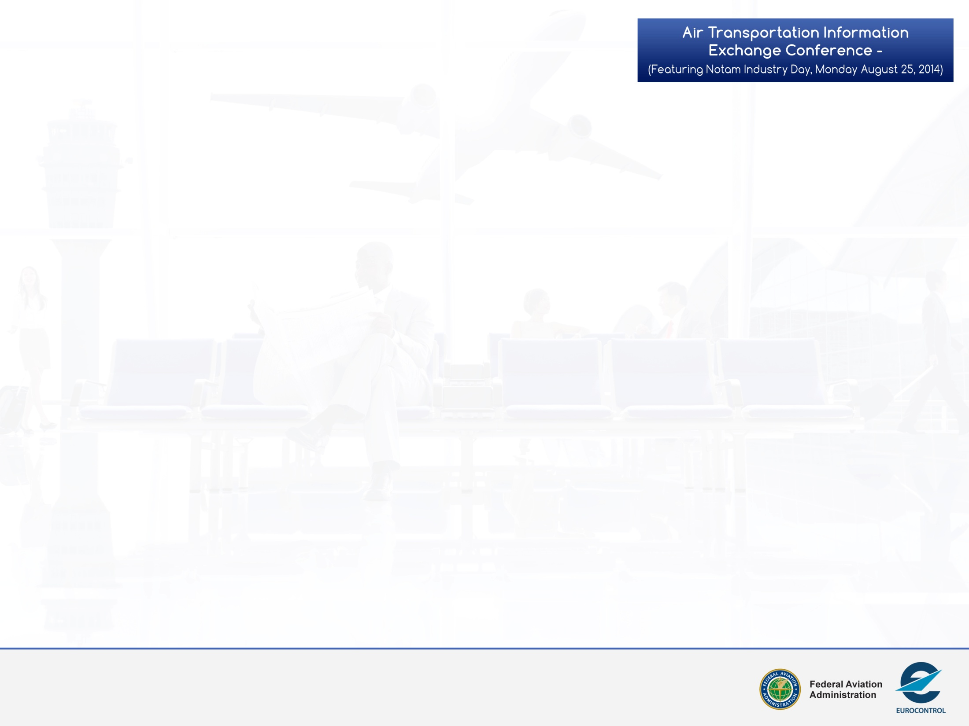
NextGen Information Management
The transition to the Digital National Airspace System
NextGen Information Management
Data (Raw Data, etc.)
Information (Knowledge from processed Data)
Information Systems (Collection, Storage, and Sharing)
Enterprise Information Management (Common Data Source for NAS Domains)
3

Slide 5
Contact Information
Pamela Whitley, FAA
Deputy Assistant Administrator for NextGen
Pamela.Whitley@faa.gov
More Information:
www.faa.gov/NextGen
5

