Slide 1
Information Management
The ICAO Perspective
Richard Macfarlane
Deputy Director, Air Navigation Capacity and Efficiency
Air Navigation Bureau, ICAO
Air Transportation Information Exchange Conference (ATIEC), Maryland, USA
26 August 2014

Slide 2
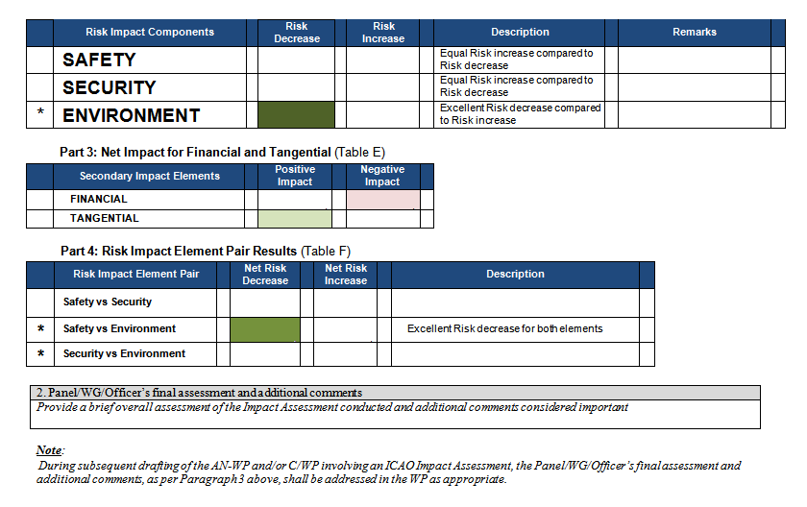
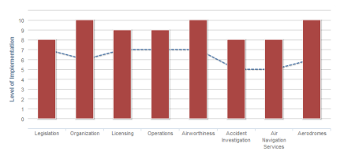



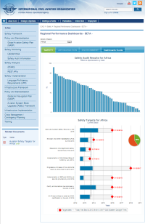
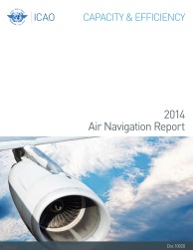



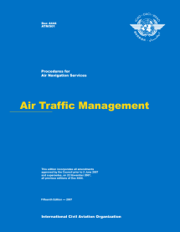





Needs Analysis / Validation
Compliance & Verification
Global Plans
if needed
Global & Regional
✓
✓
Assess & Measure
SARPs & PANS
Implementation Planning
Training & Guidance
✓

Slide 3
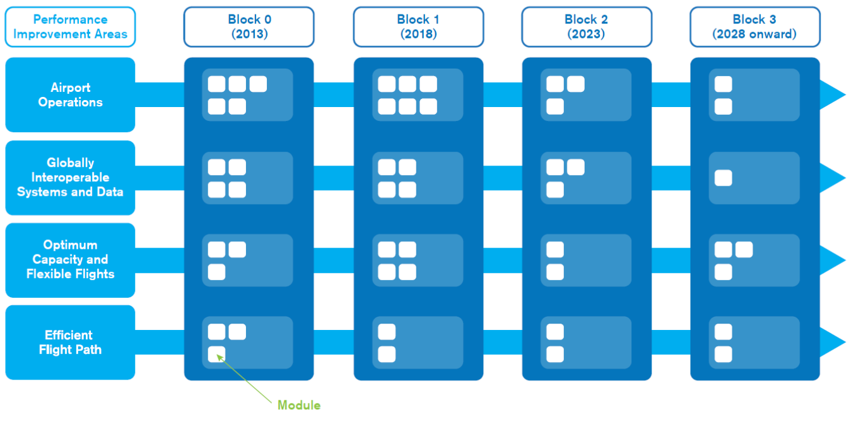
Global Air Navigation Plan (GANP)
Objectives and Priorities
PRIORITIES
Performance Based Navigation (PBN)
Continuous Descent and Climb Operations (CDO/CCO)
Collaborative Decision-Making (CDM & A-CDM) & ATFM

Slide 4
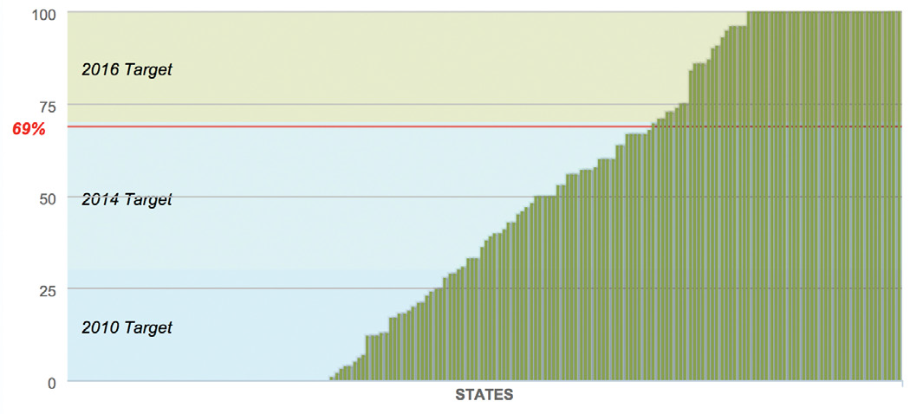


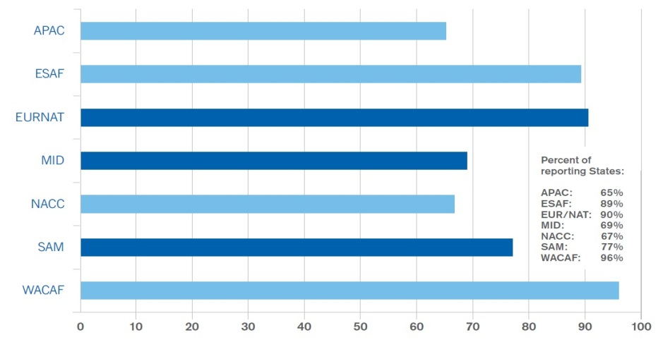
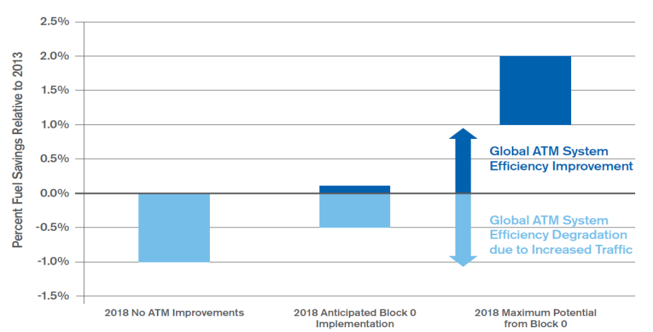
State of Global AIR NAVIGATION
PBN RUNWAY Implementation continues to rise
ATFM IS CURRENTLY BEING USED IN AREAS OF TRAFFIC CONGESTION
AIM CONSOLIDATION PHASE IS ONGOING
STUDY ON POTENTIAL ENV BENEFITS OF ASBU B0 SHOWS NET GAIN

Slide 5

Planning and Integrating for
IMPLEMENTATION

Slide 6
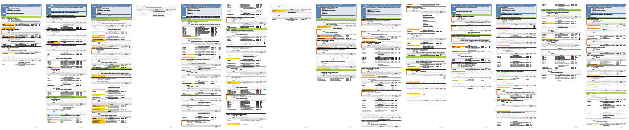
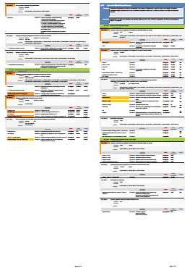
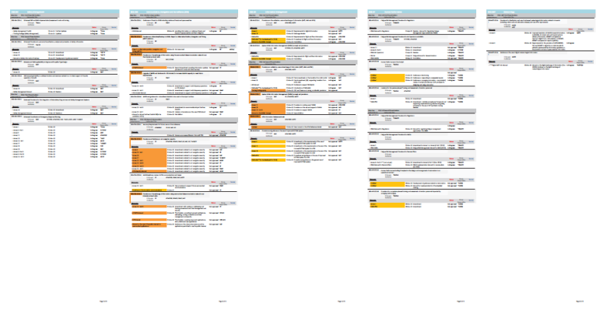
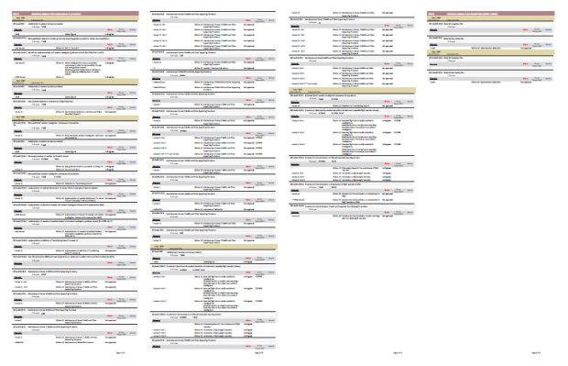
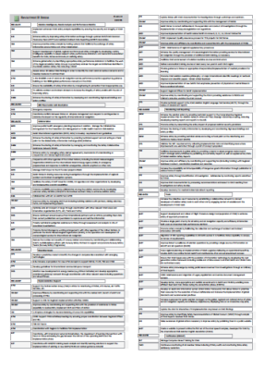
AIR NAVIGATION INTEGRATED WORK PROGRAMME
Safety and Air Navigation Regulatory Operational Improvements (ROI)
Enablers
Recurrent Activities

Slide 7
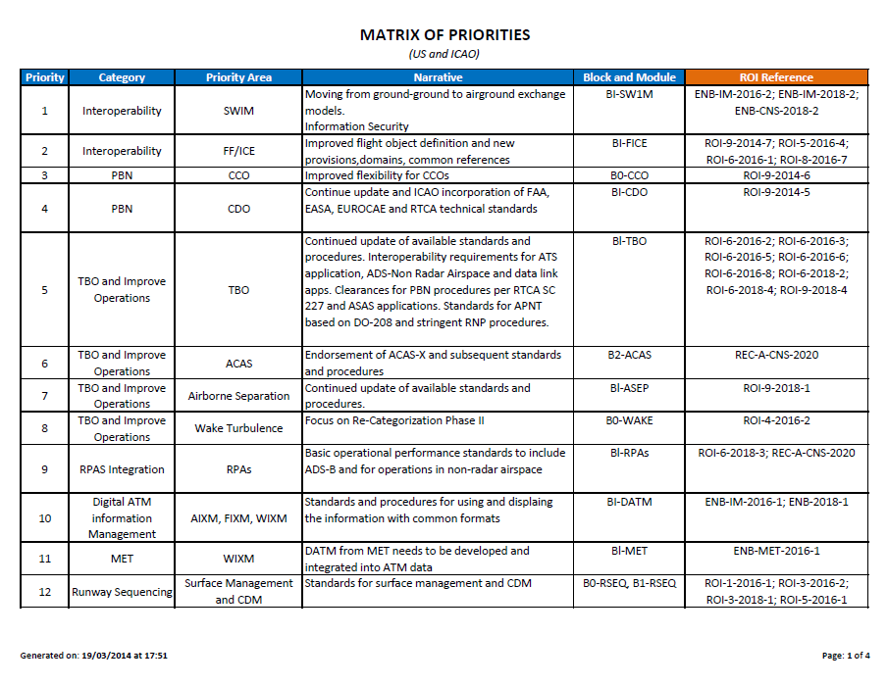
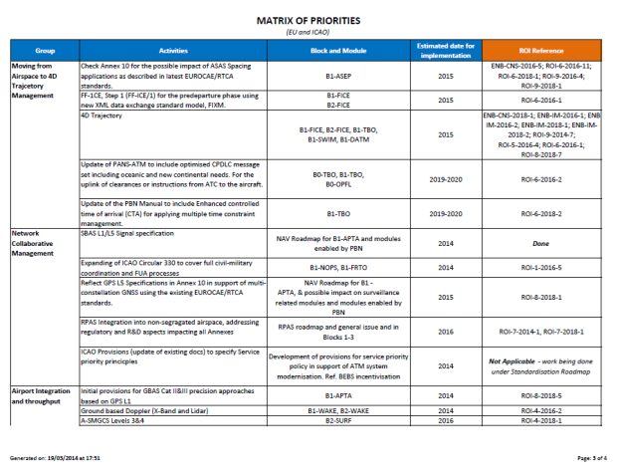
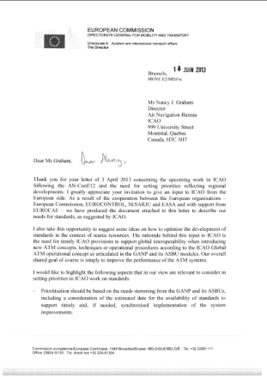

INTEGRATED with State Priorities
US Priorities
EU Priorities
AIR NAVIGATION INTEGRATED WORK PROGRAMME

Slide 8

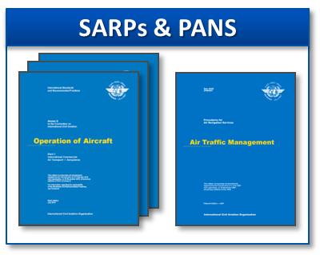
ANC Panels
TORs
SARPS & PANS PACKAGES

Slide 9


TRADITIONALLY
TRAINING
ROLL-OUT
ANC Panels
TORs
SARPS & PANS PACKAGES

Slide 10


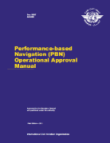






TRADITIONALLY
IMPROVED METHODS
PRIORITIZED AN WORK PROGRAMME
Implementation Planning
ANC Panels
TORs
Deliv. & Dates
SARPS & PANS PACKAGES
WORK PACKAGES
& SCHEDULES
Guidance Material
Training
Symposia
iKIT
AIR NAVIGATION INTEGRATED WORK PROGRAMME

Slide 11
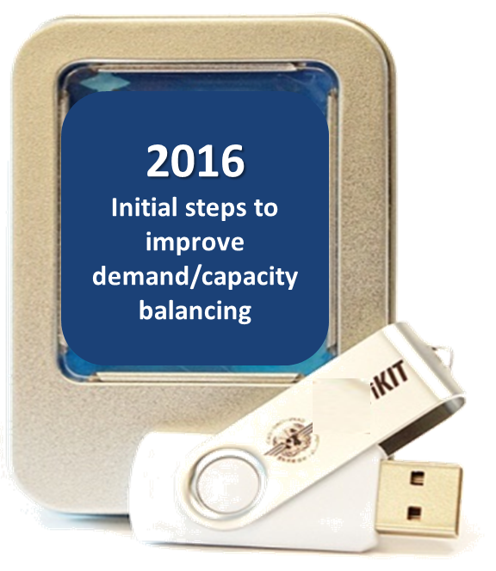
Integration for Implementation
Amendments to ICAO documentation do not stand on their own, but once packaged in clear deliverables, provide a tangible operational benefit
The air navigation integrated work programme provides:
  Transparent overview of all activities
  Tool for prioritization
  Plain language intention that provides a clear message to the States and all aviation stakeholders and partners
  (IATA, ACI, CANSO, etc.)
  An outcome for implementation

Slide 12


Why Integrated Planning is Important
Information Management as an enabler to:
Achieving improved safety performance at and in the vicinity of aerodromes
Achieving optimized aerodrome departure/arrival rates in all meteorological conditions
Improving communication, navigation and surveillance
(CNS)
Related ASBU Modules:
  System Wide Information Management (SWIM)
  Flight and Flow Information for the Collaborative Environment (FF-ICE)
  Digital ATM Information (DATM)
  Airport Collaborative Decision Making (ACDM)
  Advanced MET Information (AMET)
  Digital Aeronautical Information Management (DAIM)
  Wake Turbulence (WAKE)
  Runway Sequencing (RESQ)
  Network Operations (NOPS)
  Trajectory Based Operations (TBO)
  Free Routing Operations (FRTO)
Information Management
iKIT

Slide 13



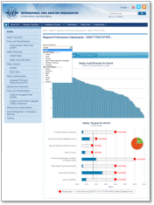
Regional Implementation – Air Navigation
Revise Regional
Air Navigation Implementation Plans
✓
✓
Revise Regional
Air Navigation Plans
Next GANP
2015
Establish Regional Priorities, ASBU Modules & Targets
Regional workshops and meetings
In progress
GANP
Revised PIRG TORs & Work Programme
✓
✓
Annual Global Air Navigation Report
Regional Performance Indicators
PIRG Meeting Reports
Annual ANC/Council Review

Slide 14
Global Indicators for all Regions
(Used in dashboards and harmonized with global plans and reports)
SAFETY
State Safety Oversight System
Significant Safety Concerns
Accidents
Aerodrome Certification
State Safety Programme
AIR NAVIGATION
Performance-based Navigation
Air Traffic Flow Management
Aeronautical Information Management
Ground-Ground Digital Coordination/Transfer (coming soon – 2014)
ASBU Environmental Benefits (coming soon - 2015)
(more to be added in the future by regions)

Slide 15
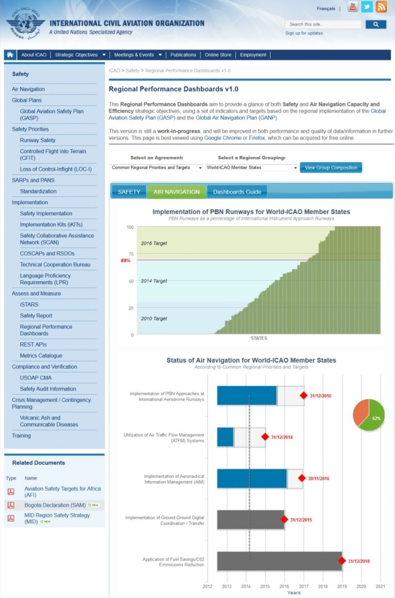
Measuring Implementation - Regional Dashboards
Measuring against the Global Plans through regional indicators
  Now Available:
  www.icao.int/safety/pages/regional-targets.aspx
  Shows the progress against regionally-agreed indicators, ASBU modules and targets
  Shows the implementation status and performance by regional grouping - by UN Region, ICAO accreditation, PIRG, RASG, COSCAP, RSOO, etc.
  Ability to drill-down on each indicator to see specific details on metric and data used

Slide 16

NEW DATE
Intent: To reach out to those States who need to upgrade their ATM systems to take advantage of block 1 capabilities.
Message:
  Be part of the symposium – We will build the stage. The show is yours.
  Bringing States together and securing active involvement and participation
  Proof of concept and experiments
  Thinking out of the Block 0 box
  Opening up the planning focus to Block 1 techniques

Slide 17

How can we work together?

