Slide 1
New Horizons Of Information Exchange
Presented to:
By:
Date:
Air Transportation Information Exchange Conference
Teri L. Bristol, ATO Chief Operating Officer
August 26, 2014

Slide 2
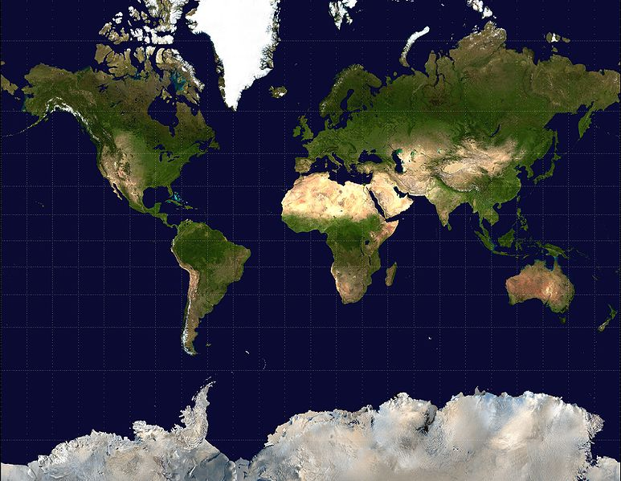
Data Exchange Today
ANSP
ANSP
ANSP
ANSP
ANSP
ANSP
ANSP
ANSP
ANSP
ANSP
ANSP
ANSP
ANSP
ANSP
Notes:
Current data exchange is point-to-point, each with unique interfaces (bilateral). This approach is decentralized and less efficient.
Some interfaces are analog (e.g. Radio/Voice)
Expensive development, test, deploy, and maintenance
New decisions constrained by old data constructs
Cumbersome data access
2

Slide 3
Global SWIM Enterprise
SWIM
SWIM
SWIM
SWIM
SWIM
SWIM
Global SWIM
SWIM
SWIM
SWIM
SWIM
SWIM
SWIM
SWIM
SWIM
Notes:
The vision for the future is a global SWIM approach, in which data is sent to a central point and provided to multiple users. This increases efficiencies and allows for a more seamless transfer of information.
Mini Global aims to meet this goal.
3

